Slide 1
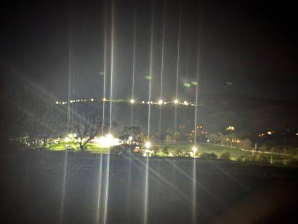
Malham Diary 2025
Malhamdale Local History Group village diaries.
Harry Potter film crew village on the Showfield with evening filming at The Cove. October 2025

Slide 2
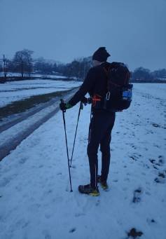
January
The 1st saw heavy rain causing Cawden Hill to burst open, flooding around the village. Heavy snowfall 4th Jan’ gave 18cm depth in the village immediately followed by bitterly cold weather for a week, night low of -9.2 Celsius on the 9th. Gritting team kept roads open, school didn’t shut. Sheep on Malham Moor were dug out of drifts and Malham was featured on BBC TV national and local news.
Miresfield Farm B&B provided interest with a large 4 day flare-off of propane heating gas due to decommissioning a faulty old gas tank.
Crisis charity cold water swimming in air temperatures well below zero continued .
Spine racer approaching Malham at dusk, checkpoint at Tarn House

Slide 3
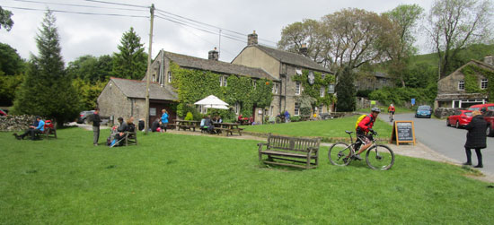
February
Cold easterly wind sets in with sunny but freezing days staying largely dry with no usual winter storms. Fields and footpaths really dry out with plenty of visitors at weekends.
National Trust Tarn House staff meet local representatives. The rumour circulates that the Scouts organisation is about to get the lease to use part of the Tarn House buildings. Implications discussed by Parish Council with favourable reception. (P.S. The lease was only confirmed the following January – by the Scouts)
Malham Cafe at the top of the village green gets a ‘Sold’ sign after being on the market for well over a year, but no one seems to know who has bought it. P.S. Failed to sell at auction in summer, still for sale at year end.

Slide 4
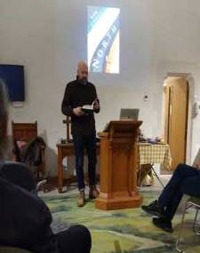
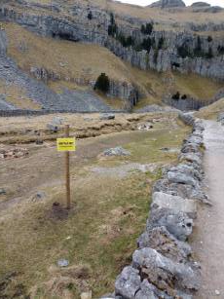
March
Jonny Campbell folk singer - Pennine Way 60th anniversary celebration gig takes place in the Chapel with a talk about the history of the A1 trunk road.
By late March it seems like almost a Spring drought is setting in with so little rain and so many warm, sunny dry days. Malham Beck is as low as in mid summer.
The Buck Inn closes fully in late March for refurbishment work as it changes hands again, to Thwaites brewery, in partnership with the Listers Arms.
Parish Council decide to place a new, more obvious ‘Falling Rocks’ sign at the boundary of their land in Gordale, following concerns over public safety from winter rockfalls and legal liabilities.

Slide 5

April
The Buck Inn reopens on the 14th under Thwaites brewery ownership with Chris managing both pubs.
Wasteland behind village toilet block cleared with two trees felled, to make a new outdoor seating area.
Very sunny, warm and dry Easter weekend on the 19^{th ;} village extremely busy with visitors, needing three car park fields to open.
The WI had a pop-up cafe in the village hall on Easter Monday; tea and cake etc. By the end of the month, the strange ongoing lack of rain was really noticeable.
Octopus Energy company sent engineers to various properties in upper Malhamdale to try to get electricity Smart Meters working, fitting cell phone tranceivers plus aerial . Some meters suddenly worked after years being dead, but many remained dumb due to thick stone walls on old properties.

Slide 6
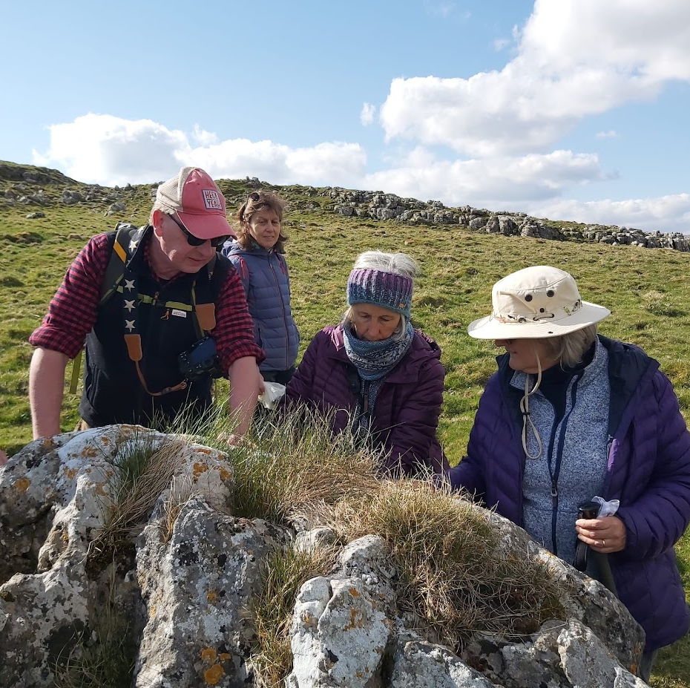
April continued
Roadworks repairs were done on Finkle Street and Gordale Lane to repair potholes.
A remarkable number of missing or escaped animals reported; chickens, hens, cows – life in the country!
Pennine Way 60th anniversary walk and picnic near the tarn.

Slide 7

May
Drought continues week after week until finally on the 24th the rain starts and continues for a few days.
Coincidentally, this was the annual duck race on Malham Beck from Lister’s bridge to the stepping stones at the ford.
This was very well attended despite damp weather, raising funds for Malham Community Group (a follow-on to Malham Safari). Marquees were erected on The Green with an evening party.

Slide 8
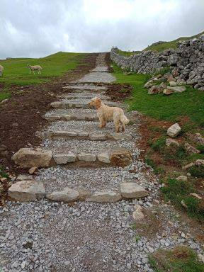
June
After the drought comes the rain, and it certainly restarted with a vengeance, all the fields greening up remarkably quickly.
MacMillan mighty hike took place again with many hundreds of sponsored walkers raising money for the cancer charity. Unfortunately, many residents were upset by some of the arrangements causing disturbance such as very noisy loudspeakers and severe traffic congestion.
Finally, after many years of appeals and upset, the National Park rangers created a properly surfaced and stepped pathway up the field behind Gordale Bridge, to cope with huge numbers of tourists damaging a wide swathe, on their way from Gordale to the top of Malham Cove.

Slide 9

July
The Malhamdale Community Group put up marquees on Peel’s field behind the village hall to again run the Opera in the Croft event with Nichola Mills singing popular operatic excerpts in the afternoon and a pop covers band playing through the evening. This was very well attended despite heavy rain, with everyone sharing food and drink.
The Alzheimer's Society ran a large sponsored walk event from the village for the first time, with no significant disturbance to village life.

Slide 10
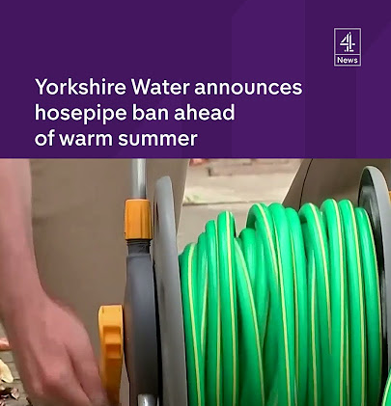
July continued
Residents were appalled to find out the scale of untreated sewage overflows into Malham Beck from Malham sewage works; Yorkshire Water releasing a figure of 112 overflows in 2023, nearly twice the previous year’s figure.
Pipe burst Finkle Street water gushing out of the road day and night waiting for Yorkshire Water – hosepipe ban in place, which continued until December.

Slide 11
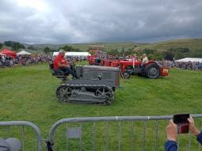
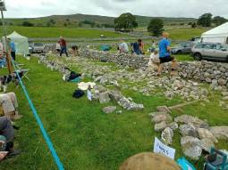
August
Malham show went very well with good weather and good attendance with all the usual competitions and exhibits. No marquees blown away, no cars stuck in the mud, just a normal show with everything well organised and working smoothly.
Boy racers in cars greatly annoyed residents in the National Park visitor centre car park one night and through the village at high speed in the middle of the night repeatedly. None were caught or identified.

Slide 12
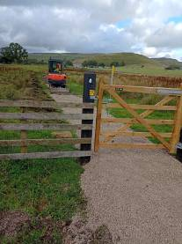
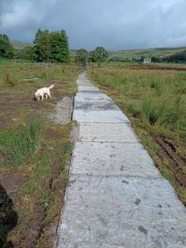
September
A very abrupt end of summer as autumn came in rapidly with days of rain turning from showers to continuous. Swallows soon departed and the river flooded over.
National Park and Pennine Way rangers made great progress on a new causeway at Miresfield Bottoms near Blackhole Bridge on the Pennine Way footpath.
After large rockfalls at Gordale Scar, with some fallen boulders the size of a chair, the Parish Council liaised with the National Park rangers and it was decided to close access to the Scar and footpath for a temporary period of 21 days and shortly after for up to 6 months, by legal order.

Slide 13
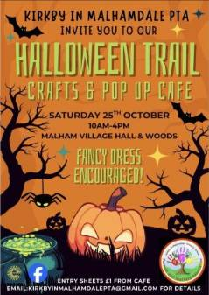
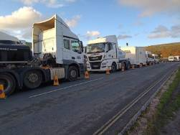
October
Loose rocks at Gordale Scar were levered off with crowbars by the British Mountaineering Council to reduce the chance of them falling on visitors.
Work started at the National Park visitor centre to build a changing room for disabled visitors.
Riverbank engineering to re-wet fields and encourage meandering was completed on Malham Beck and Gordale Beck near Miresfield by the Wild Trout Trust charity.
Harry Potter remake for TV episodes took over the village for three days; closing some roads and footpaths for filming at The Cove and Gordale Scar.
Kirkby Malhamdale primary school PTA ran a very successful halloween fundraising event in the village hall and quiz in the Malham Beck Plantation.

Slide 14
November
New gravel path created by Y.D.National Park through Hudson’s car park field, Cricket Field and Stephenson’s car park field to allow walking through these very wet, muddy fields throughout the year, rather than along Chapel Gate road. This was very well received by residents but shortly after completion was badly damaged by torrential rain.
Renovations of the Malham YDNP visitor centre began with building of disabled toilet /washing facilities in the picnic area and remodelling of the front facade and entrance. Integrated solar panels were fitted into the front roof and much re-roofing overall.
Residents volunteered to sponsor the purchase of a recycling box for medicine tablet blister packs as no single organisation could continue to support this.

Slide 15
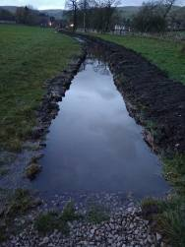
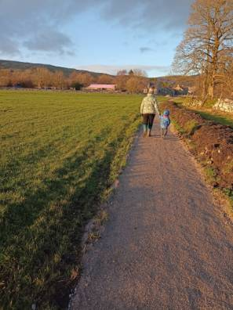
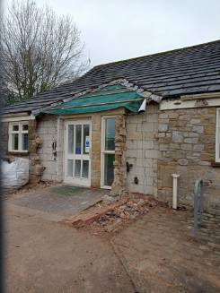
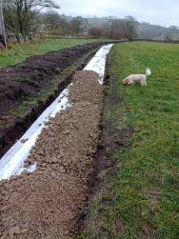
November - Continued
Yorkshire Dales National Park centre loses its porch
New path completed, began as Malham canal

Slide 16
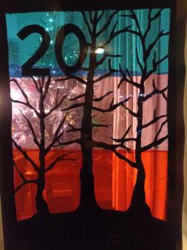
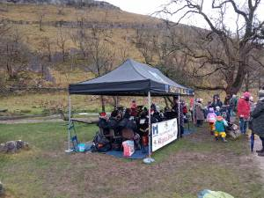
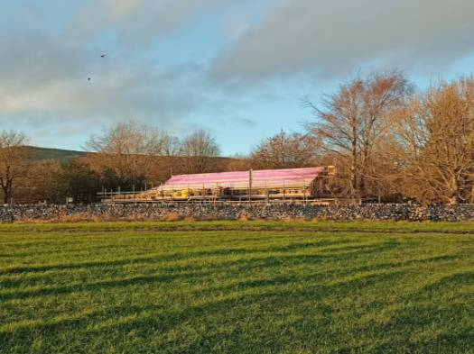
December
Carols at The Cove was organised by members of the local community and for once was neither a washout or bitter cold; very well attended.
National Park Centre renovation continued with new front doors and porch plus integrated solar panels going on the roof. Closed over Christmas week when sunny weather brought very many visitors.
As has now become a usual tradition, Advent windows went up throughout upper Malhamdale in resident’s houses.

