Slide 1
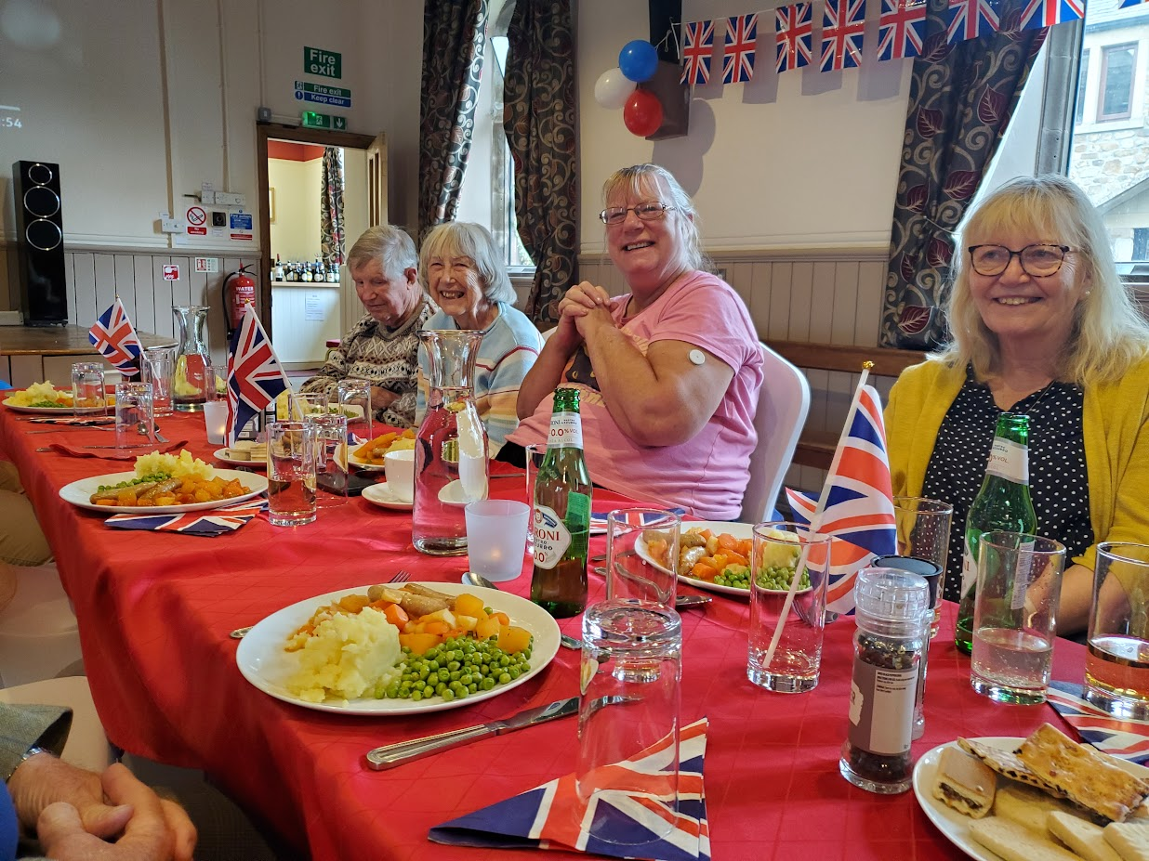
Kirkby Malham Diary
2025

Slide 2
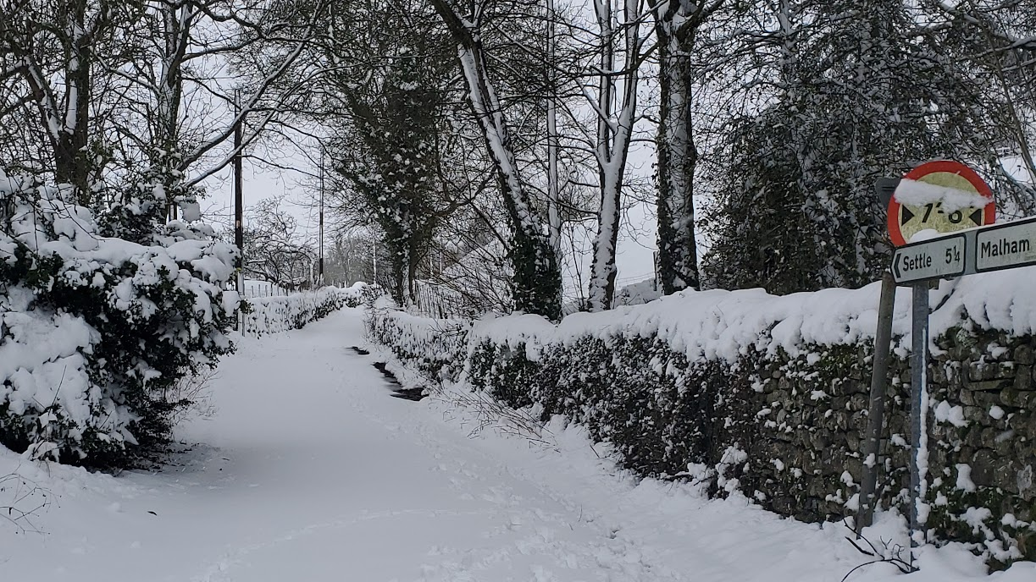
5th January brought heavy snow. The road to Settle was definitely closed!

Slide 3
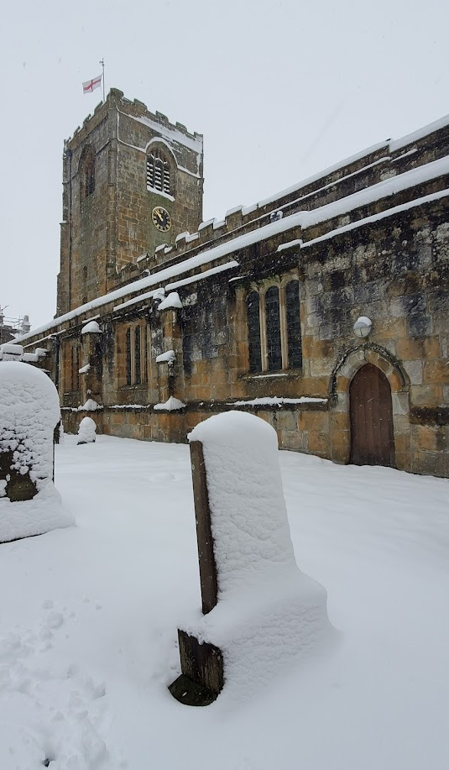
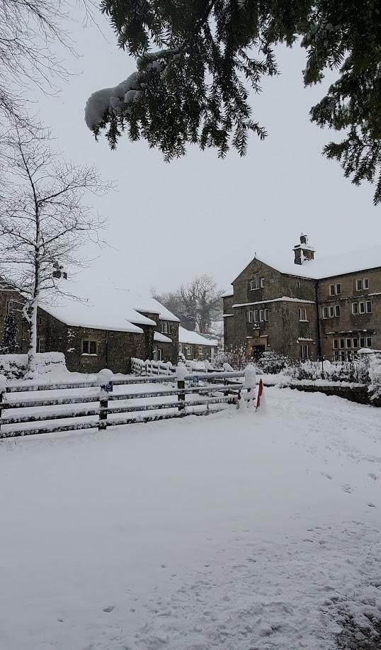
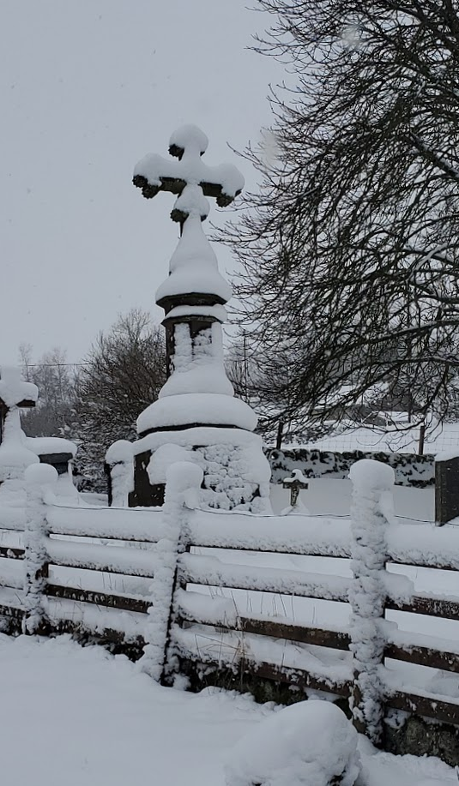
The snow lasted for a week due to sub zero temperatures.

Slide 4

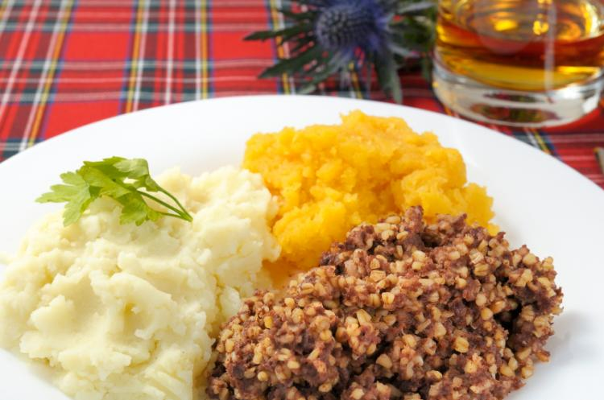
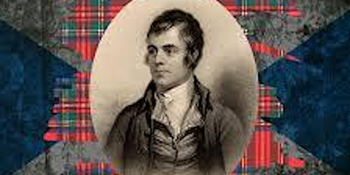
But regular January events such as Burns Night and Film Night went ahead as normal in Kirkby Malham Parish Hall.

Slide 5

25 Jan – A rare chance to see the planets in alignment, if you were very lucky.

Slide 6
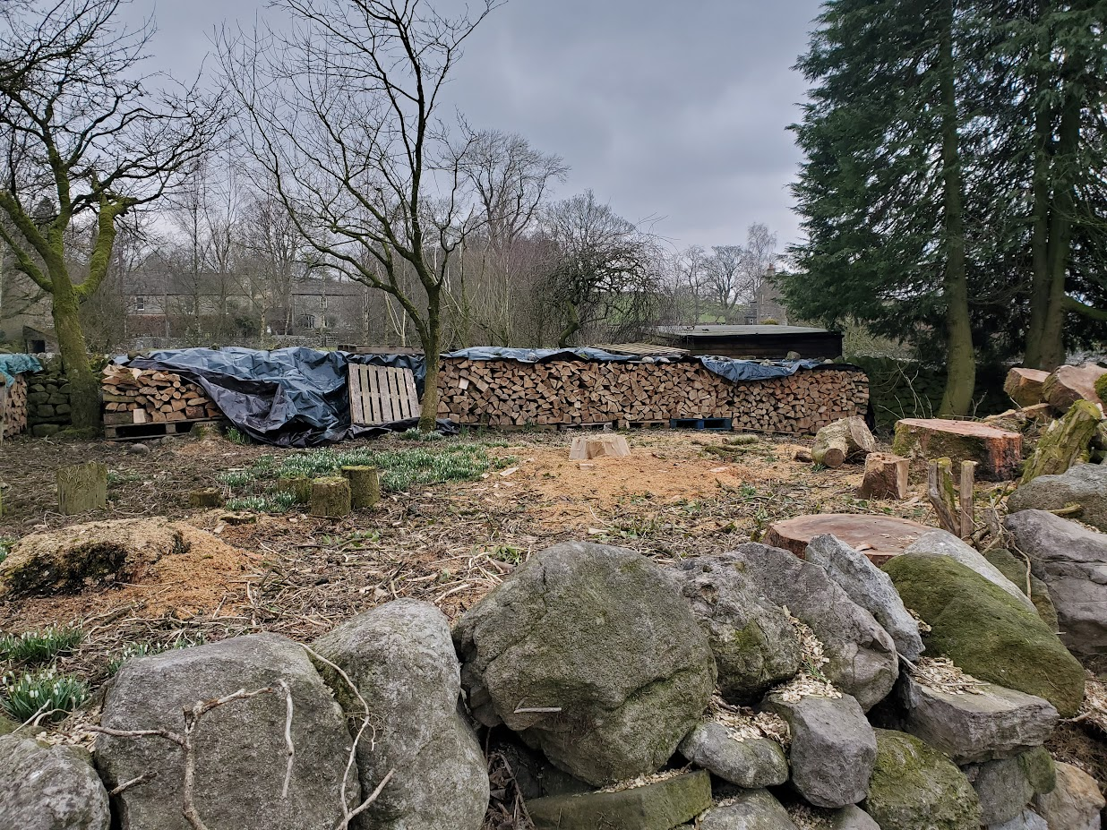
An impressive log stack, following the removal of several large conifers.
New trees were then planted on this site on Greengate.
February

Slide 7
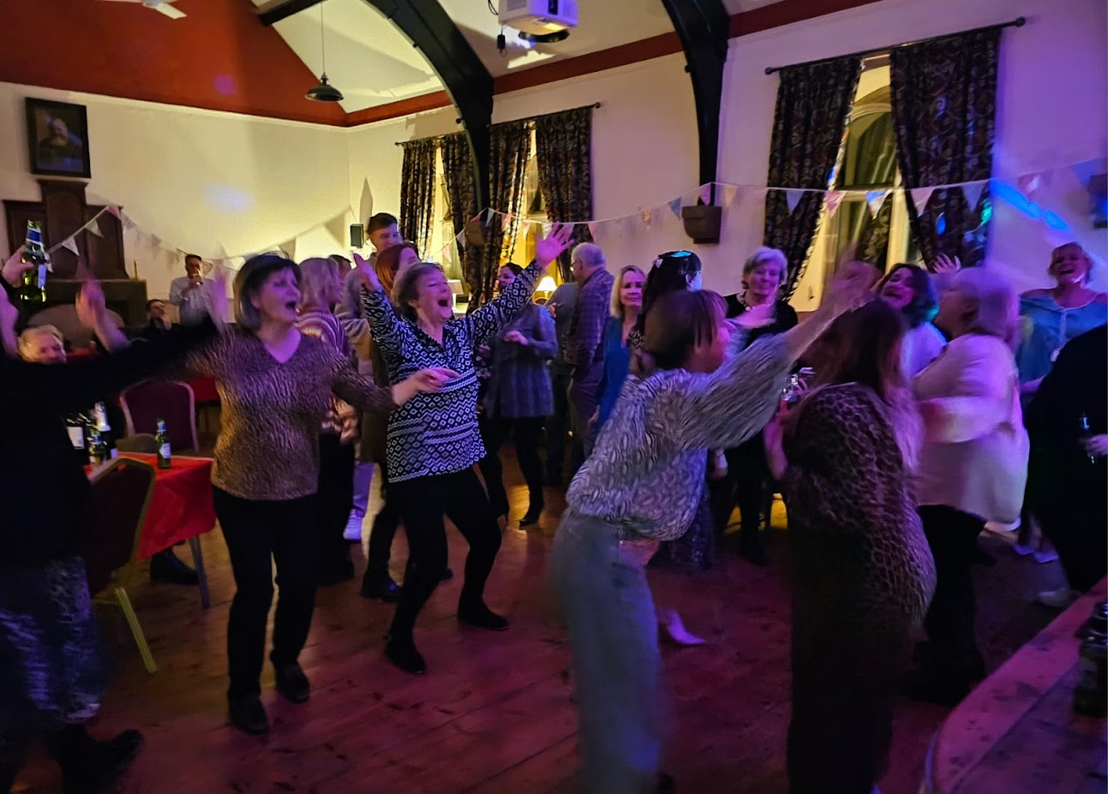
A performance by Lucas Watts had everyone dancing at this community event, held in the Parish Hall.
March 1st

Slide 8
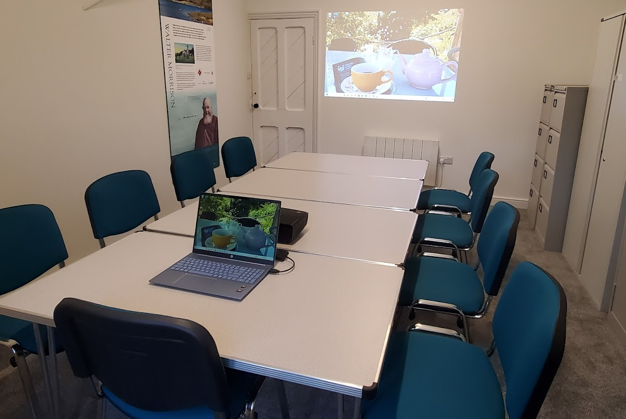
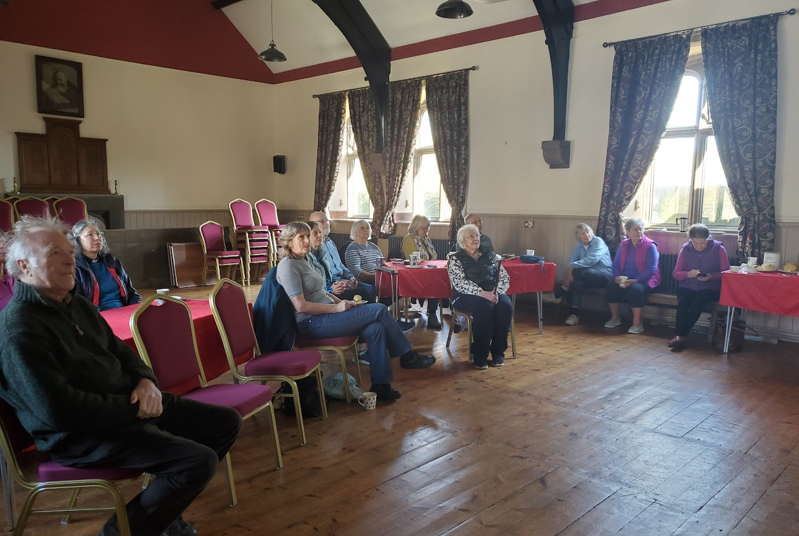
5th April – Open Morning at the Parish Hall for visitors to visit the new facilities upstairs and view a slideshow of archive material.

Slide 9
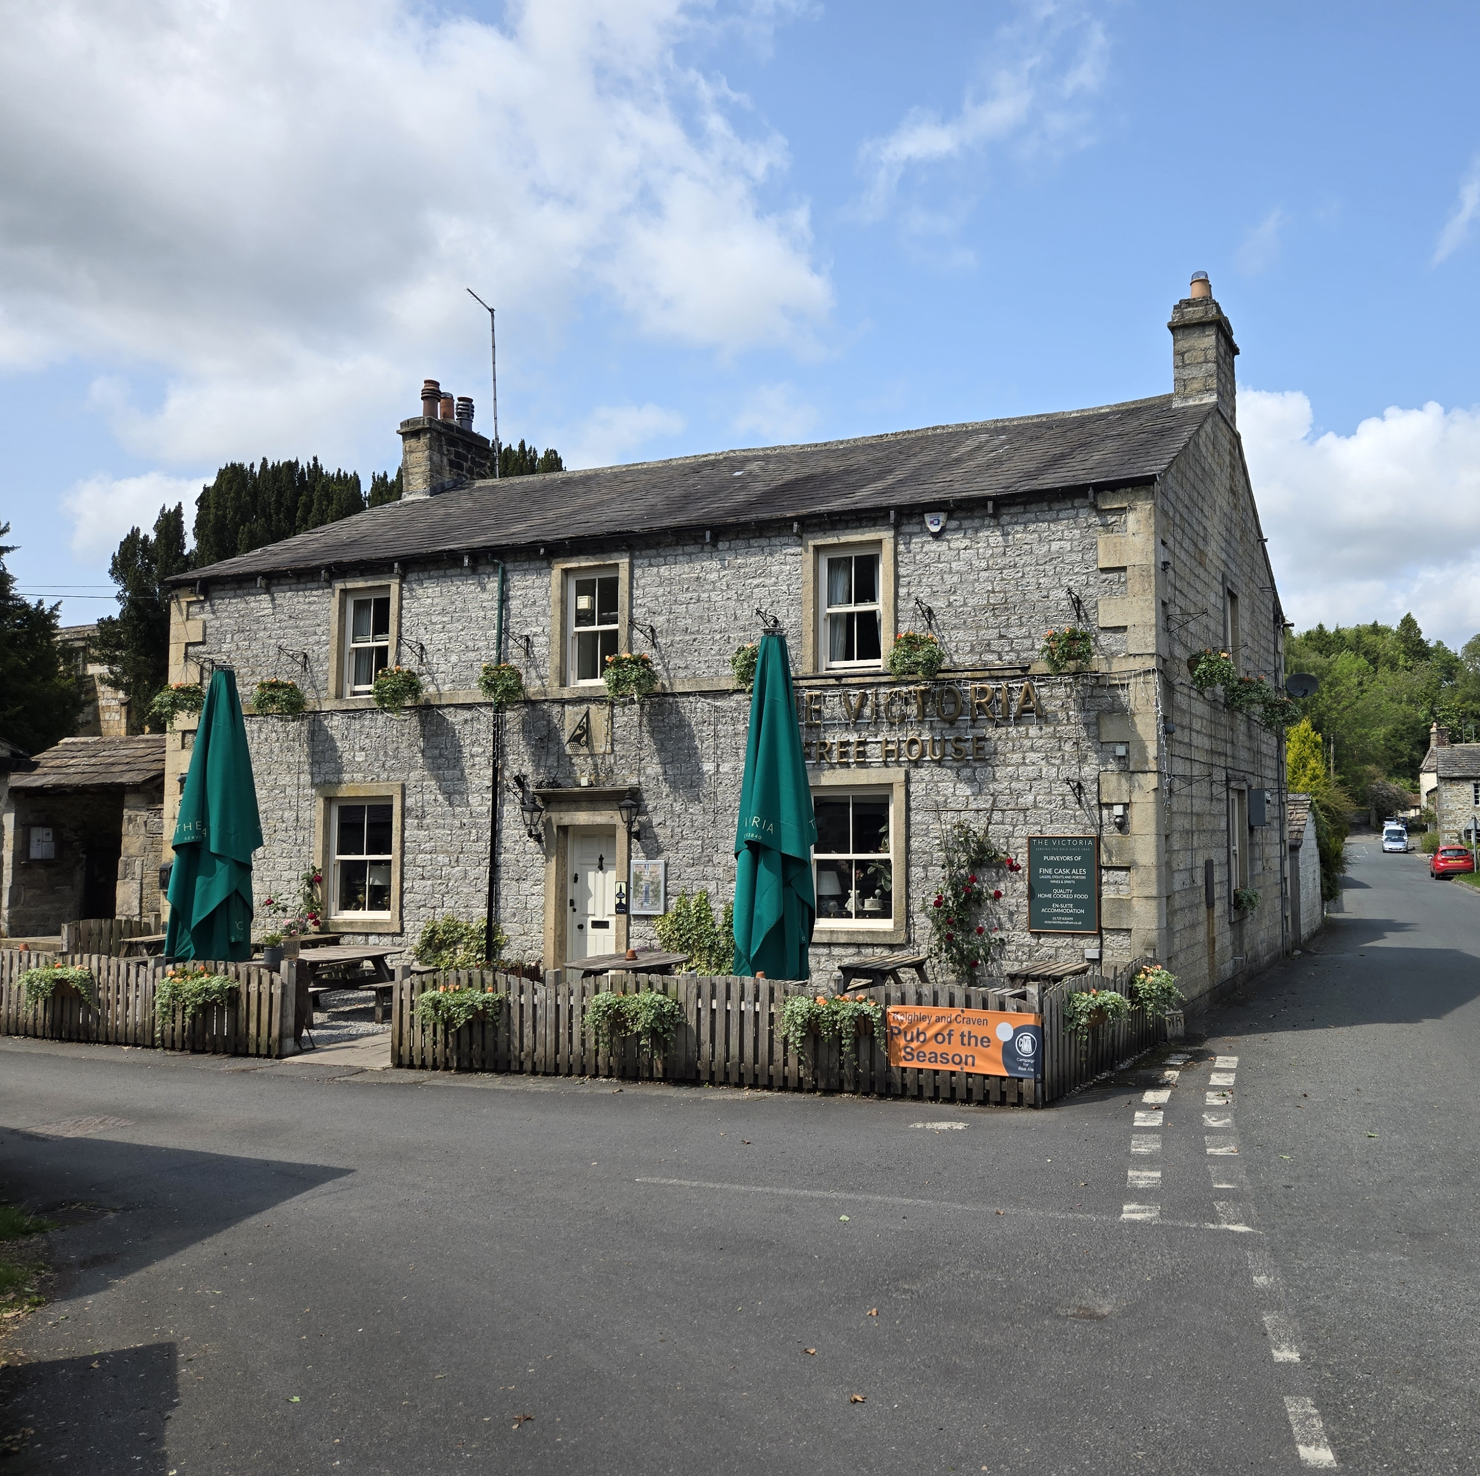
April 6th - The Victoria was named as Craven CAMRA pub of the season (Summer).
Regular quiz evenings are enjoyed by locals.

Slide 10
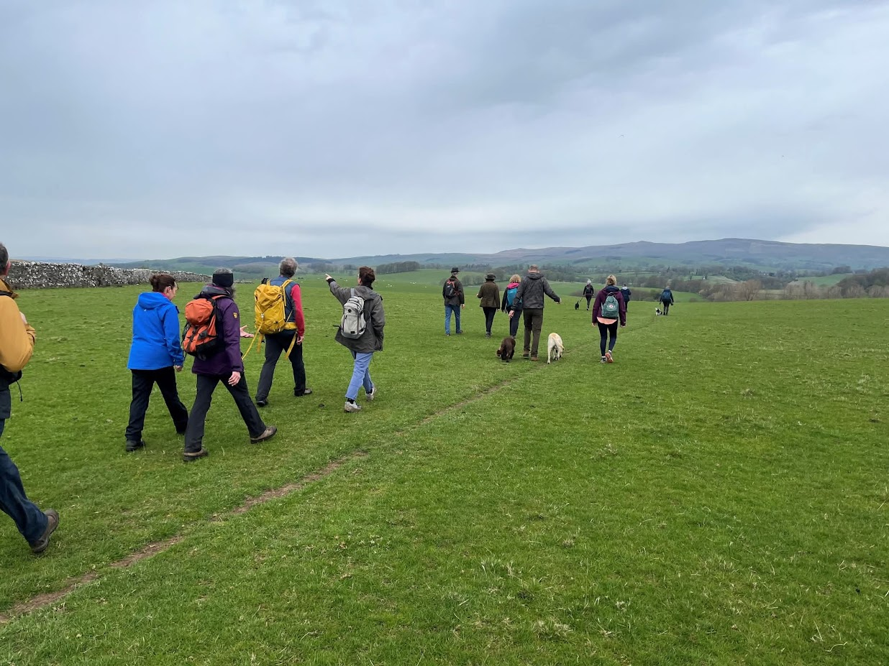
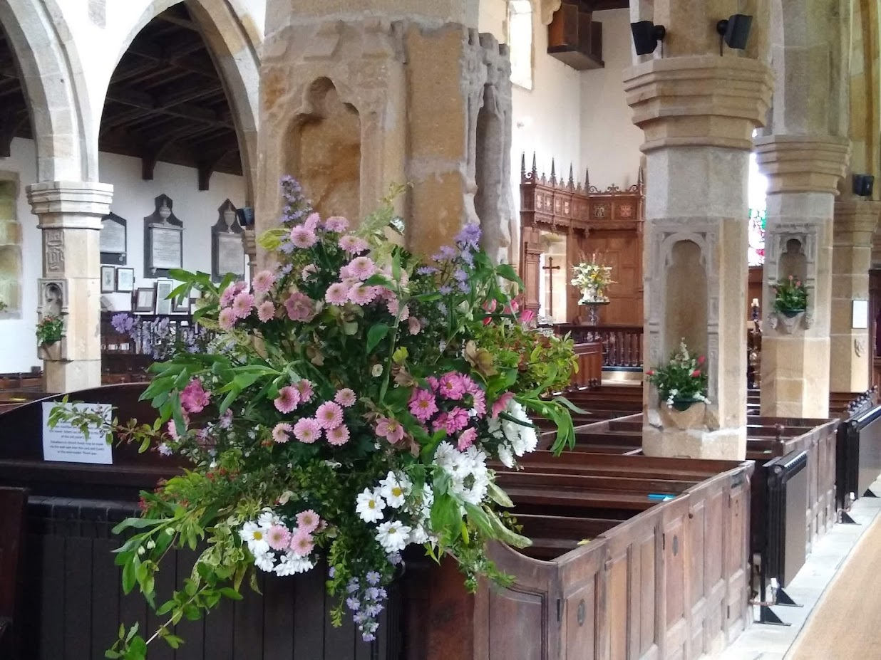
April – Annual Good Friday Walk and Easter celebrations

Slide 11
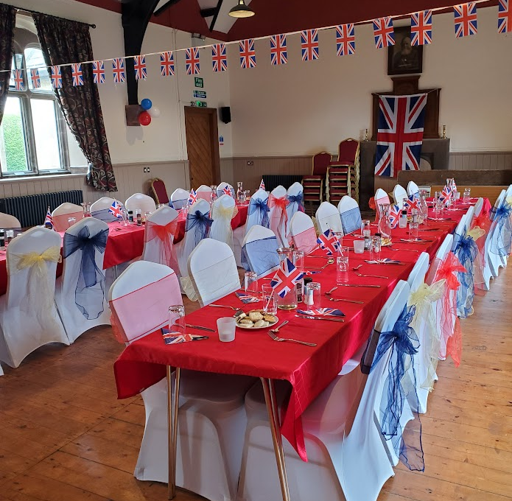
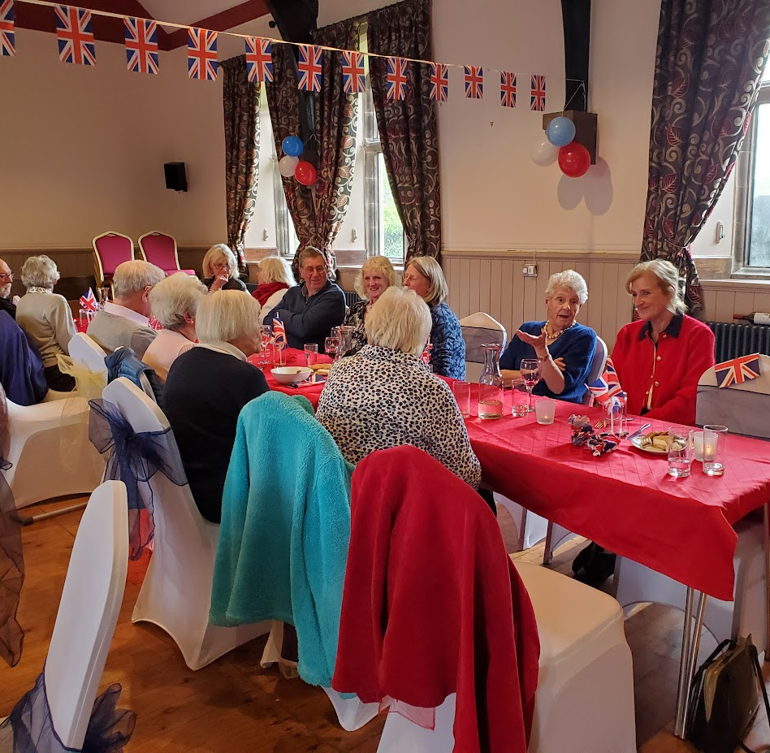
8th May - VE Day 80 celebrations
A celebratory lunch consisting of sausage casserole and rhubarb crumble was served. A slideshow presentation “Malhamdale at War” was shown and songs featuring Vera Lynn were played.

Slide 12
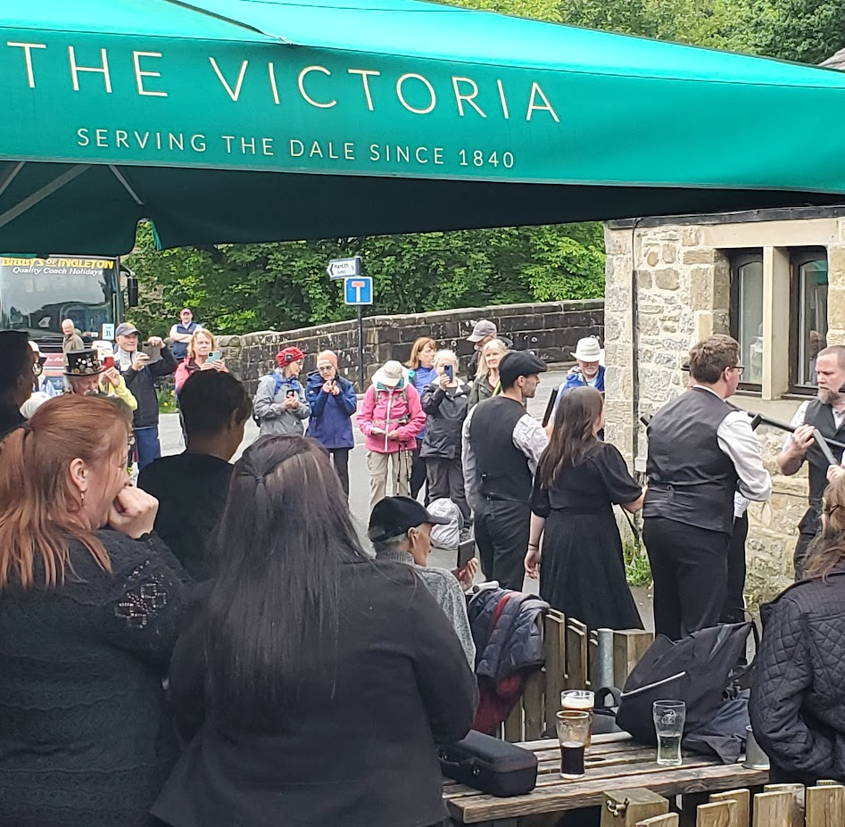
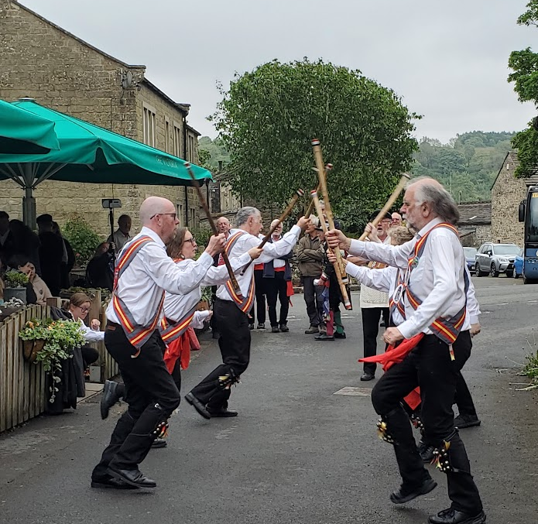
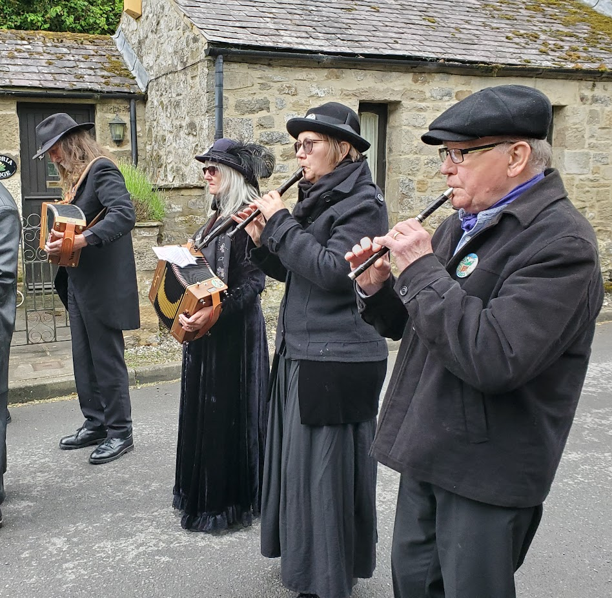
The late May Bank Holiday weekend saw the first rain for several weeks.
This was welcomed by gardeners and farmers.
However, it was damp and grey for the annual visit of Morris Dancers.

Slide 13
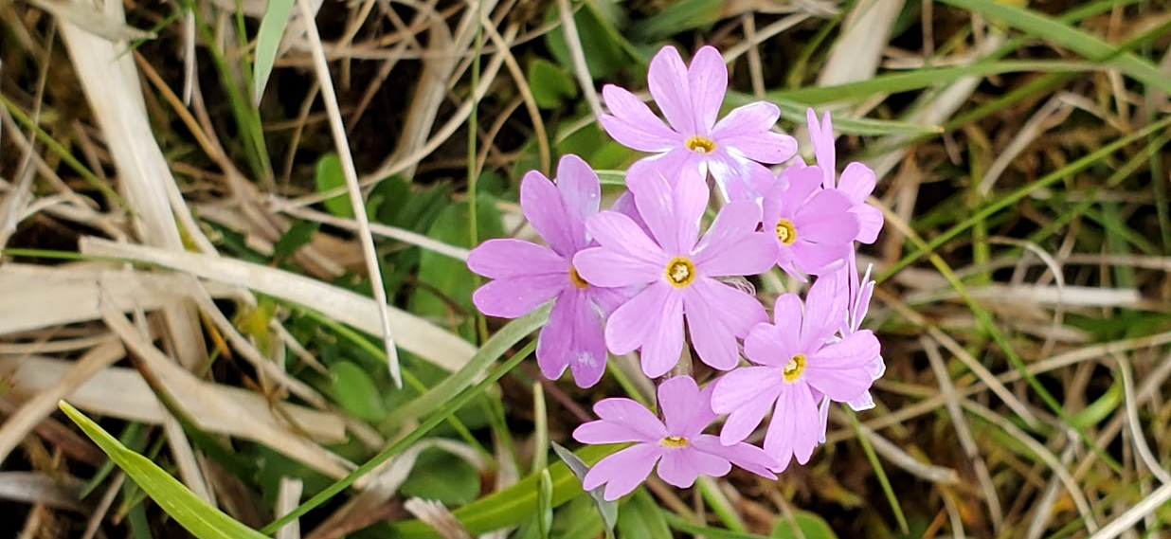
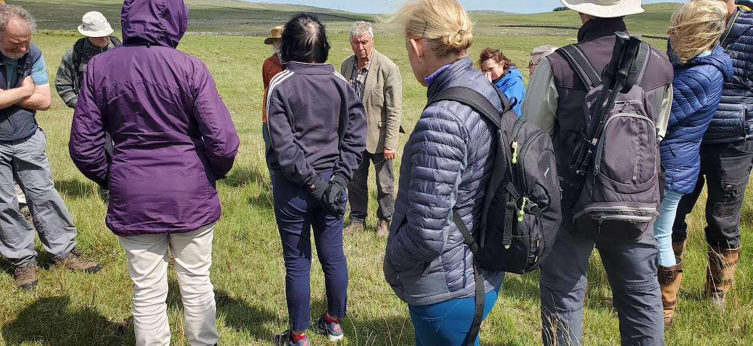
2nd June – Wildflower walk at Lee Gate Farm, organised by Paul McWhinney.
Frank Carr shared his knowledge of the flowers growing in a SSSI site at Lee Gate Farm.
A highlight was the Bird’s eye primrose which grows well on limestone pasture.
The walk concluded with tea and some delicious cakes!

Slide 14
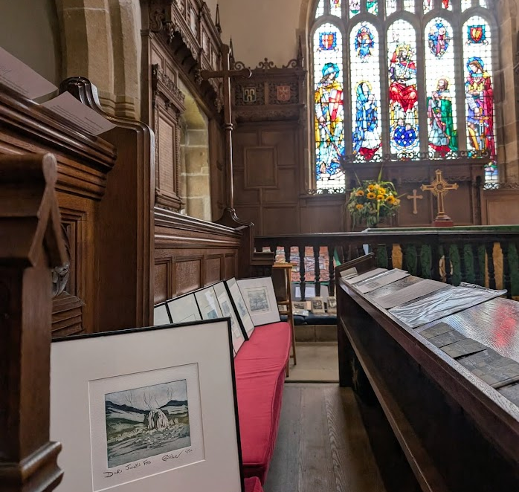
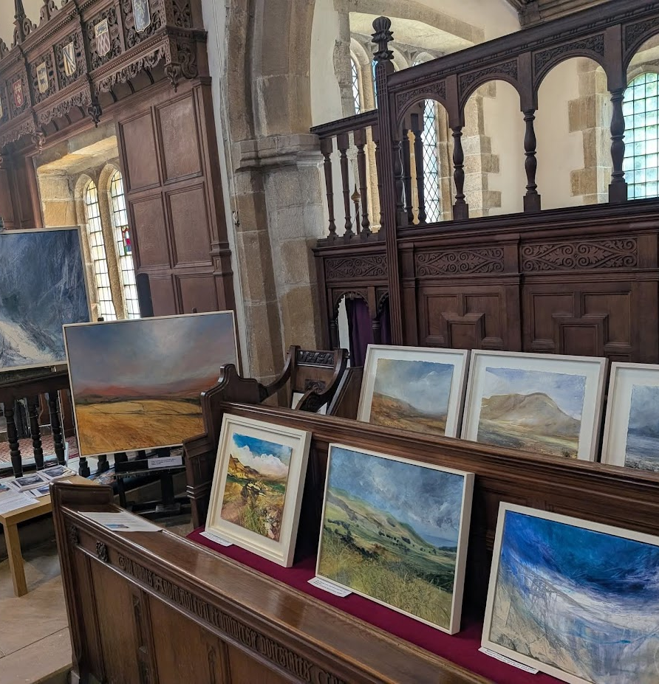
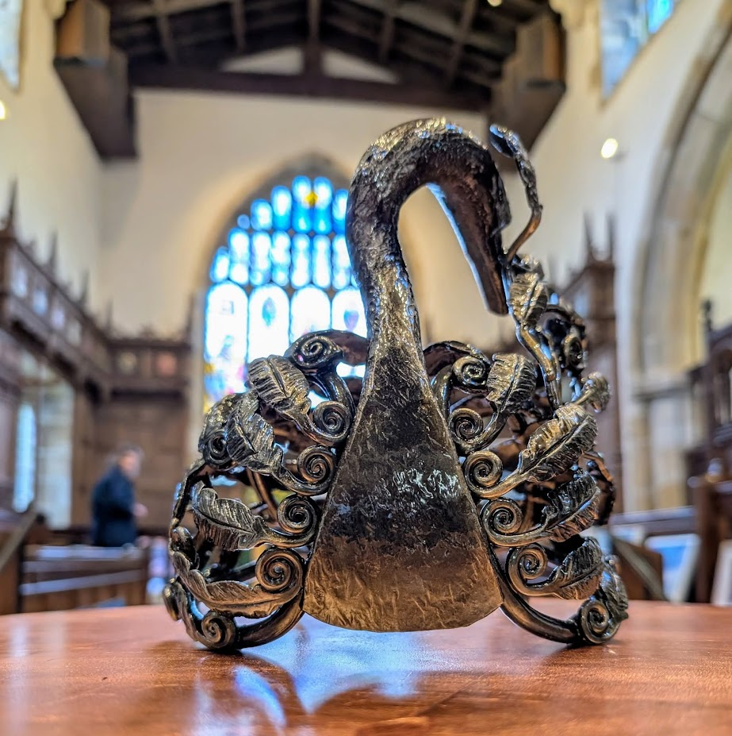
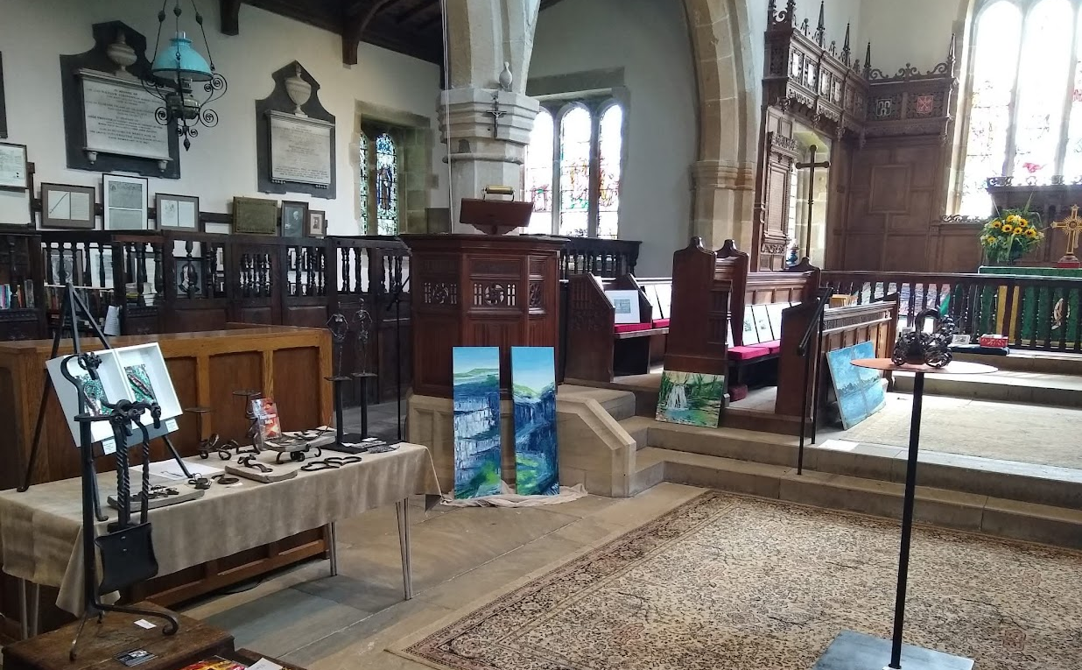
Art in the Dale has become a regular feature in June, celebrating the talent of local artists.

Slide 15
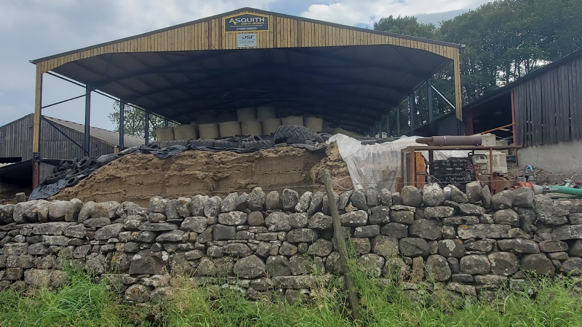
A roof was erected to cover part of existing silage pit at Kirkby Beck Farm.
This will help to reduce the risk of diffuse pollution.
July

Slide 16
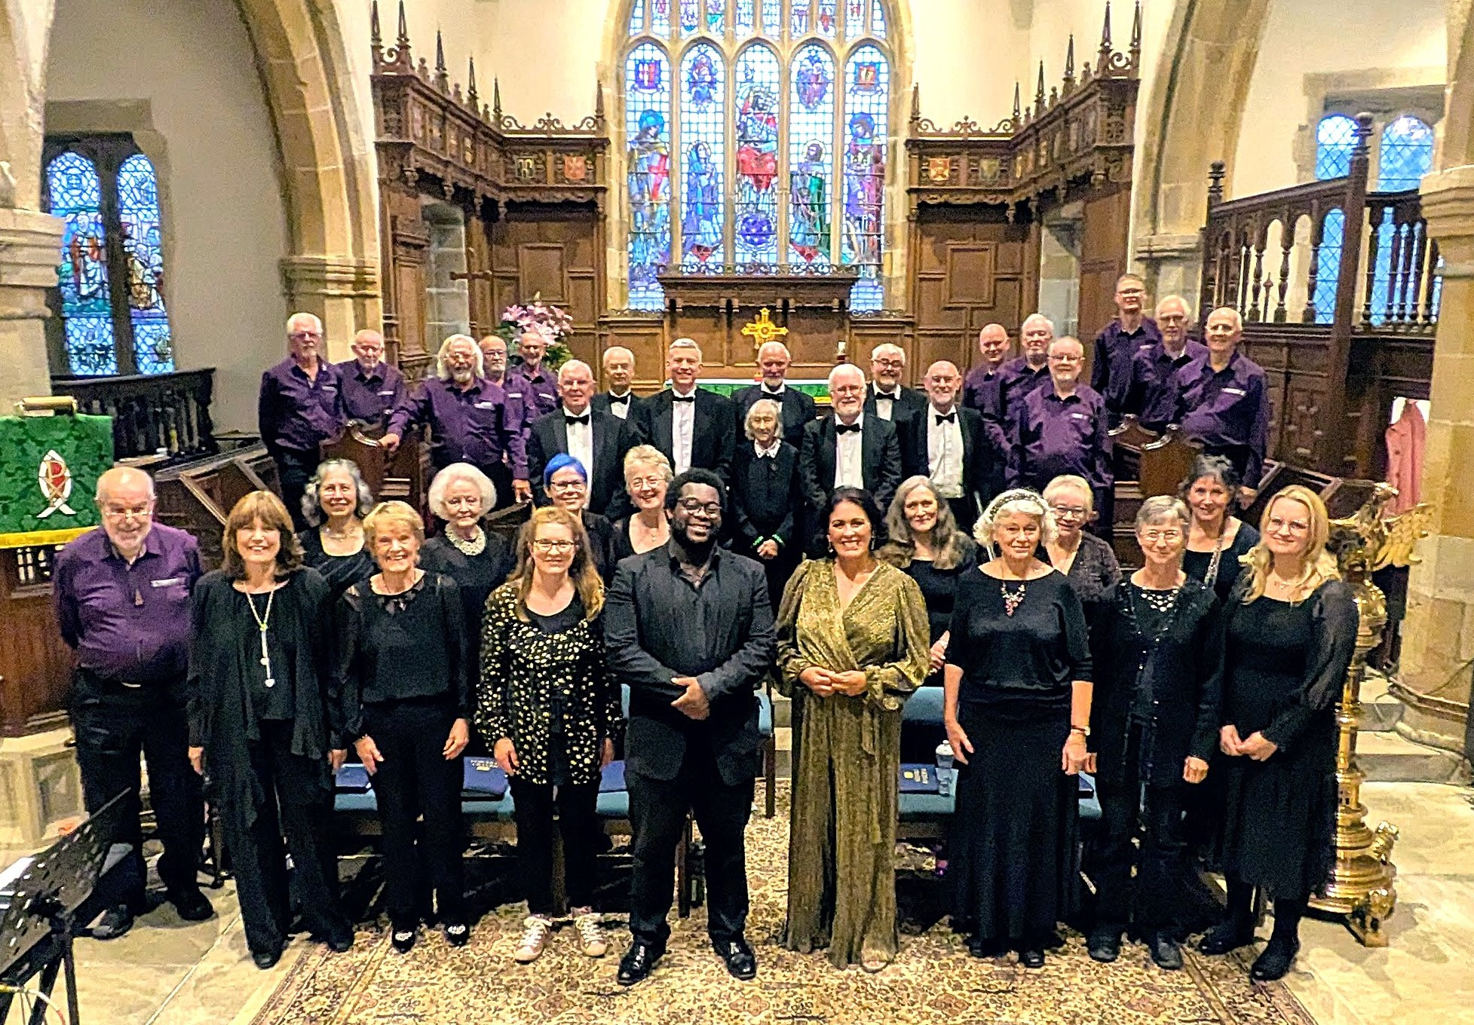
4th July – End of summer season concert at St Michael’s
“Voices of Craven” finished their summer season with a concert in Kirkby Malham. They were joined by Male Ensemble “Libertas"

Slide 17
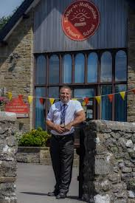
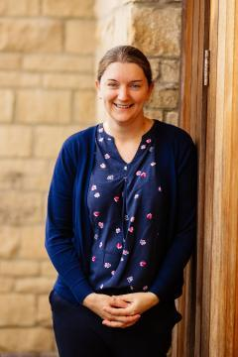
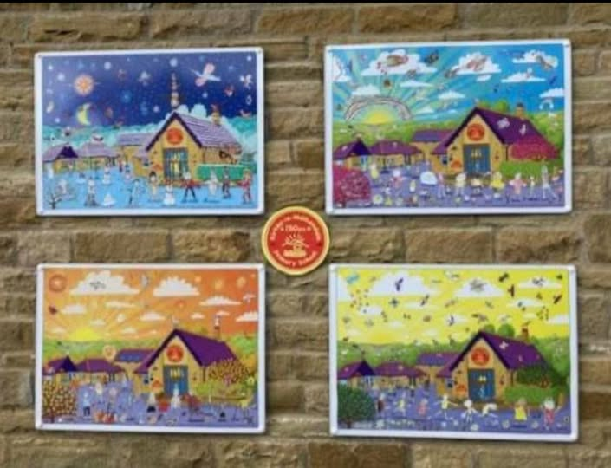
July - Kirkby-in-Malhamdale Primary School celebrated its 150th anniversary and also said farewell to executive headteacher Richard Wright. His successor is Mrs Claire Roberts who will take up post in September.

Slide 18
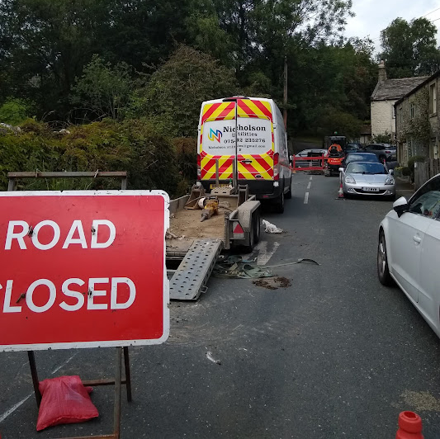
August - A hosepipe ban and a water leak!
The sudden closure of Main Street for a water leak took people by surprise and led to a lengthy diversion for many visitors and disruption for residents. Even when the work was finished some people were diverted unnecessarily as Google did not update its maps for quite a while.

Slide 19
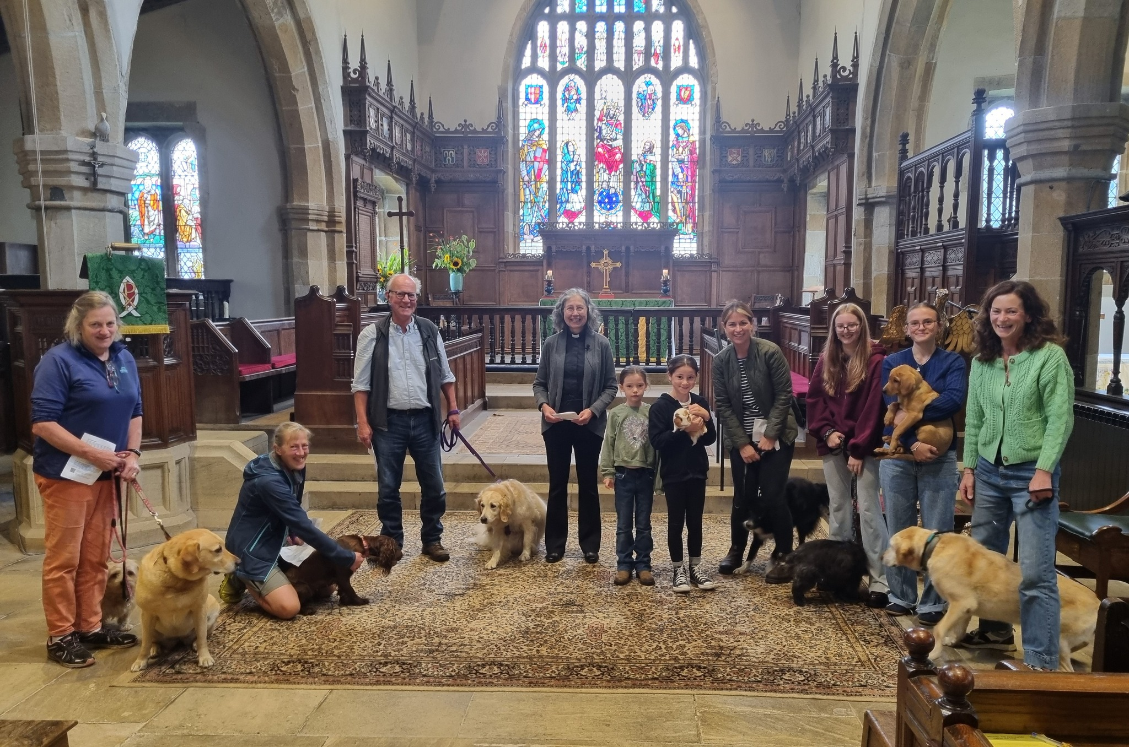

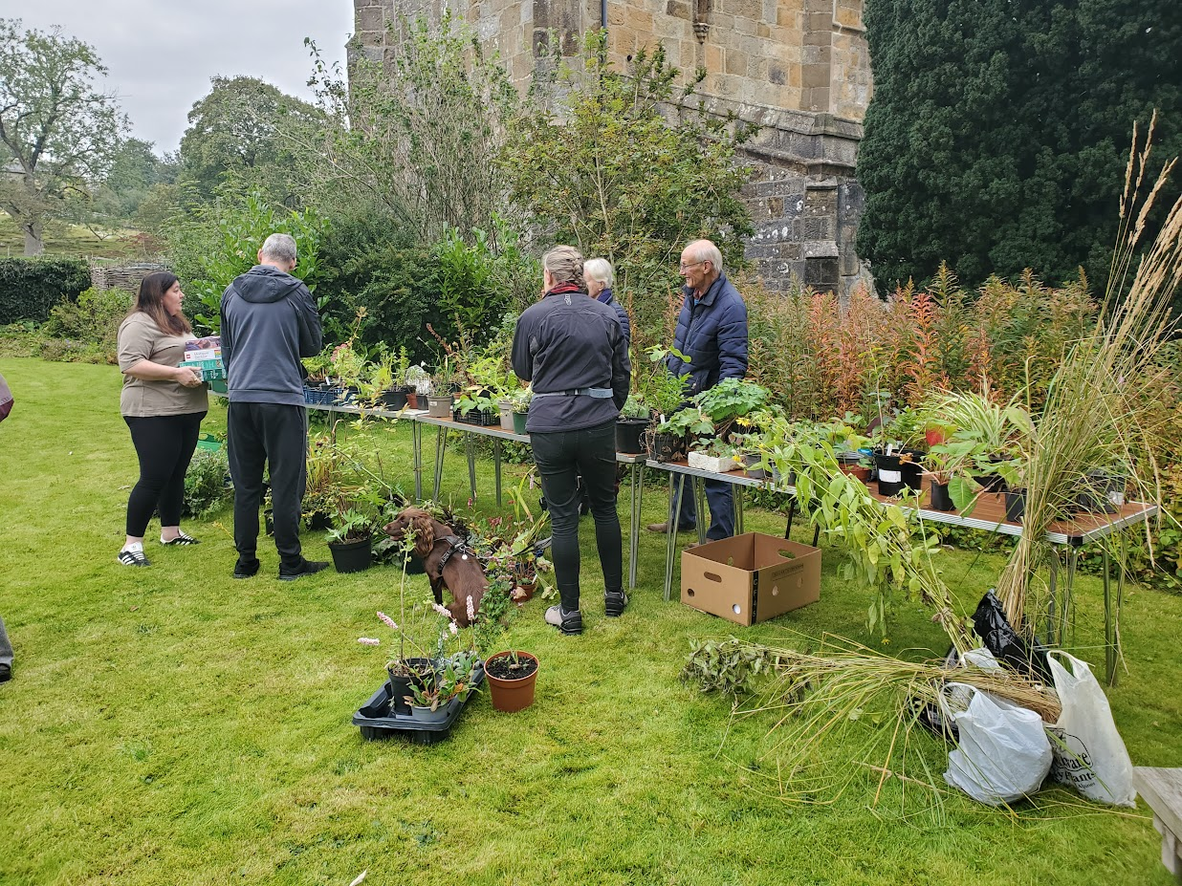
During September the church welcomed visitors to the heritage open days event and held a special service for pets to attend!
The annual plant sale also took place in the vicarage garden.

Slide 20
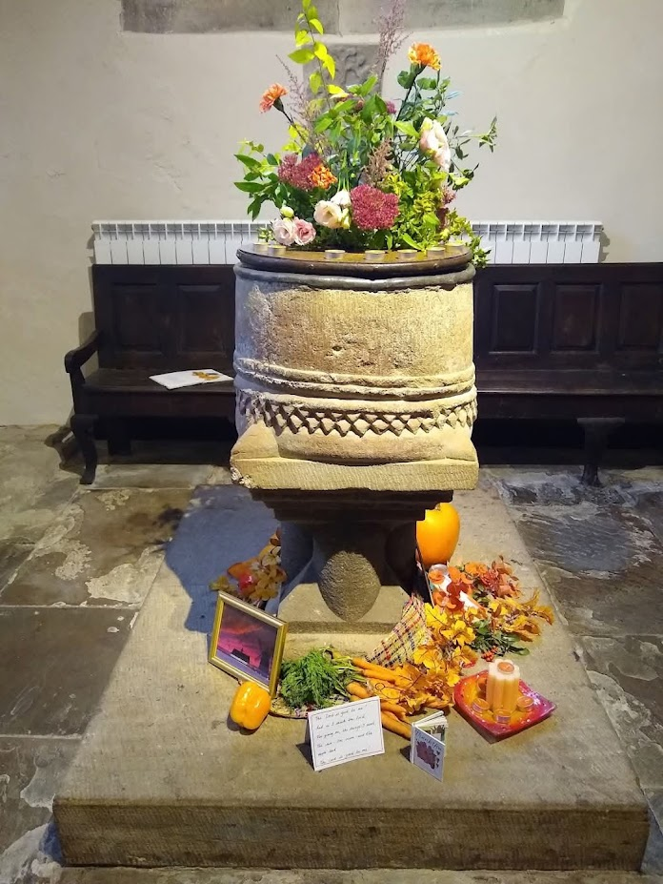
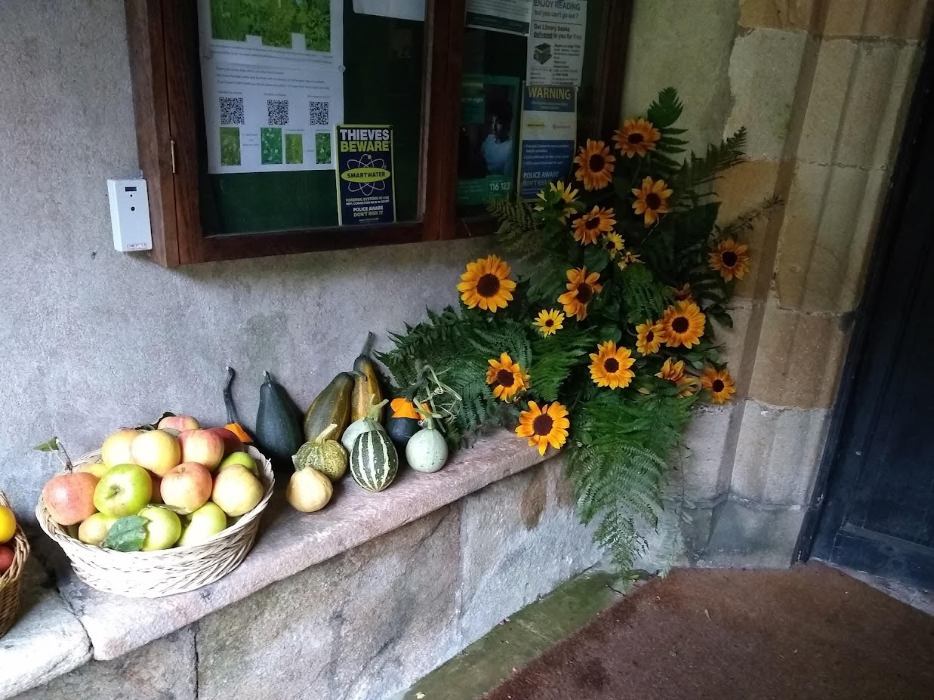
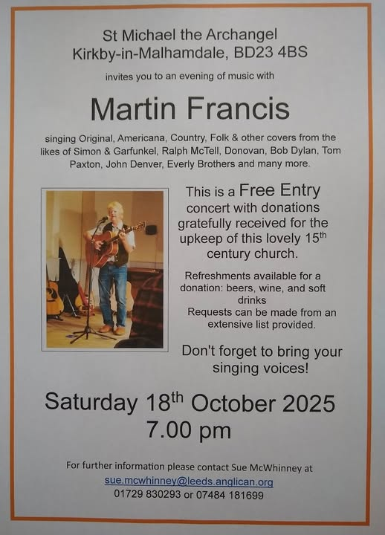
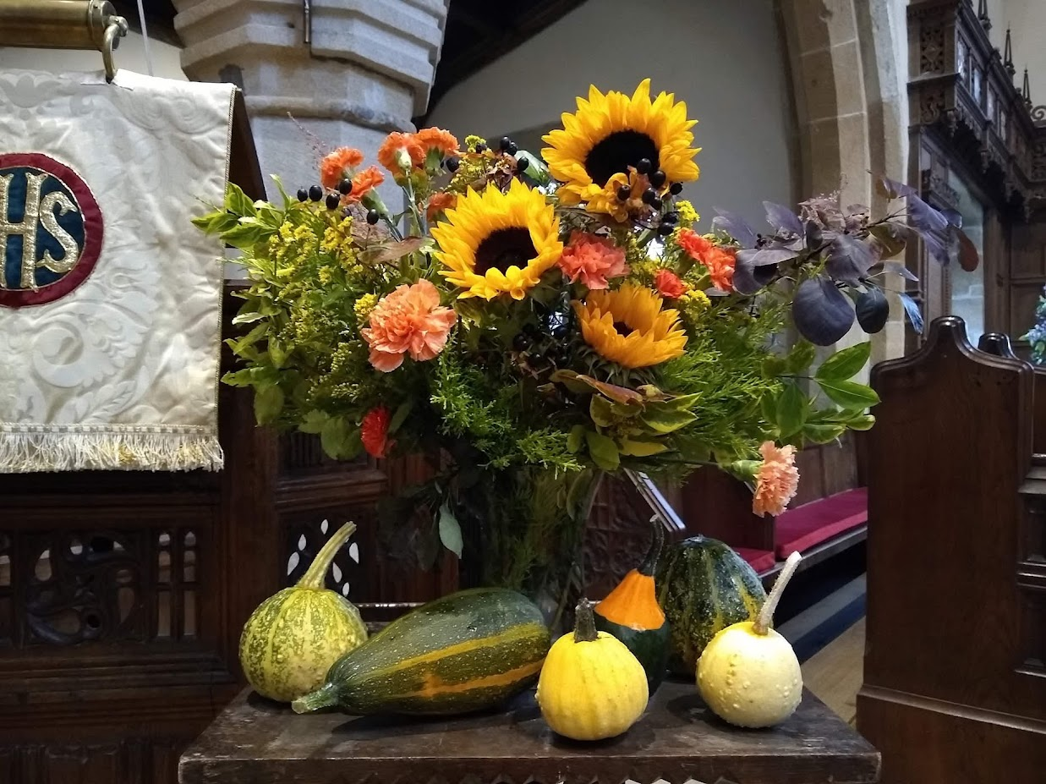
October – Harvest Festival and a folk concert.

Slide 21
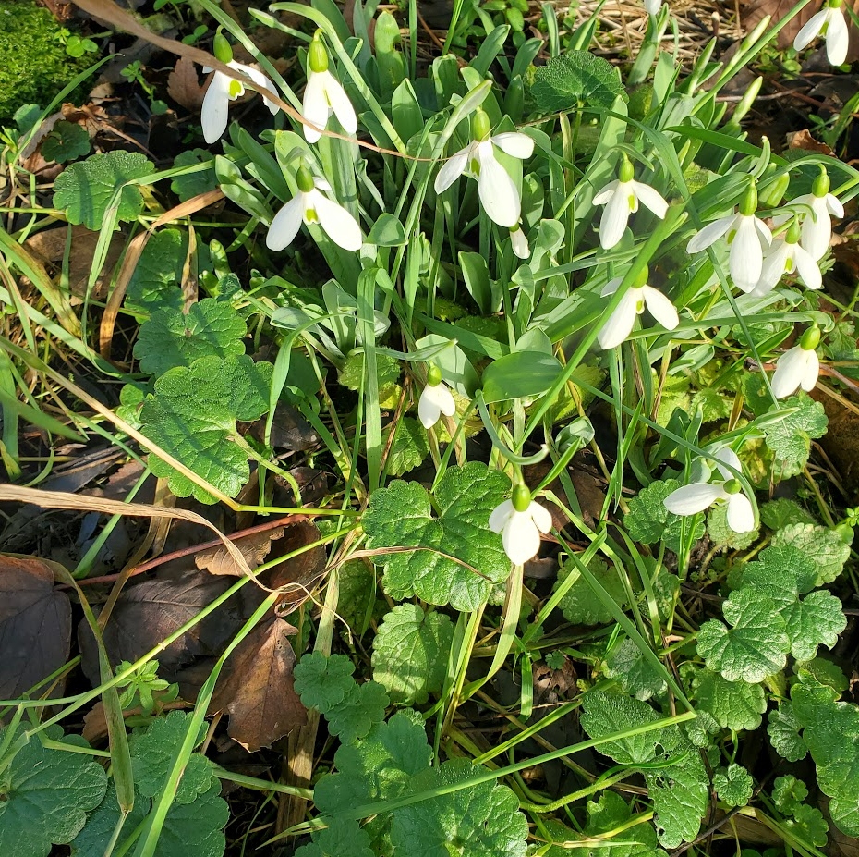
Nov 6th – These snowdrops were found flowering on Hanlith Lane. Is this a record?
Have you noticed other plants flowering out of season?

Slide 22
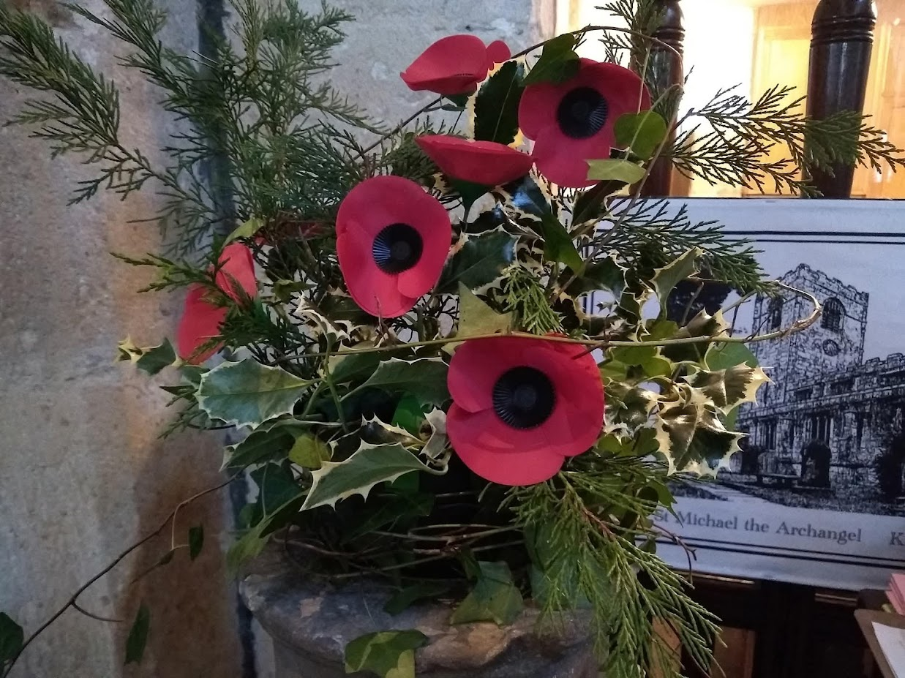
9th November – Remembrance Sunday
Wreaths were laid at the war memorial inside church and the names of those who fell in WW1 were read out. This was followed by a two-minute silence at 11am.

Slide 23
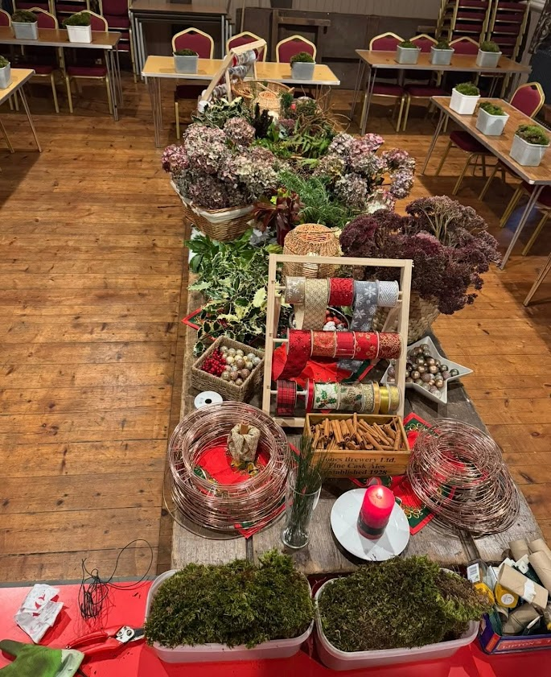

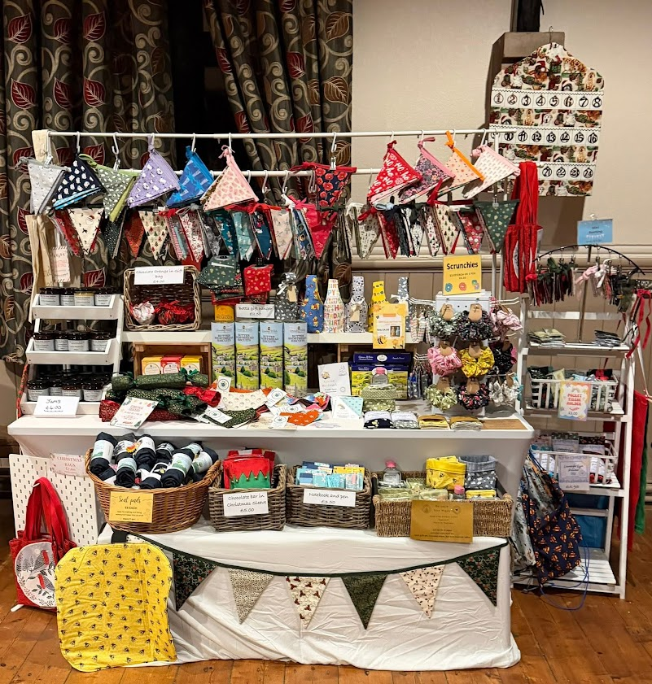
November – there were several events at the Parish Hall
Lunch clubs have become a regular event.
Wreath making workshops
Christmas Fair with local crafts

Slide 24
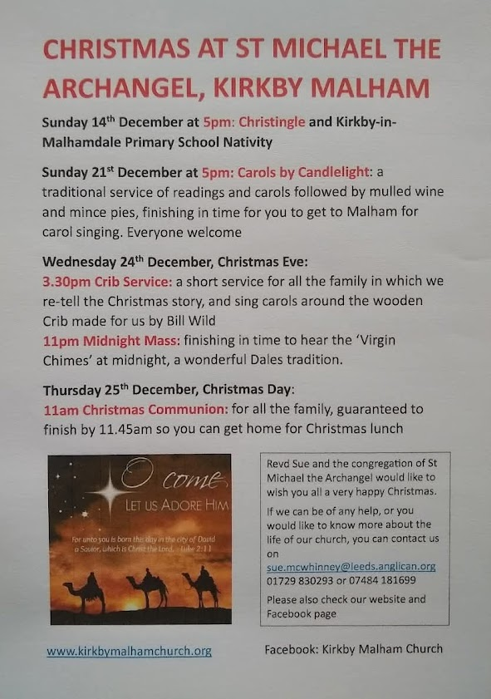
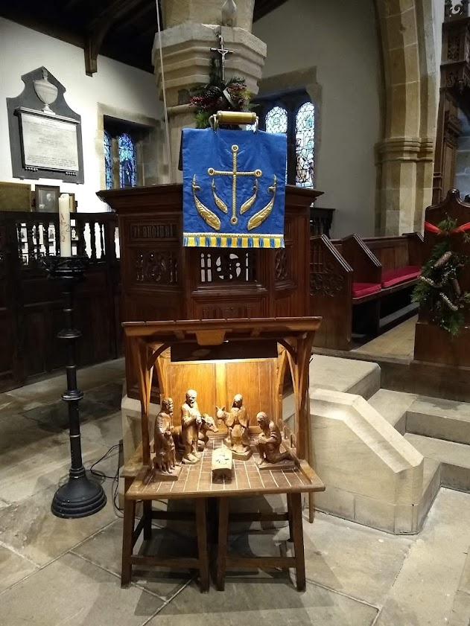
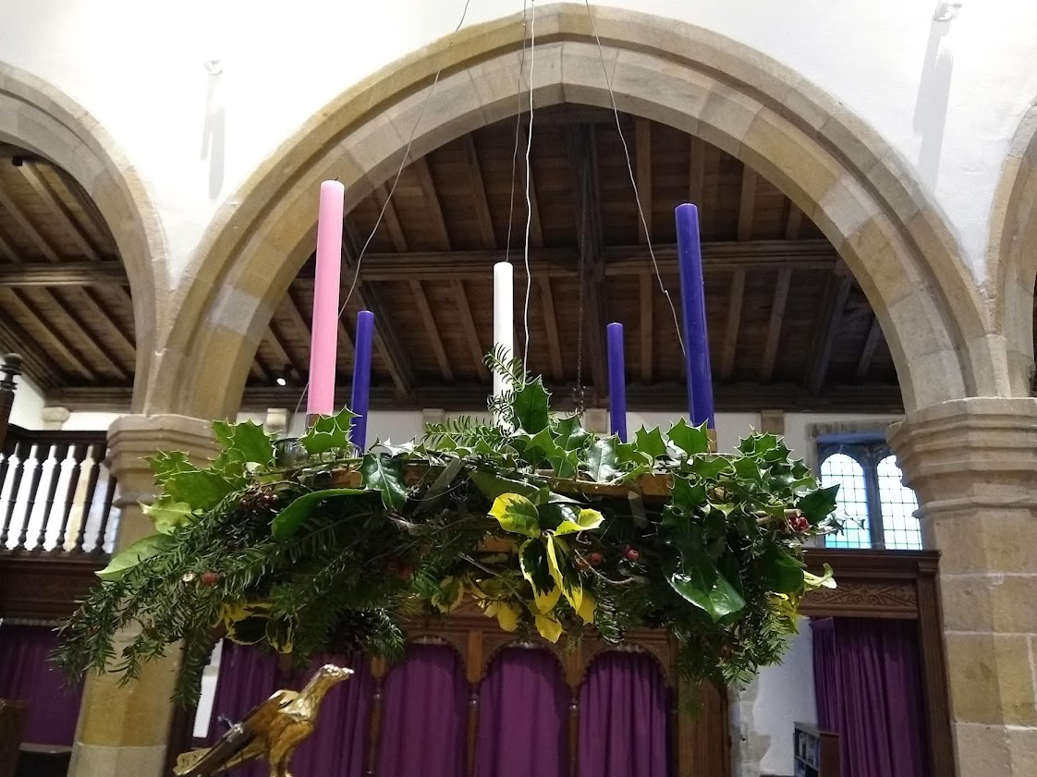
December - traditional Christmas Services and festive events.

Slide 25
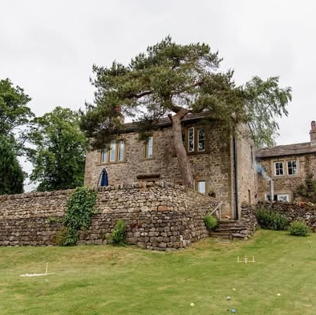
Property news
Property sites indicate The Manor House was sold in August 2025.
The new owners of Yeoman’s Barn visited in the summer but are currently living abroad. The house has remained empty for most of the year.

