Slide 1
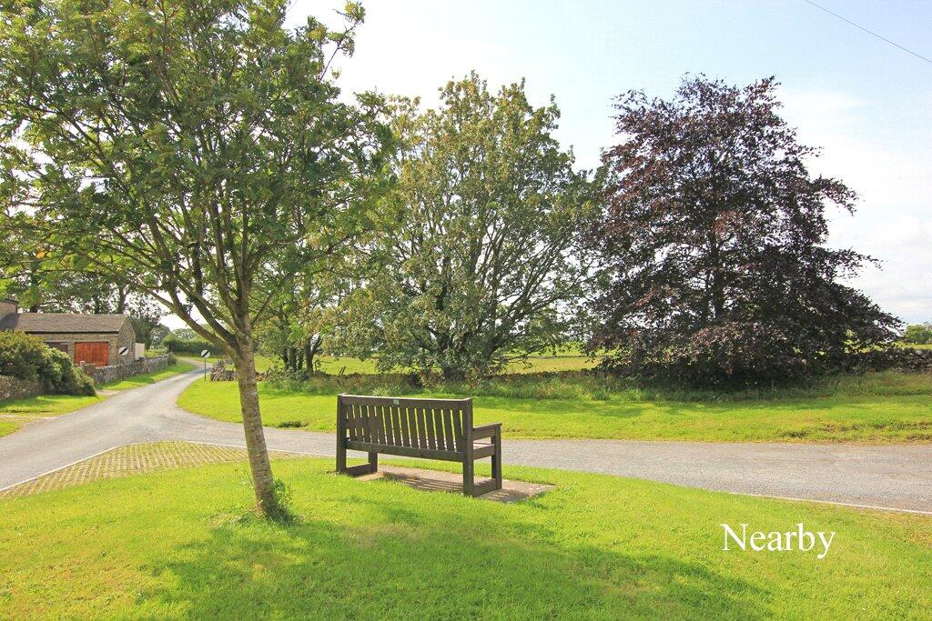
Airton & Scosthrop
Parish Diary 2025
Malhamdale Local History Group
Colin Lugton, 1 January 2026

Slide 2
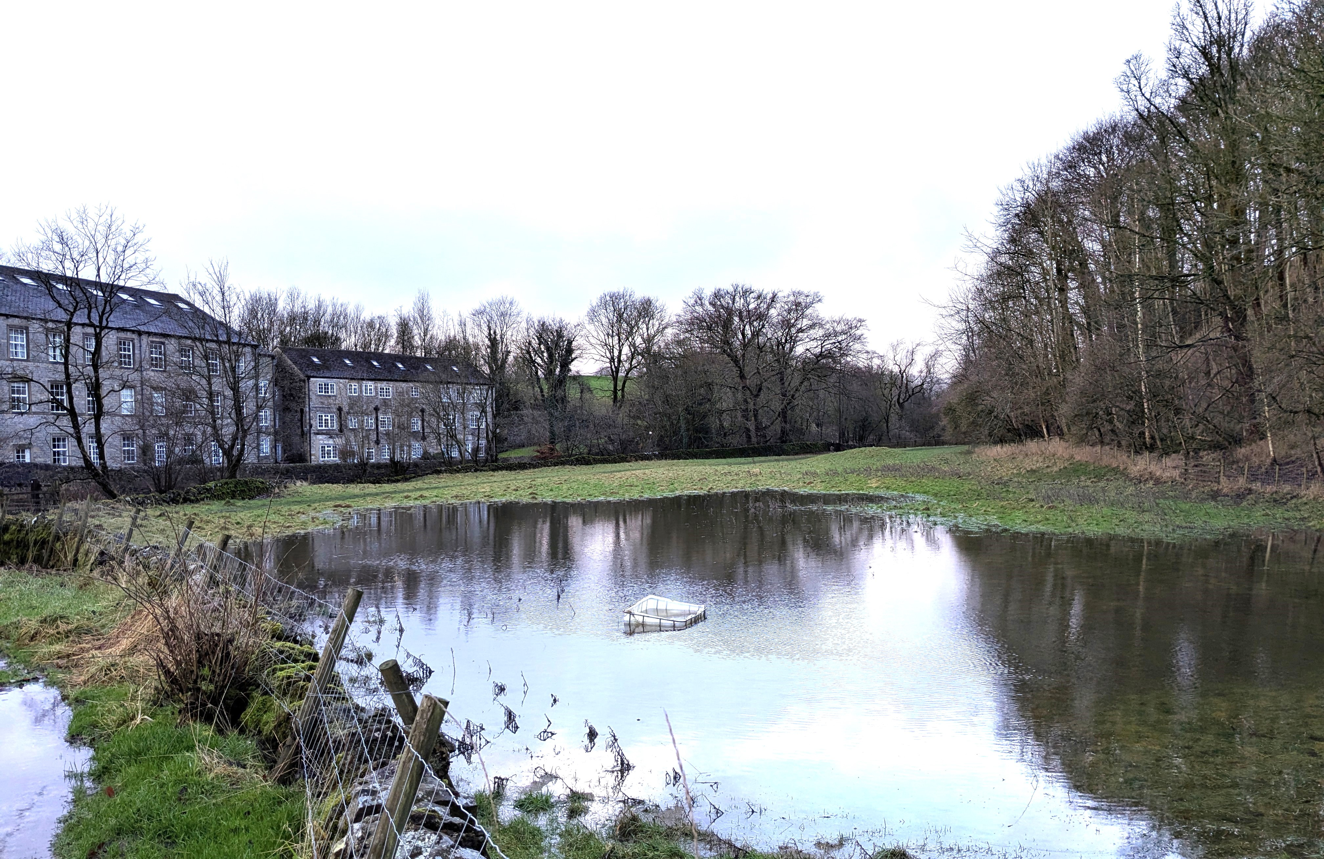
1 January
The new year at Airton Bridge started with a flooded field.

Slide 3
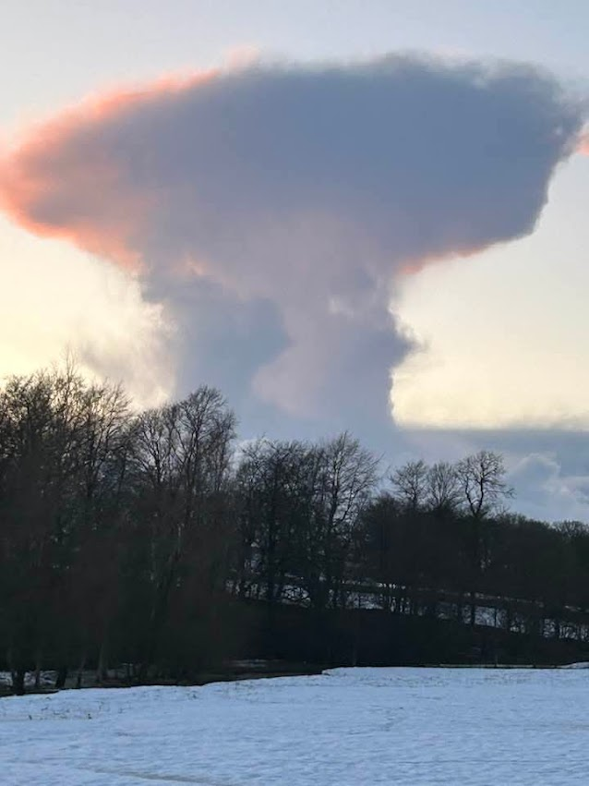
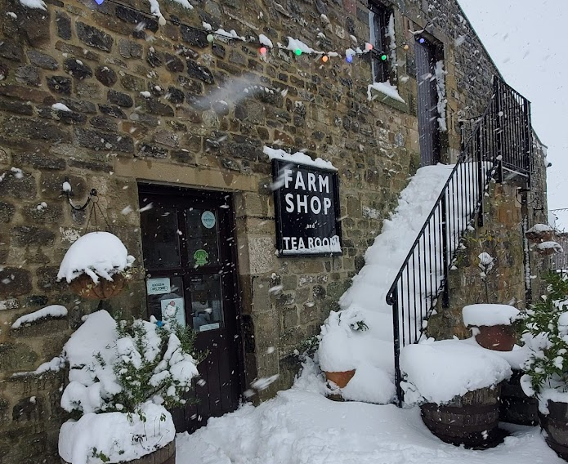
This was closely followed by heavy snowfall and an unusual cloud formation.

Slide 4
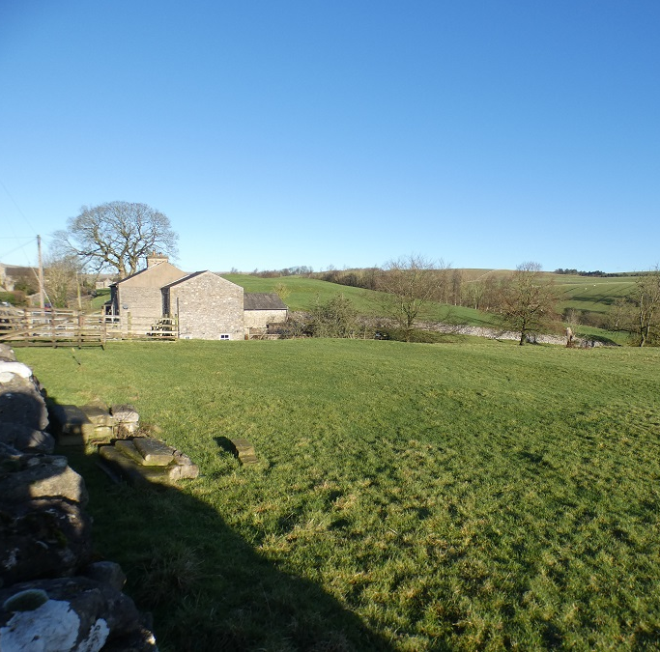
31 January
Residential Development Land at Hallgarth
The chair of Airton Parish Meeting reported that the site is now marked on the WBW website Sold subject to contract.
“I have been in touch with the Planning Policy Officer who assures me that the current Planning Permission is for only 3 houses, but the landowner is keen to get planning for 2 more houses.”

Slide 5

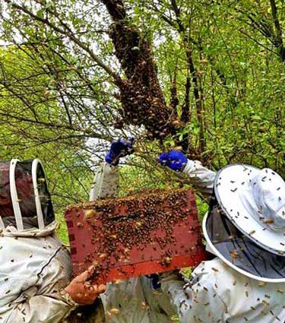
30th April – the owners of Ellis Barn thought they had a swarm of bees looking for a nesting site in their roof.
They were seeking help or advice from a local beekeeper.

Slide 6
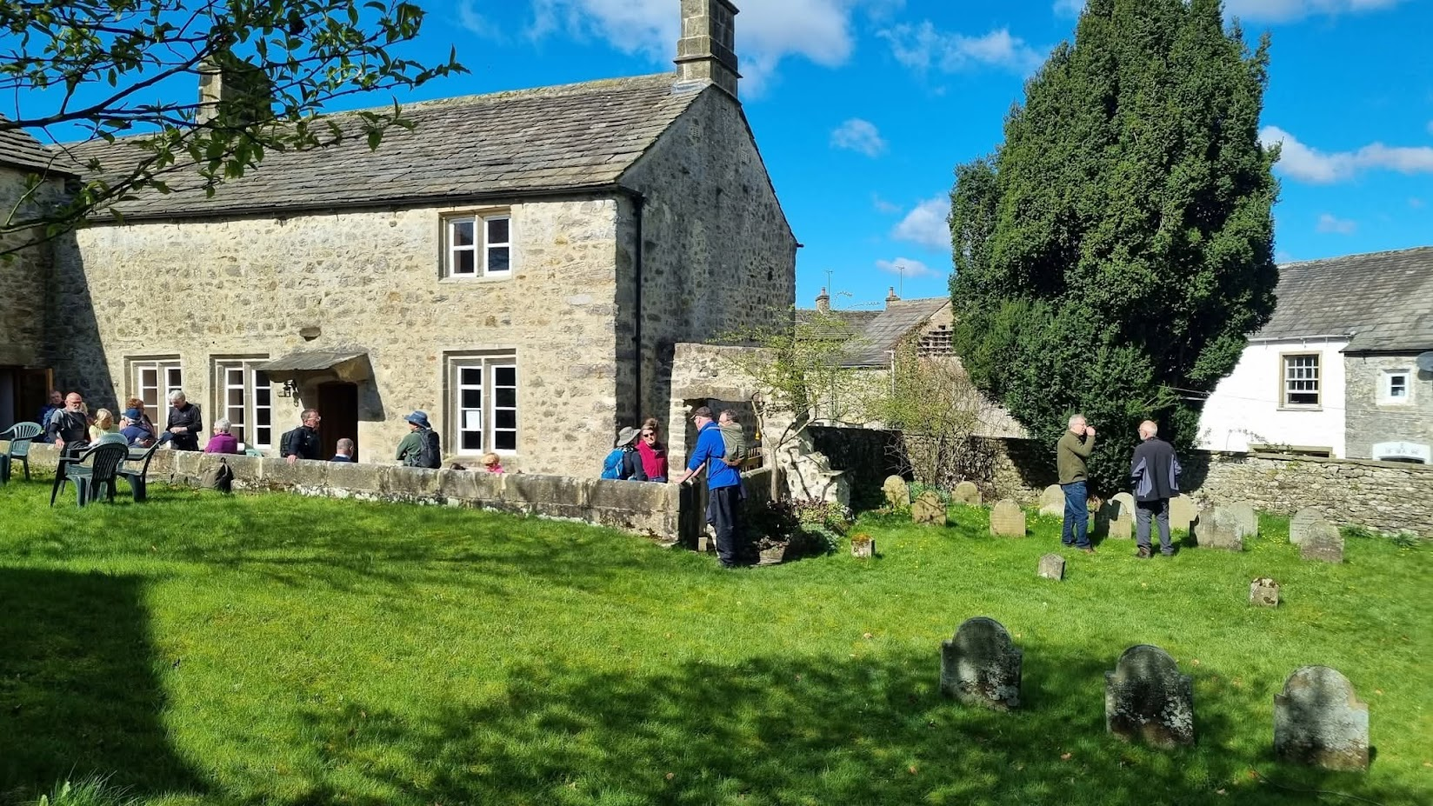
5th May – Open Day and pop-up café at Airton Friends’ Meeting House.

Slide 7
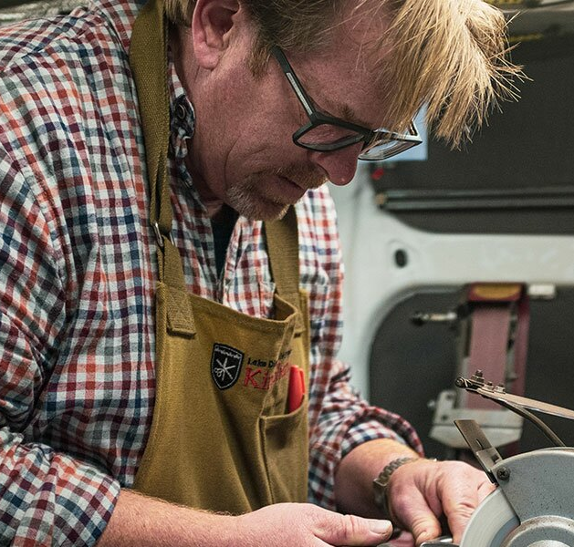
31st May – anyone needing their knives sharpened were able to go along to the see the “King Sharp” knife sharpener at the Farm Shop.

Slide 8
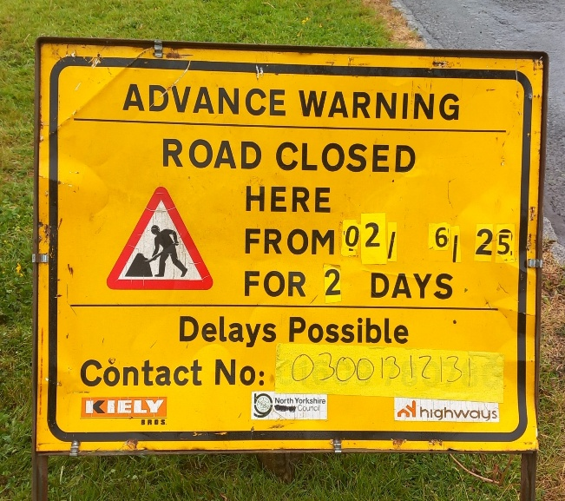
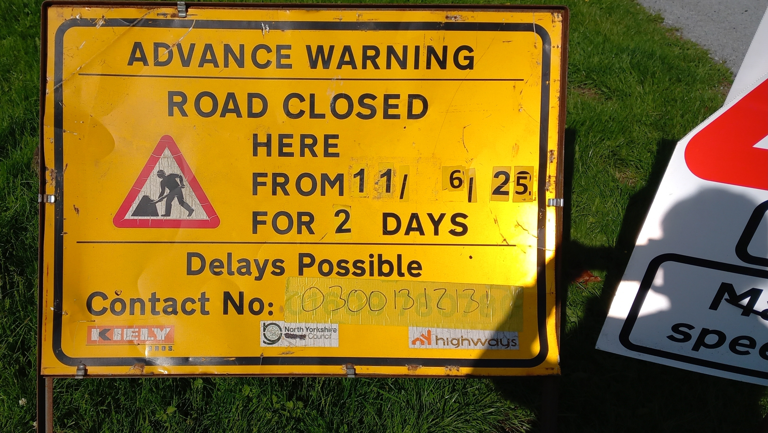
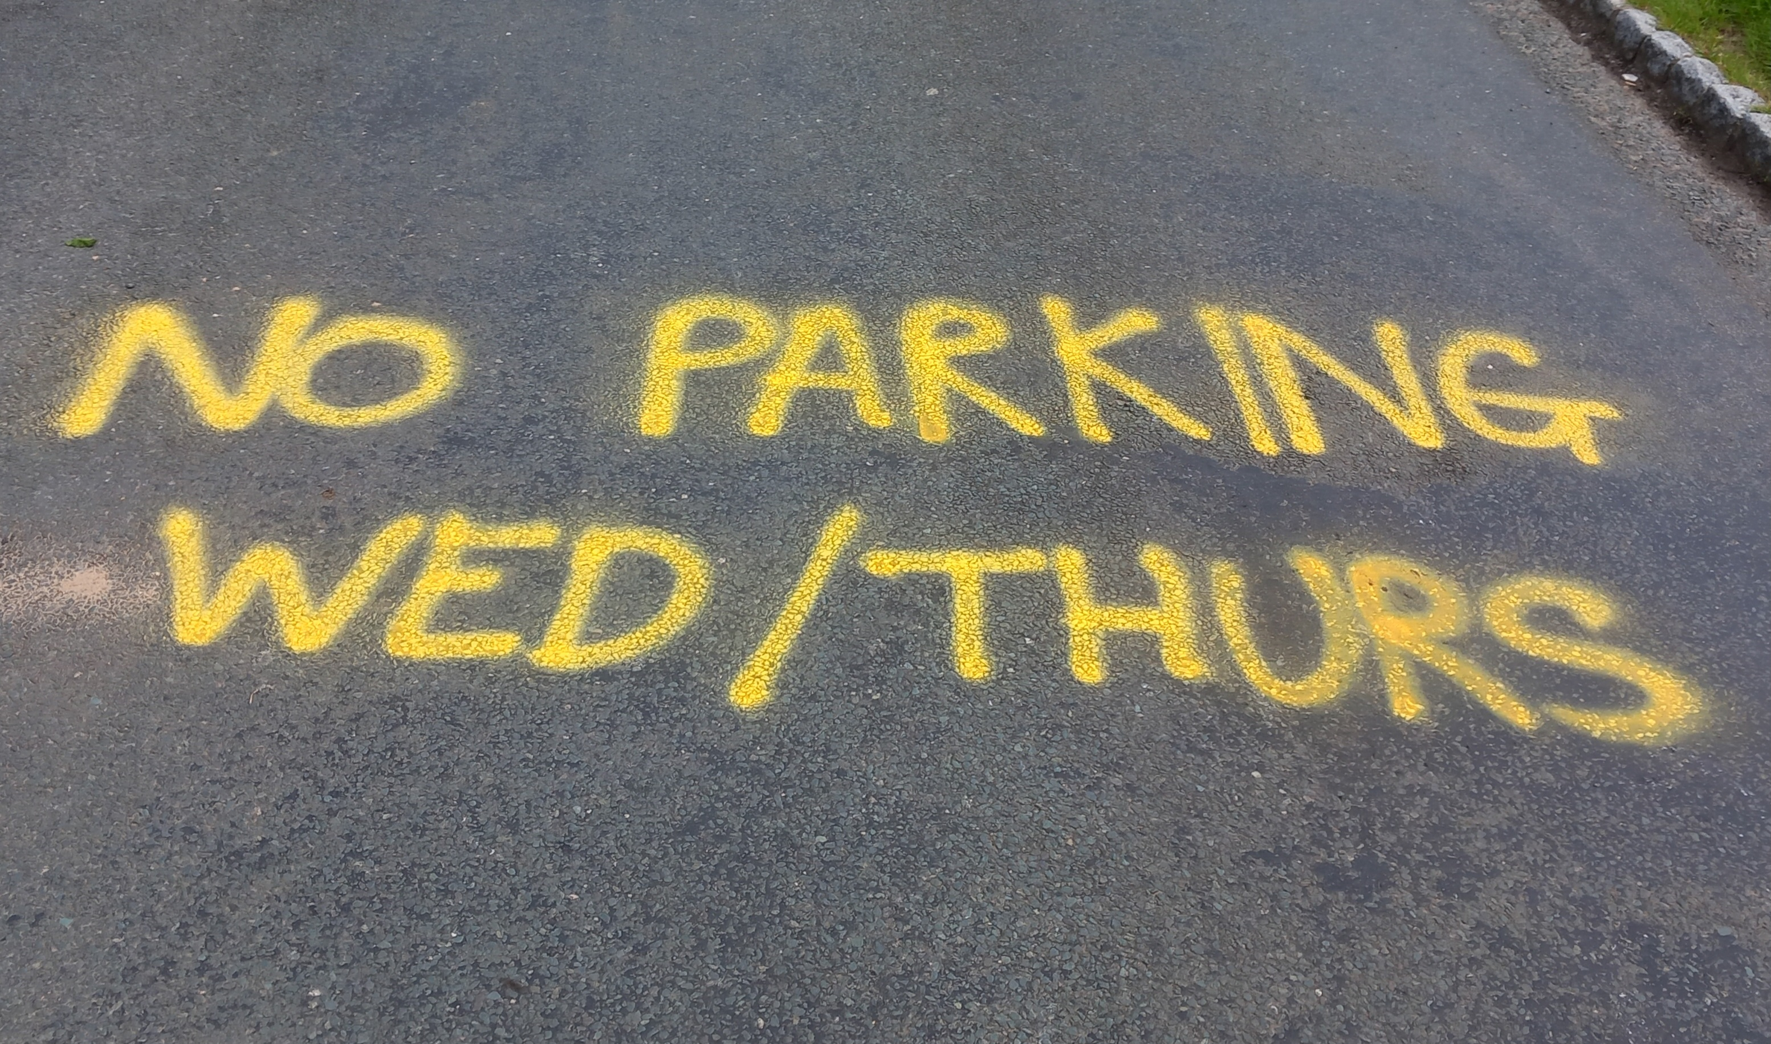
June
After a delayed start and a lot of signage the road around the green and to Airton Bridge was resurfaced.

Slide 9
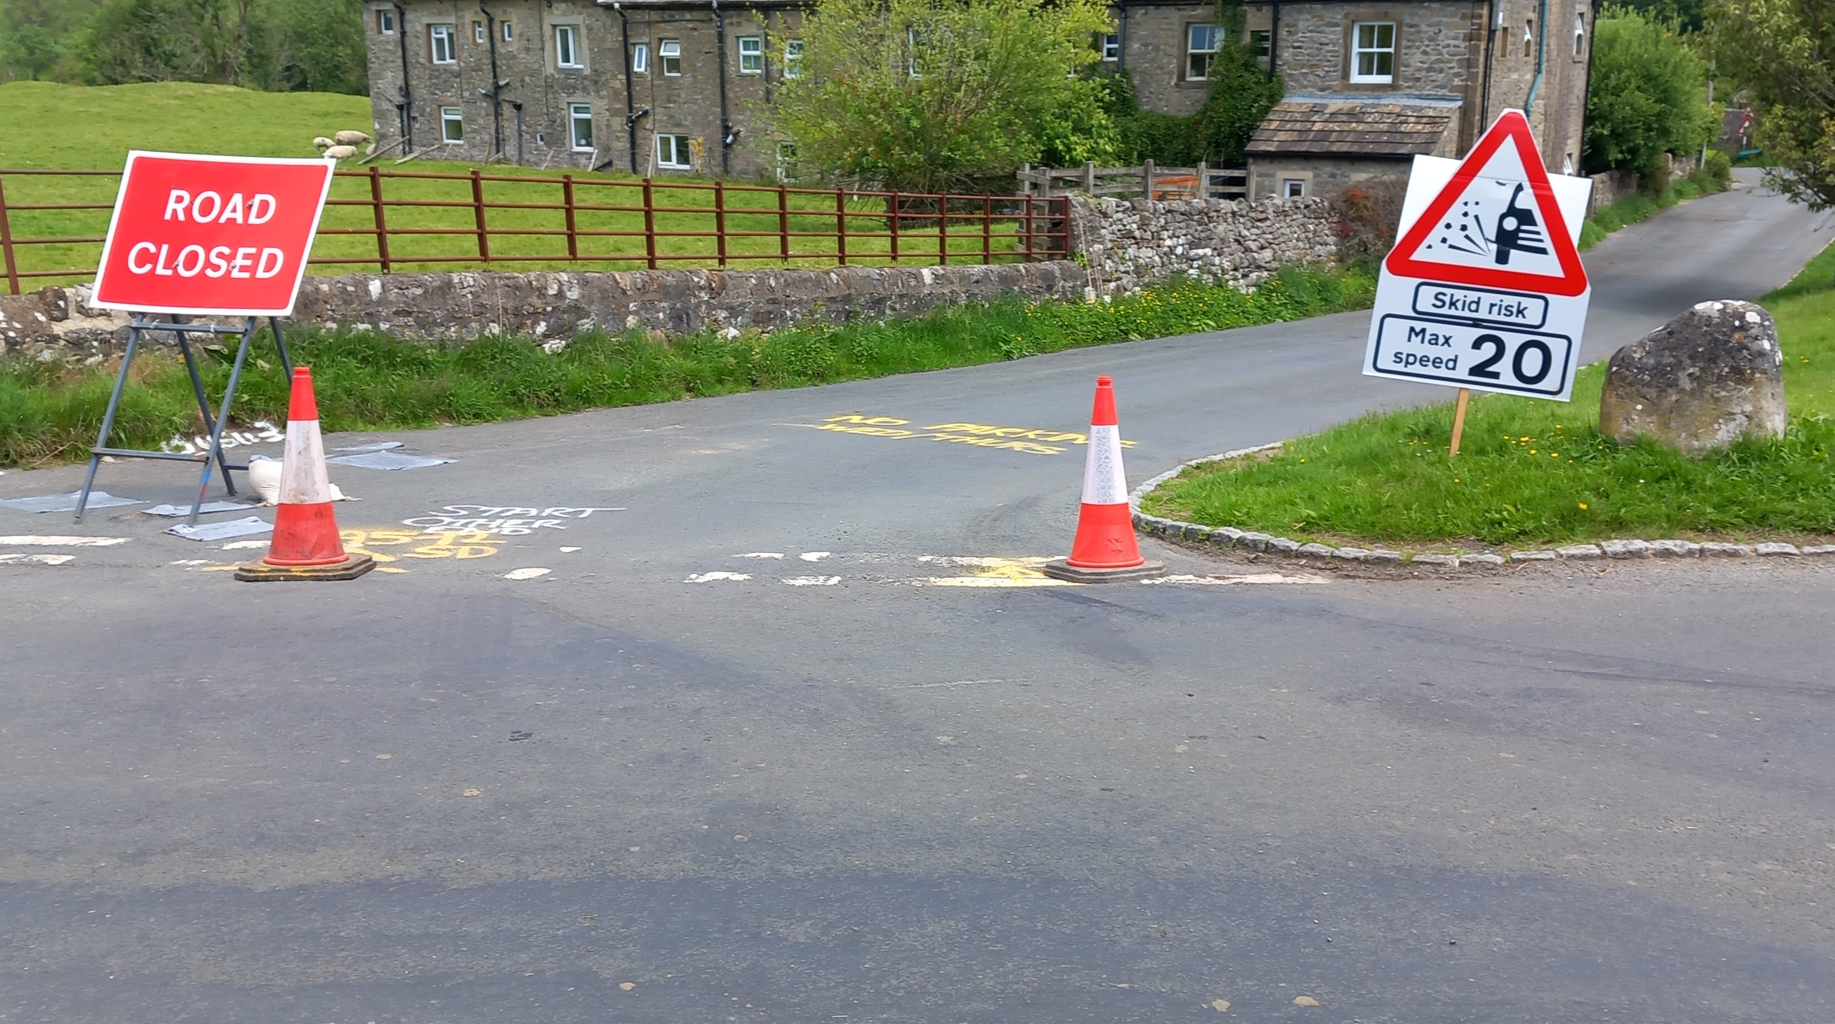
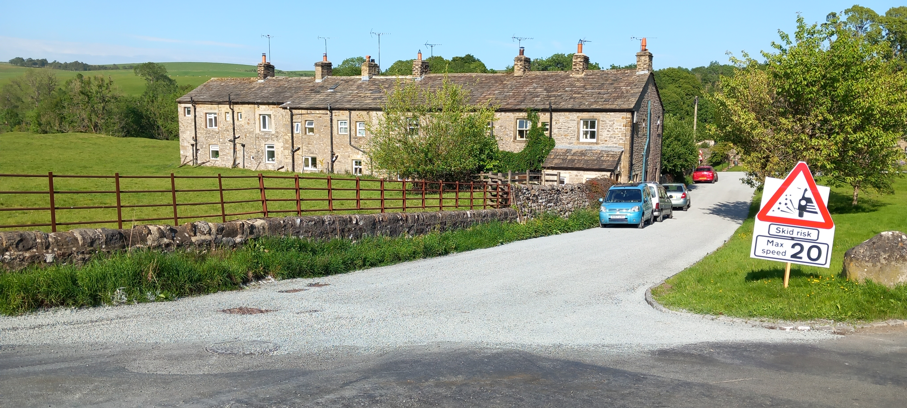
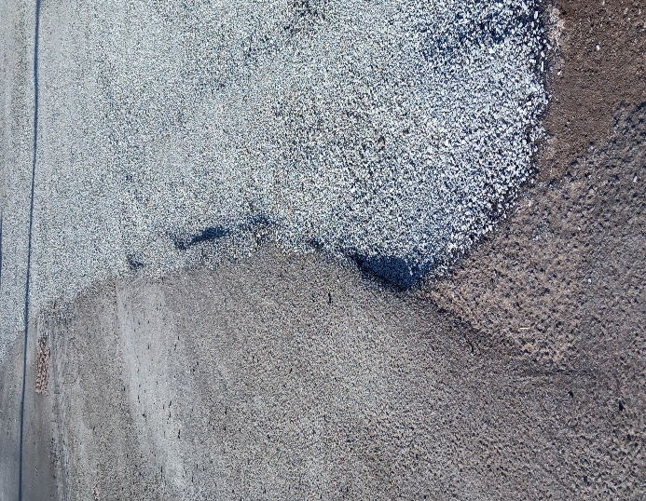
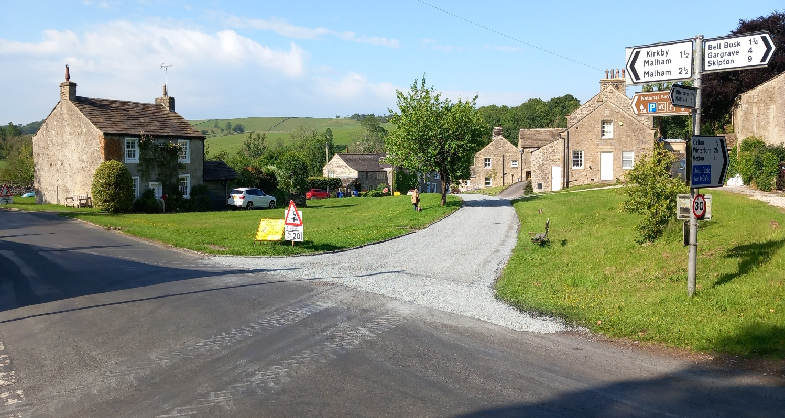
The resurfacing was not perfect.

Slide 10
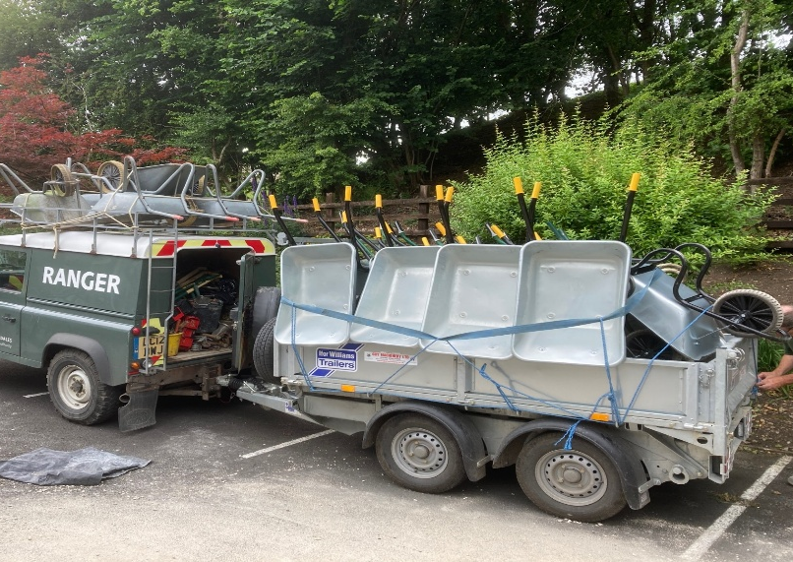
Airton Mill
Thanks to the Yorkshire Dales National Park for repairing a 600 metres section of the footpath along the Mill Race. Three park rangers, along with a few YDNPA volunteers, including Trevor Brooks (Scosthrop), were ably assisted by a squad from the Harrogate Army Foundation (35 junior soldiers, an officer and NCOs) to lay 36 tonnes of aggregate.

Slide 11
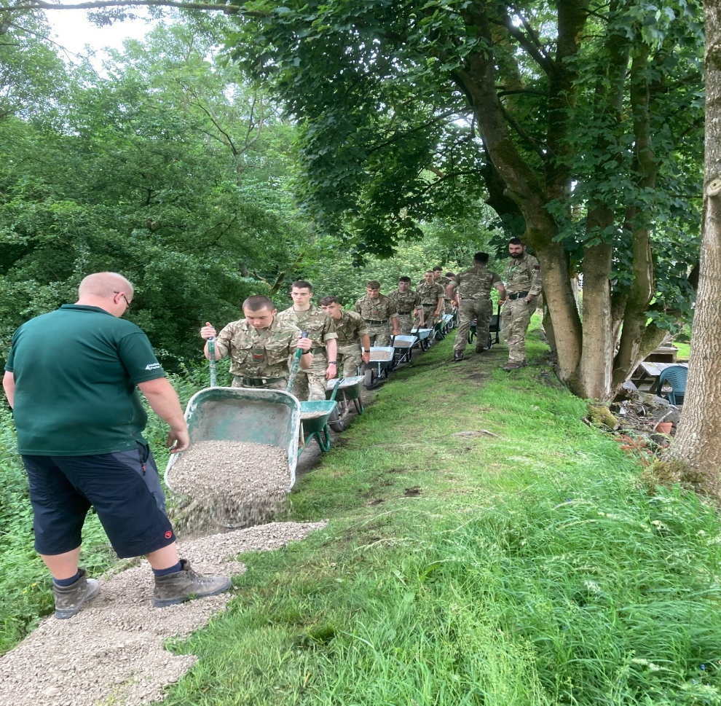
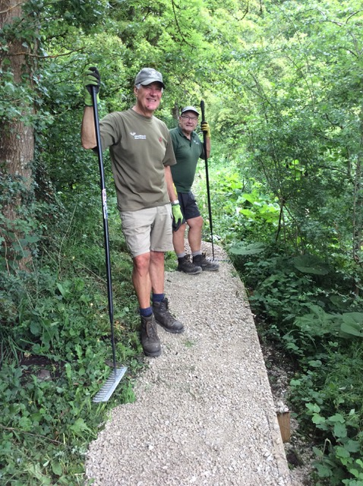

Slide 12
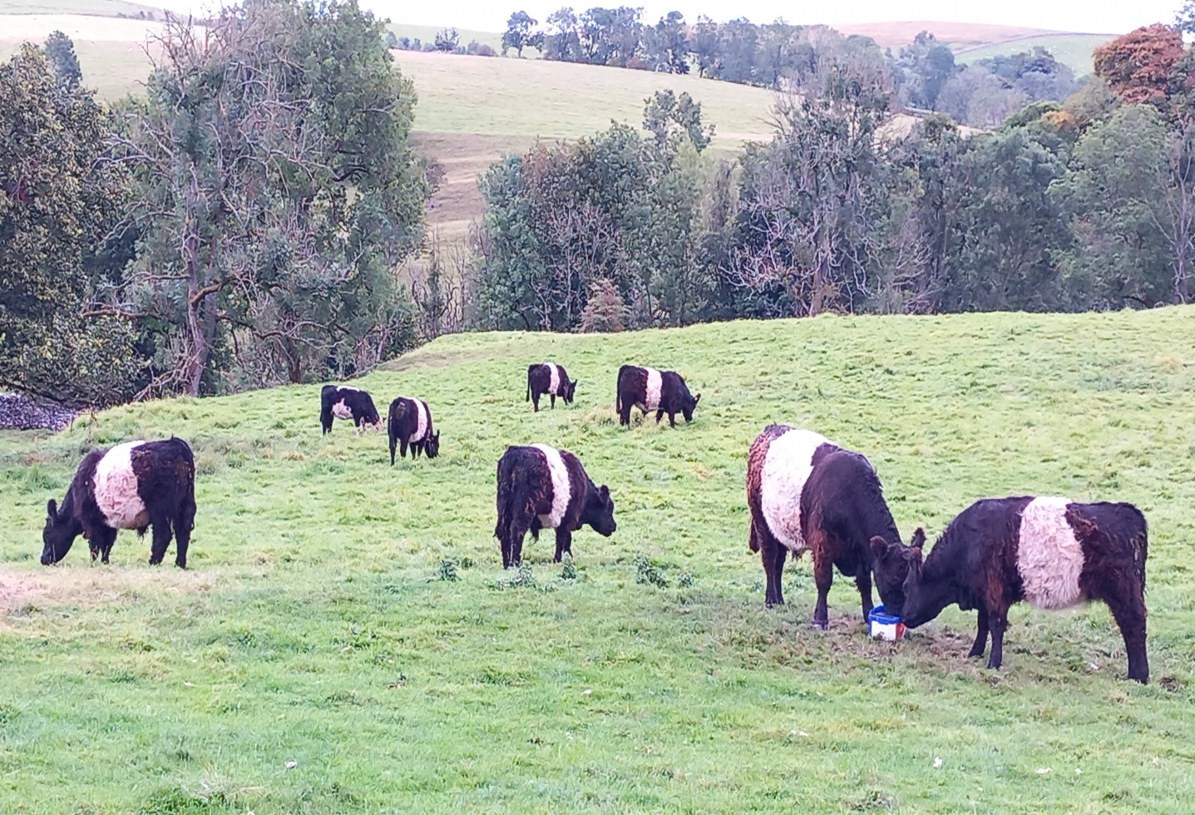
August
For the first time, Belties (Belted Galloways) were seen grazing in Airton (opposite the former Methodist Chapel). Also, two were grazing near the river in the rewilding field.

Slide 13
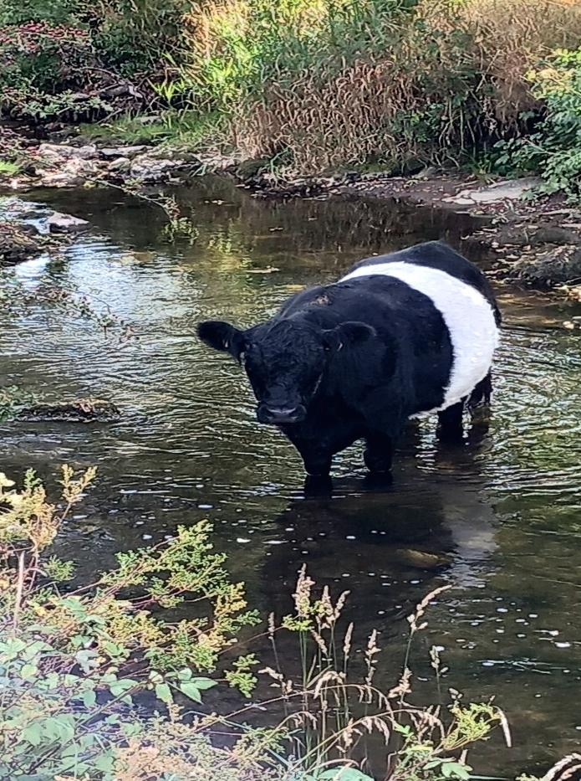
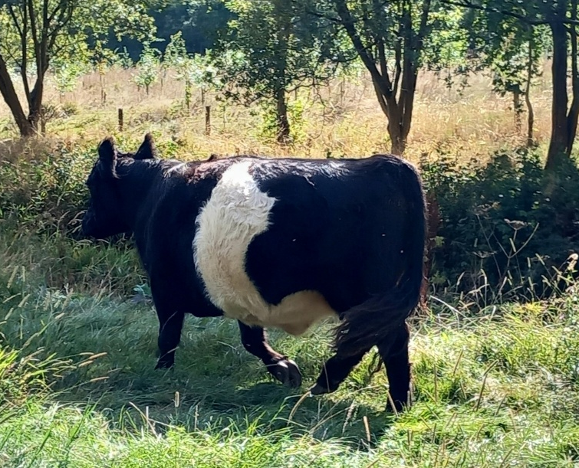

Slide 14
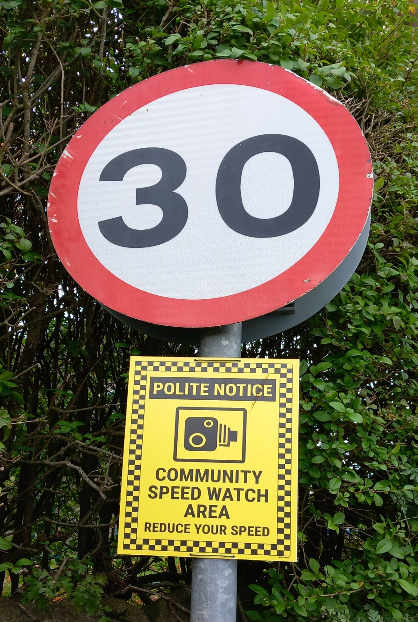
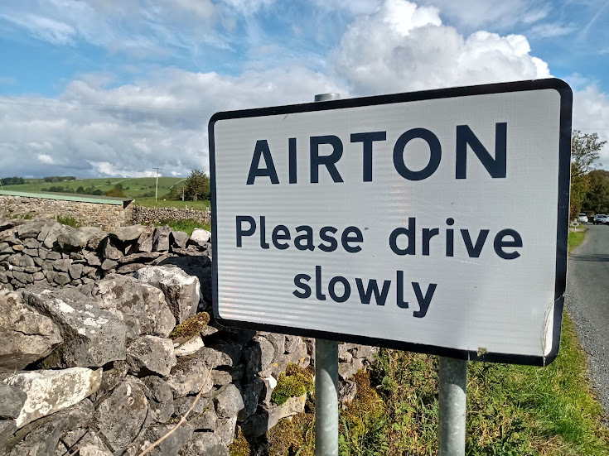
August
Community Speed Watch Area signs were erected at the various roads entering Airton.

Slide 15
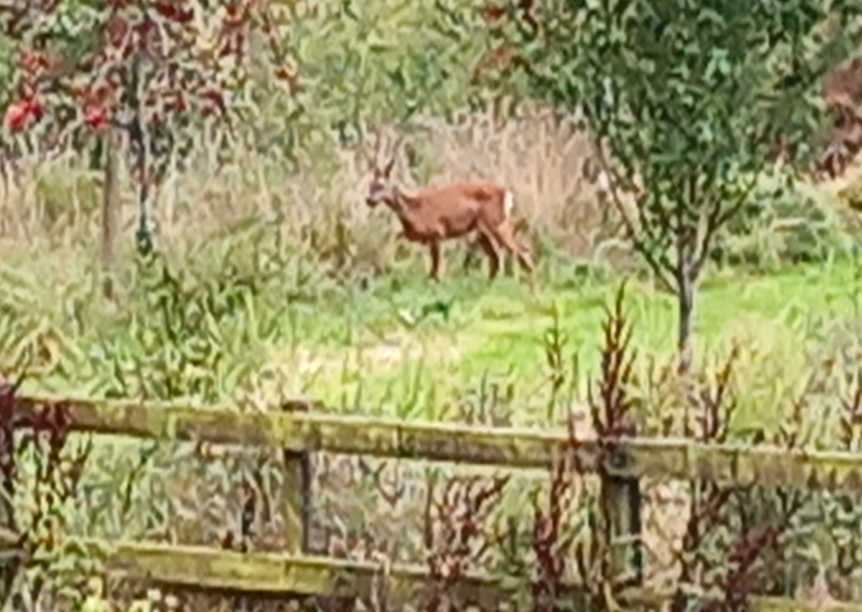
September
A deer was seen in the field at the southern end of the village during the early evening. Subsequently, a family of up to five deer has often been seen in the morning.

Slide 16
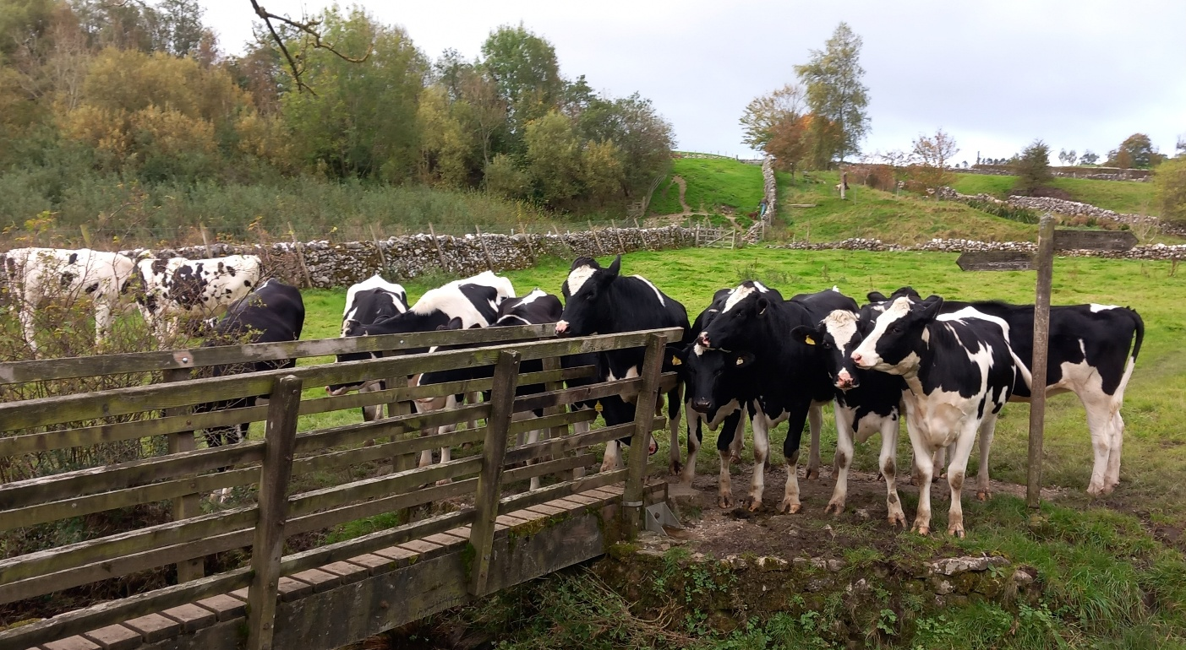
10th October
Cattle blocked the Pennine Way as the footpath crossed the River Aire, and refused to move backwards.

Slide 17
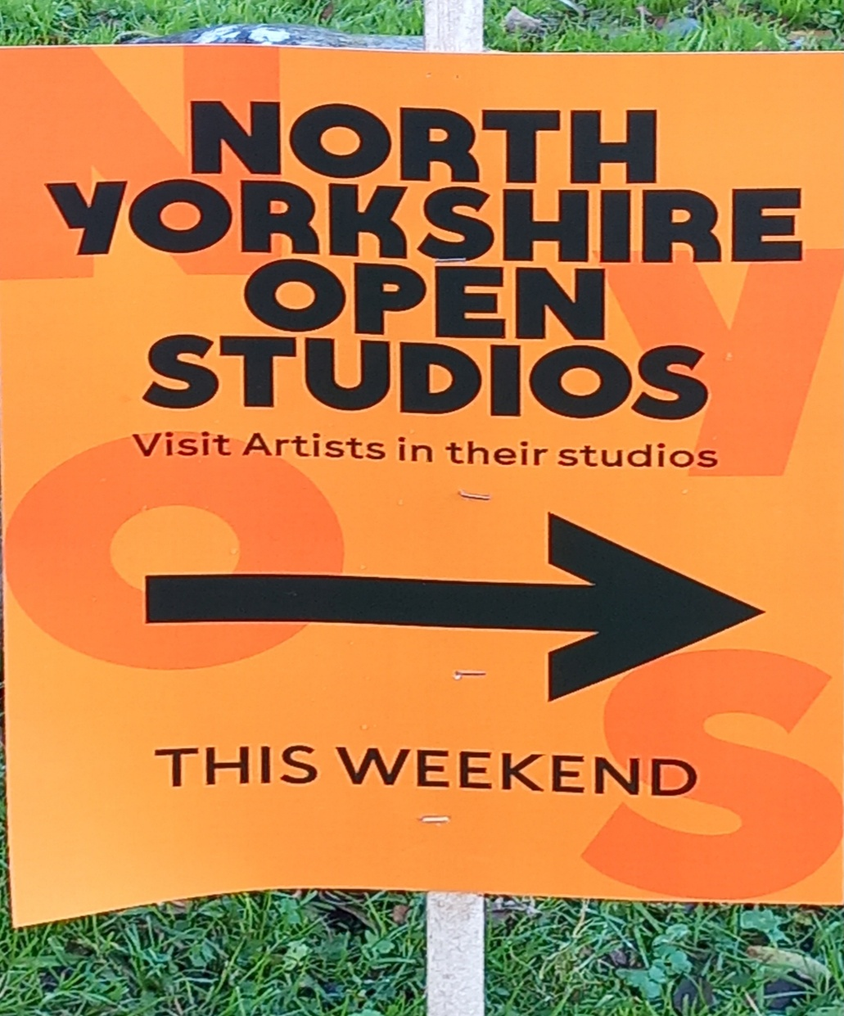
November
Airton welcomed Yorkshire Open Studios for the weekend.

Slide 18
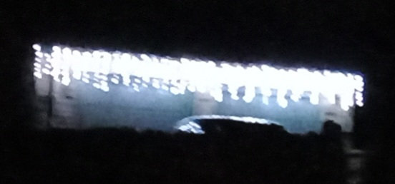
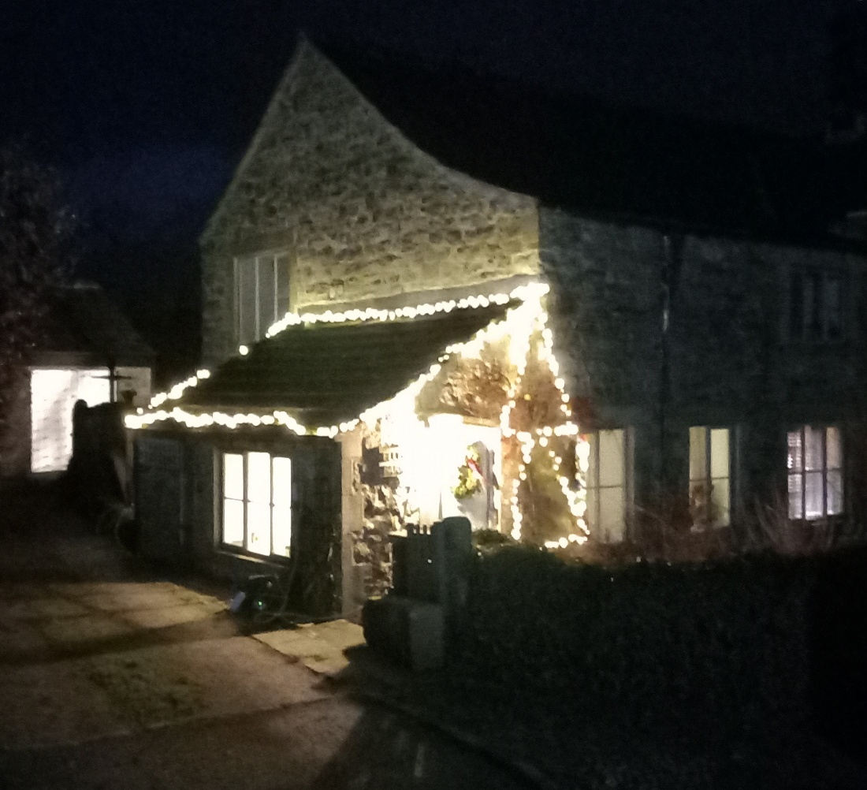
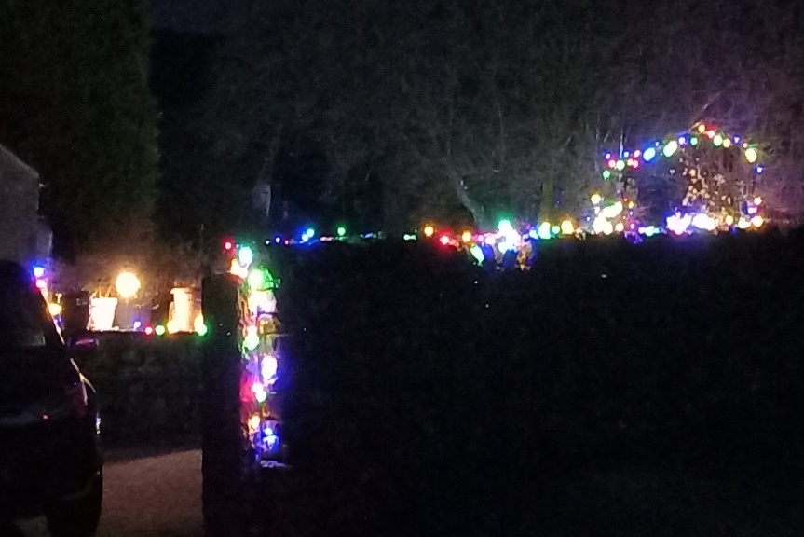
December
Some of the white and coloured decorative Christmas lights in Airton & Scosthrop.

Slide 19
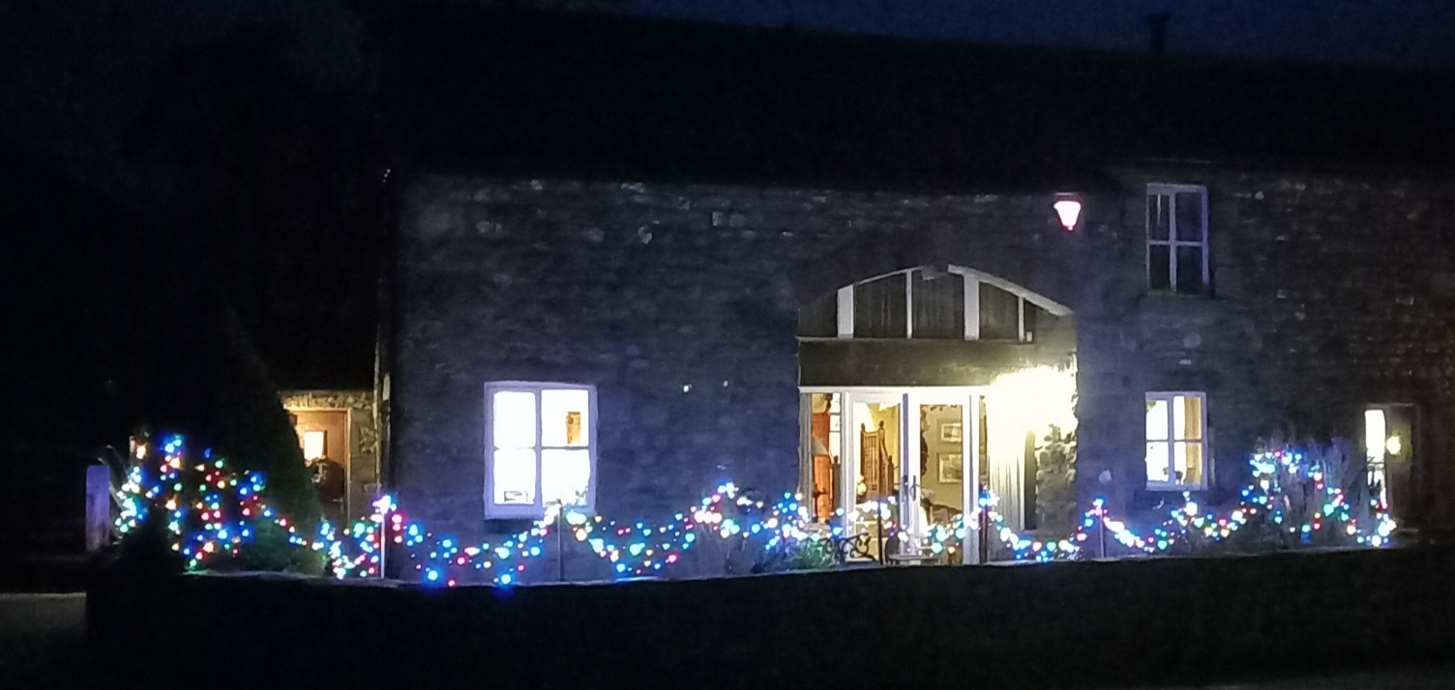
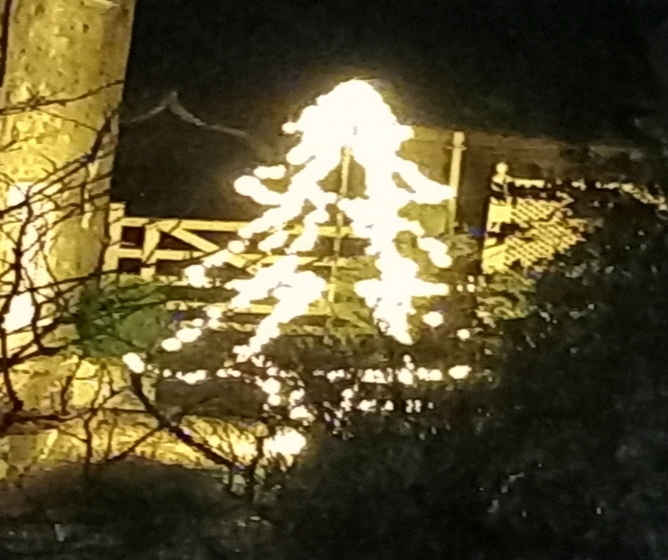
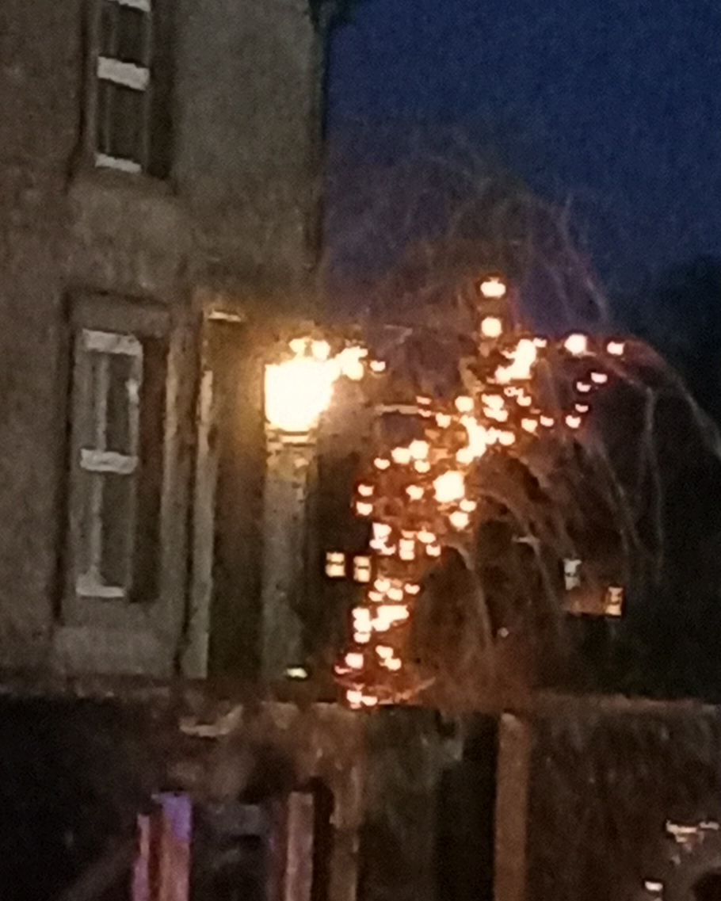
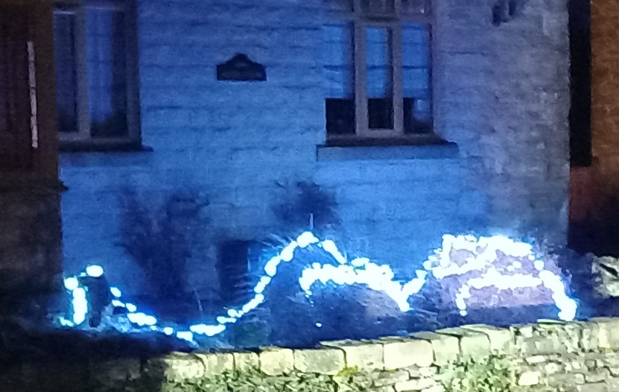

Slide 20
With thanks to Peter/Jenny Robinson and Trevor Brooks for some of the photos and notes.

