Slide 1
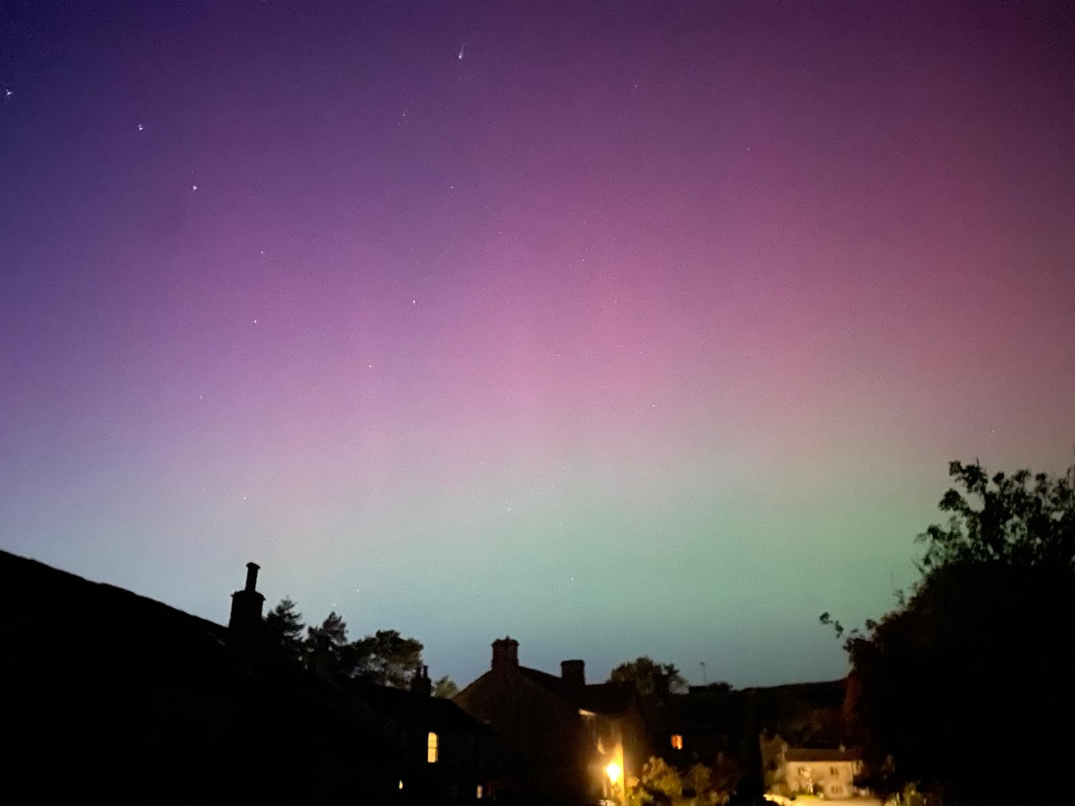
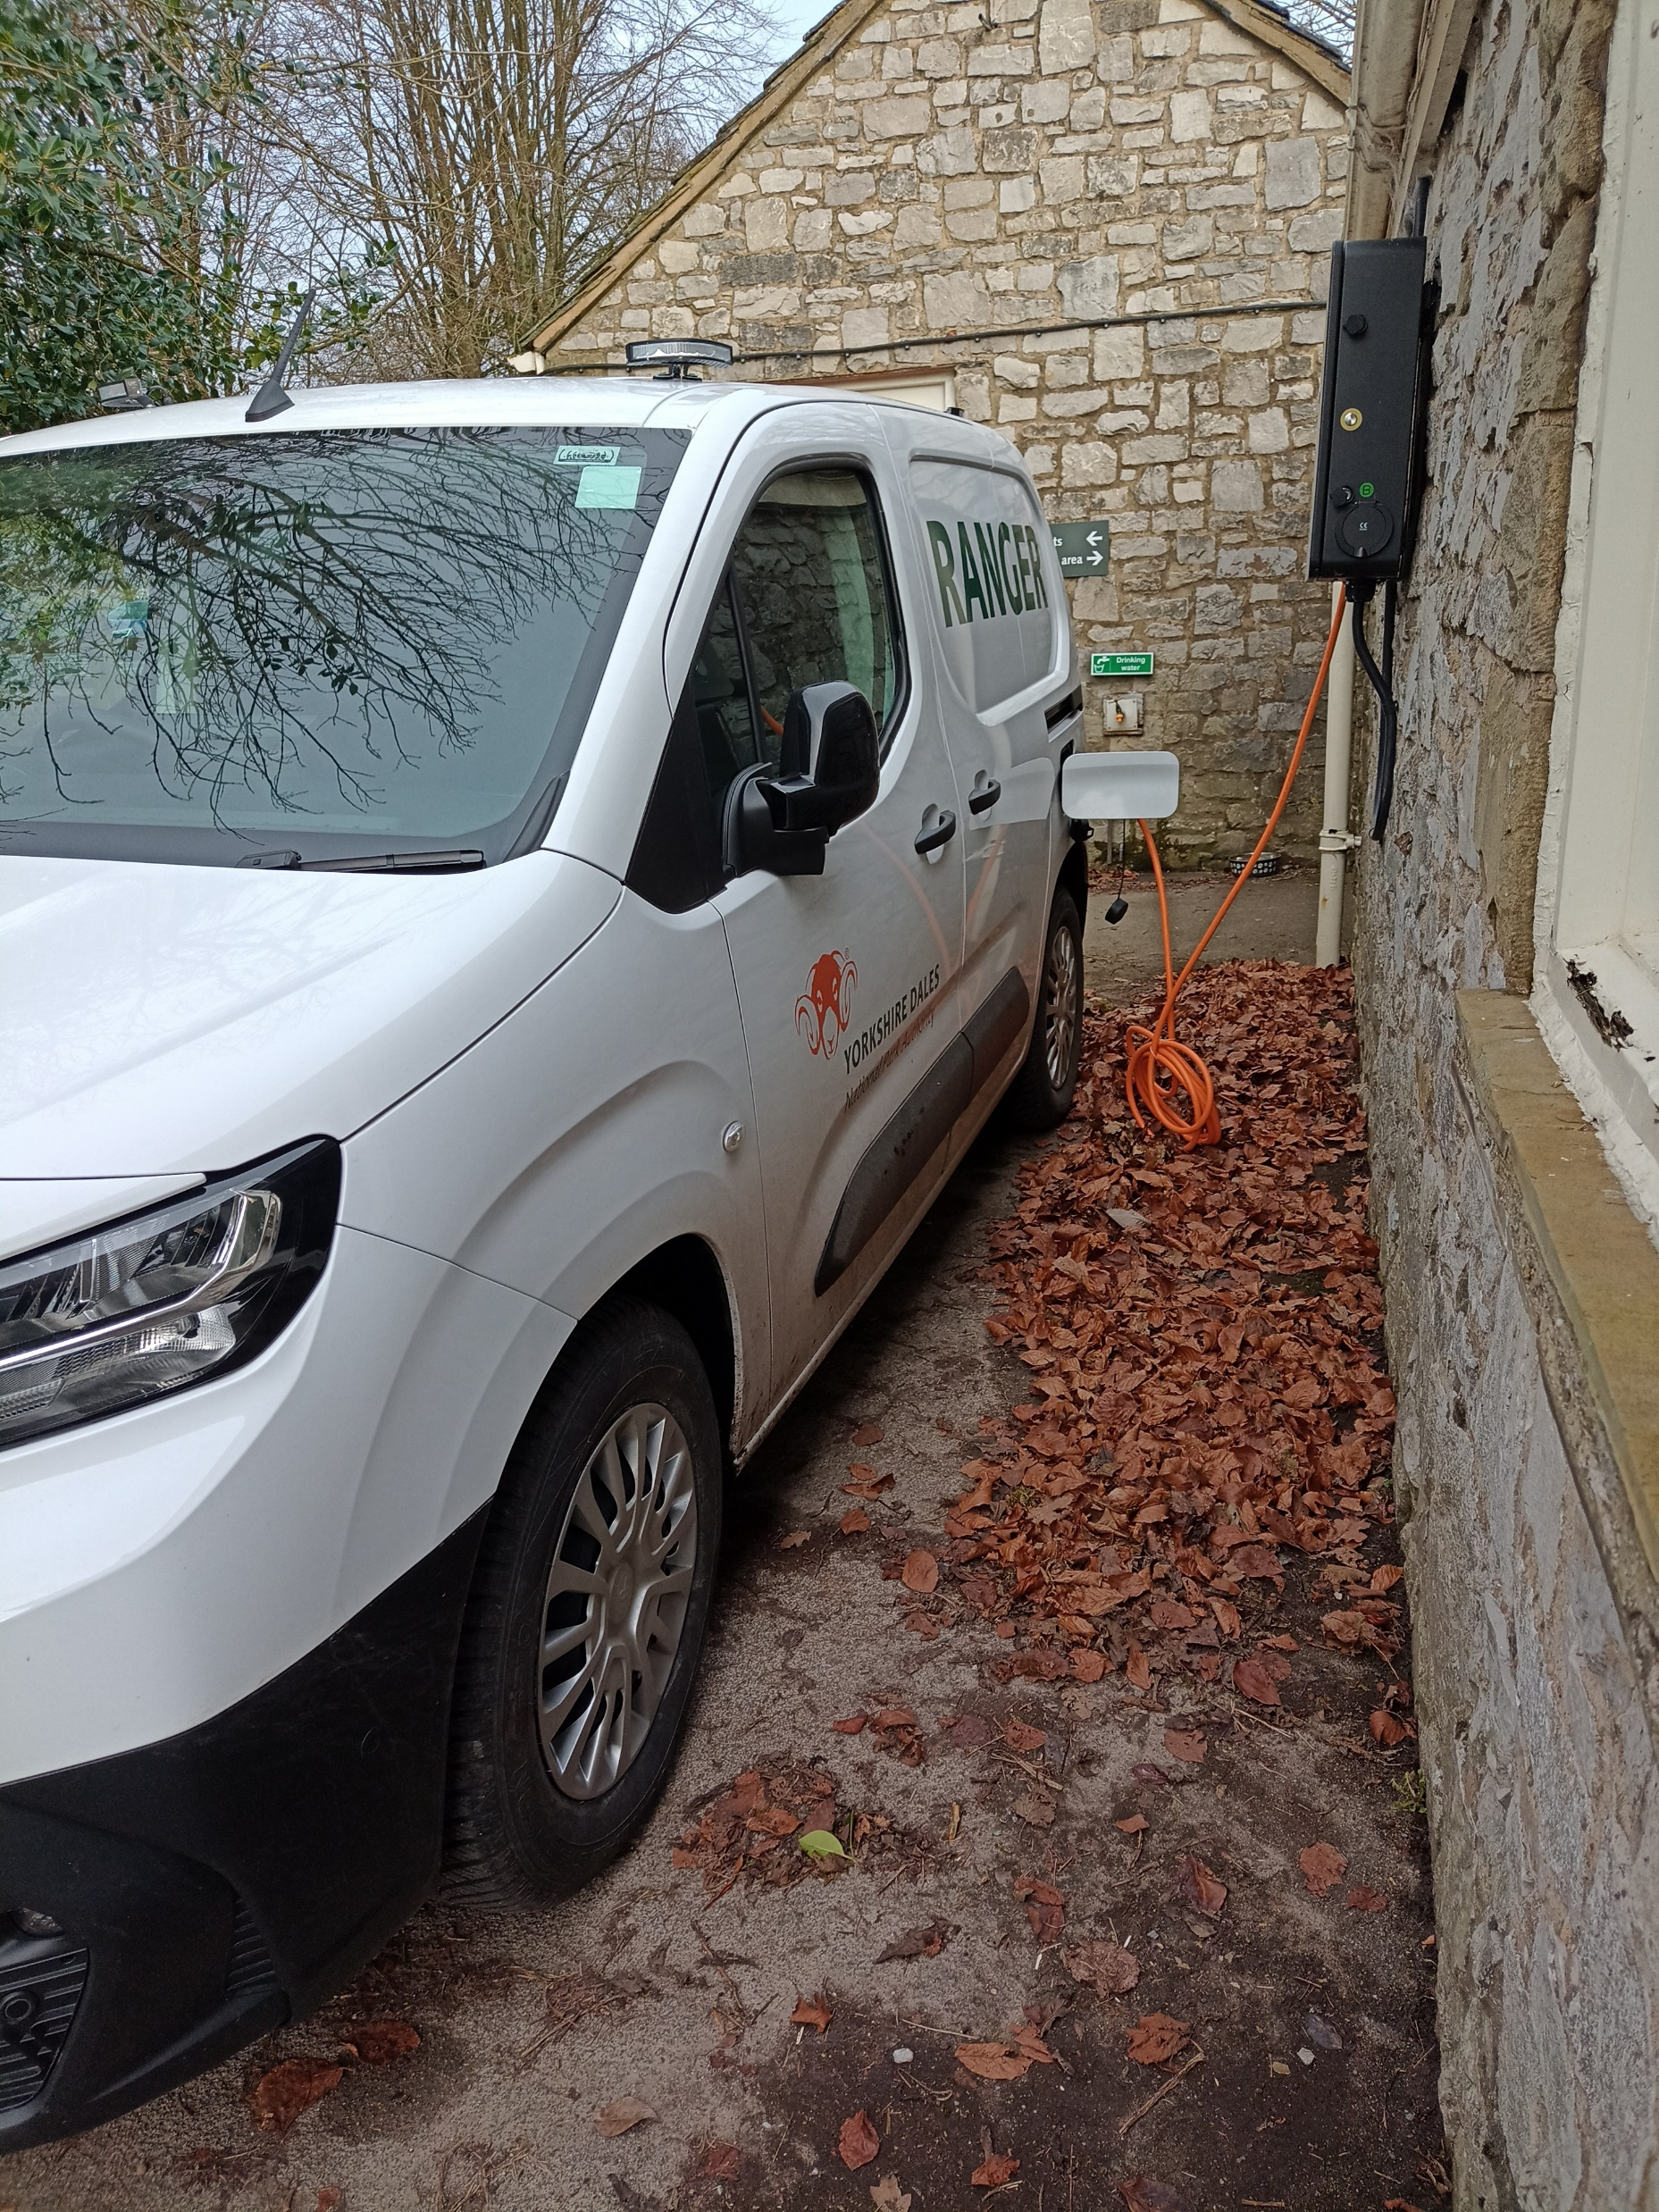
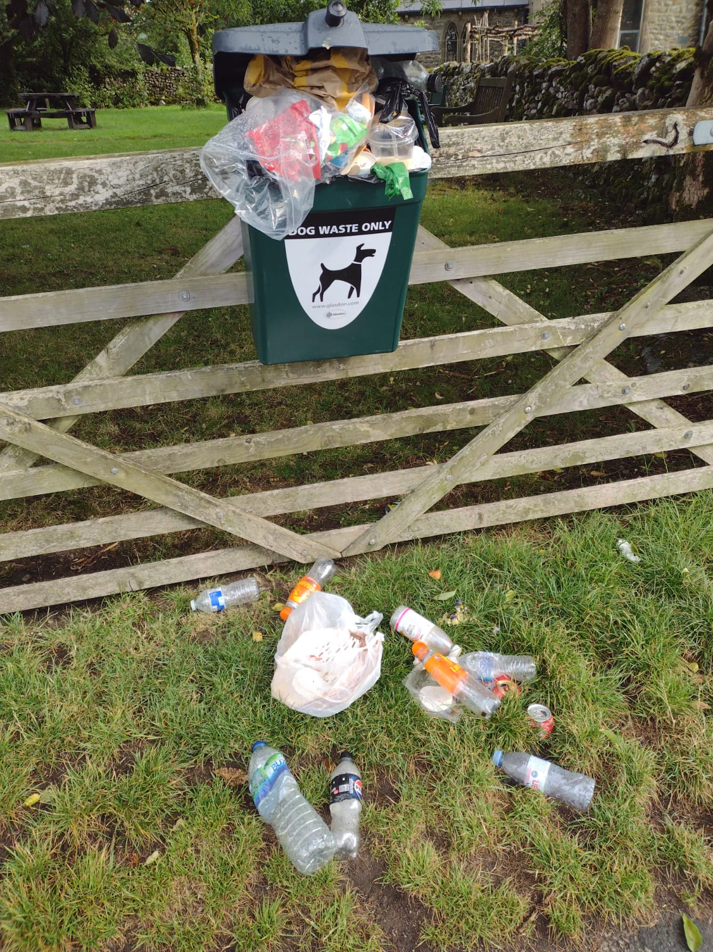
Malham Diary 2024

Slide 2
January
Crisis on the second weekend with sunny, dry weather bringing a large number of visitors after an extremely wet week. With car park fields unable to open, we were back to many cars parked on double-yellow lines causing congestion and blatantly illegal.
Very cold third week of January, 10cm of snow on Tuesday nearly cut off the village; below freezing at midday, hit -9.9 C on Wednesday night, gritters couldn’t clear the road. Followed by the 9th named storm (Isha) with wind gusts scheduled at 62mph. Many days until Settle road open to normal cars. No bin collection, primary school shut one day.
A number of large ash trees suffering from ash-dieback were felled in the plantation opposite the Buck Inn. Wild swimmers swam every day to raise money for Crisis charity.
Spine race runners came through day and night running the Pennine Way.
Newspaper deliveries ceased being delivered up the dale from Hellifield to the shop due to contract problems. Many people very upset not to be able to get a daily paper.
Problems with water supply, small power cuts and internet connections down for various reasons.

Slide 3
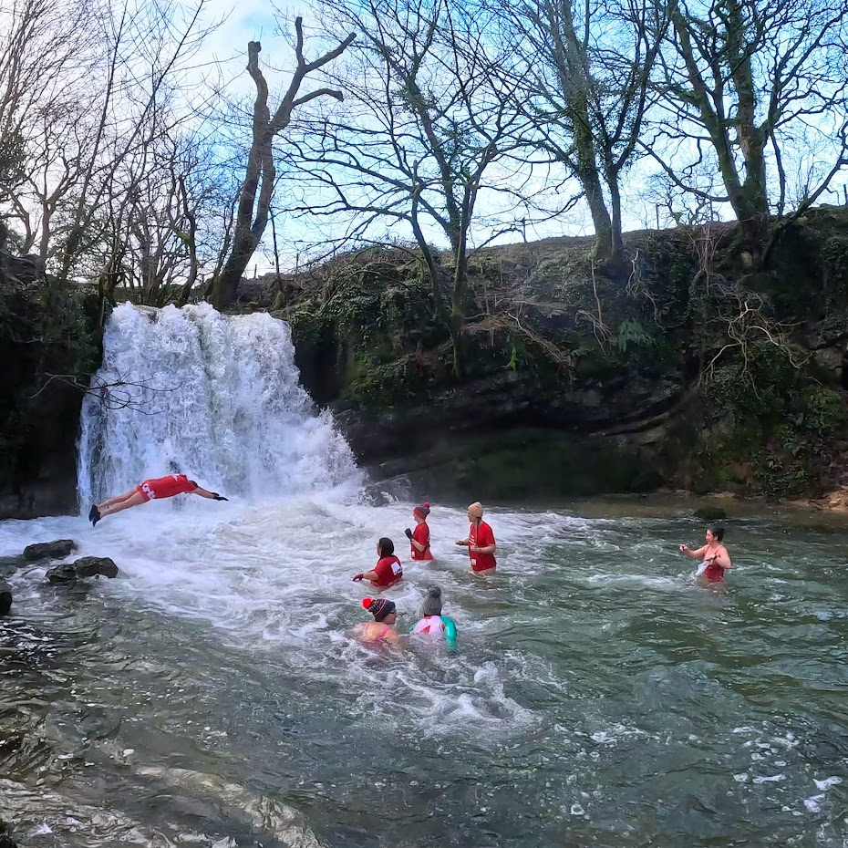
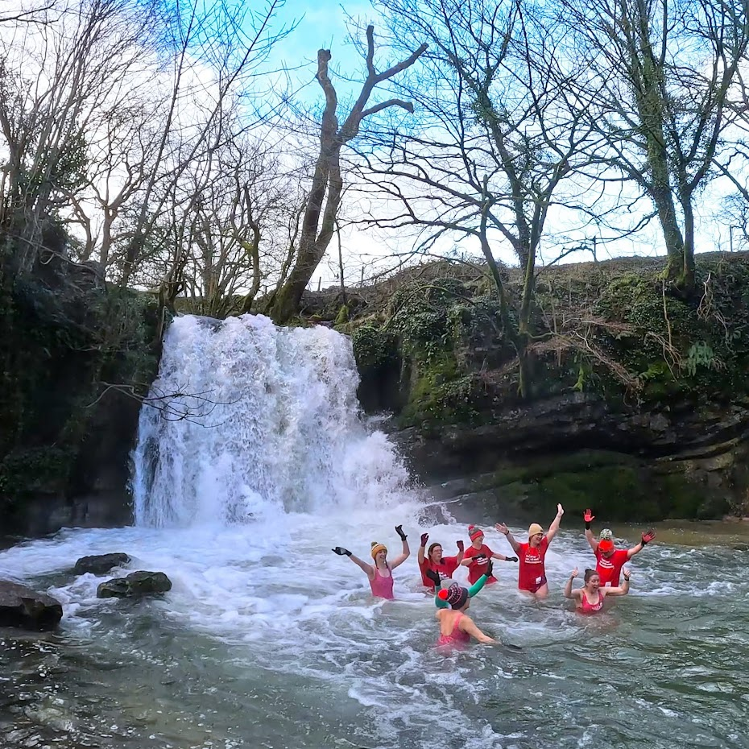
Wild swimmers braving the cold for “CRISIS” throughout January.

Slide 4
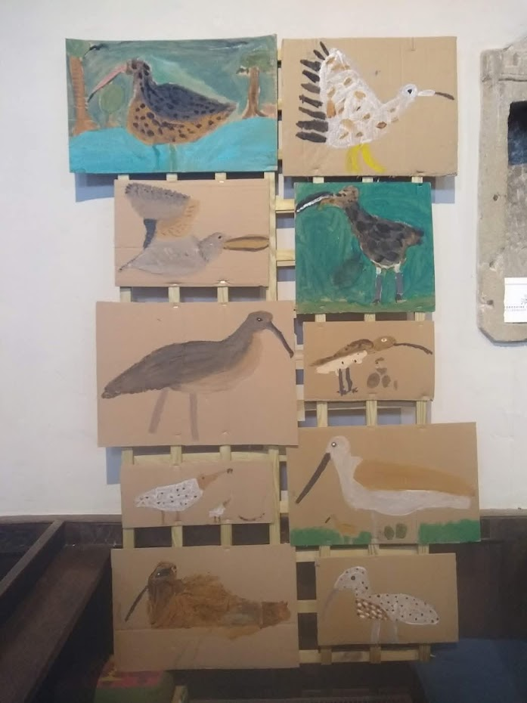
February
Wet, wet, wet was February, with well above average temperatures but one light snowfall at village level and plenty of visitors through half-term week and any reasonable weekend day.
The road closure for drainage work on the Malham Brow road was posted by Highways but amidst much local objection to a full road closure was postponed.
Curlews returned mid month with plenty heard and seen. (By December when statistics were processed the curlew population was found to be stable and possibly slightly increasing)
Curlew pictures by local children

Slide 5
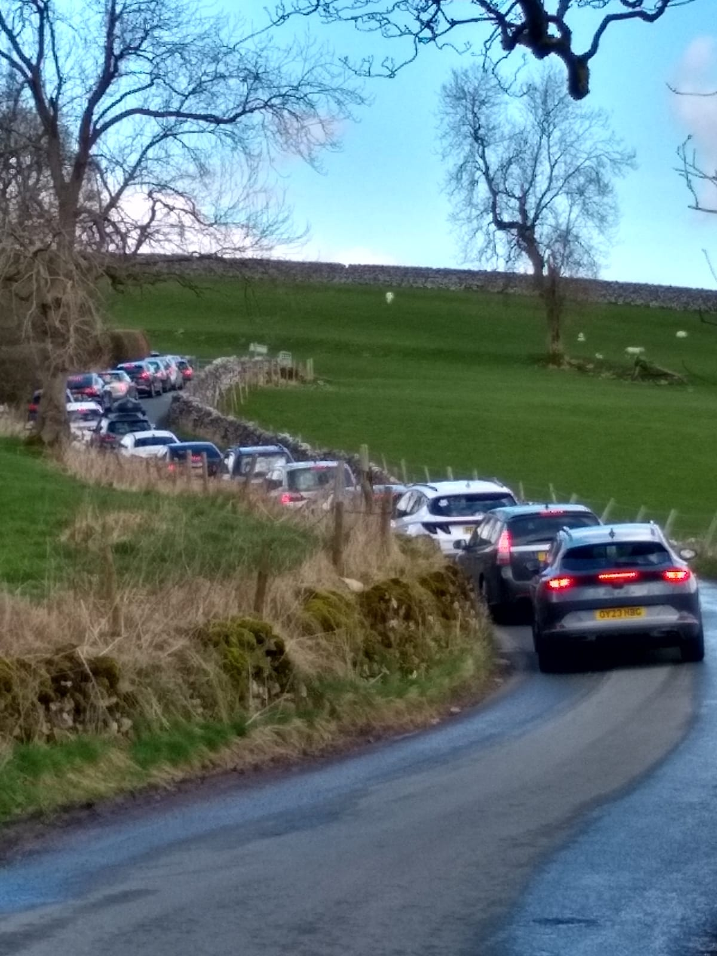
March
March did indeed see the road closed for most of a week (9:15 – 3:00 pm) into the village whilst essential drainage work was done on the brow to stop water and ice surface problems. Residents, visitors and hospitality workers had to park their cars near the school and walk down, then retrieve cars late afternoon.
The traffic calming chicane was also finally completed on a permanent basis at the southern entrance to the village, but with traffic lights. End of a very long saga!
On one sunny Saturday, with fields totally waterlogged preventing car parking, the village became partially cut off due to so many cars parked between the school and brow. People were queued for around an hour, no chance for emergency vehicle access.
More disabled access gates fitted on the footpath to Janet’s Foss.
Pop-up cafe at village hall to raise funds for St Michaels church.

Slide 6
April
Malham Women’s Institute ran a pop-up cafe in the village hall on the first of the month, to raise funds for the WI.
Malhamdale Environmental Group (MEG) ran a special event about sustainable foods and other products from local sources, hosted by Chris Wildman, focussing on goods in his Airton Farm Shop. A few hours at the Windy Pike tree nursery to build tree sapling grow boxes in partnership with Yorkshire Dales Millenium Trust.
Problems of waterlogged fields persist with parking problems for visitors once the National Park car park quickly fills up on weekends.

Slide 7
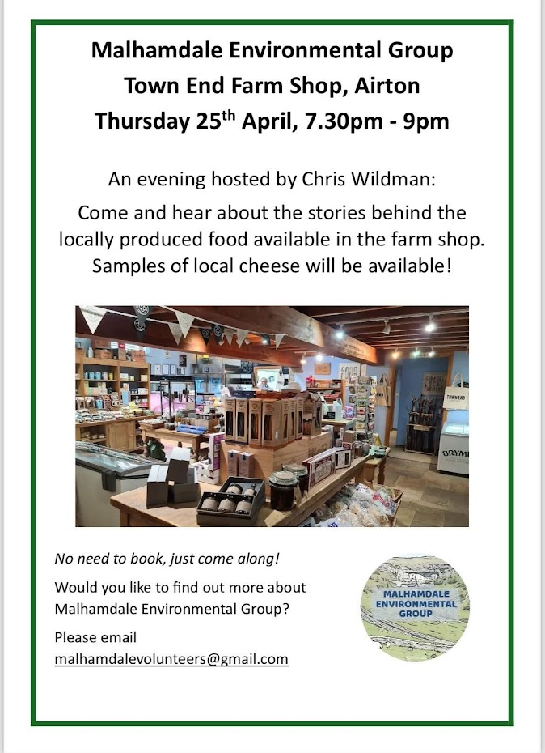
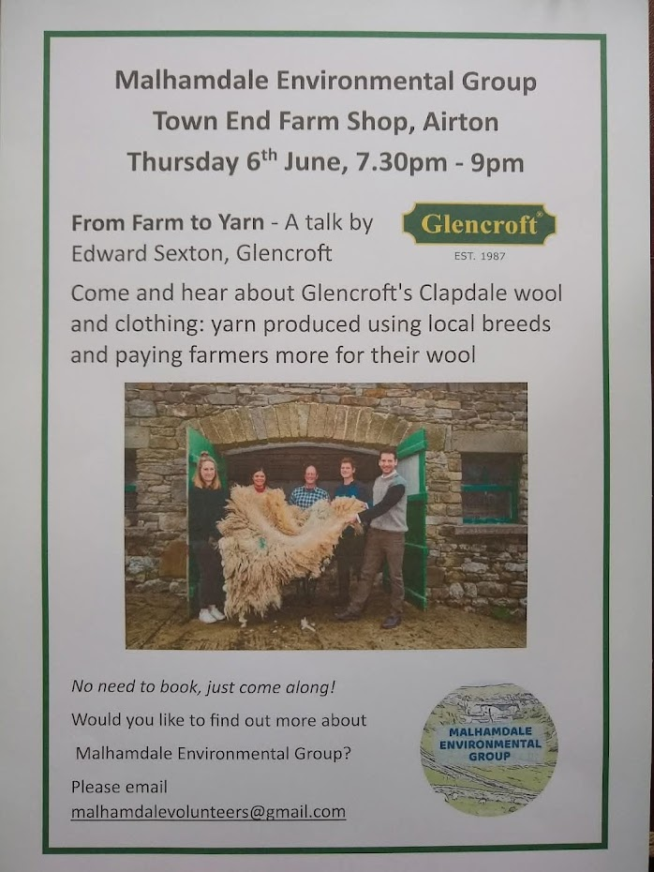

More Environmental Group events

Slide 8
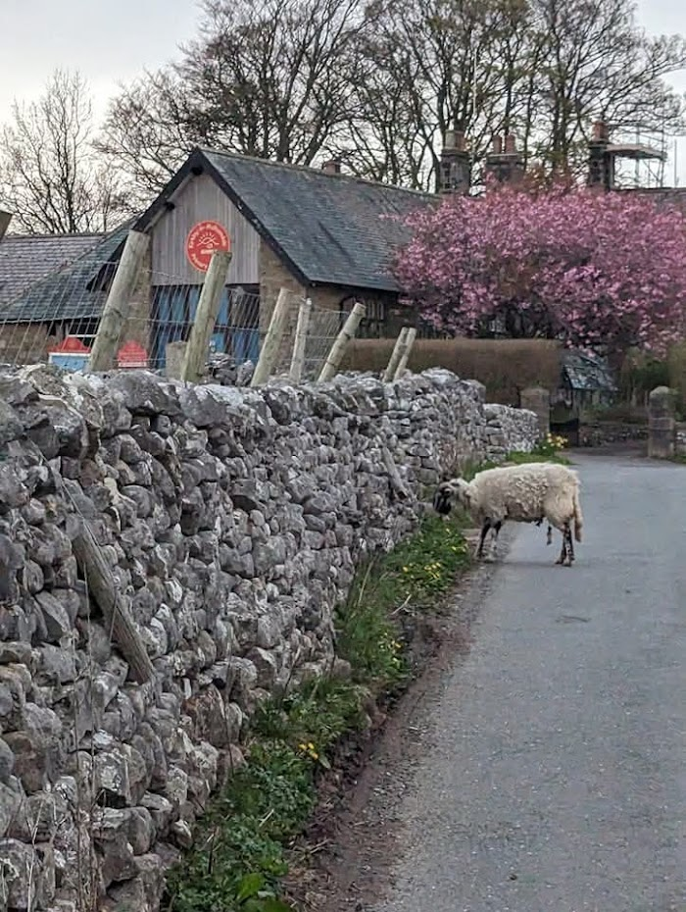
May
Last appearance of a Malham Safari animal on the triangle roundabout. The dodo to symbolise the extinction of the Safari initiative.
Late May bank holiday saw the start of a Safari replacement, the Malham community fundraising initiative. This was a duck race from Lister’s bridge to the stepping stones with just local people buying tickets; followed by evening picnic on The Green.
8th of May saw first swifts in the village, the 10th saw a fantastic display of Northern Lights seen by many through the night.
Sheep escaping frequently into the village from nearby fields, even going to the shop!
Sheep visiting the school.

Slide 9
June
Macmillan Mighty Hike ran again, Malham to Hebden near Grassington, and back again for the fitter participants.
Proms in the Croft took place on the 9th with Nicola Mills doing ‘Opera for the People’. Villagers brought picnics for a lovely evening out.
Filming for ‘All Creatures Great and Small’ on Cove Road caused a brief road closure.
A very chilly June, well below usual averages, with only one short burst of hot weather and plenty of cold rainy weather. However, Malham Chapel garden now in second year looks truly marvellous now fully finished.
Drains re-laid in Cricket Field allowed field and footpath to dry out at last.

Slide 10
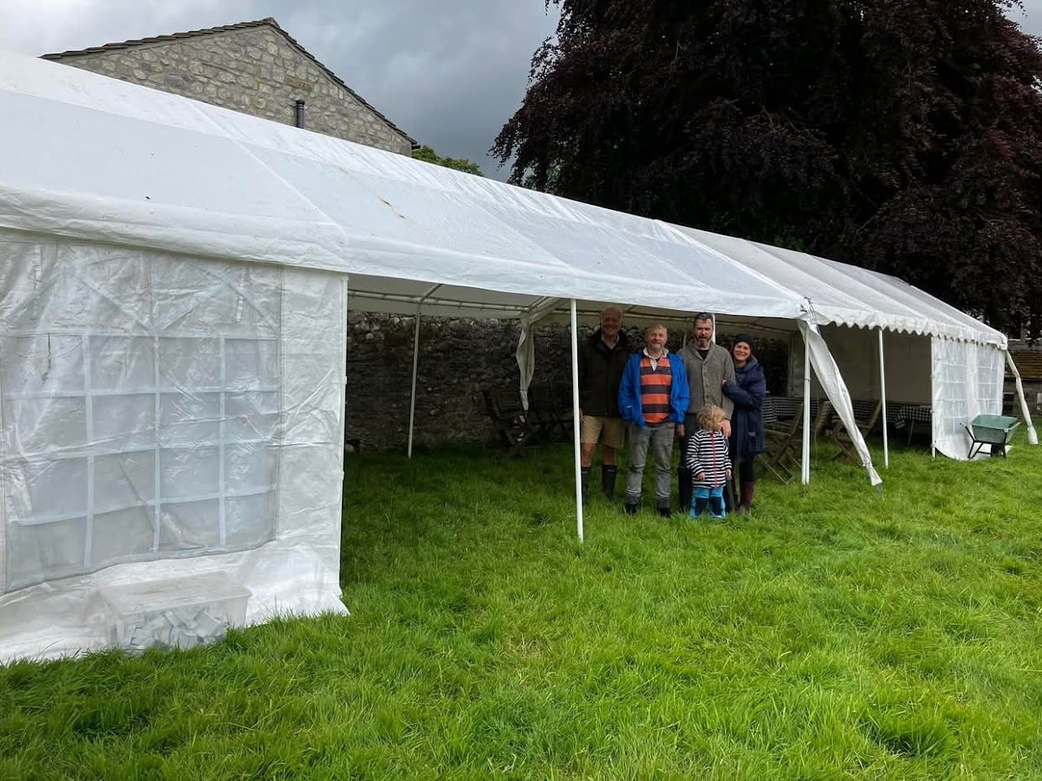

Marquee ready for Proms in the Croft

Slide 11
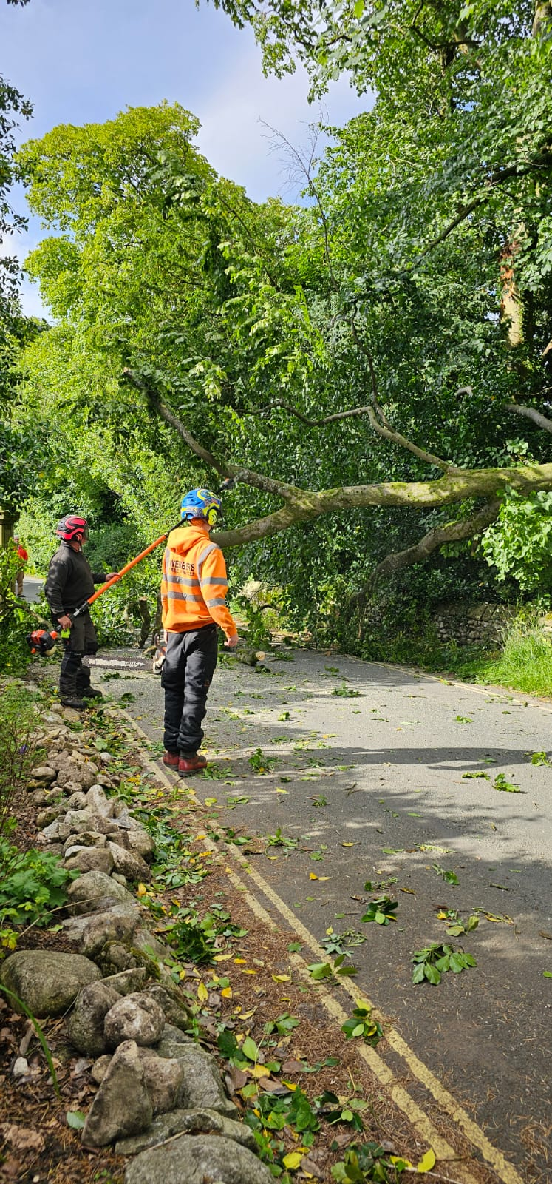
July
Very little recorded for July!
Only a tree down on Cove Road opposite Cromwell cottages, very unusual in mid-summer.
The Village Hall was used as a polling station for the General Election.

Slide 12
August
Visitor numbers seemed back to ‘normal’ with many foreign visitors as well as UK tourists on holiday in the area.
Weather and temperatures were also back to normal, certainly better than last year.
However, at the end of the month, storm Lilian blew in from the north west and wrecked half the marquees for Malham Show just one day before the show Saturday. Some marquee parts were blown right over Chapel Gate road and down the cricket field to the beck. After local people stepped in to consolidate and help out, the show proceeded perfectly well.
Due to a worrying drop in numbers of swifts over recent years, some specific nest boxes were installed on local barns. Swallow numbers maybe better than last year.
Mid August - fantastic displays of the Northern Lights, many people getting great photographs.

Slide 13
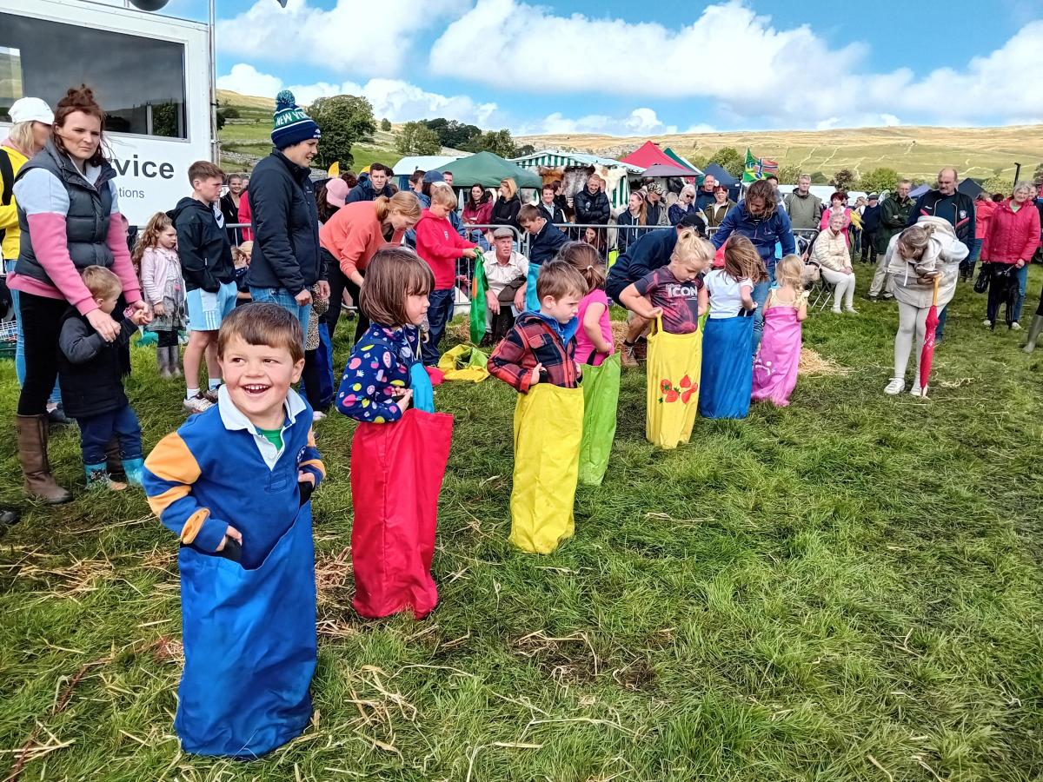
Storm Lilian fails to dampen spirits at Marvellous Malham Show
Craven Herald

Slide 14

September
Remedial work was done in Robert Hudson’s car park field ‘Pantlands’, to improve drainage on the footpath to Hanlith and enlarge the well (Kelltree Well?) with a stone surround.
Malham W.I. agreed to sponsor a large blister pack (pharmaceutical tablets) recycling box for upper Malhamdale, to be sited at a house in Malham.
Mains water cut off for all in Malham and some other villages for half a day due to pipe leaks/maintenance. Pallets of water bottles were delivered for residents to collect from YDNP Centre.
On behalf of the National Trust a private consultancy spent a day in Malham Village Hall collecting resident’s stories and recollections about Tarn House.
Very long tightrope across most of the width of The Cove was really impressive.
Yorkshire Dales National Park rangers received a new all-electric van, chargeable at the visitor centre by their office.

Slide 15
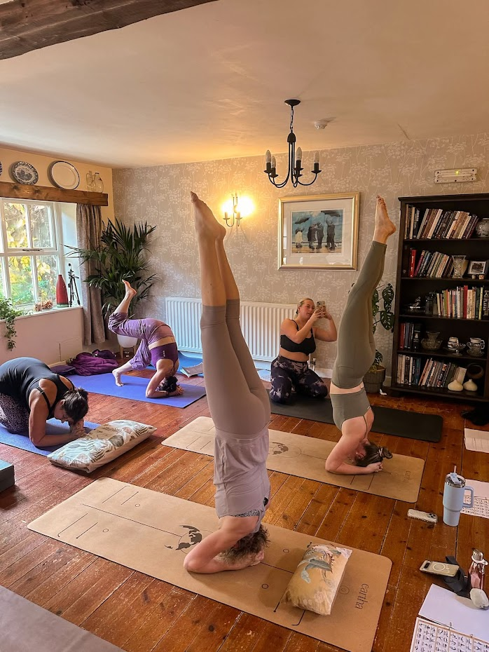
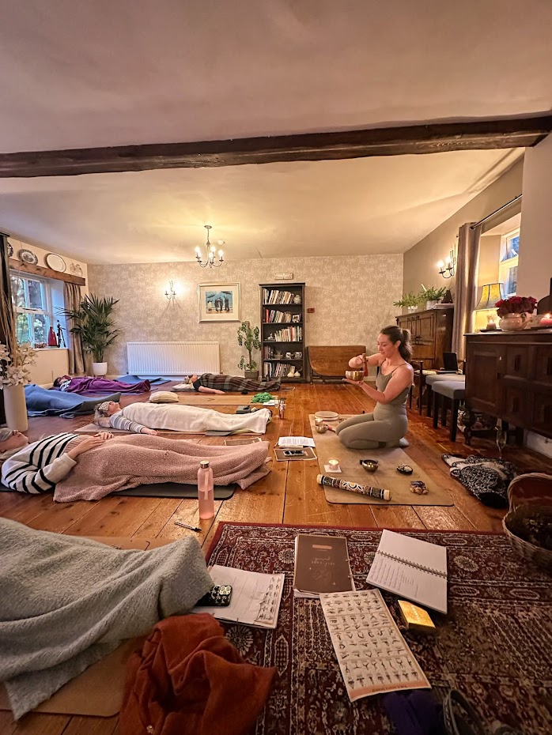
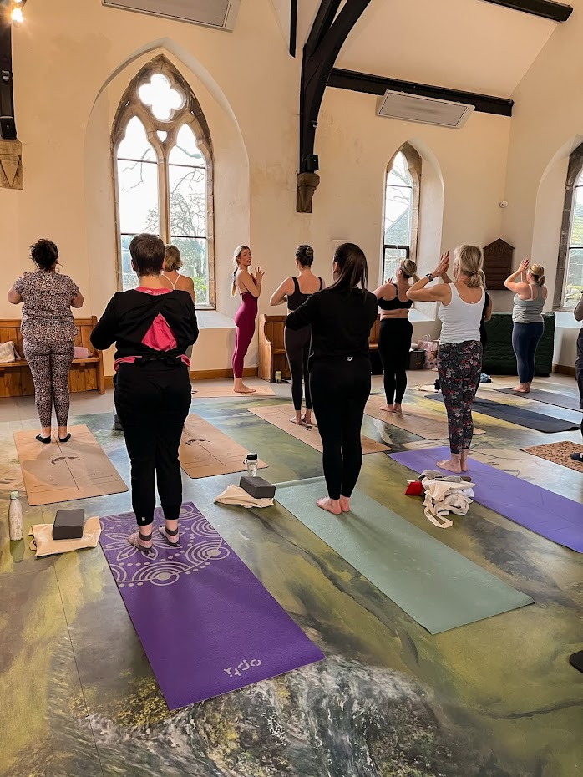
Several Yoga retreats have been held in Malham Chapel. These are popular with locals and visitors.

Slide 16
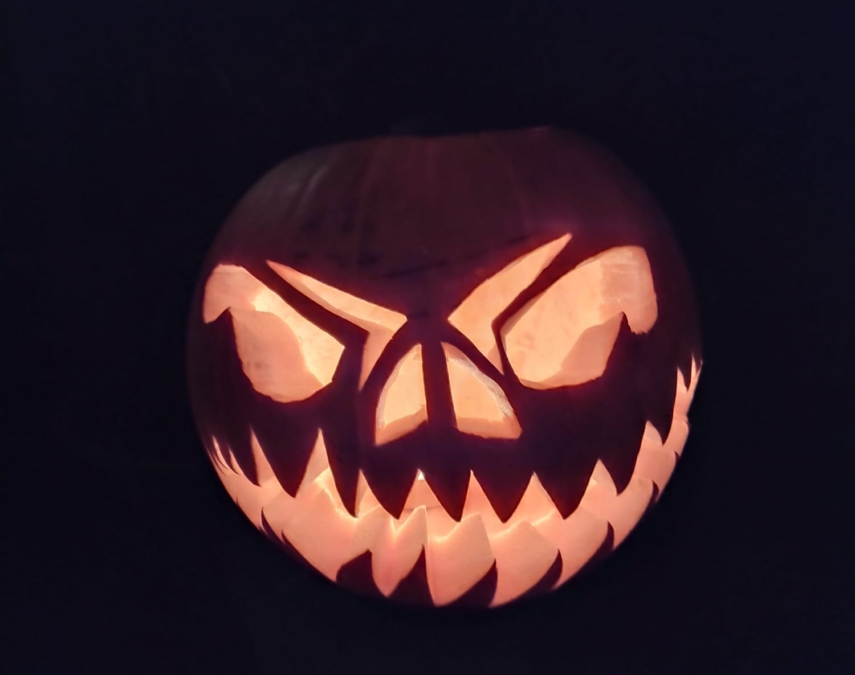
October
Many people had a good laugh on the 10th when the BBC online weather forecast was for 17,000 mile per hour winds in Malhamdale – no thanks!
Plenty of people managed to see and photograph a spectacular Northern Lights display, even from within the village and without specialist equipment.
A wine-bottle corks recycling scheme got fully underway for both cork and plastic corks.
The Malhamdale Community Group reconvened at The Listers Arms pub to discuss and plan community gatherings now Malhamdale Safari is long gone.
Halloween saw a small gathering of Trick or Treat children circulating with parents around the village in super scary costumes to impress residents and accept sweets.

Slide 17
November
Malham WI had a visit from Settle Courtyard Dairy, to taste and explain about local and traditional cheeses and their production on farms.
The National Trust based at Malham Tarn house made progress on their ‘Heart of the Dales’ Project, developing details and visiting all 18 farmers involved. A long-term landscape recovery plan through peatland restoration & woodland development. Phase 1 of tarn dam repair work completed, phase 2 planned spring 2025 as ground dries out.
Malhamdale curlew monitoring project reported it’s findings from sites on Malham and Calton Moor. Numbers of wading birds and breeding rate data showed a little promise amongst the gradual decline trend.
Weather through the Autumn this year was more ‘normal’, slightly cooler than last year but noticeably drier, with footpaths remaining less muddy and all passable. Decent snow cover on the 17th and 23rd, 22nd night down to – 8.1 in the village, and then flooding once it all thawed.
The first ‘Listed’ building in Malhamdale, actually in Malham, was fitted with a large array of roof-mounted solar panels connected to large storage battery and car charger, all well hidden from public at ground level.

Slide 18
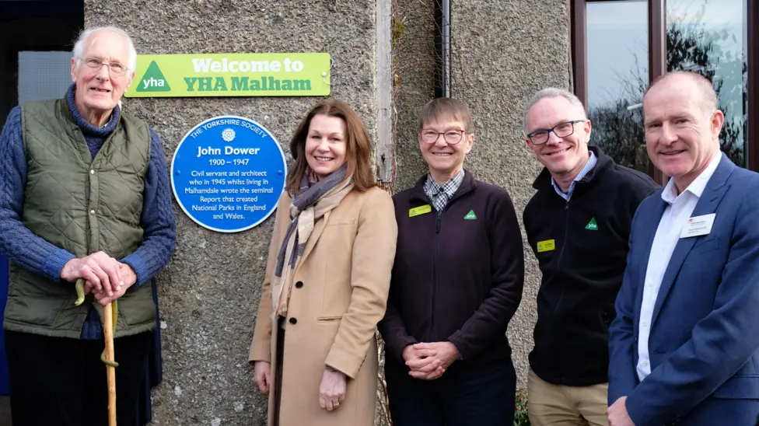
Malham Youth Hostel hosted a large celebration and unveiling of a Blue Plaque to celebrate the 75th anniversary of the founding of the English & Welsh National Parks and contribution of Mr John Dower
Photo YDNPA

Slide 19
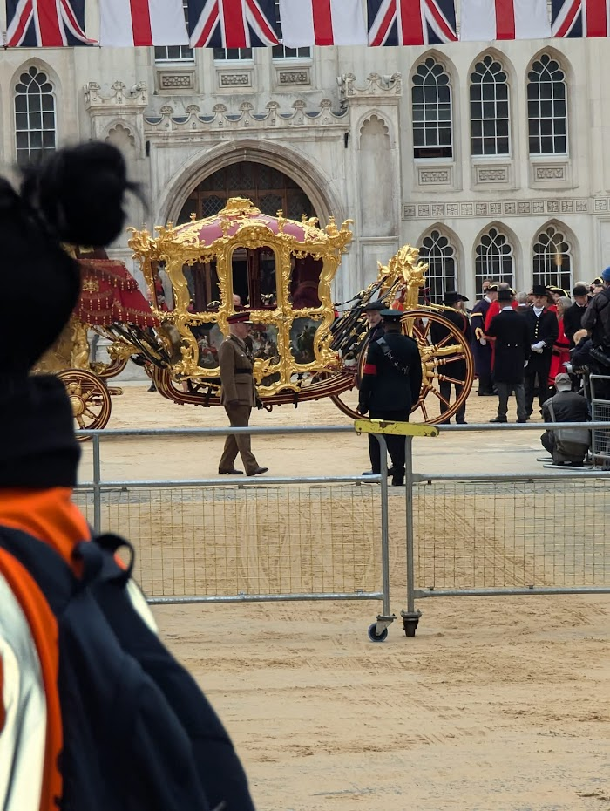
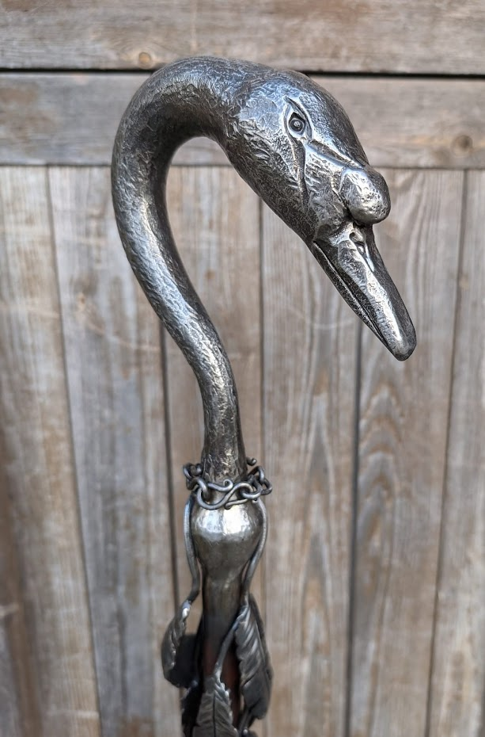
Malham Blacksmith Annabelle Bradley at the Lord Mayor’s Show – 9th November
The Worshipful Company of Blacksmiths presents three gifts at a ceremony before the Lord Mayor’s Show.
One of the gifts was designed and forged by Annabelle Bradley, with additional feathers forged by competing blacksmiths at the Great Yorkshire Show.

Slide 20
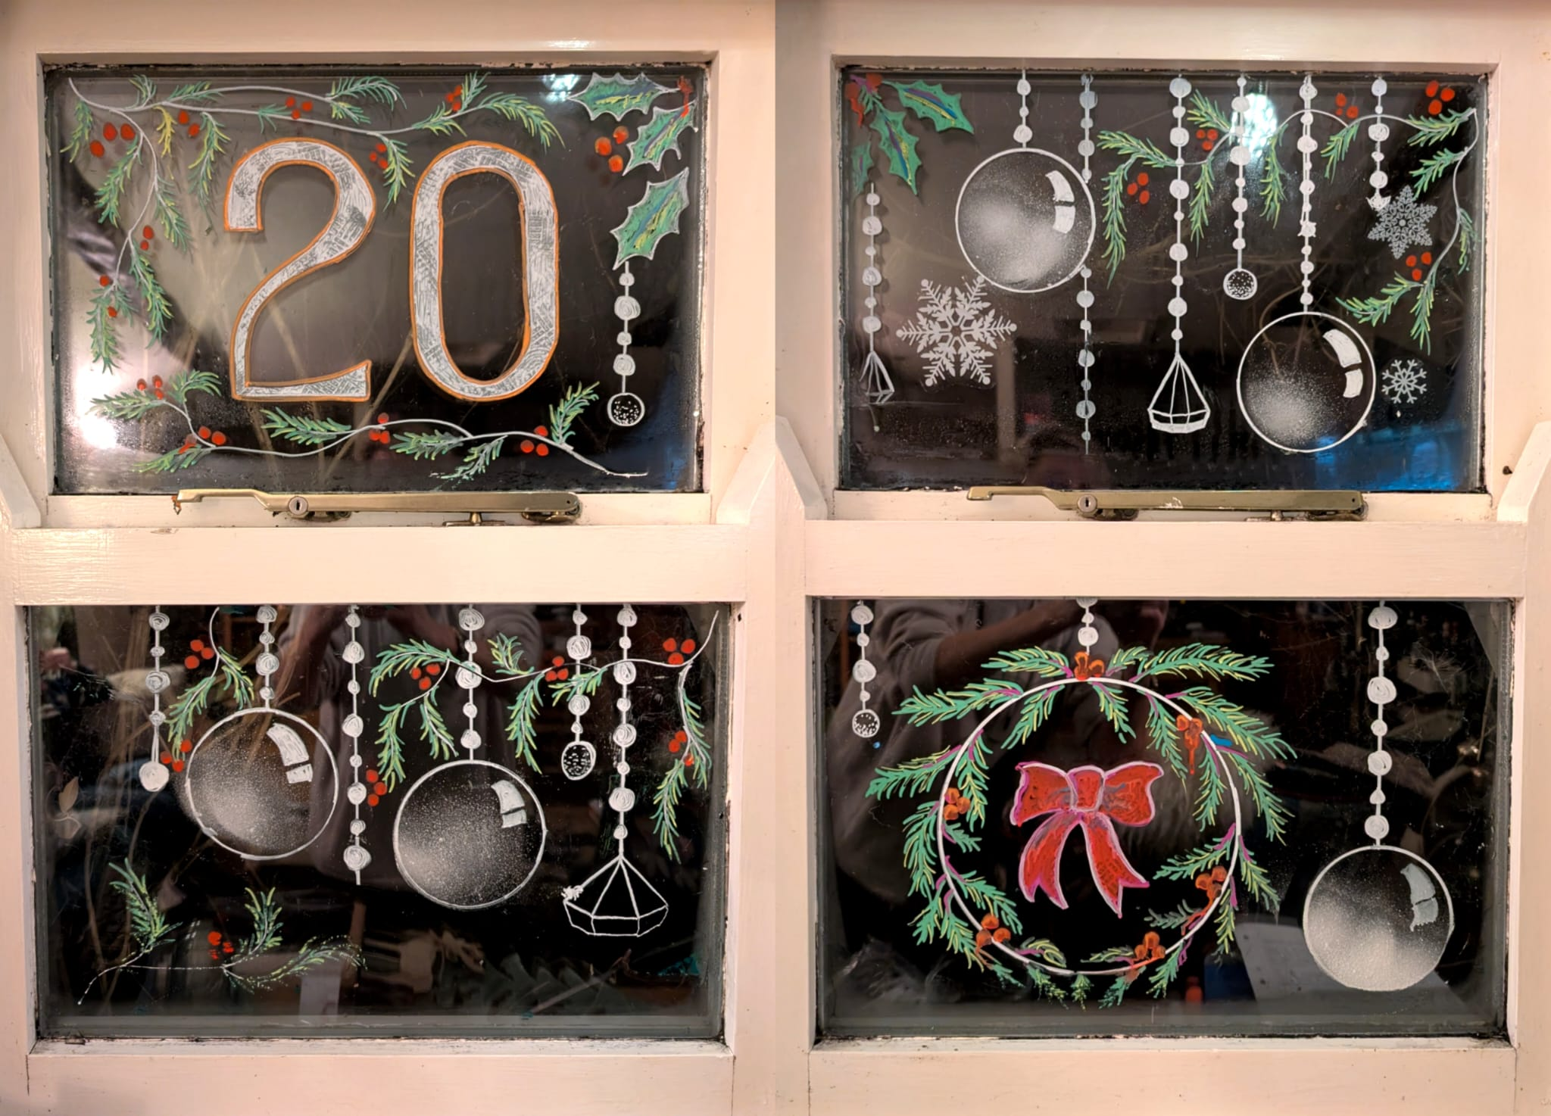
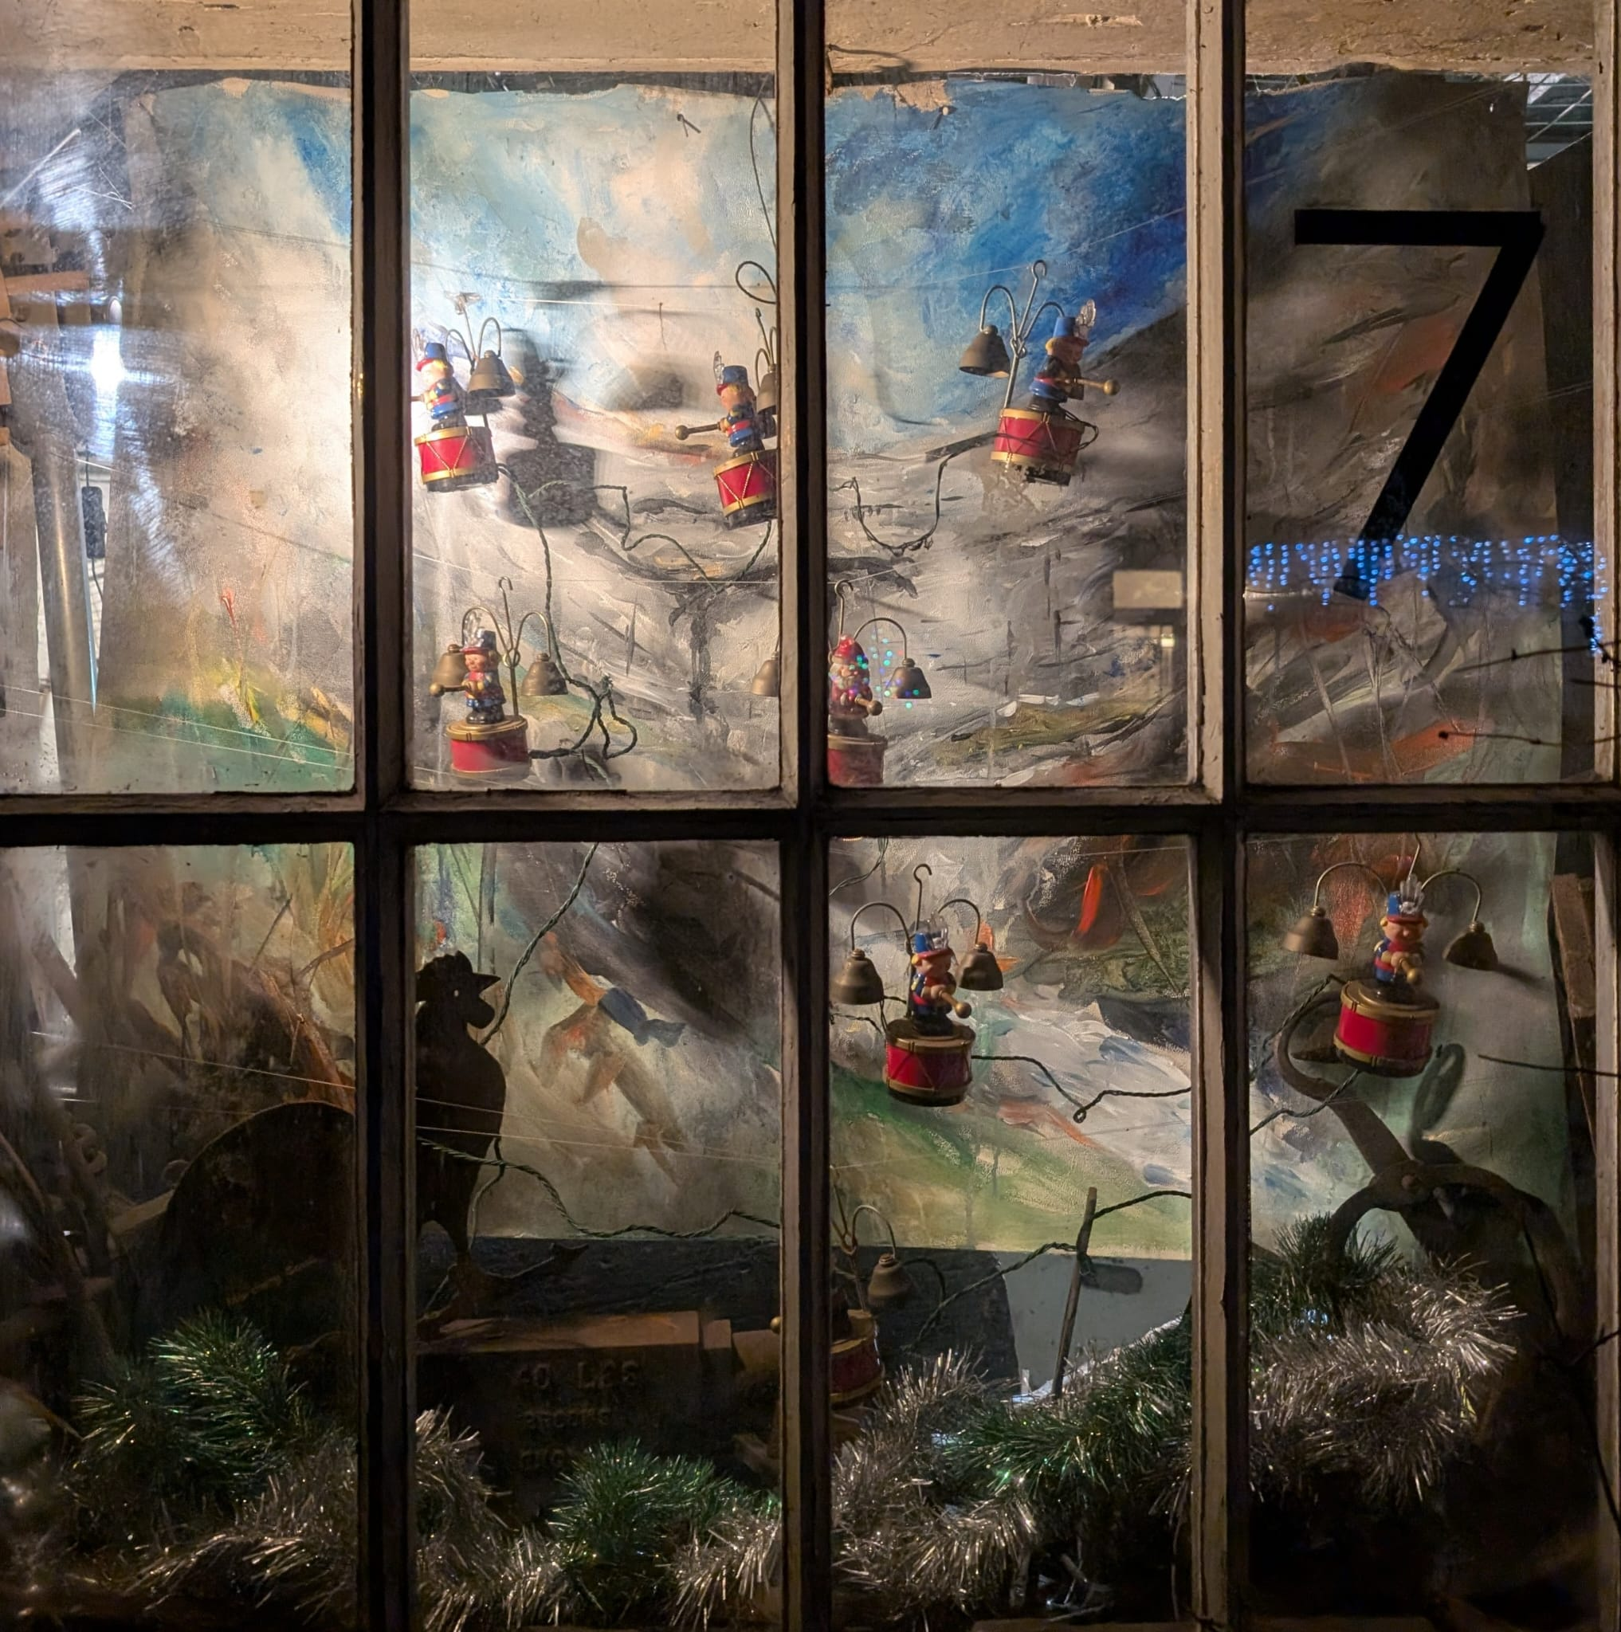
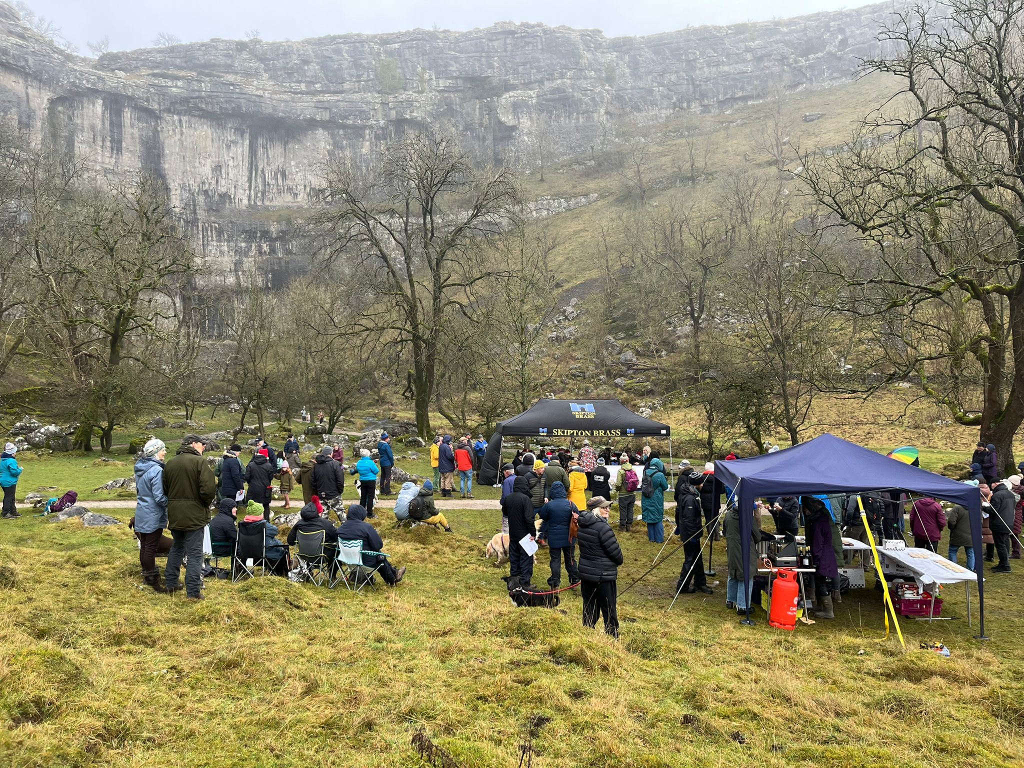
December
Advent windows started again with many residents, mostly in Malham bidding for their preferred date and creating lovely Christmas displays.
‘Carols at the Cove’, Skipton brass band & singing was cancelled due to storm Darragh passing through for a very windy weekend, but no damage. However, it took place later on the 15th with large audience, refreshments and a wonderful atmosphere.
Ash trees were felled in the National Park Centre car park due to Ash die-back disease.
Carol singing in the Buck Inn and Listers Arms were very well attended and then on Christmas Eve around the village a hardy group of carollers walked round without the usual heavy rain or blistering cold. Indeed, December was an exceedingly warm month on average.

