Slide 1
Malham Diary 2021
A Year Learning to Live with Coronavirus

Slide 2
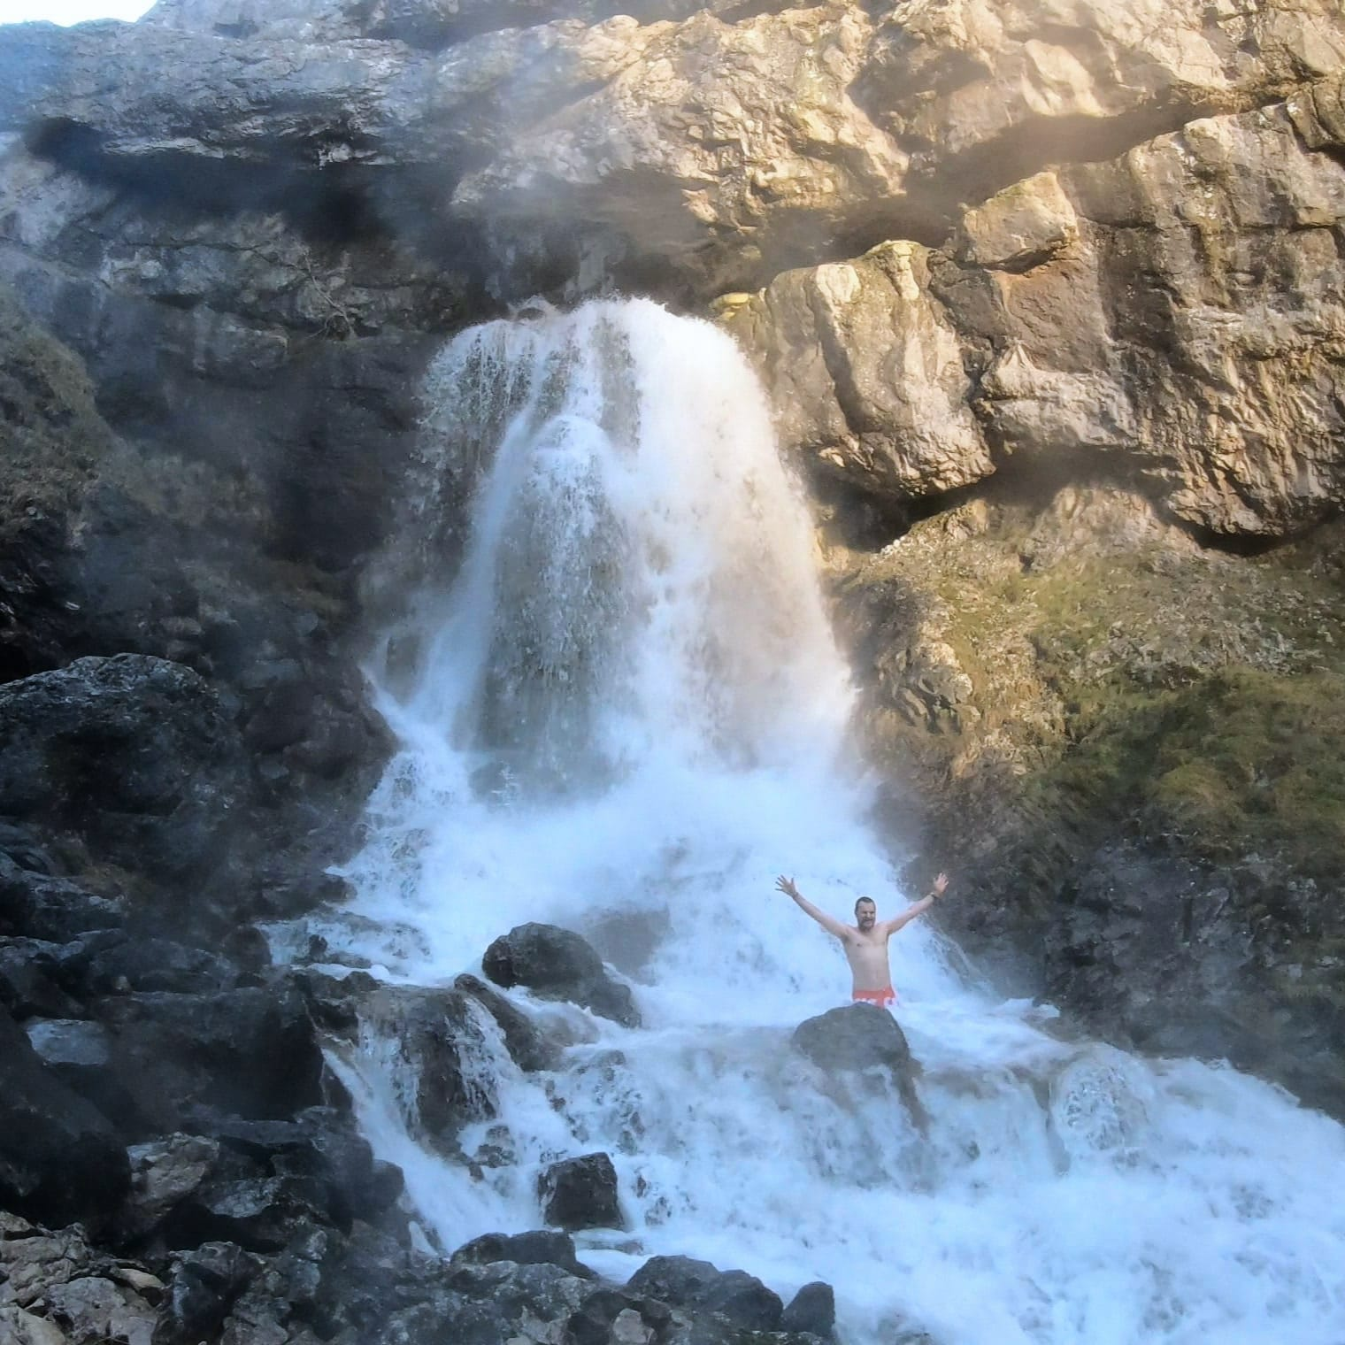
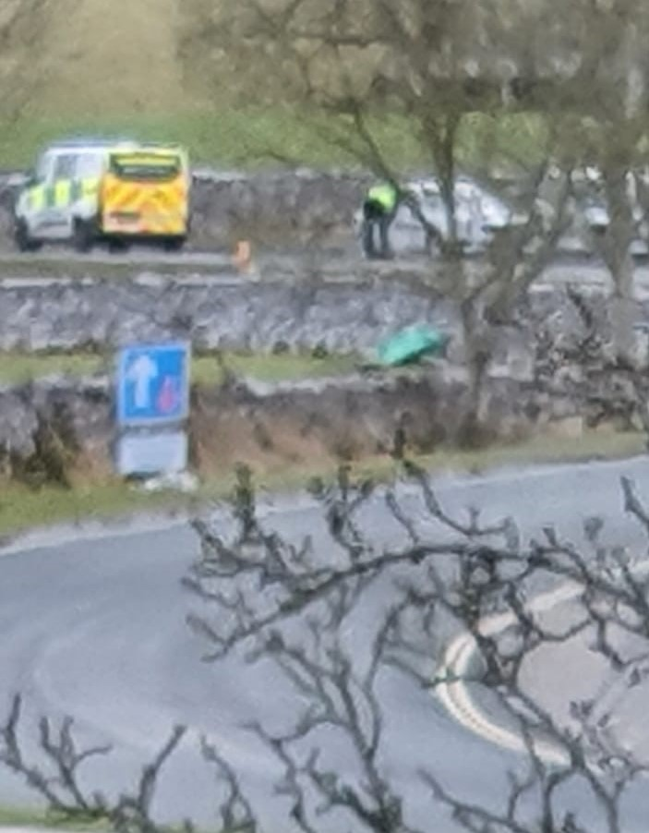
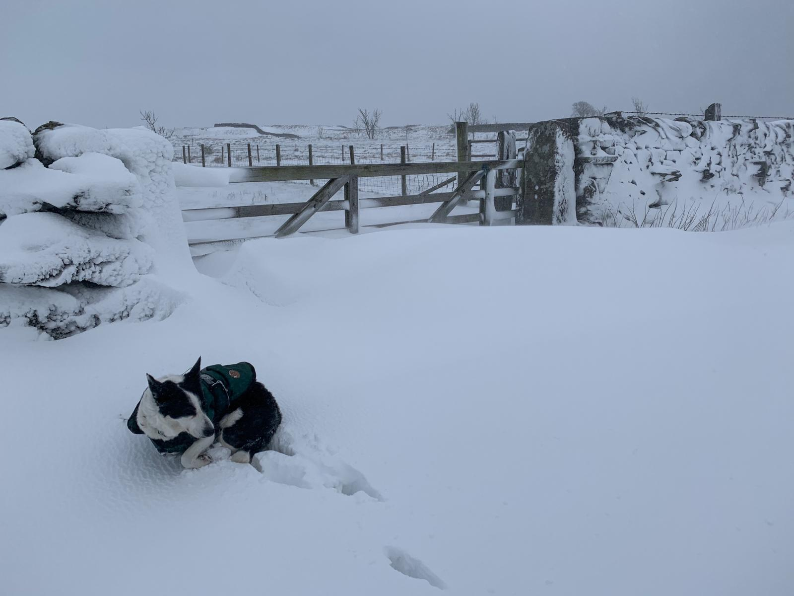
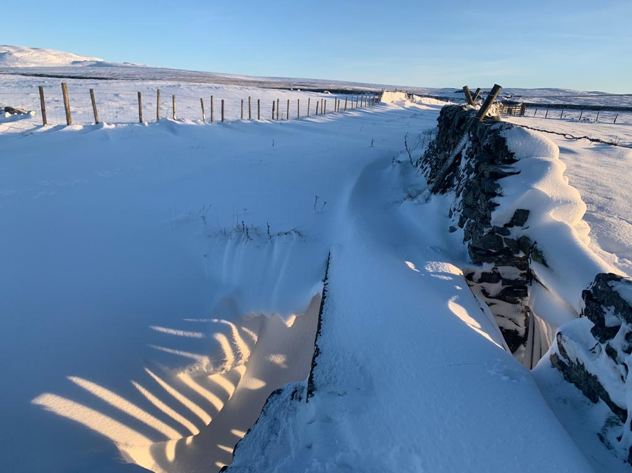
January
A cold month (average 2.8c in Malham ) to follow a cold December. Cawden Hill bursts open after Storm Christoph on the 20th , new sandbag store put into full use in many places around the village; volunteers patrolling in shifts through the night. Proper snow on the 9th and later, fairly deep snow gives proper Christmas card scenery.
Elderly residents start to get their first Covid19 vaccination and are greatly relieved to feel a sense of safety coming; John Simpson even gets his booster jab three weeks later for almost full protection.
Visitor numbers are greatly reduced but still more than expected as the country is in full lockdown with Government issuing ’stay at home’ messages and ‘stay local’ for exercise. Police patrolling at weekends, turning people back if from further than Skipton. Many fines issued to visitors from Merseyside & West Yorkshire conurbation. ‘Spine Run’ of the Pennine way through Malham is cancelled due to coronavirus.
Malhamdale Covid19 Response WhatsApp social network and community Zoom video conferencing meetings continue to support people and various online events organised locally. Schools closed except for essential worker’s children. All other children taught by parents with online lessons. Covid19 rates very high throughout January.
Stuart Gledhill of Malham and the ‘Dales Dippers’ do a month of wild, cold-water swimming every day with sponsorship to raise money for the Crisis charity which helps homeless people.

Slide 3
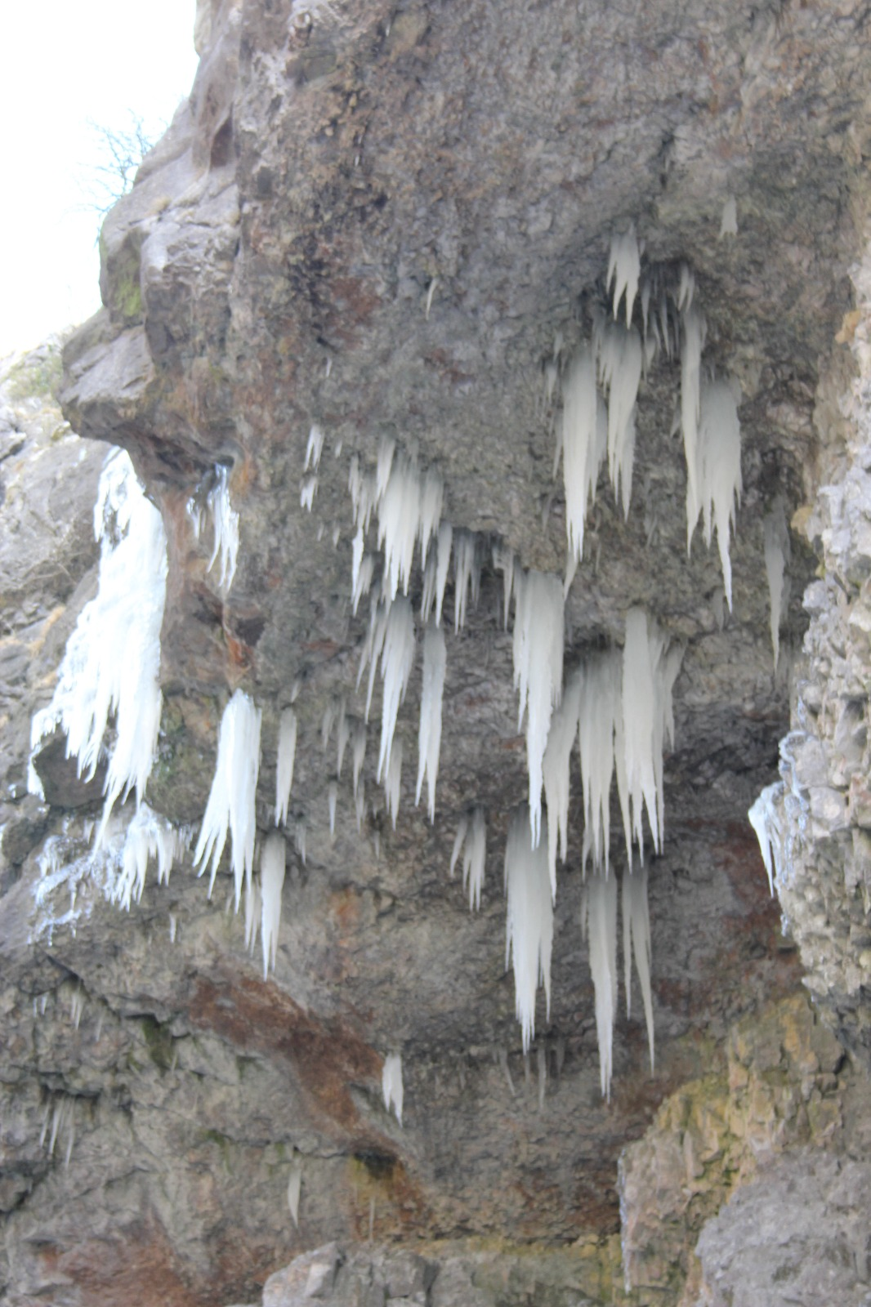
February
Cold winter continues with fairly deep sticky snow early in the month giving snowmen and igloo on the Green. After a short mild few days a fierce freezing east wind sets in for over a week with sub-zero daytime temperatures and persistent ice and dry snow. Gordale Scar very impressive with huge icicles and frozen waterfalls and Gordale Beck frozen over in beautiful ice formations. Middle of the month weather flips completely, above average temperatures set in feeling like spring with a glorious end to the month.
Residents in their 70s then 60s are called up for their first Covid19 vaccinations in Skipton and Keighley.
Electricity North-West have moved overhead power lines behind the Village Hall and adjoining cottages to underground connections and dug up the road in the centre by Ronnie’s shop to connect houses in the centre.
All pubs, cafes, hotels and shops remain closed, even for take-out food and drink. Malhamdale Primary School remains shut for all but essential worker children; most learn online at home. Visitor numbers low, police patrol.
Tree planting gets going in earnest organised by MEG, Malhamdale Environmental Group, a sub-committee of Malham Parish Council. Saplings are planted in copses up Malham Rakes road verges and underplanting in Malham Beck Plantation and Atkinson’s copse.
By mid February, plenty of people in their 60s are getting a first Covid 19 vaccine at Skipton Hospital and other health centres, plus anyone vulnerable or infirm getting first and second doses.

Slide 4
March
The first of March sees a young man ‘tasered’ by police in a field near Prior farm. This followed two young men being seen camping near the Cove armed with a gun. Police were called, the man holding the gun apparently refused to drop it when requested so he was felled with a taser shot and both arrested. Quad bike thef later in the month; crashed and smashed at Newfield Hall bend.
March weather starts dry and cold, below average with freezing nights and misty then bright cold days.
All accommodation, pubs and cafes remain fully shut, only the Gordale refreshment van continuing to serve at weekends. Visitors continue to build up at weekends, supposed to be ‘local’ only but obviously not so.
Frogspawn seen in ponds mid-March onwards.
5th March online cheese tasting evening! Cheese was delivered from Courtyard Dairy just north of Settle and distributed to many Malham residents who used Zoom to have an online interactive talk about the cheeses.
Residents in their 50s-60s booking and getting Covid first vaccines but many having to travel to Burnley, Bradford, Morecambe etc to get the jab.
Village getting fairly busy with visitors who are supposed to be ‘local’ , but with no government or police definition there are many from the big northern conurbations such as Manchester, Liverpool, Leeds etc. Plenty of wild-camping walkers doing the Pennine Way.
Prior Hall returns from holiday cottage usage to permanent residential. An ill badger found at Janet’s Foss; taken to vets but had to be put down.

Slide 5
April
April weather is truly spring like, such warm days early on, followed by a real cold snap at the end of the month with strong, freezing easterly winds. Swallows returned mid-month along with oystercatchers and curlews frequently seen and heard in fields around the village. Still no significant leaves on the trees, seems like a proper cold winter has slowed everything developing compared with recent spring seasons.
Camp sites open with camping starting on the field adjoining Miresfield Farm B&B. Visitor numbers really increase with good weather. Old Barn cafe doing a roaring trade from their hatch onto the pavement.
Wild swimmers frequently seen at Janet’s Foss waterfall, not just the hardy ones, a huge increase in popularity over last couple of years. Hot air ballooning on still mornings from the show field is lovely.
Many adults in their 70s upwards getting their Covid 19 second vaccinations done, elderly and infirm done with second jabs, often people travelling to Ingleton, Keighley, Skipton, Settle for jabs.
National Park Visitor Centre reopens to visitors inside rather than outside-only since opening in February. MCR (Malhamdale Covid Response) Zoom meetings continue regularly to support residents
Land changed hands at Miresfield and Belted Galloway cattle were brought down into village fields.
Drone flying problems at The Cove even though there are peregrines nesting.
Peat-free compost brought back into village in bulk after being made partly from local sheep’s wool.
Malhamdale Local History Group meetings continue online with Zoom. Plenty of new lambs escaping from fields onto the roads.

Slide 6

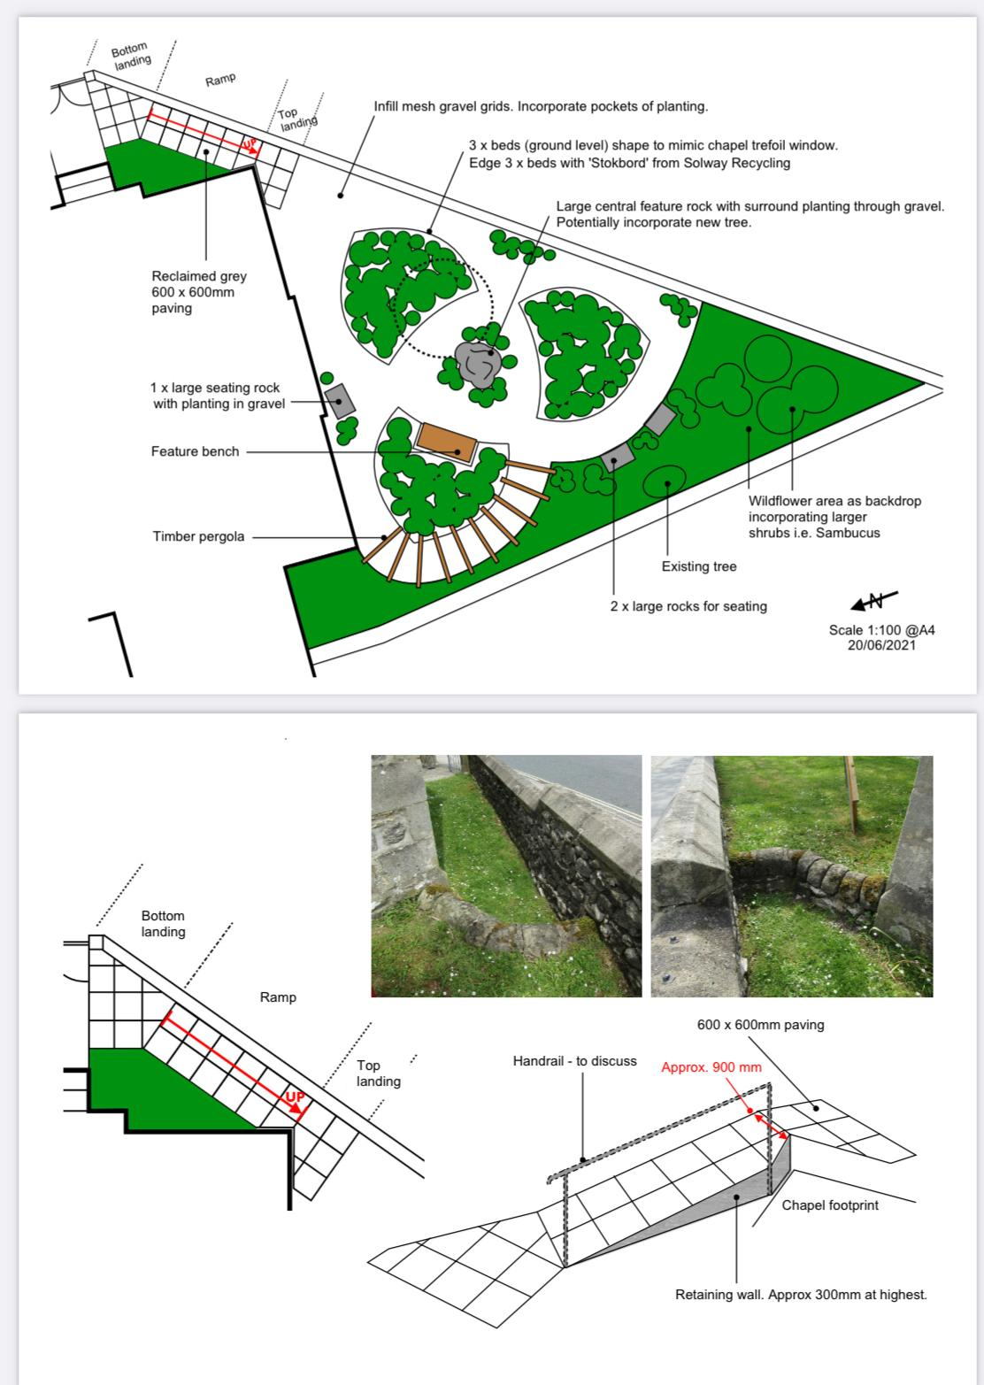
May
Leaves on some of the trees at last by mid month with super weather on many days. Bluebells out at last, very delayed this year.
Many middle aged residents getting second Covid 19 vaccinations and even younger people getting first doses.
Walter Morrison festival started to celebrate the centenary of his death and his life of philanthropy to people of Malhamdale, Craven and various other localities. The festival is started with a talk at the Folly in Settle by Robin Bundy, local historian and expert on Walter Morrison and is continued with displays throughout the summer in Malham Chapel and Kirkby Malham Parish Hall along with various other places.
Malham Environmental Group members met with members of Malham Chapel to discuss the creation of a sensory garden in the triangle of land at the front of the chapel.
Malham Safari did not take place as Covid restrictions prevented adequate preparation and residents did not want even more visitors in the village.
Online evening social gatherings continue via Malhamdale Covid Response Whatsapp social network.
On a beautiful sunny Sunday 30, the road into the village was so busy mid-morning with visitor traffic, it became totally gridlocked forcing people to abandon cars and residents to walk back into the village to get home. Eid holidays brought more first-time ethnic minority visitors for family picnic parties and walking during mid-May.

Slide 7
June
All trees and hedging are in full leaf and summer has come at last.
Significant problems with parcel delivery couriers delivering parcels to incorrect addresses or parcels vanishing. Residents have become reliant on online shopping and many continue to work from home.
Malhamdale Covid Response (MCR) online Zoom meetings continue for interested residents to discuss problems and solutions related to Covid19 and it’s direct and indirect impact on the community – such as perceived visitor overload and progress of local vaccinations. The Whatsapp MCR text and image based social network continues to be very well used for anything from lost dogs and parcels to giving away used household items and swapping home-grown vegetables.
A change of leadership for the over-60s Cameo club but a determination to keep it running despite Covid19.
Four peregrine falcons successfully fledged at The Cove. No RSPB peregrine watch again this year to allow members of the public to use telescopes to view the chicks.
Malham partially cut off for a day due to water main works across the road near the chapel.
Change of landlord at The Buck Inn, some local disappointment that the owners, a pub ‘chain’ refused to allow the pub to have proper ‘home cooking’ in the kitchens.

Slide 8
July
A warm, sunny month with somewhat above average temperatures, and continuing hordes of tourists from all around the UK but unusually, very few indeed from anywhere abroad due to covid19 travel restrictions.
Walter Morrison book of commemorative Malhamdale walks published and available for sale in local shops.
A set of Walter Morrison information boards were displayed in Malham Chapel for a few days, manned by members of the Local History Group to explain information to visiting tourists.
The first couple of days have a large charity sponsored walk centred on Malham Show Field with hundreds of walkers raising money for the Macmillan nursing charity by walking either 13 or 26 miles. Residents became upset due to roads blocked by coaches transporting some of the walkers back to the village.
Internet cable problems up the dale cause significant problems for residents over a few days as so many rely on high speed broadband internet for their work as well as for daily purchases.
Kirkby in Malhamdale Primary School finished creating an outdoor ‘Forest’ learning area for children’s activities.
Malham Womens Institute held a meeting as an actual trip out to a gin distillery at Otterburn instead of the usual Zoom meeting format.

Slide 9
August
Throughout the summer months a variety of minor rural commonplace events were posted on the local Whatsapp social network – dogs, chickens, cats lost and found along with sheep and cows wandering in the roads. Minor car accidents, roads blocked, mis-behaving tourists clog the airwaves.
Malham Show took place as normal this year on the Show Field at Chapel Gate. This was the only village agricultural show to take place in the area, all others being cancelled due to concerns regarding coronavirus.
Malham WI had their annual main trip out to Levens Hall but couldn’t look around inside due to Covid restrictions, however they did report that the gardens were excellent. They than visited Beetham Nurseries and dashed back to Malham Village Hall for a conventional meeting with talk about IDAS (womens refuge).
The Environment Agency conducted their regular fish count in Malham Beck after a break for Covid reasons. Data is logged for the same 50 metre sections of the river for comparison – only just satisfactory results.

Slide 10
September
Covid booster jabs started for elderly residents.
Quad bike thefts continue, with a spate this year. In September one gang was filmed leaving Malham wearing black balaclavas. When chased, the quad bike crashed badly at a roundabout on the North Skipton bypass very severely injuring the rider.
Visitors still flocking to Janet’s Foss for swimming and picnicing on warm weekend afternoons, not just the hardened cold-water swimmers.
Members of Malham and Airton WI met together for the first time this year having a talk and demonstration of tai-chi.

Slide 11
October
Further talks take place on the life of Walter Morrison, the actual talks being in Giggleswick Chapel but also available for the public online using Zoom.
Planning permission was granted for developing the Malham Chapel sensory garden and initial marking out of the design to match the gable-end window was undertaken.
Outdoor play and learning sessions for pre-school children with parents/carers, started at the primary school in their new ‘forest’ area.
Change of manager at The Listers Arms, farewell to Darren after many years good service.

Slide 12
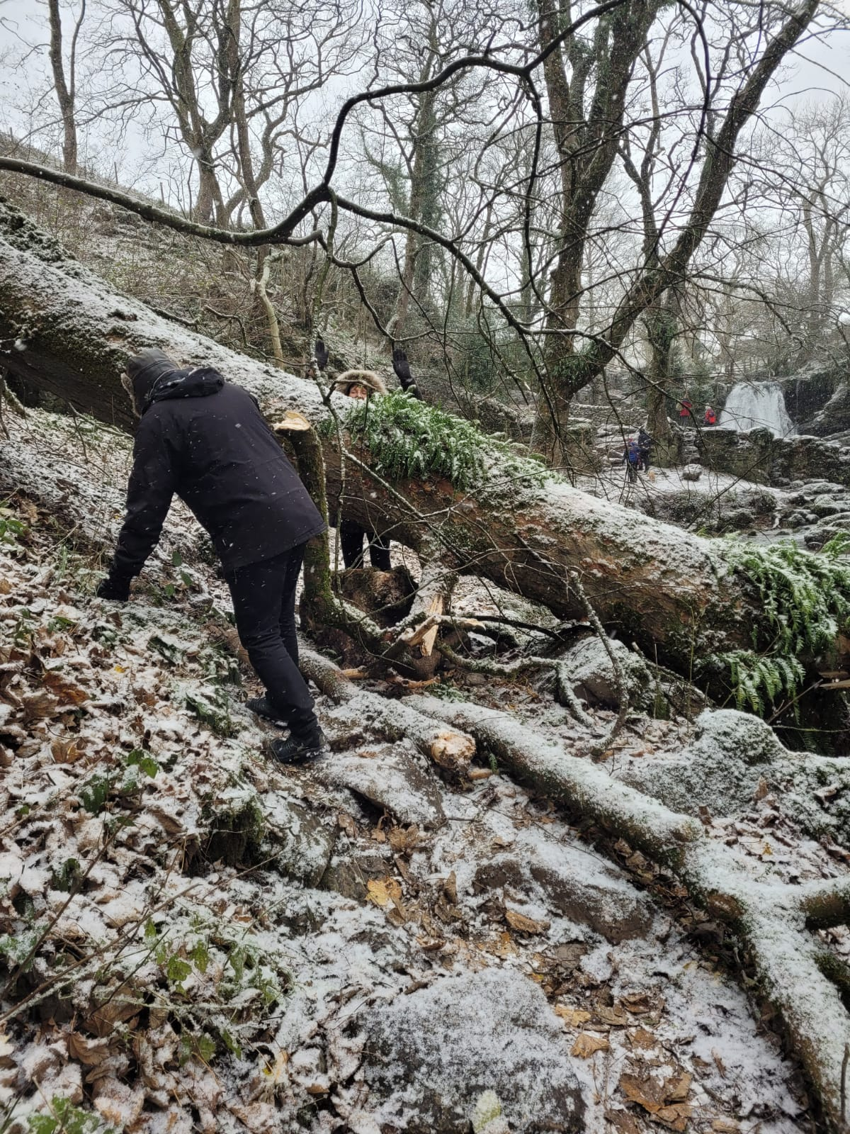
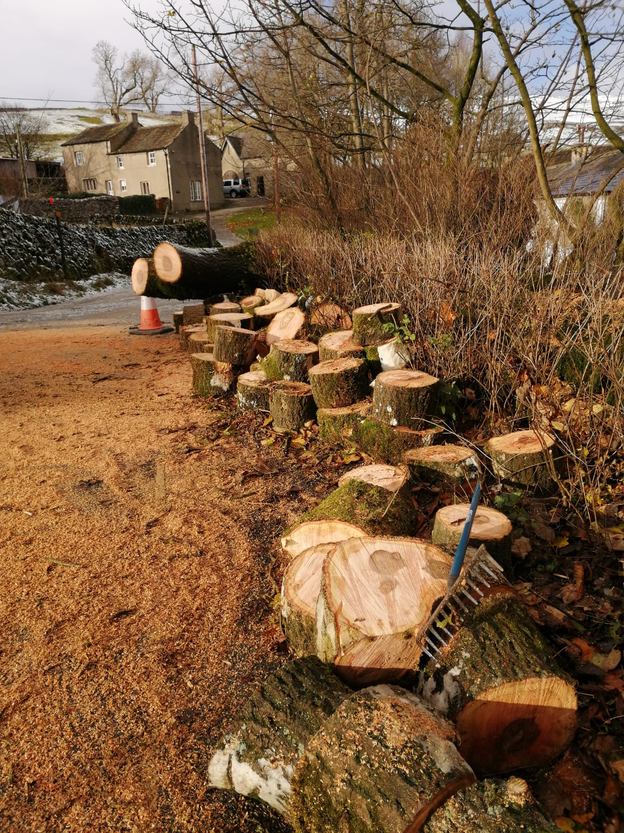
November
Weather started normally but caught out many people with a sudden very cold night at the end of the month, down to -5.2 Celsius recorded on the riverbank and definitely colder out of the village. The first named winter storm hit the village from the north instead of the usual south-west. Storm Arwen uprooted many trees and broke large branches off many more, blocking Cove road near Moon’s farm and with a number of trees blocking the road down to Gargrave. Electricity cables down blocked the road to Settle. On the 28th^{th} a heavy fall of snow fell with strong winds keeping drifts on Pikedaw for the next three weeks.
Work started on ‘Ashley’s Barn’, the controversial barn at the foot of Malham Raikes (Tarn Rd). This was finally with planning permission to convert it to a take-away food outlet /farm shop, after failed attempts by prior owners to convert to a residential property.
An emergency meeting of Malham Safari committee in The Buck Inn decided to postpone the safari for 2022 due to mixed feelings about the whole concept, workload, recruitment problems and necessity to clear animals from Ashley’s Barn and Kirkby Malham barn (also due for imminent conversion to residential use). These were burnt on a large bonfire at Kirkby Brow top Farm, as they were damaged beyond repair due to damp and Jackdaws.
First turf cut on Malham Chapel sensory garden and installation of boulders and seating.
Tree blocks Janet’s Foss path

Slide 13
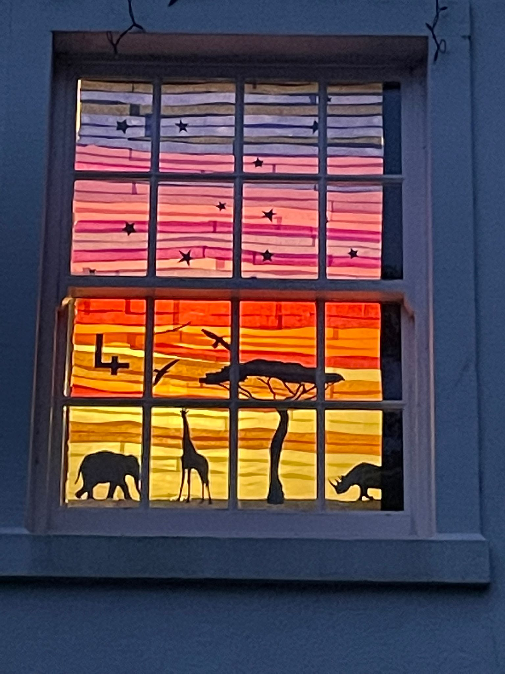
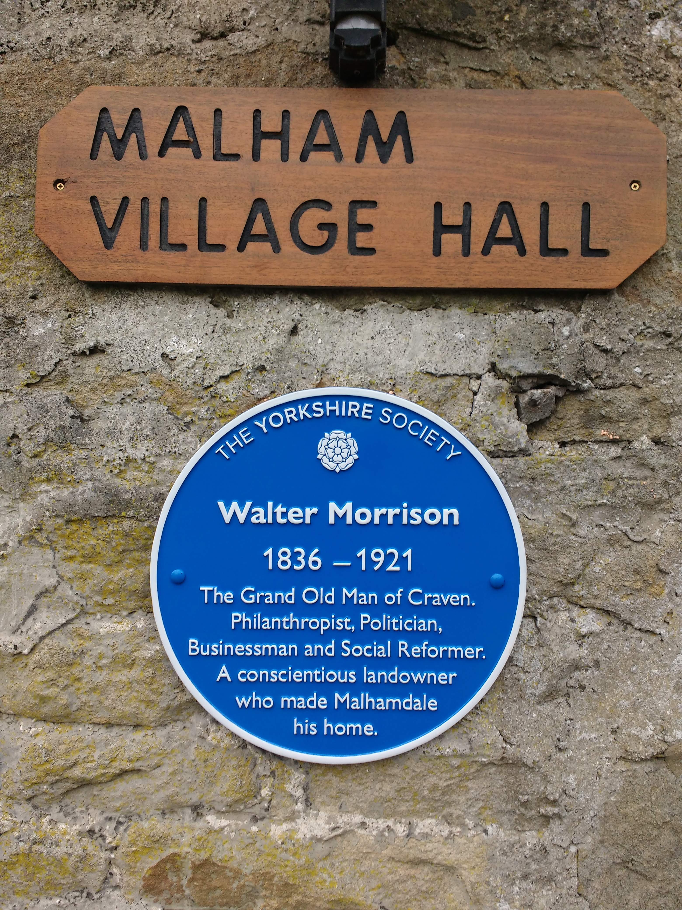
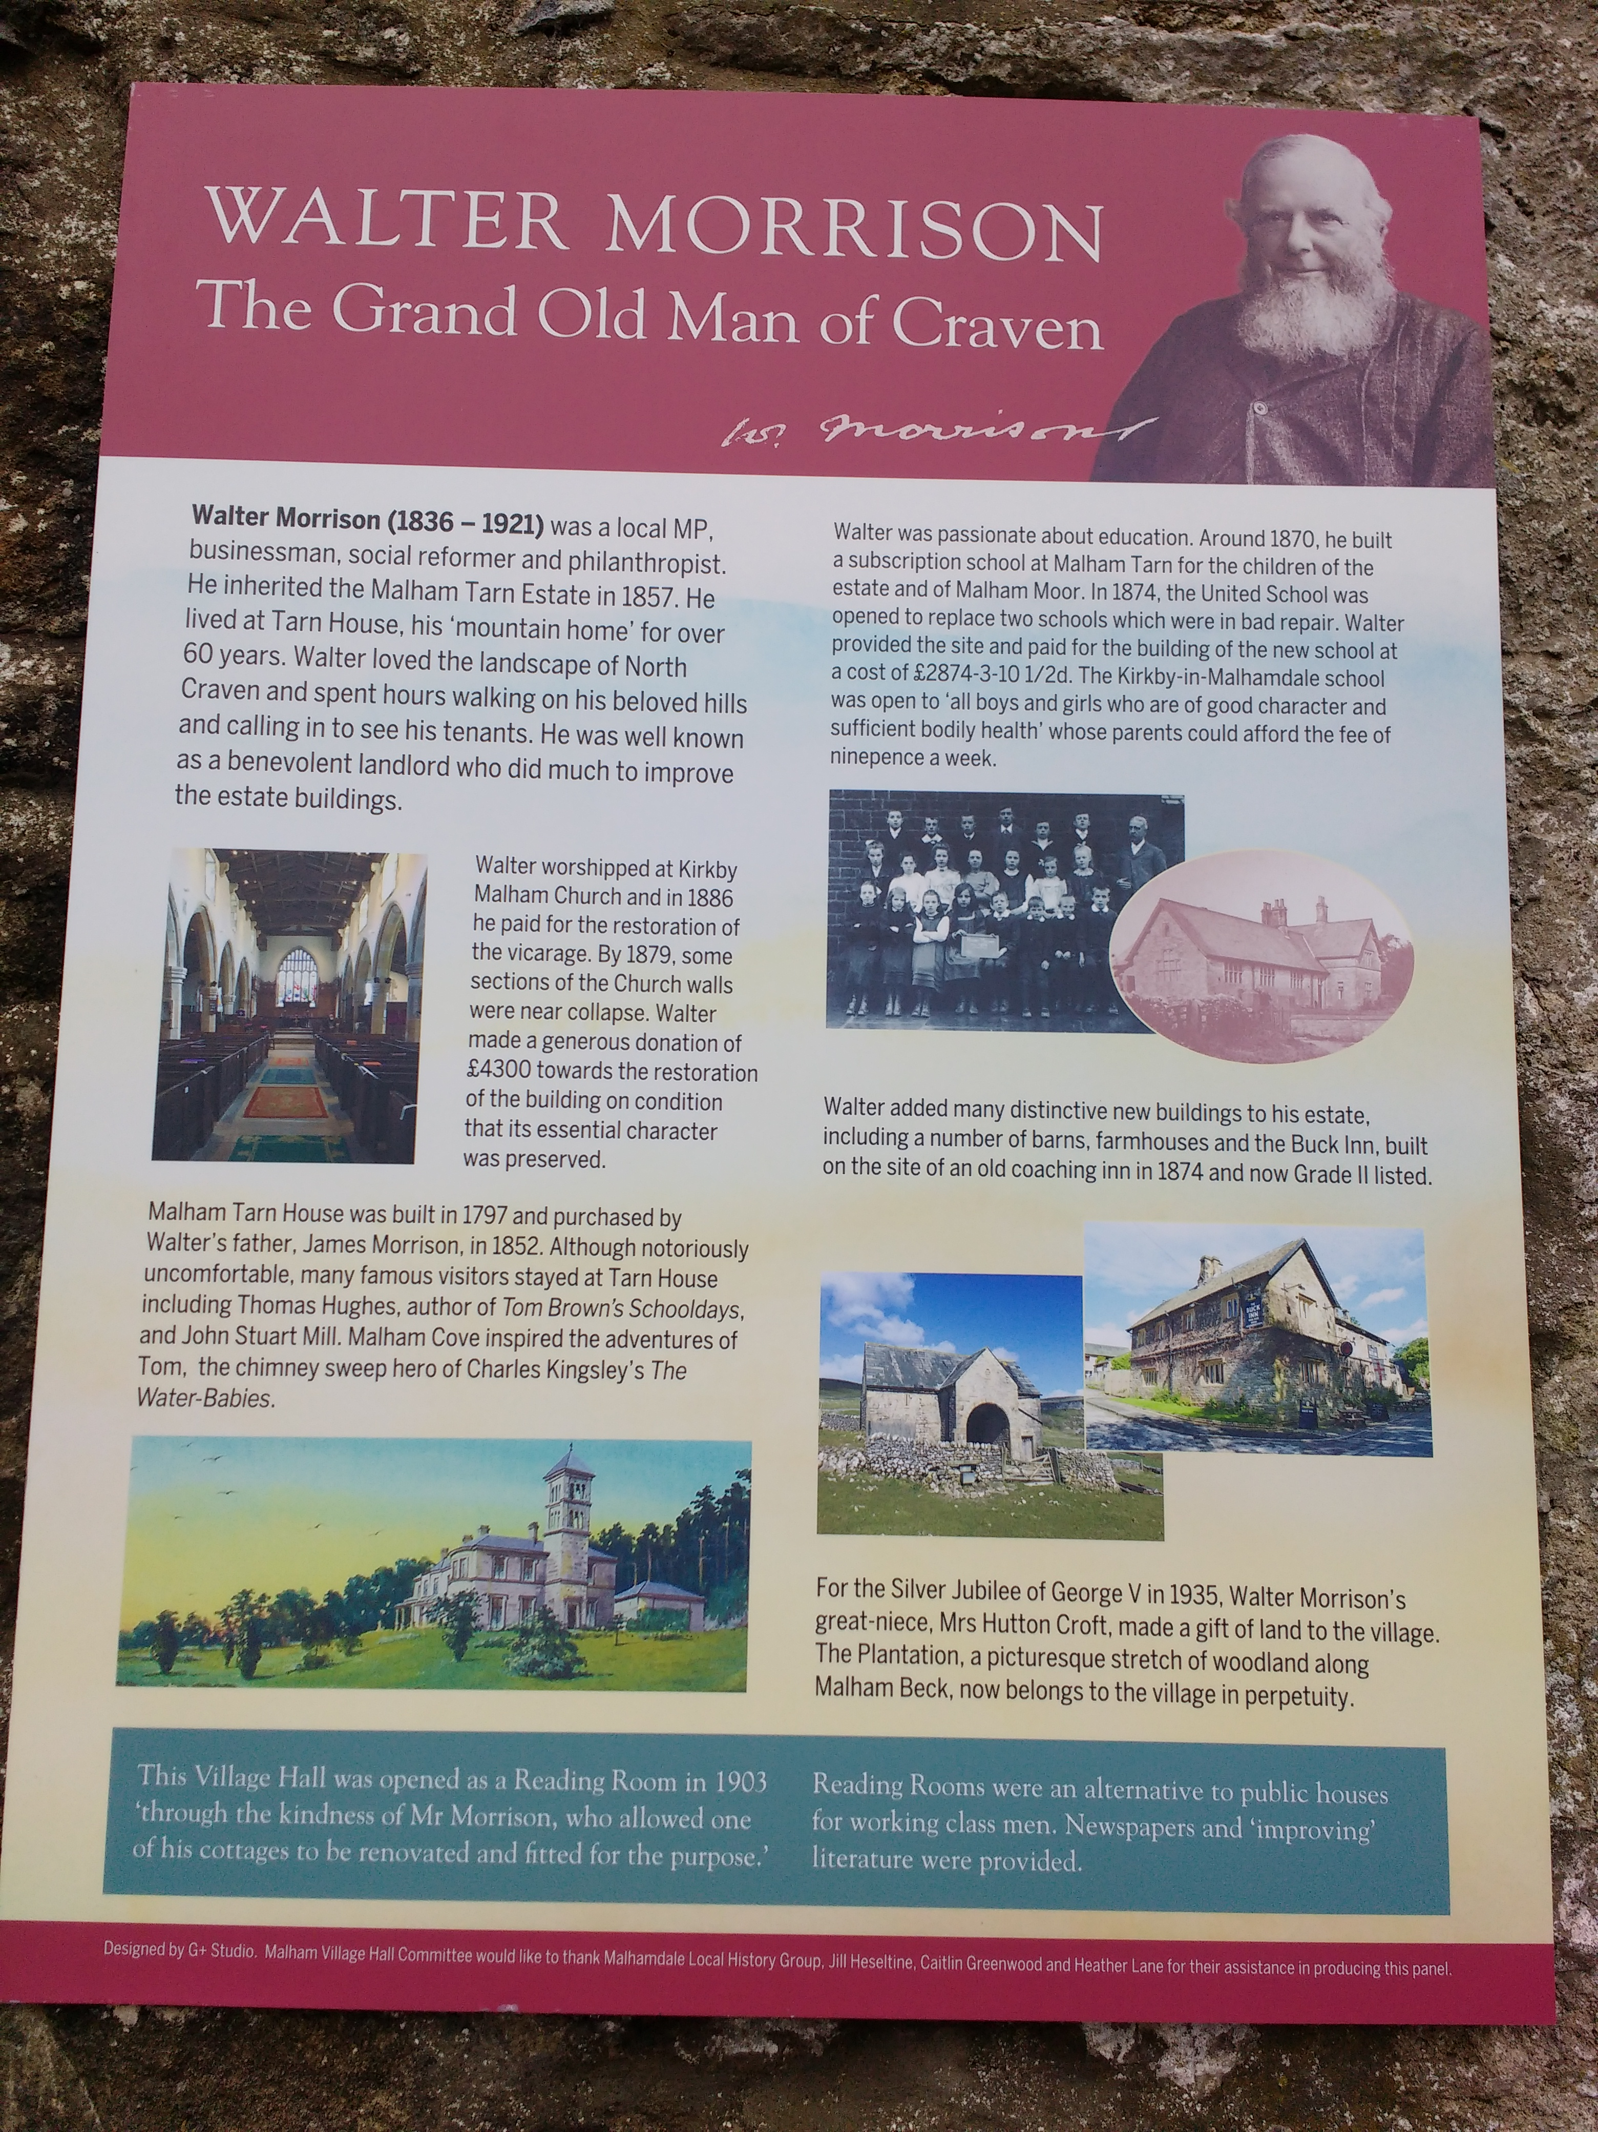
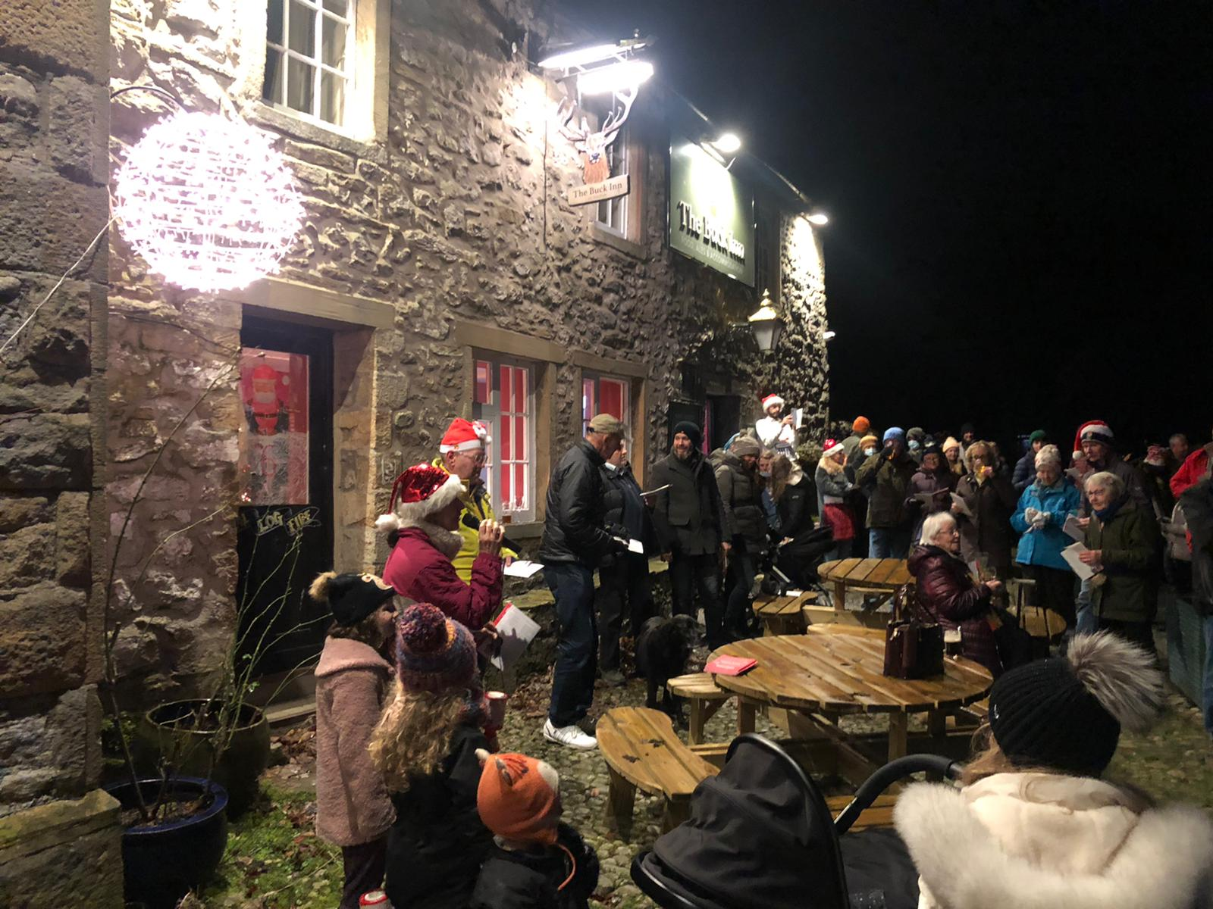
December
Storm Arwen cleanup – Huge fallen horse chestnut tree in Malham Beck Plantation and Beck Hall copse sawn up.
Festive advent windows repeated as last year, including Kirkby Malaham, residents volunteering for a day number.
Visitor numbers greatly reduced until week preceding Christmas, even then fewer than last year as all shops open. Between Christmas and New Year, viitor numbers bounced back to usual fairly busy levels.
Numerous families in the village were impacted
Blue plaque celebrating Walter Morrison installed on the village hall and unveiled at a ceremony outside. Also a noticeboard explaining his life and contribution to the locality, produced jointly with The Folly at Settle as part of the Walter Morrison Festival.
Carol singing for charity took place outside at The Buck Inn and Listers Arms, with people allowed inside to buy drinks at the bar but to drink outside. The Listers Arms also provided festive sausages and mince pies.
The year ended exceptionally mild with moderate southerly winds giving a dry 31st with an afternoon temperature recorded at 12.5 degrees Celsius in the village.

