Slide 1
Malham Diary 2020
(Retrospective)
Malhamdale Local History Group
A year dominated by the coronavirus Covid19 pandemic and Malham resident’s response to it’s effects.

Slide 2
January
The calm before the storm. Malham experiences a usual wet, mild winter whilst residents hear about coronavirus cases in China spreading slowly to other nearby far-eastern countries.
Ongoing and increasing problems for farmers due to visitors having dogs off lead and worrying/killing sheep. The village and surrounding footpaths were surprisingly busy with visitors for the time of year.

Slide 3
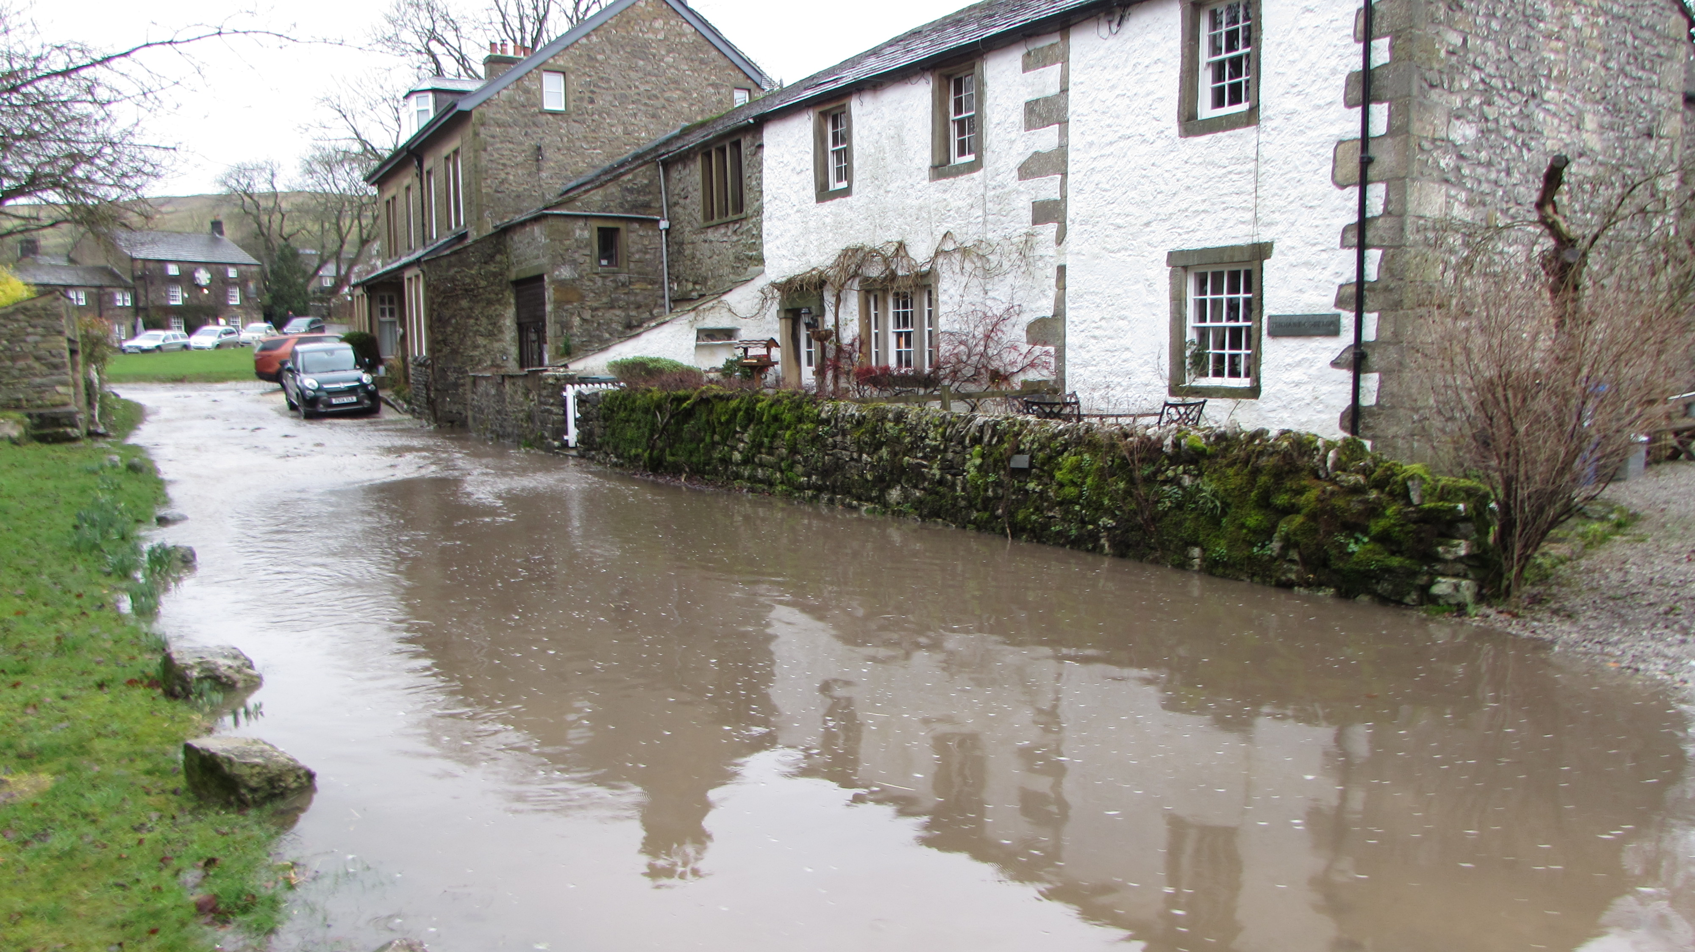
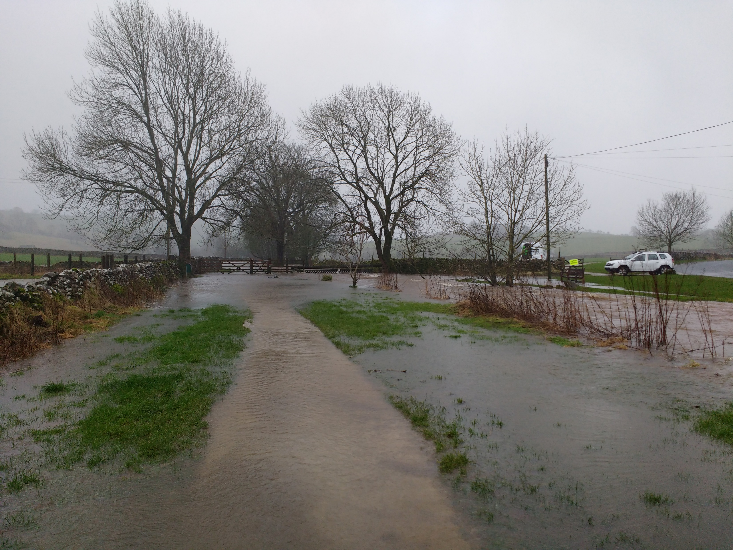
February
Storms Ciara and Dennis unleash severe rain and exceptional gales; Pennine way footpath impassable at Blackhole Bridge, Cawden bursts with water and rocks flooding down Finkle Street.
Malham Environmental Group undertake three tree-planting projects with ‘People and the Dales’ (Yorkshire Dales Millenium Trust) refugee volunteers from local cities.
A letter and map was sent to all Malham households regarding plans to greatly extend the double yellow lines for parking problems on roads around the village, Residents were asked for their views and any objections.
Discussion at Parish Council about the status and need for an ongoing Malham Village Parish Meeting. It was decided that Kirkby Malham Parish Council actually fulfilled the role of the independent Parish meeting and that in view of the lack of commitment from village residents, the annual Malham Parish Meeting should be dissolved.
Discussions took place at Parish Council with a ranger from Yorkshire Dales National Park regarding poor and inadequate signposting for visitors wishing to walk into the countryside from the village. It was decided to instal new signposts in the village to get people started on their walks. This took place gradually throughout the spring.

Slide 4
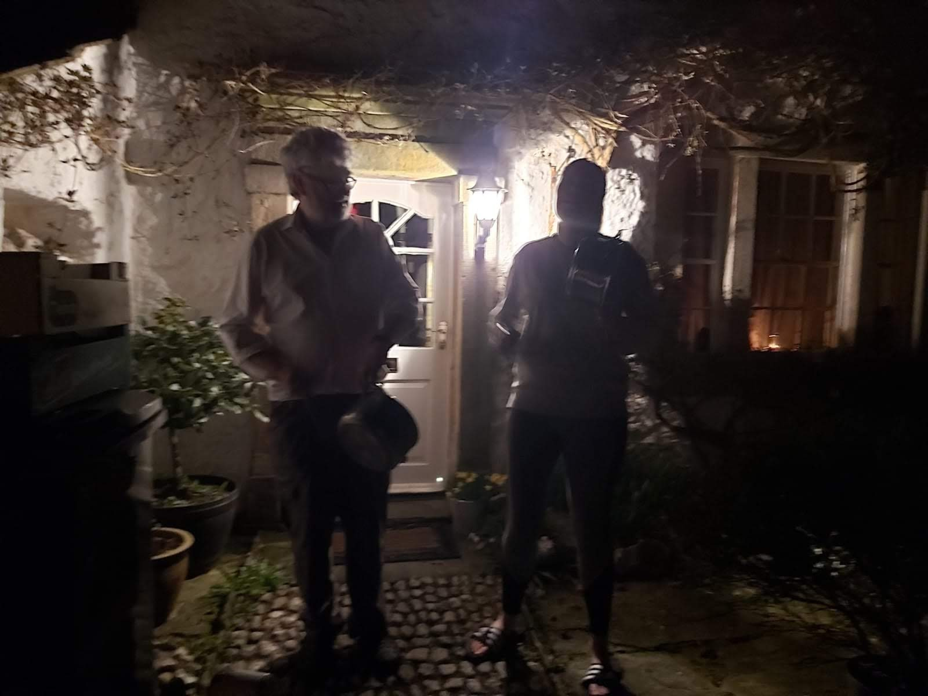
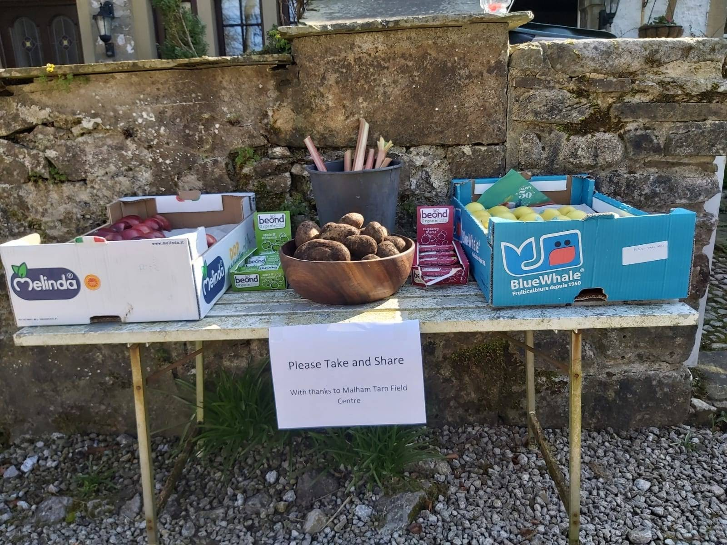
March
Residents start seriously discussing forthcoming coronavirus epidemic, sense of impending crisis as effects seen in Europe; at Malham Safari meeting in Listers Arms hotel people realise the Malham Safari will probably be cancelled.
Start of full lockdown at the end of March. Malham village became extremely quiet with almost no visitors. Police start patrols and issue warning signs to fix to footpath gates. All shops, pubs, accommodation, school and National Park Information Centre close immediately.
Near end of March the MCR ‘Malhamdale Covid19 Response’ WhatsApp social network group was set up for residents to share information, ideas, help with shopping, deliveries, prescriptions etc. to help reduce the need for people to leave their homes. Also weekly evening Zoom video-conferencing meetings for discussion; with briefings from Yorkshire Dales National Park officer, Craven Council, Malhamdale Emergency Plan rep, N.Yorks County Council, National Health Service consultant, Parish Council and other residents. Numerous elderly/ infirm residents started full shielding procedures, not leaving their houses/gardens at all.
‘Clap for Carers’ takes place every Thursday evening at 8pm with clapping and other noise heard throughout the village. Residents start sharing and exchanging produce to avoid going shopping.

Slide 5
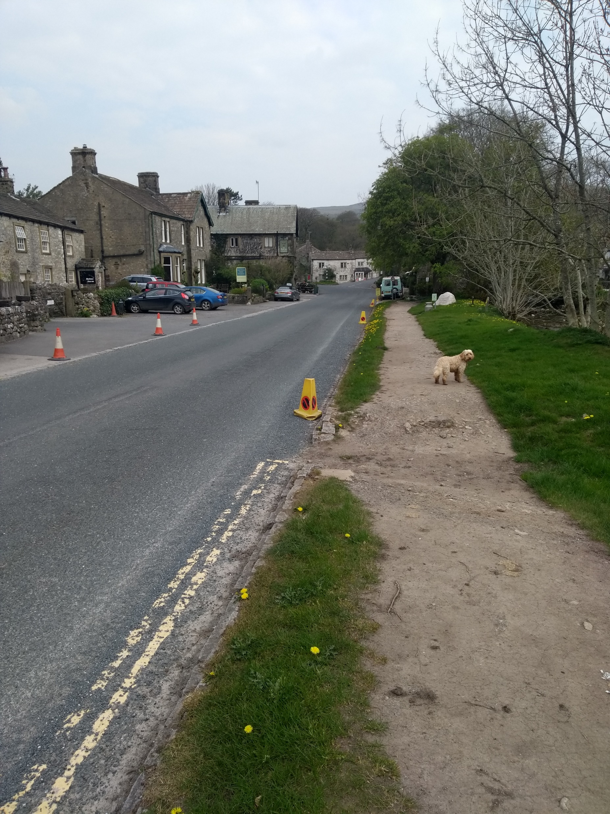
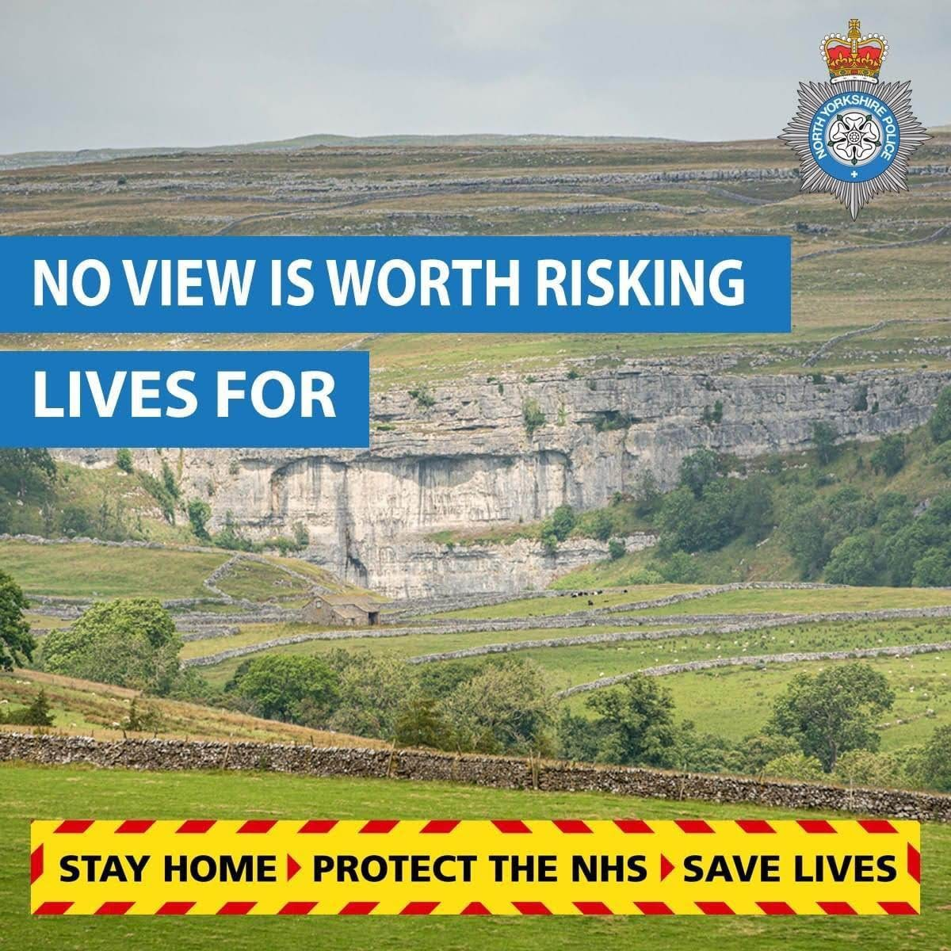
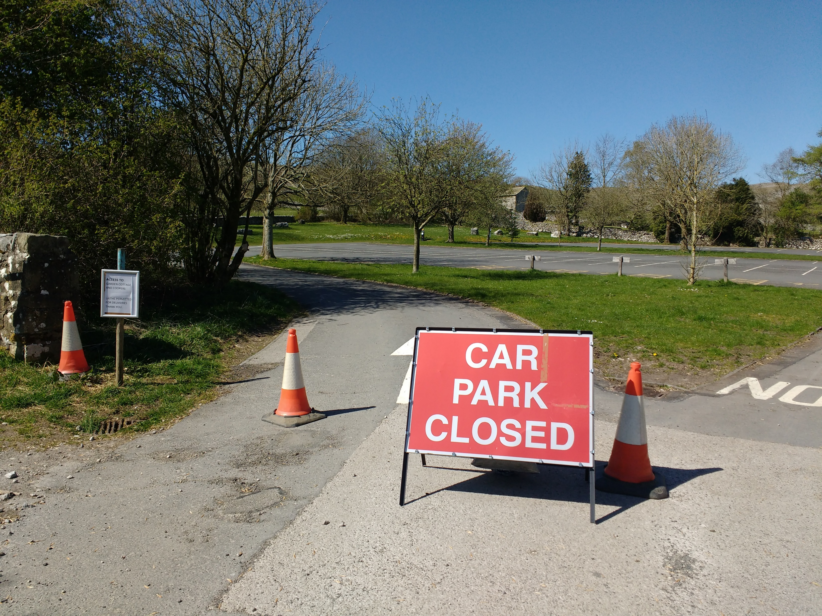
April
Full lockdown of the village, police making daily visits to turn away visitors but also the community discovered we had an ongoing drug trafficking problem with dealers using Gordale as an exchange point. Malhamdale Watch WhatsApp group starts operations with community constables and other Craven District groups to monitor suspicious activity in the area which could be criminal.
Community groups such as Malham Women's’ Institute and Malhamdale Local History Group start to use online social network apps and Zoom for video-conferencing.
Gordale Lane closed to visitor traffic.
Some village residents start to work entirely at home working online instead of commuting long distances.
Weather is wonderful, warm, sunny and beautifully clear skies – no aircraft vapour trails; incredibly quiet throughout the village.

Slide 6
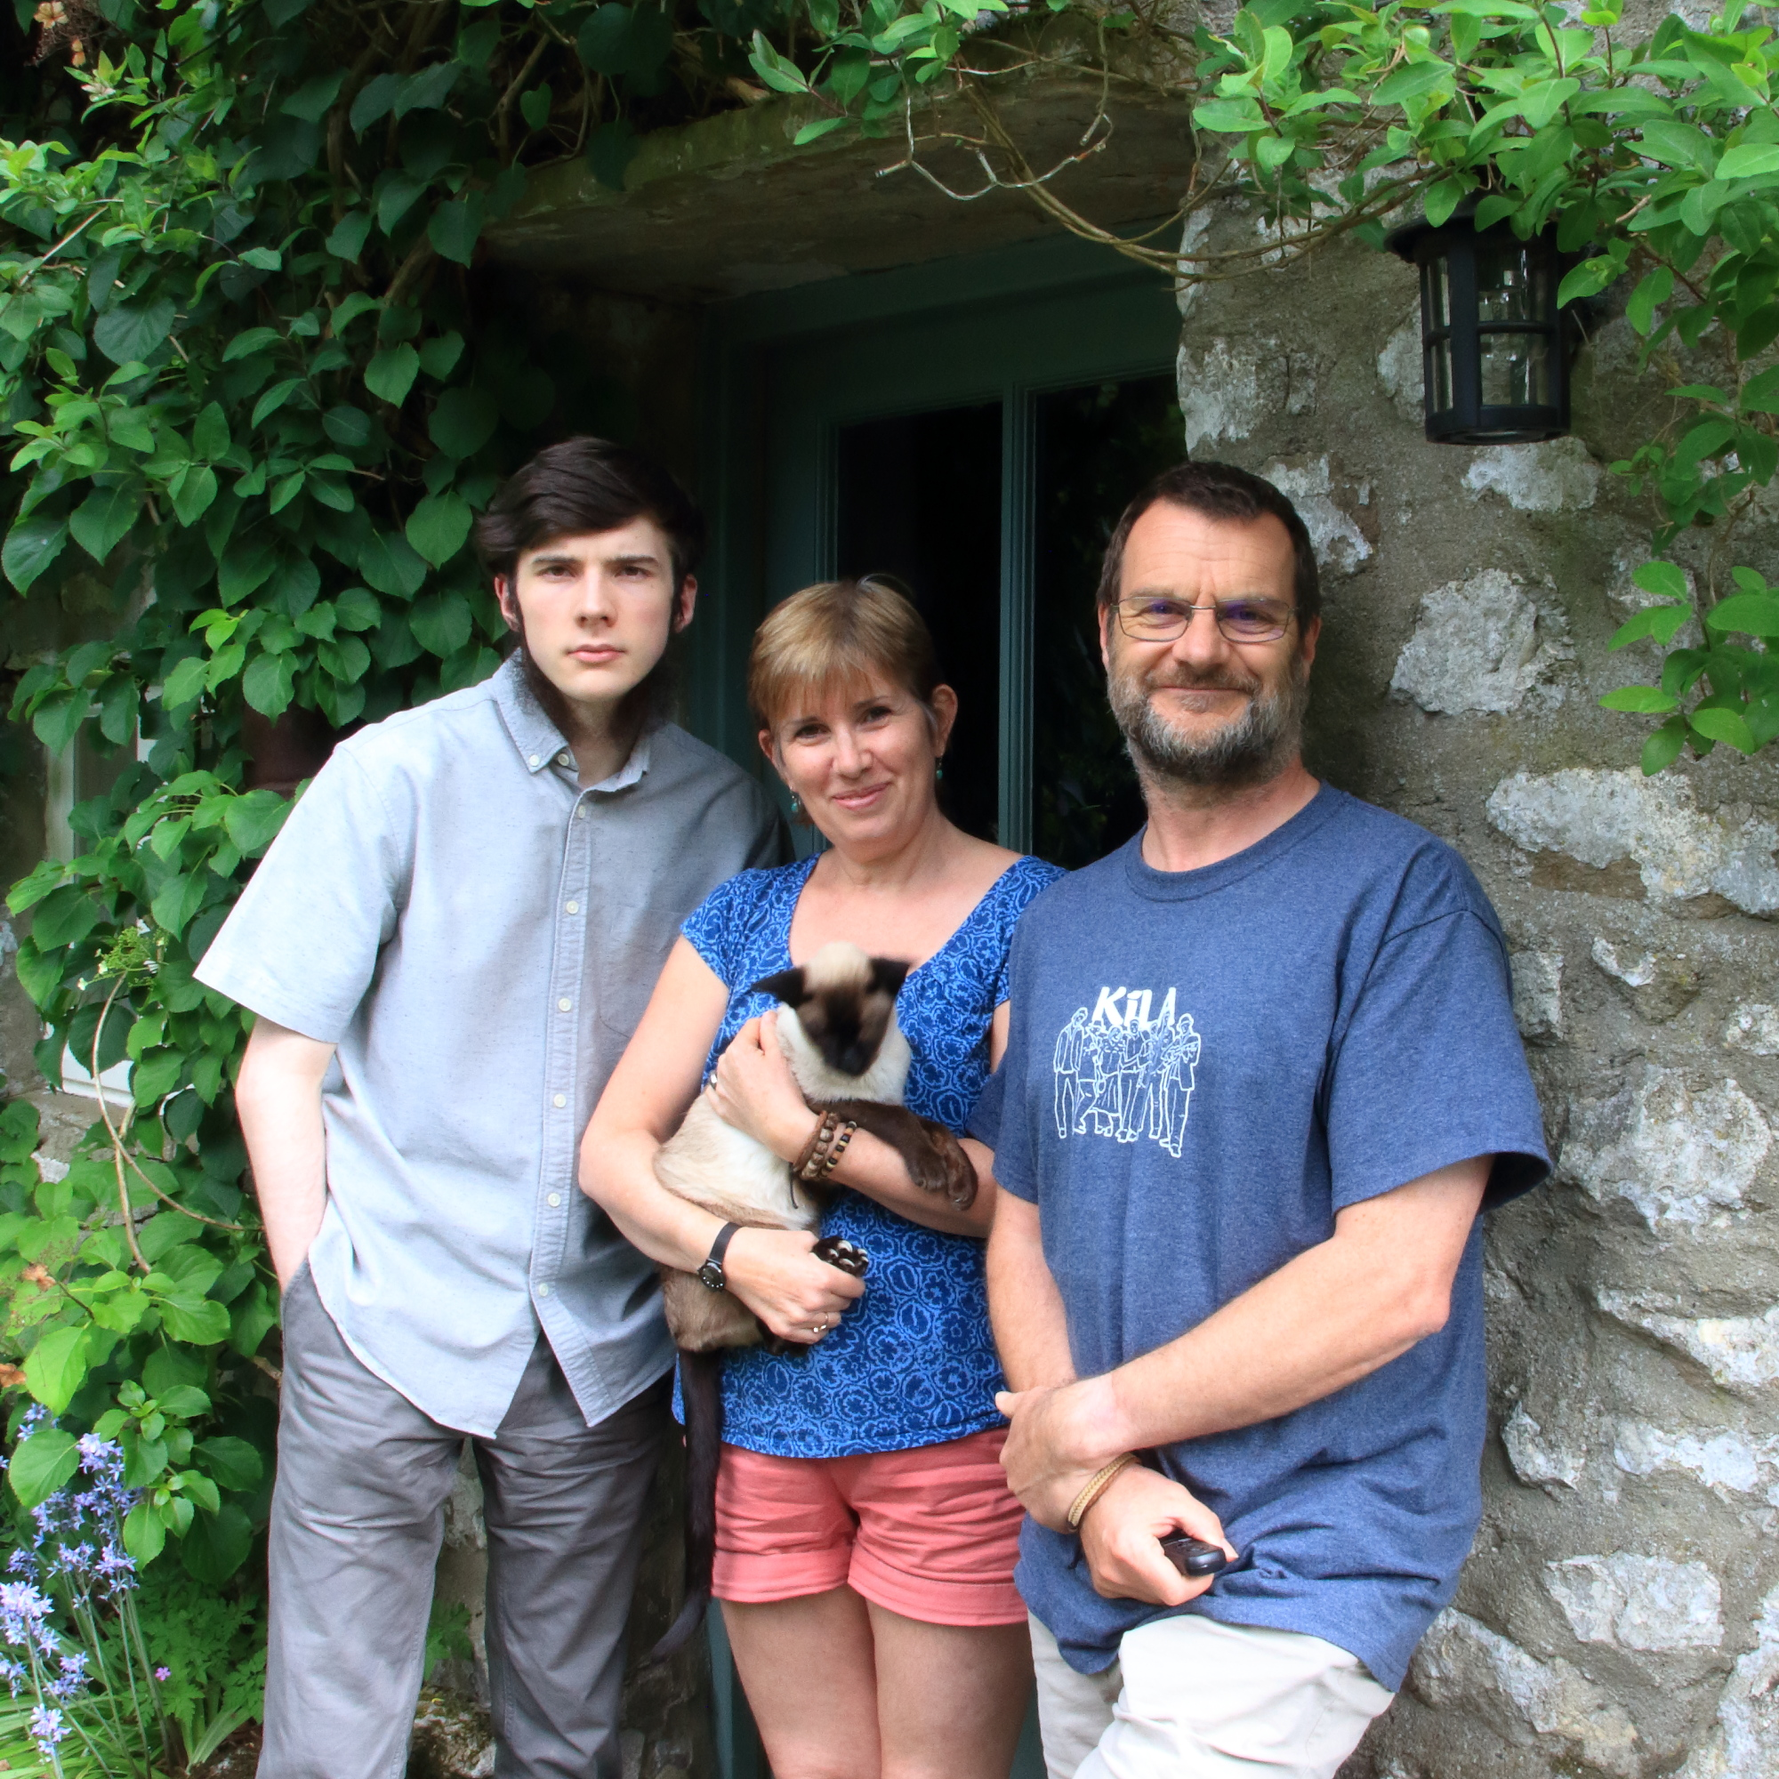
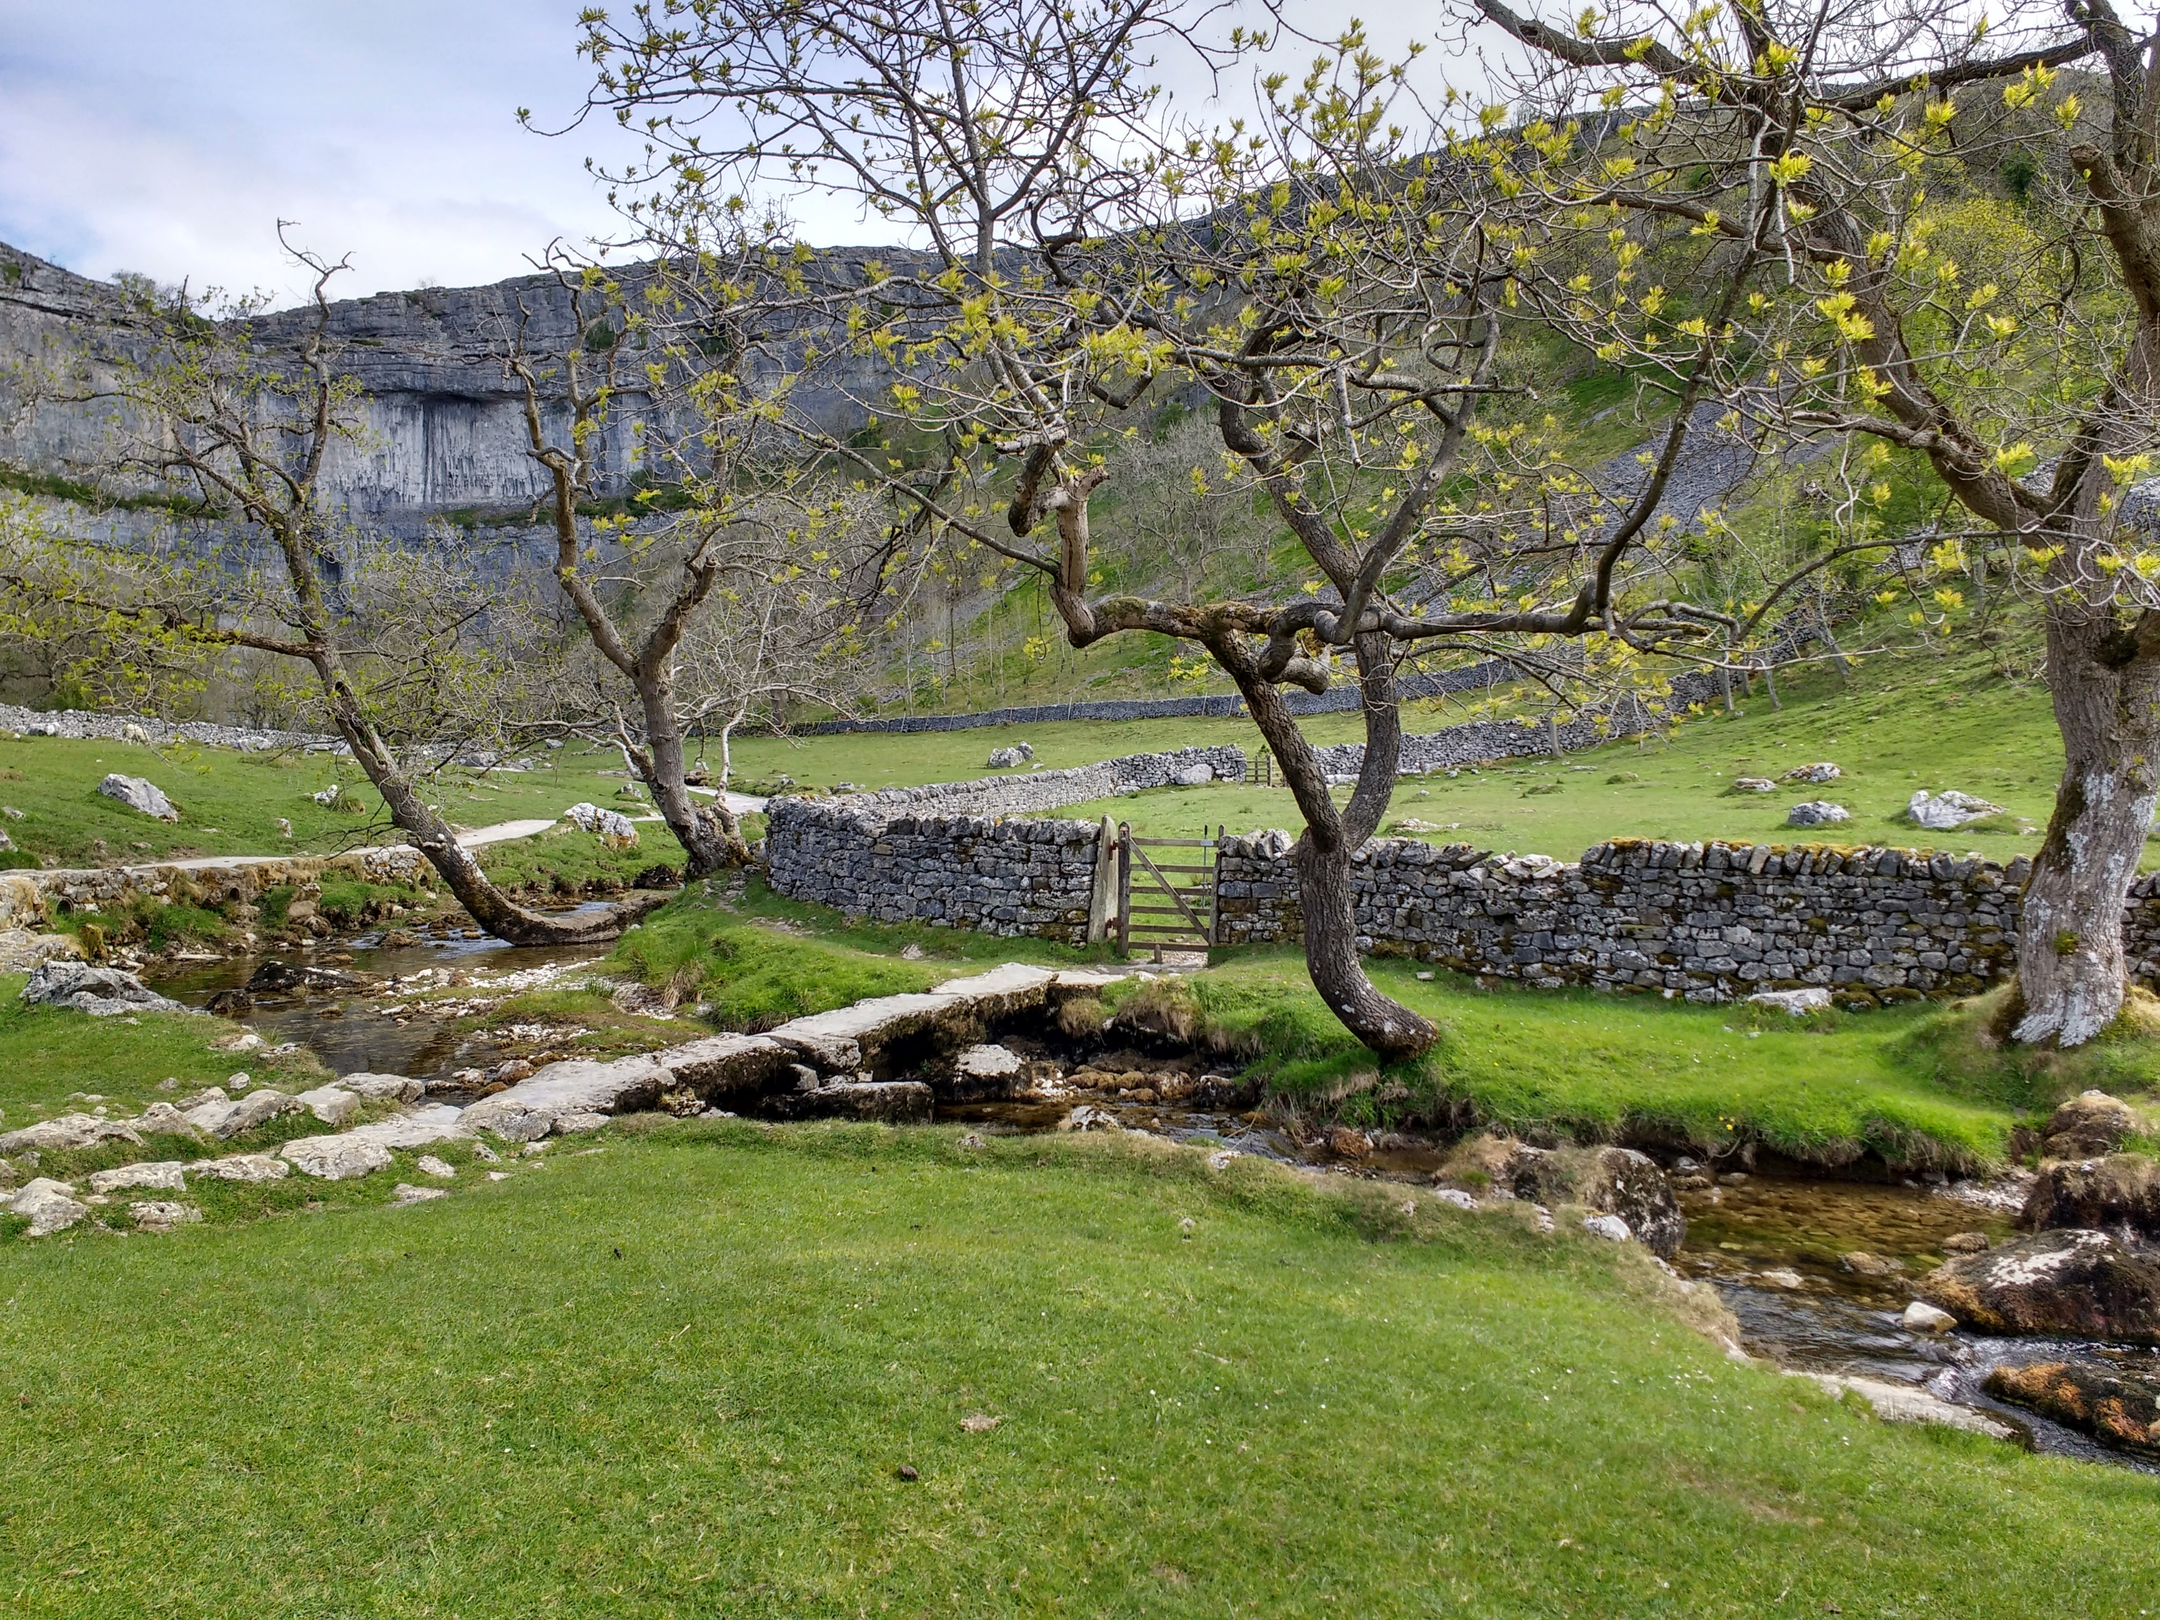
May
Continuing very dry, sunny weather; rivers running low.
A severe late frost just as new leaves and fruit blossom arrives - no fruit later in the year!
V.E. day remembrance celebrated in gardens throughout the village.
Late May lockdown eased, visitors start to arrive in huge numbers.
On-the-doorstep project recorded photos of Malham residents standing on their front doorsteps in family groups as a record of lockdown isolation.
Gordale Lane closed to visitors at junction with Tarn Rd at top of Finkle St. Signs placed by North Yorkshire Highways after police institute a Traffic Order to close Gordale lane for tourists and stop parking within the village.

Slide 7
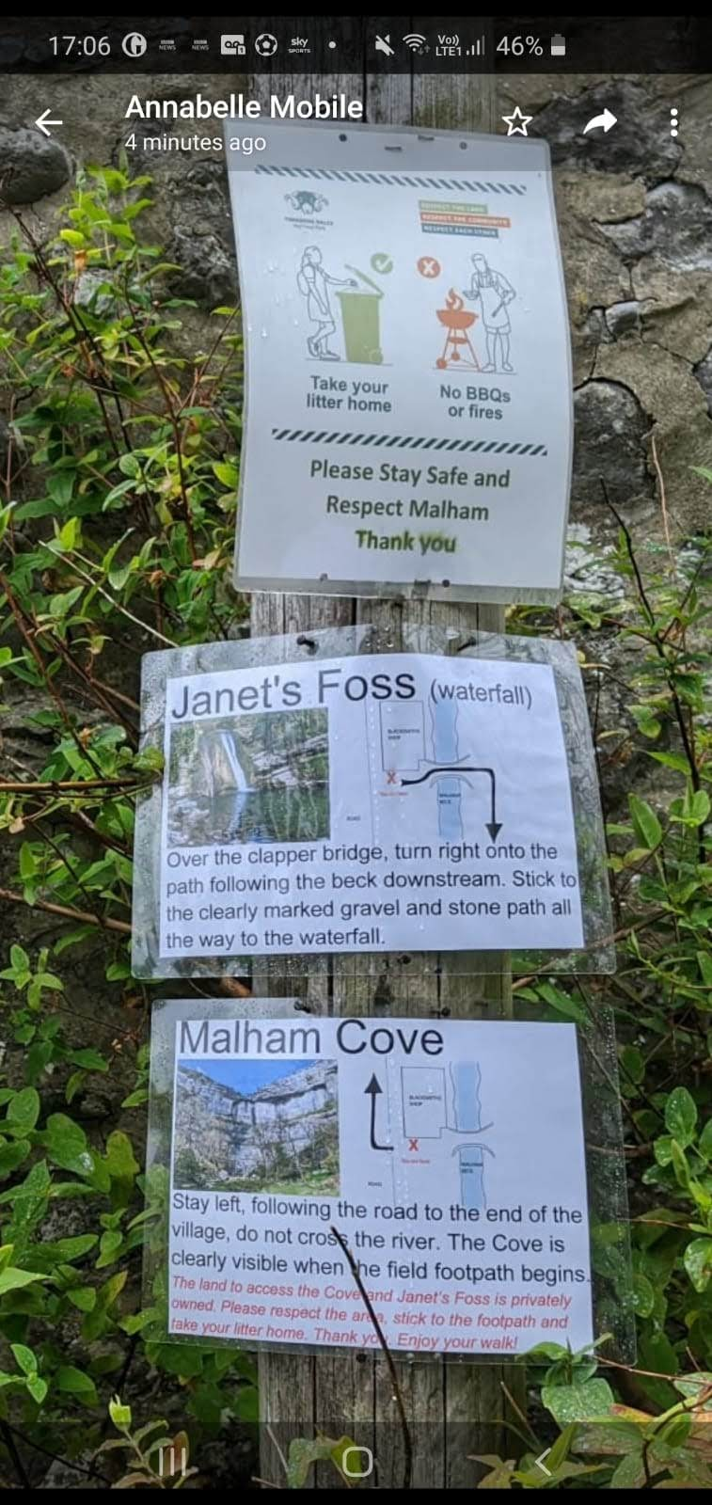
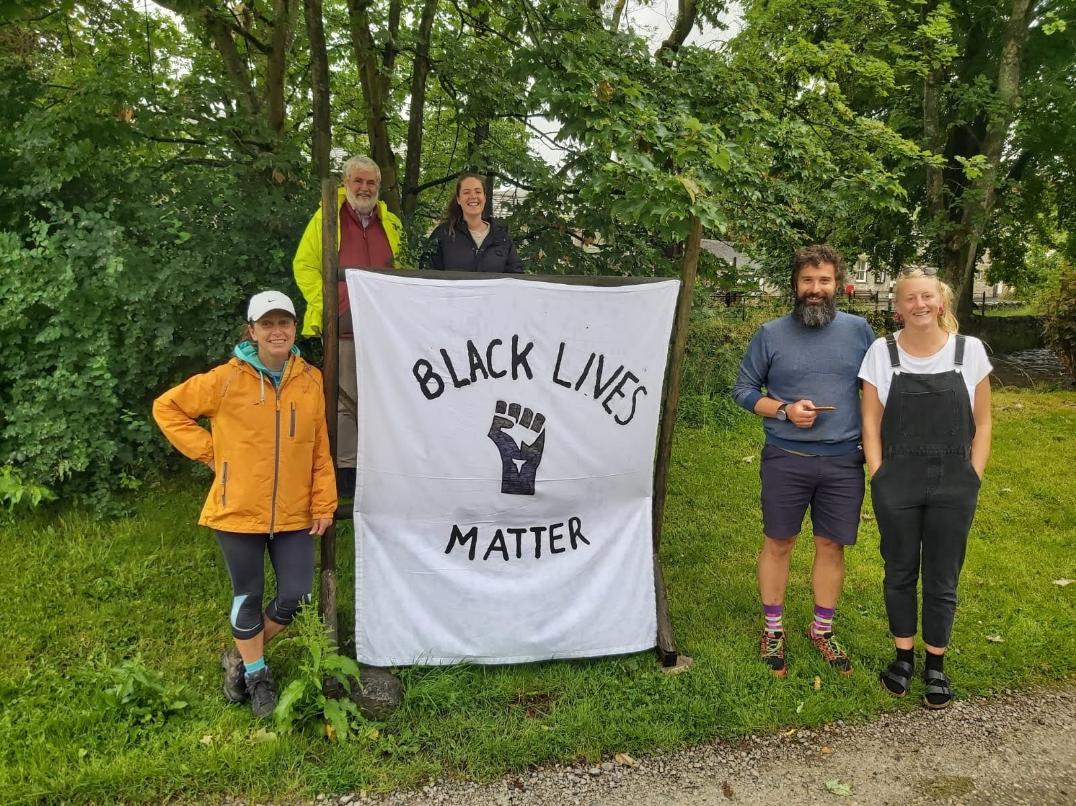
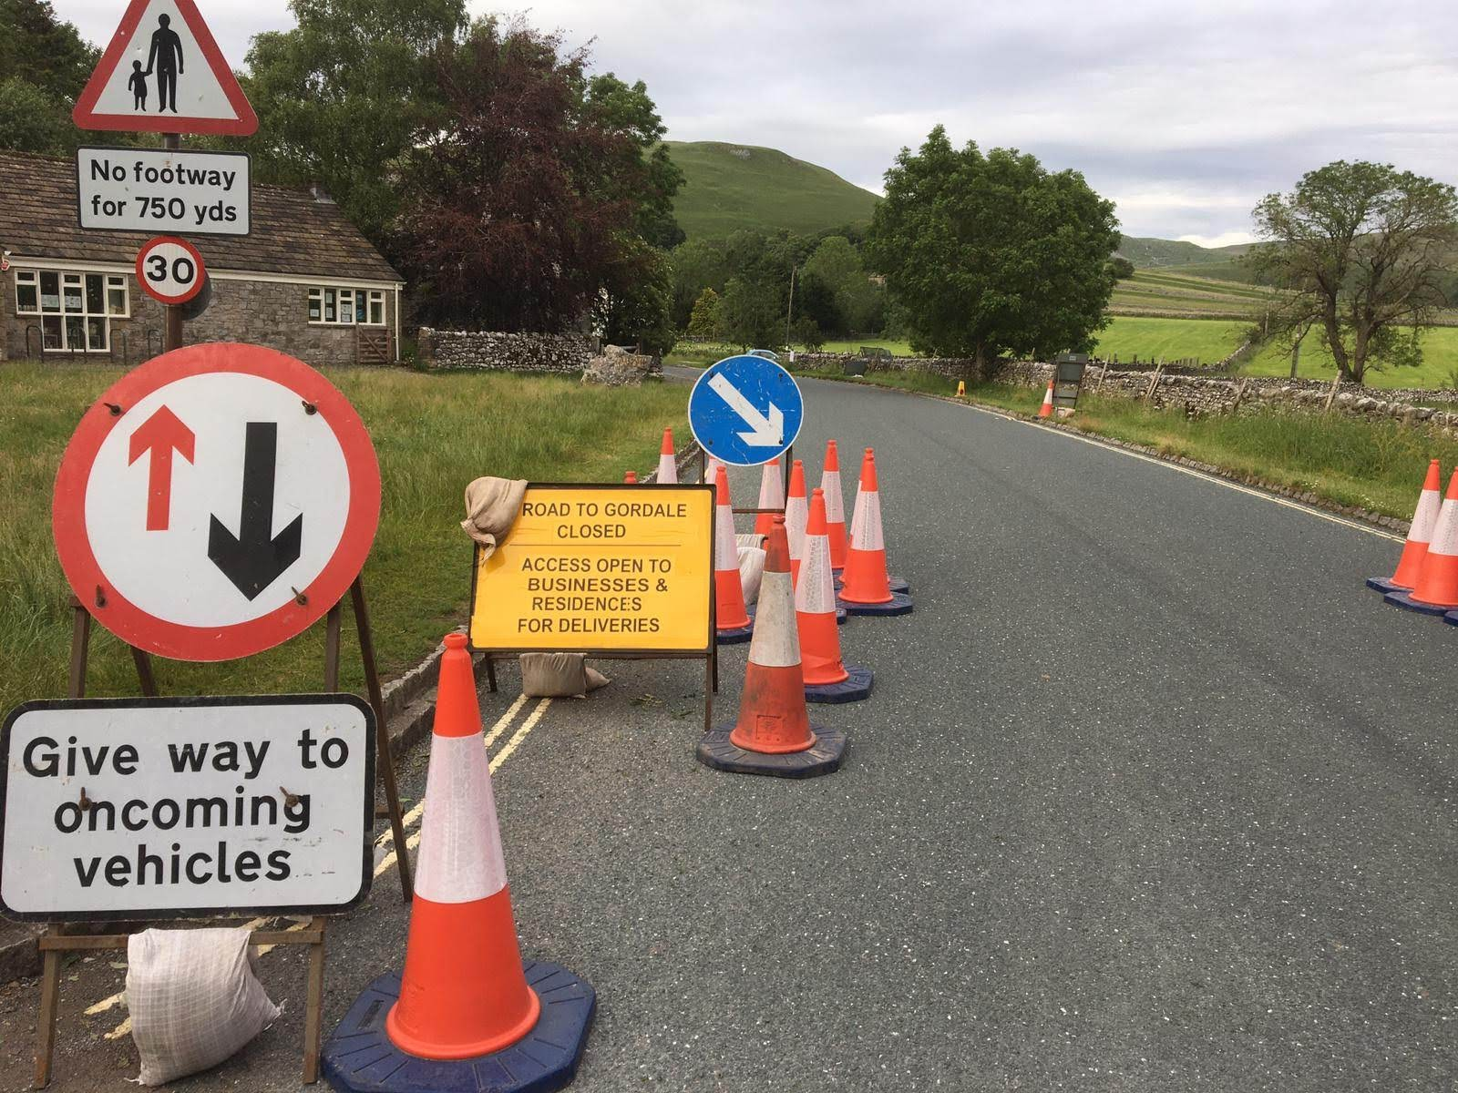
June
Social distancing traffic management to allow visitors to safely walk in the road properly spaced and for queuing for Old Barn Café take-away hatch blocking pavement.
Black Lives Matter campaign reached Malham as also a much higher proportion than usual of ethnic minority visitors came to walk and enjoy the countryside, many for the first time – Janet’s Foss extremely popular even in the evenings. Significant problems with litter as so many picnics and barbeques.
New slabs put on path between smithy and ford opposite chapel. ‘Dales Maker’ volunteers give maps and information to the hordes of visitors as the National Park Information Centre remains closed. Gordale Lane closed to visitor traffic.
Local farmer Neil Heseltine become chair of Yorkshire Dales National Park Authority.

Slide 8
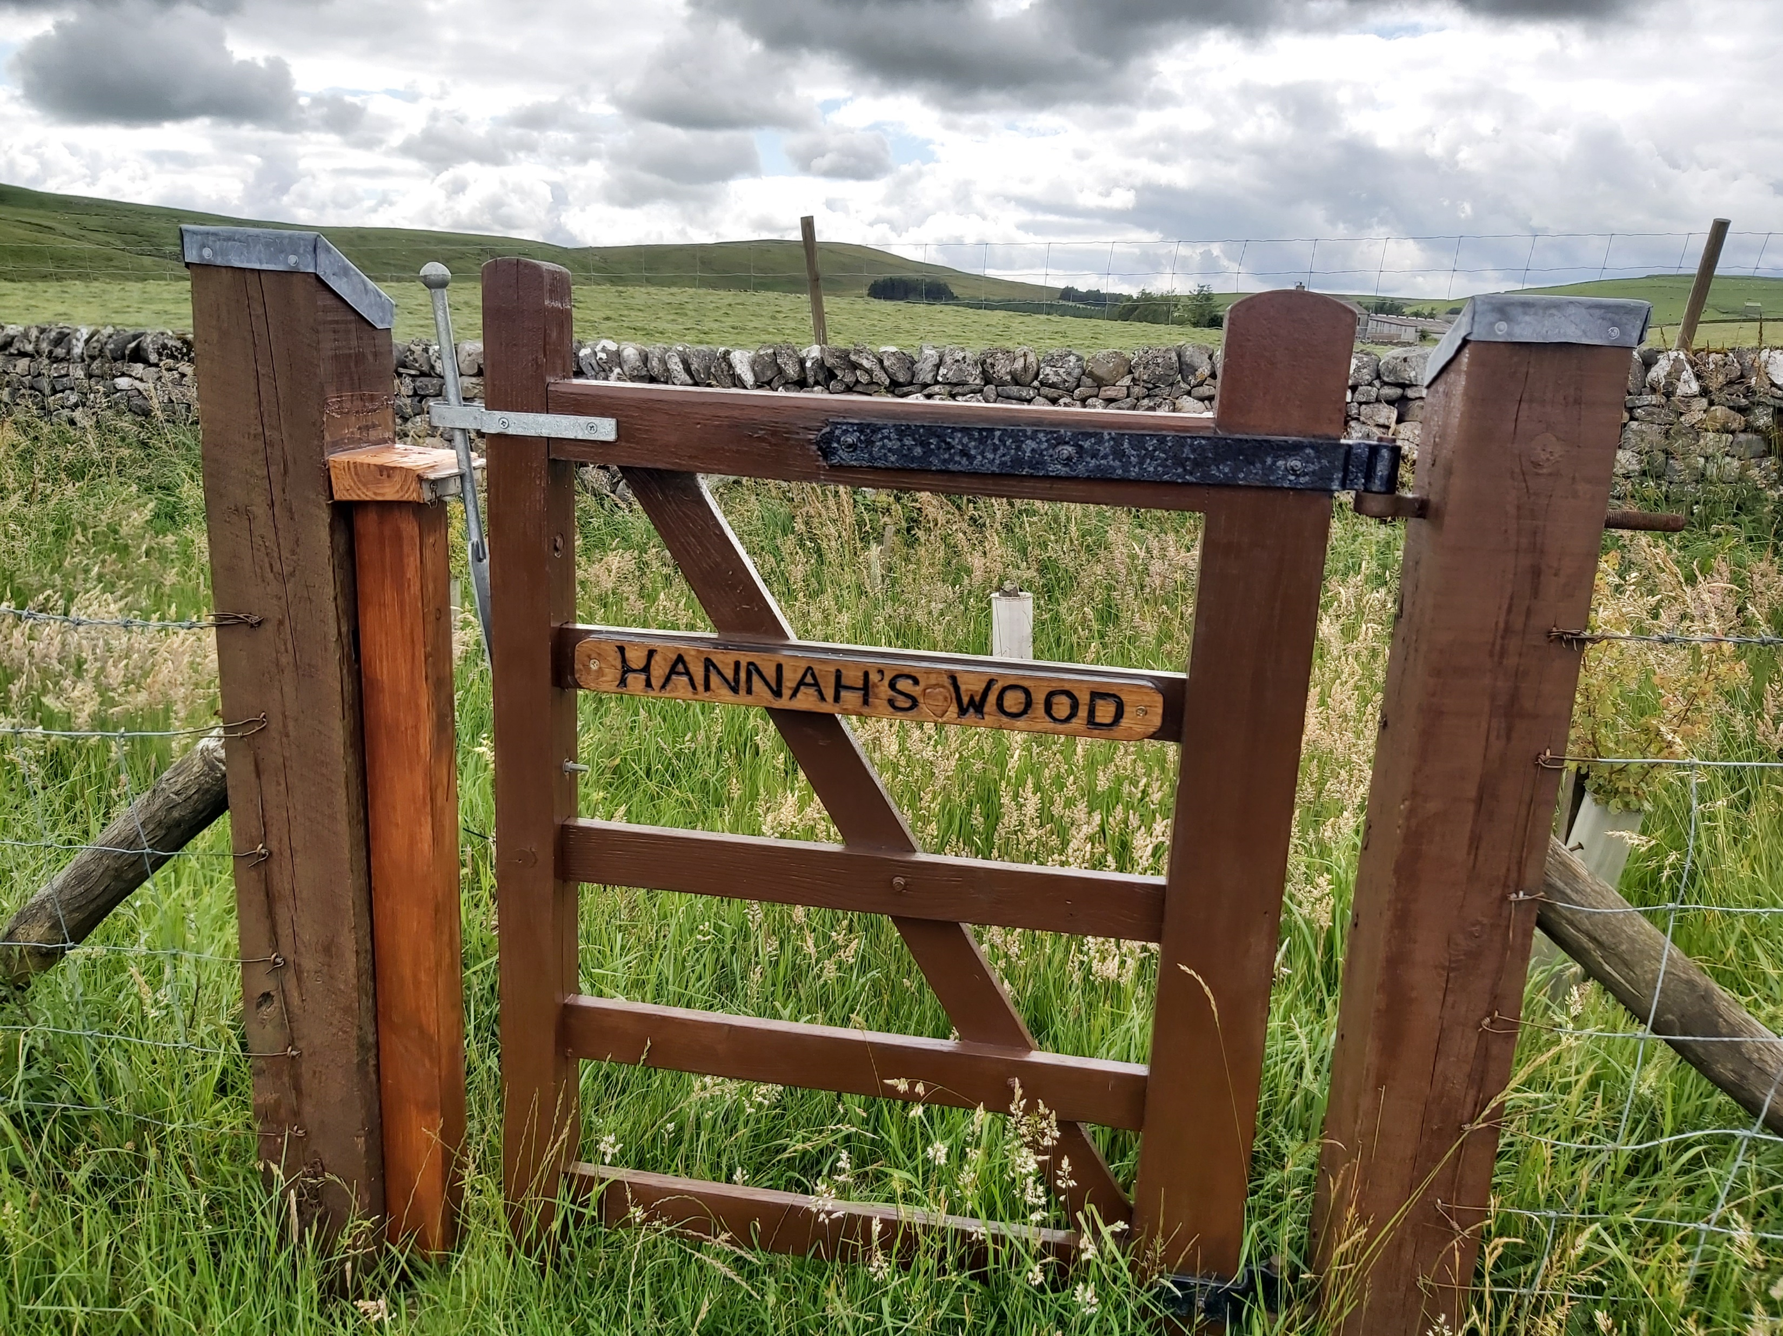
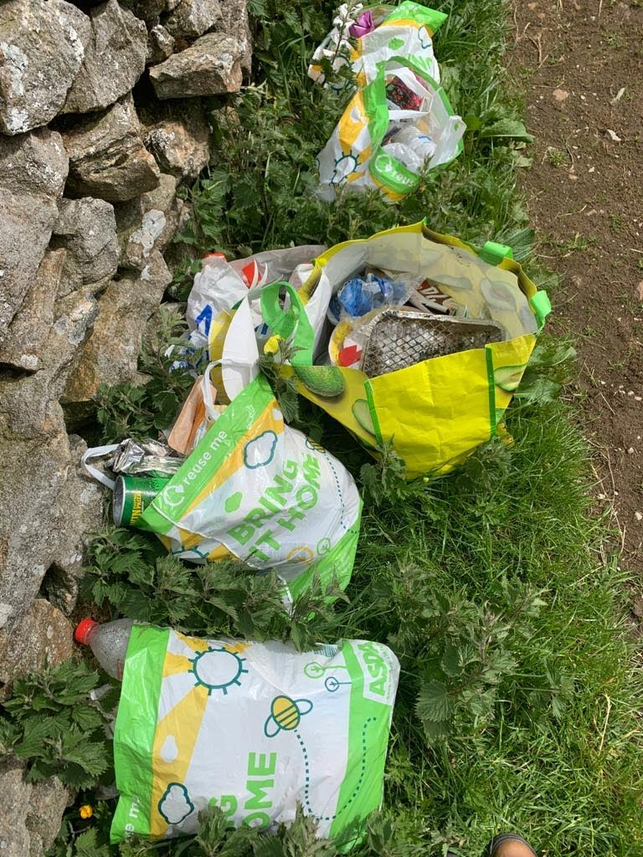
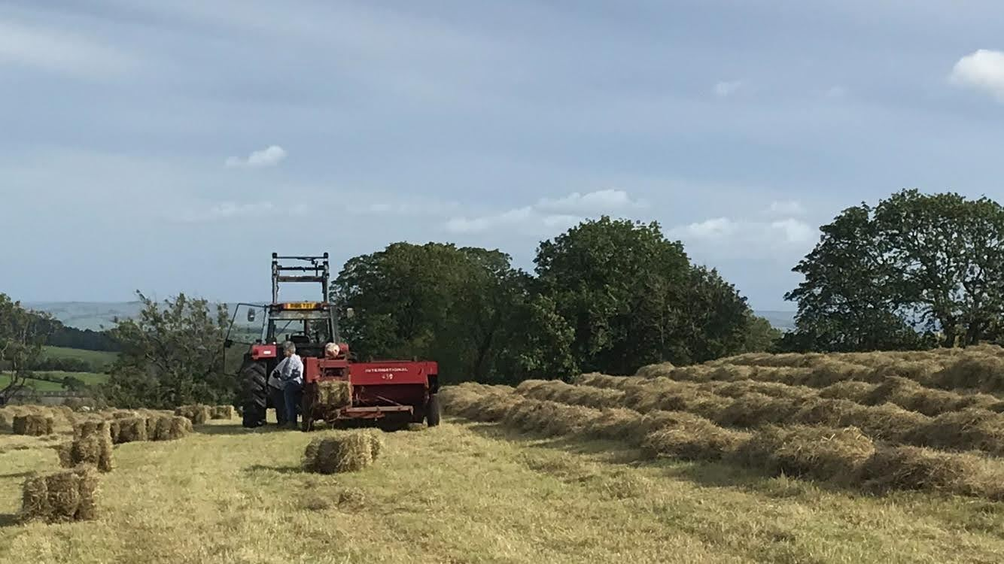
July
A cloudy, cool month, disappointing after a beautiful spring.
Lockdown fully eased with plenty of day-visitors and holiday makers in village accommodation. Litter problems continue and social distancing on narrow footpaths becomes difficult.
Remembrance woodland created in memory of Hannah Pickles who worked at Malham Tarn Field Studies Centre.
Village primary school is re-opened for the last few weeks of term but secondary pupils continue with home learning only, largely online.
Hay-making on Heseltines’ farm

Slide 9
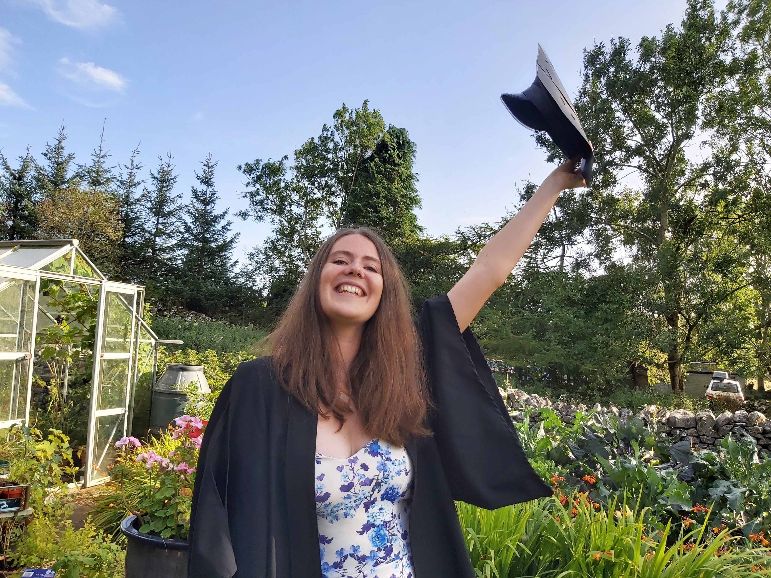
August
Malham Show does not take place! Still large numbers of day visitors and many residential.
Pubs and hotels in the village offer ‘Eat out to help out’ scheme’, half-price meals to eat in, table service only, socially distanced. Lister Arms fully booked.
National Park Information Centre fully open again with support from volunteer Dalesmakers to cope with crowds of visitors.
Graduation and results days cancelled at schools/colleges/universities – some students had their own improvised ceremonies in Malham village.

Slide 10
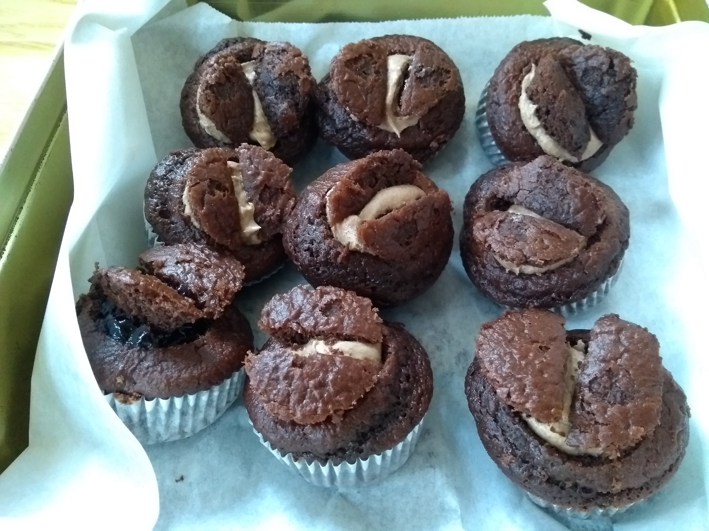
September
School re-opens for the first time in many months.
Malham Womens Institute members bake 90 buns to celebrate Malham WI 90th anniversary. Buns donated to Airedale hospital Accident and Emergency department.
Cawden Barn at the top of Finkle Street gets approval at a YDNP Planning meeting on Zoom, for conversion to a take-away food outlet. This was the first approval after numerous planning applications for conversion to residential use were rejected. A number of village residents observed the meeting live on Zoom.

Slide 11
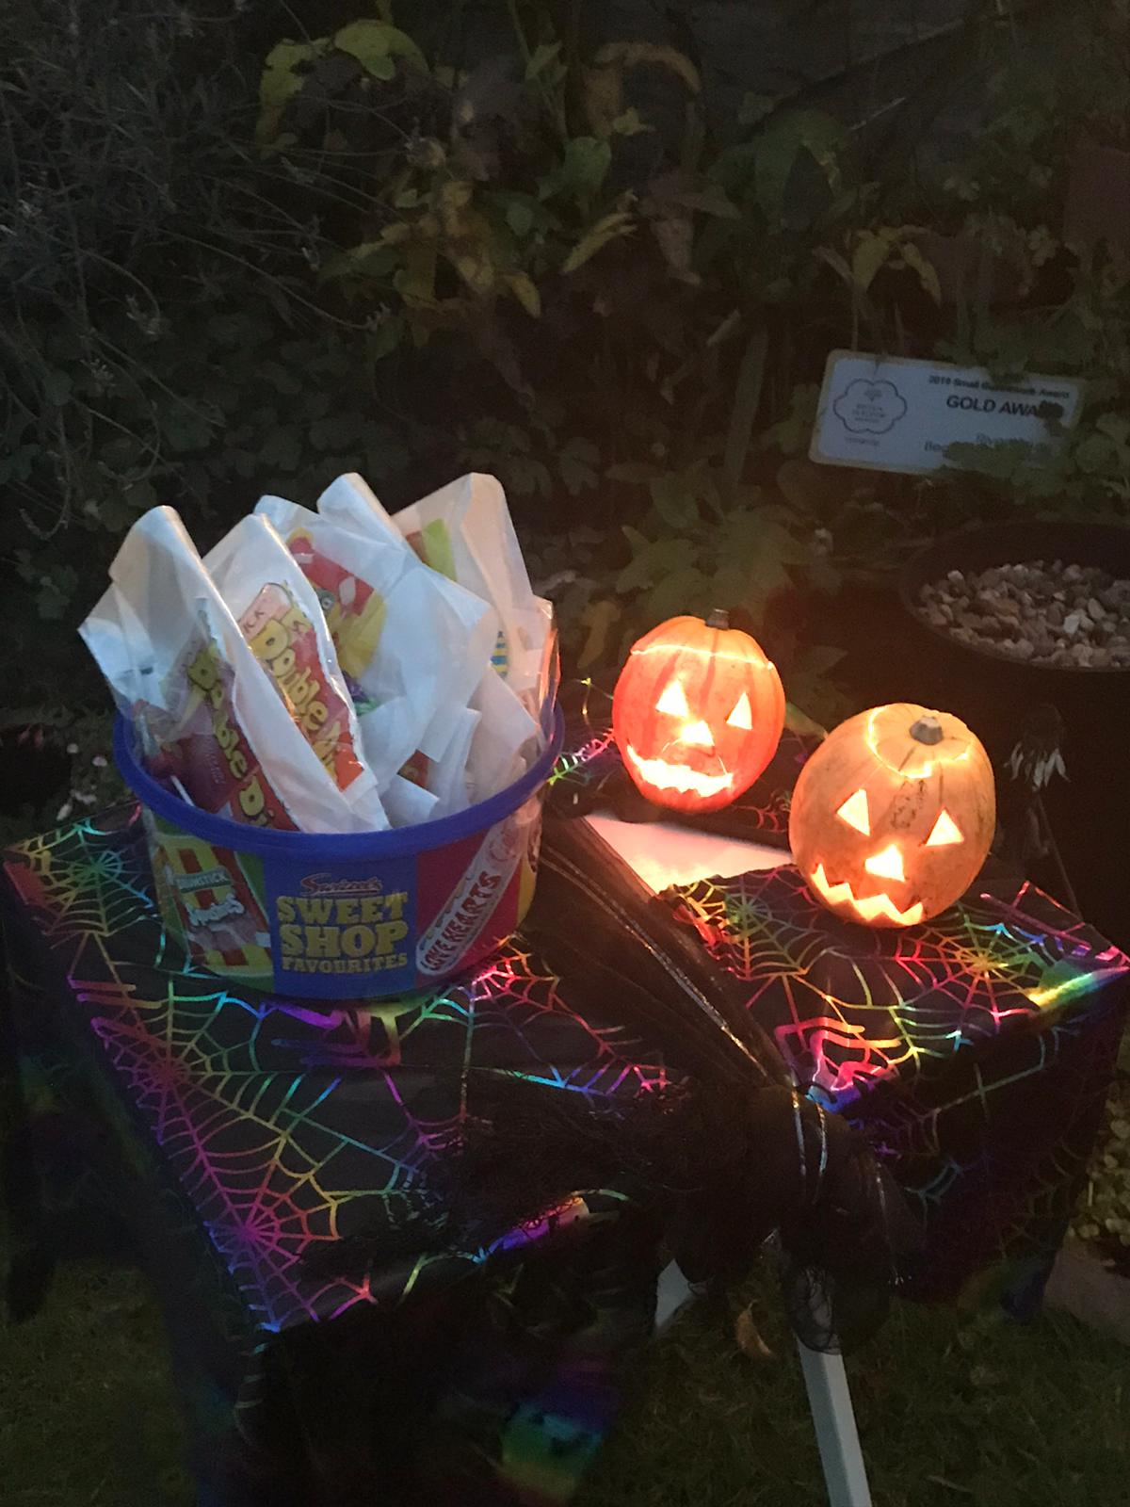
October
Huge film crew set up camp on show field and in Gordale to film for ‘The Witcher’ , a Netflix production
Halloween adapted for social distancing – villagers put out carved pumpkins with sweets in front of houses rather than any children knocking on doors.

Slide 12
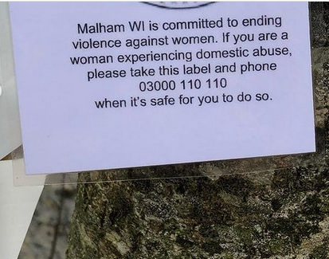
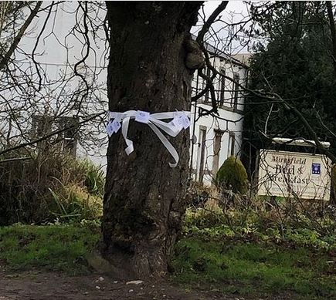
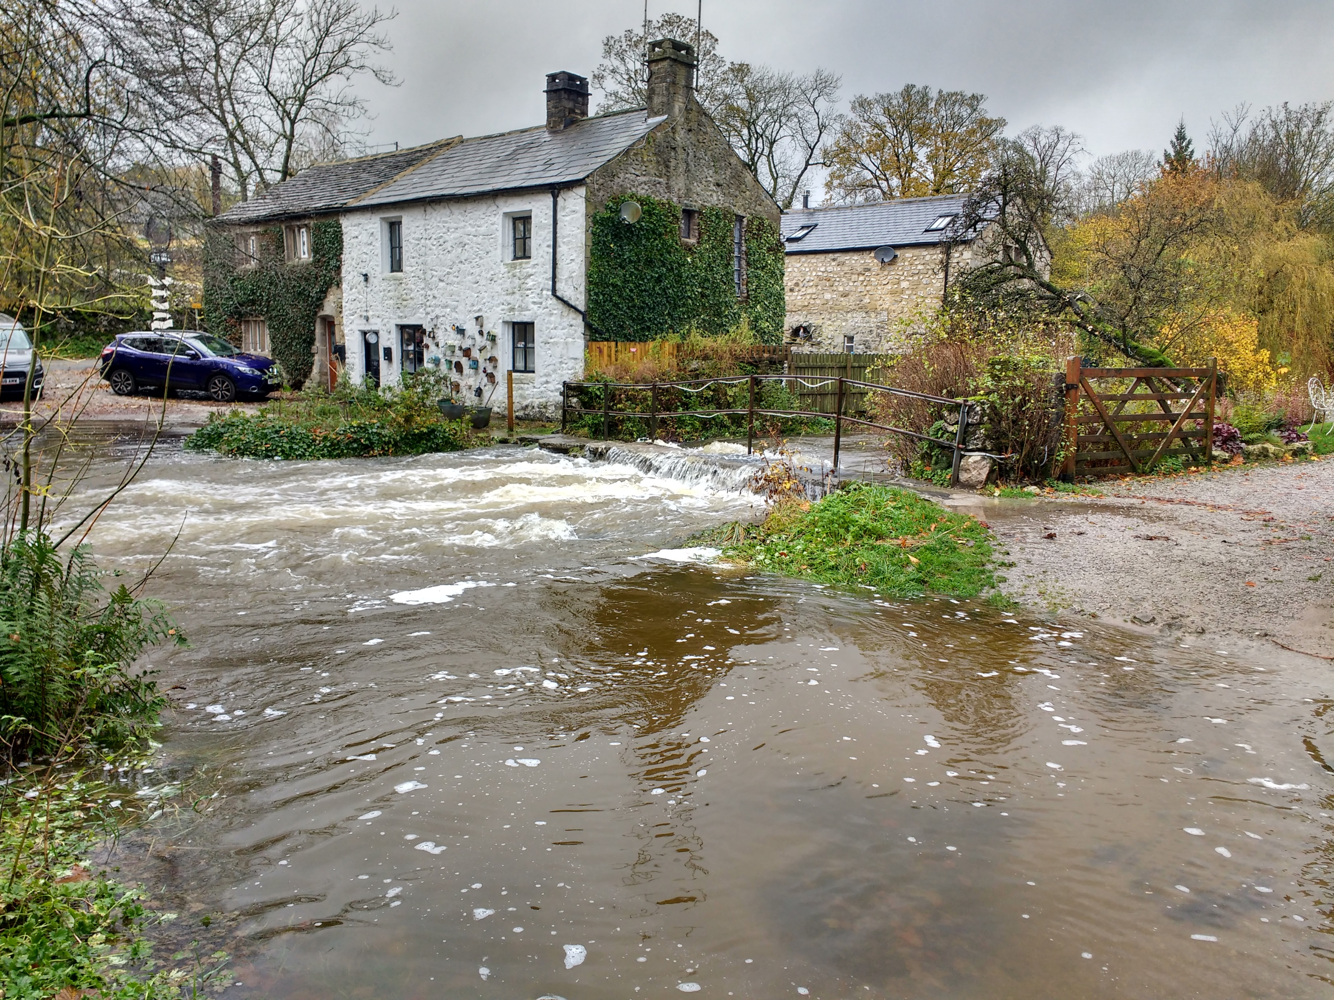
November
Severe rain again, Cawden hill bursts open for second time this year.
Second lockdown instituted, village accommodation closes but still plenty of day visitors from cities far afield, many residents remain angry about spread of coronavirus as case numbers increase rapidly.
No bonfire night parties on November 5th, just private family groups.
Malham WI support white ribbon day to support action to end violence to women.

Slide 13
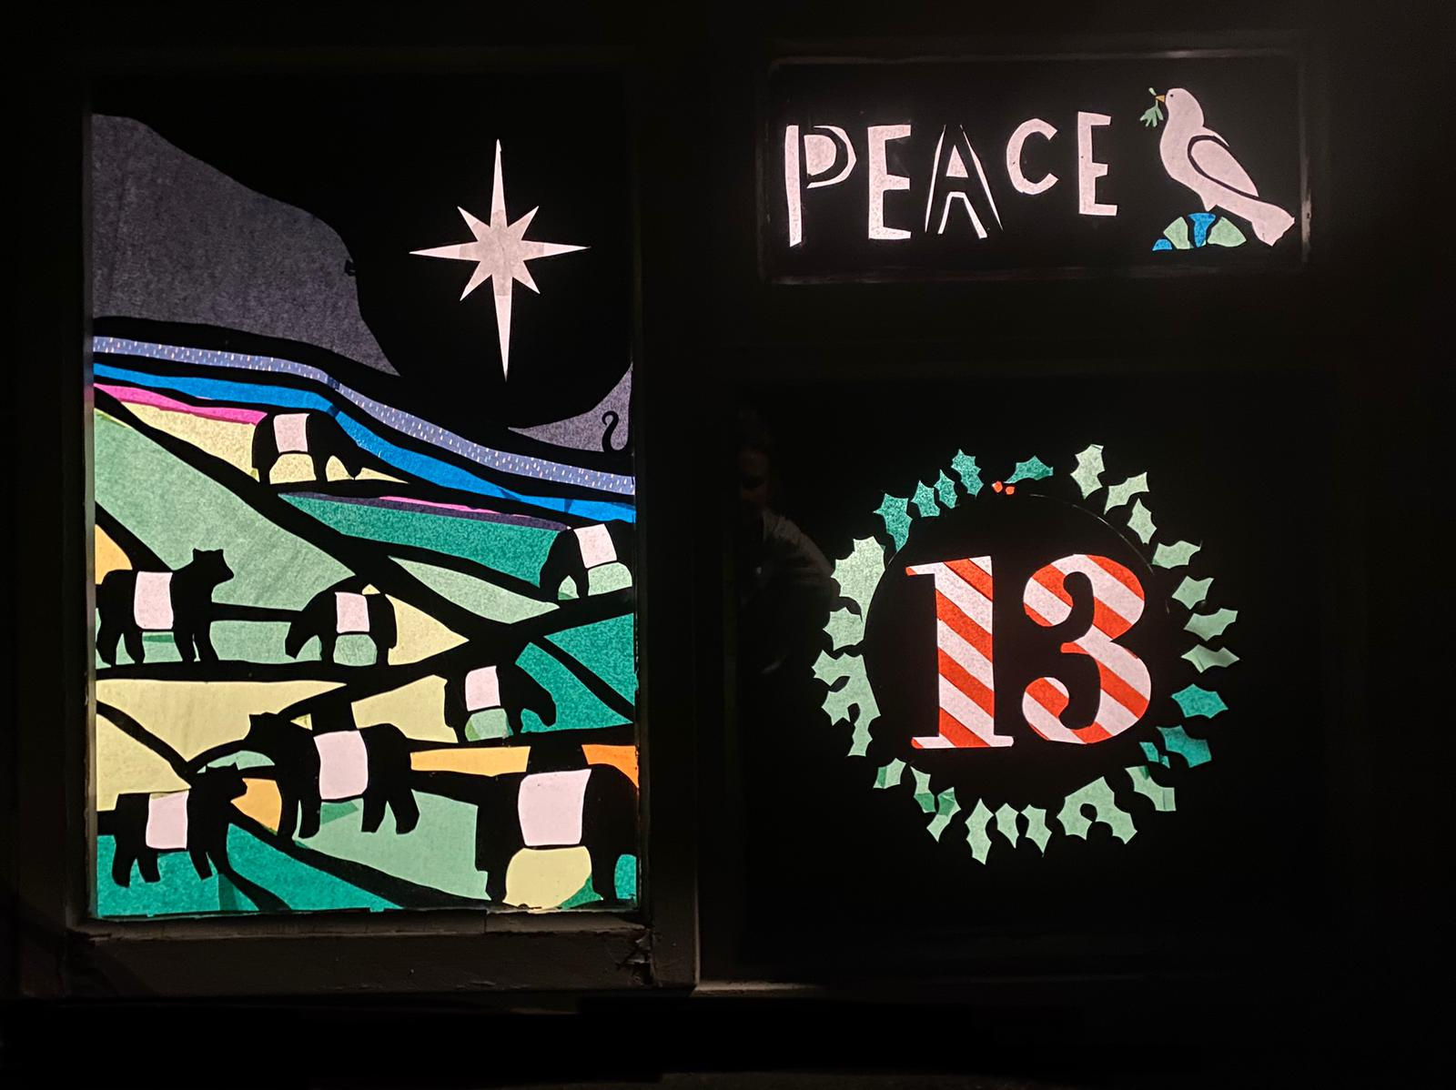
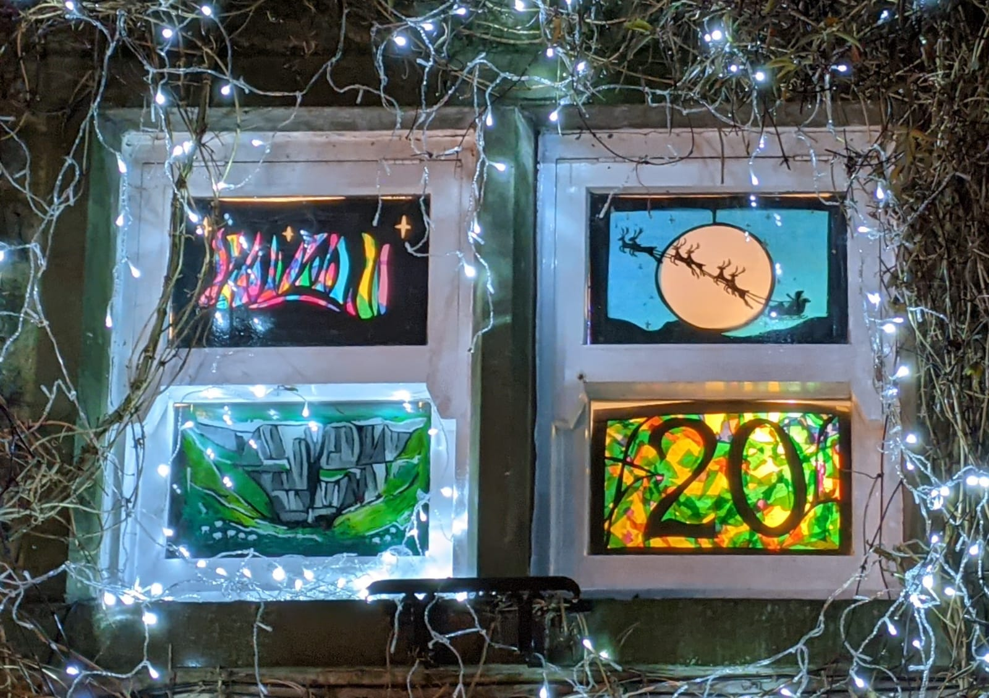
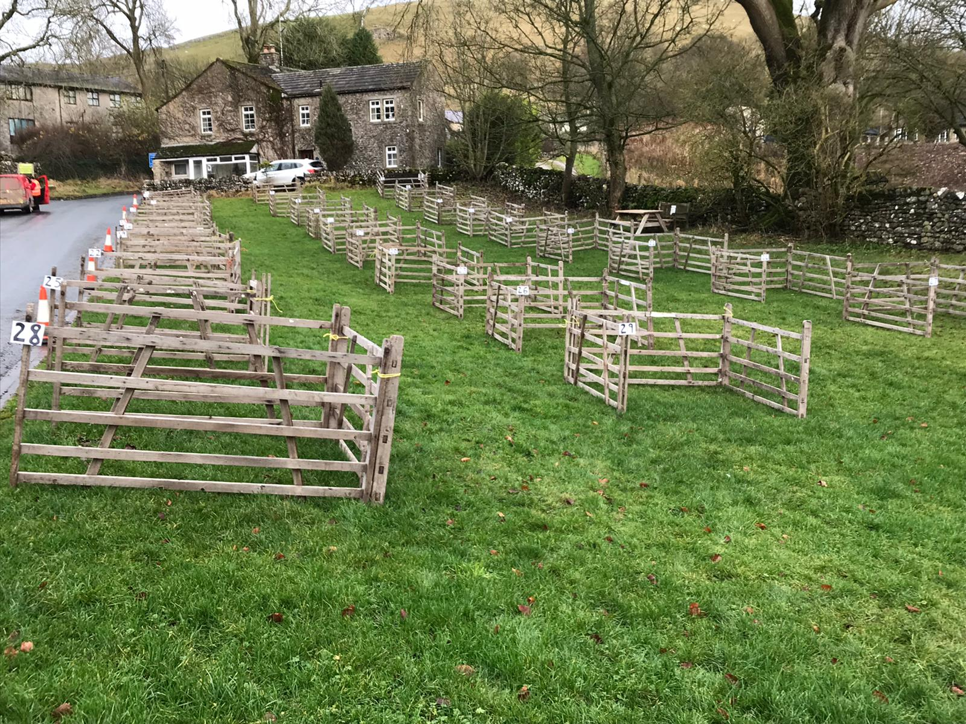
December
Advent windows created in resident’s front windows. Tier 2 allowed all pubs/hotels etc to stay open until just before Christmas. Christmas quiz evening on MCR Zoom, very popular.
Carol singing on The Green instead of in pubs, each family in a sheep pen two metres apart, Listers Arms doing takeout drinks and nibbles.
Lantern making workshop on Zoom vey popular just before Christmas. Many residents put up Christmas lights and decorations earlier than usual with a communal switch-on and walk around the village 6/12/20.
Christmas eve carol singing took place on a reduced scale. Long period of dry, cold weather sets in at end of month.

