Slide 1
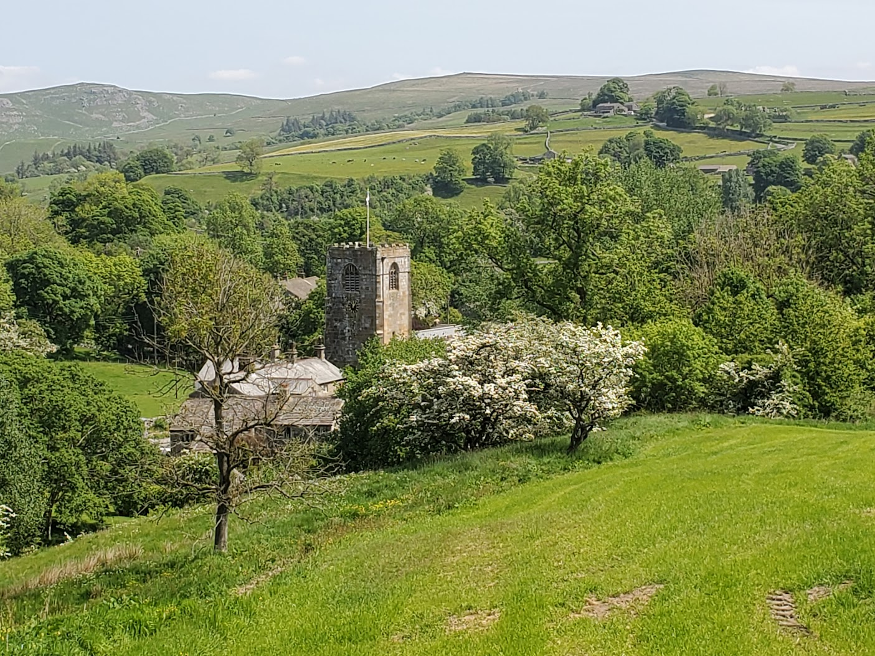
Kirkby Malham Diary
2023

Slide 2

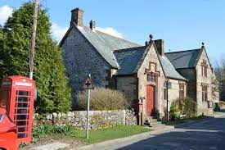
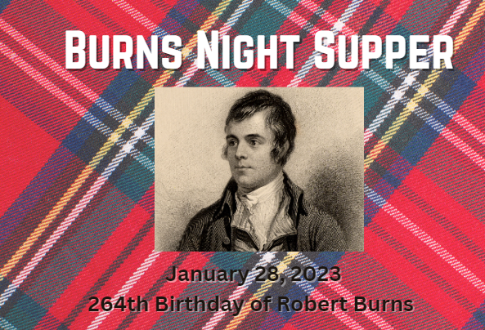
January 2023
The Parish Hall provided entertainment during a wet and windy month.
The first Film Night of the year took place. Those attending enjoyed a pie and peas supper. Drinks were also available from the bar.
A Burns Night Supper was held on 25th January.
A Valentine’s Evening followed in February.

Slide 3
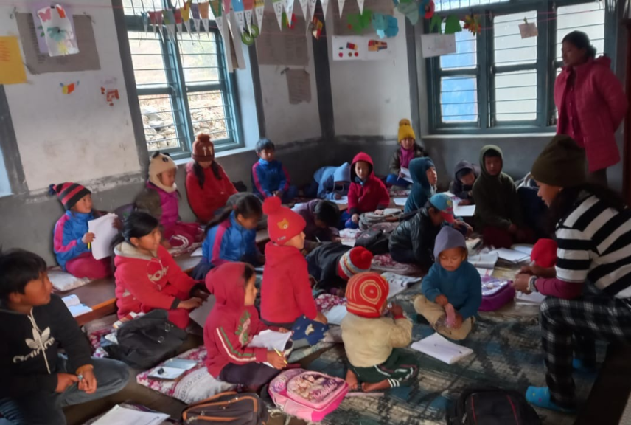
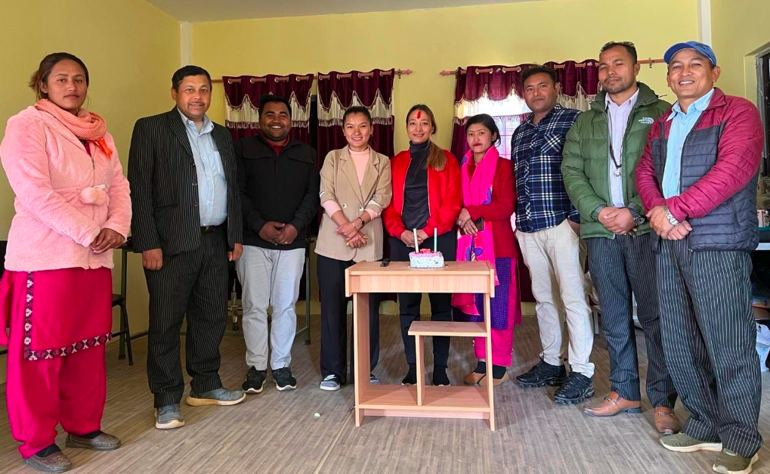
February
The Cameo Club met at The Victoria where Pat and Liz Wherity talked about their work with the Kasin Charity in Nepal. This charity is helping to secure the future of Nepal’s younger generation through the provision of schools and hostels.

Slide 4

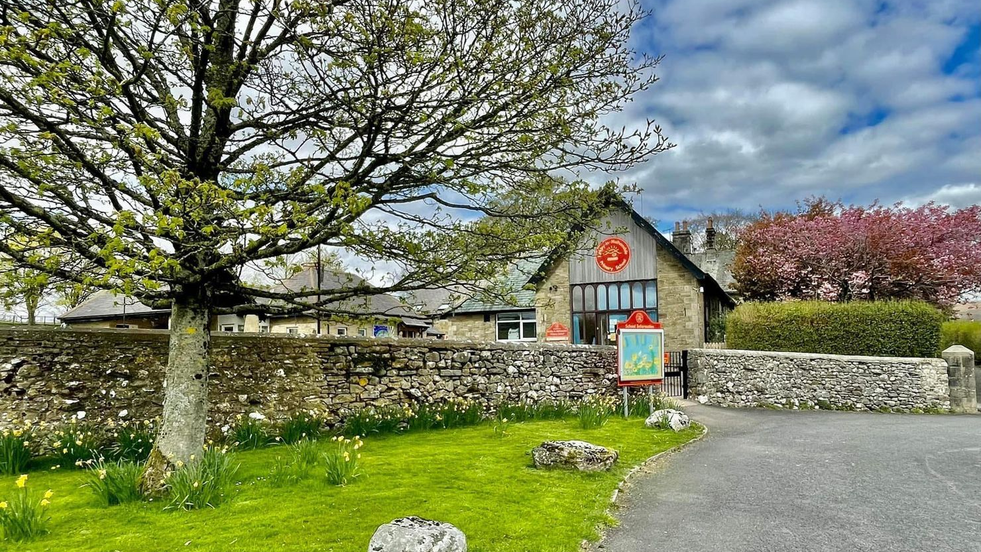
24th February – one year since the invasion of Ukraine.
Our Ukrainian families are very much part of the local community: the mums have found jobs nearby and the children attend local schools. A committee continues to organise support and social activities.

Slide 5
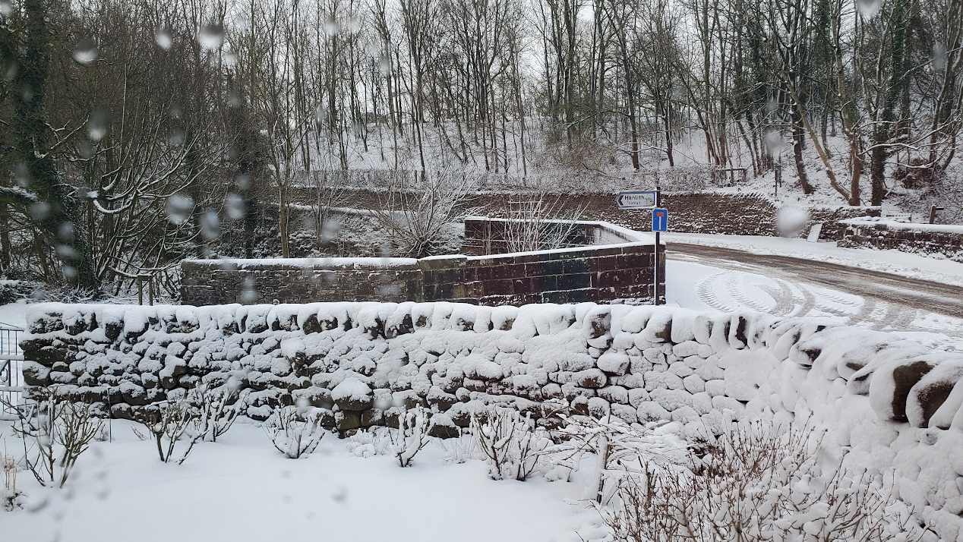
After a mild Winter March brought some Spring snow.

Slide 6
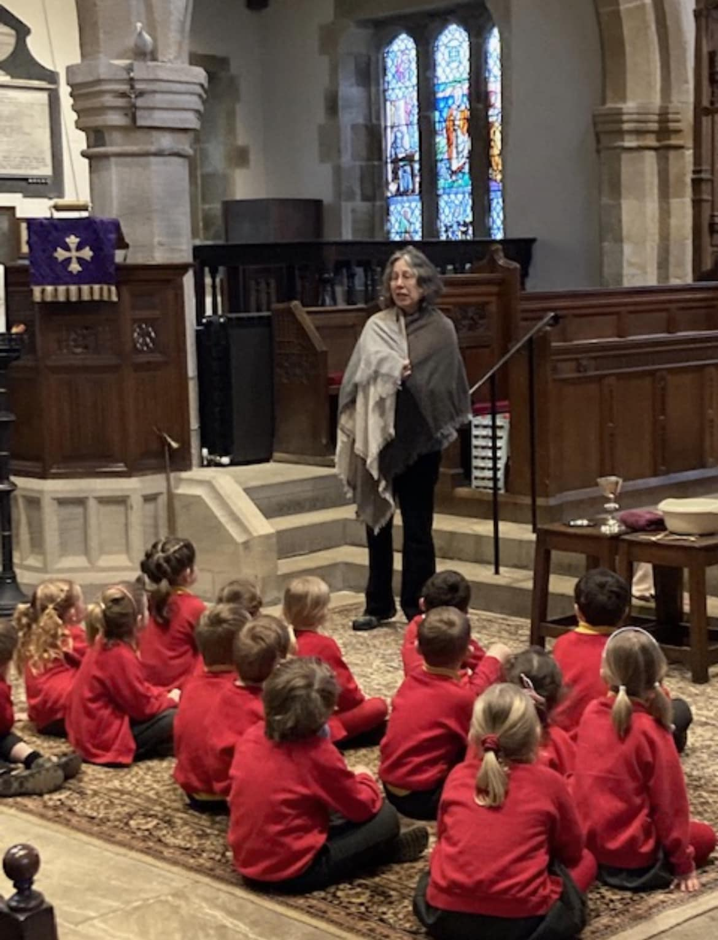
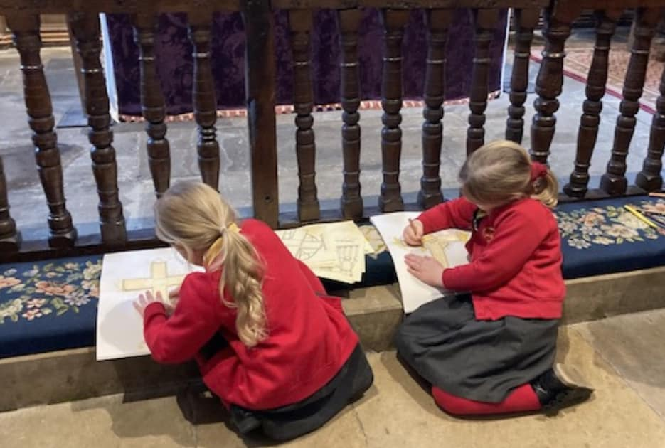
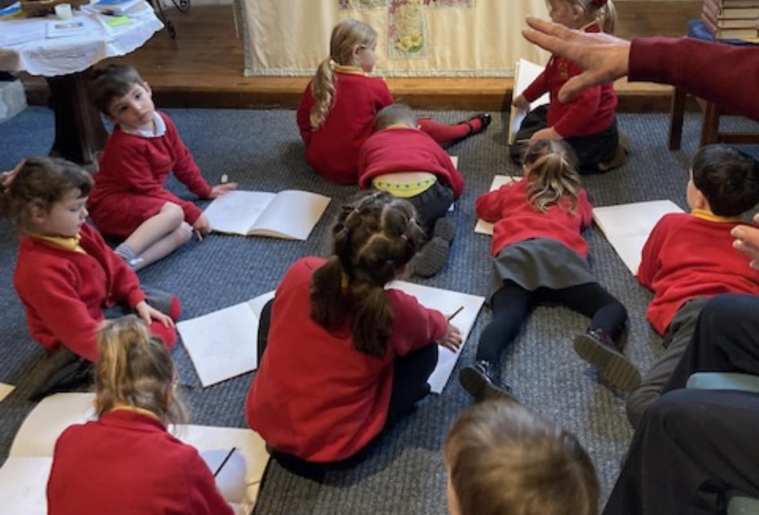
March
The children from Kirkby in Malhamdale Primary School spent a morning in church as part of their work on Easter.
In the afternoon they moved to the Parish Hall where they gave a performance of “Dance through the ages” to parents and carers. This was linked to project work on Walter Morrison, the school’s benefactor, and commenced with a Victorian two-step.

Slide 7
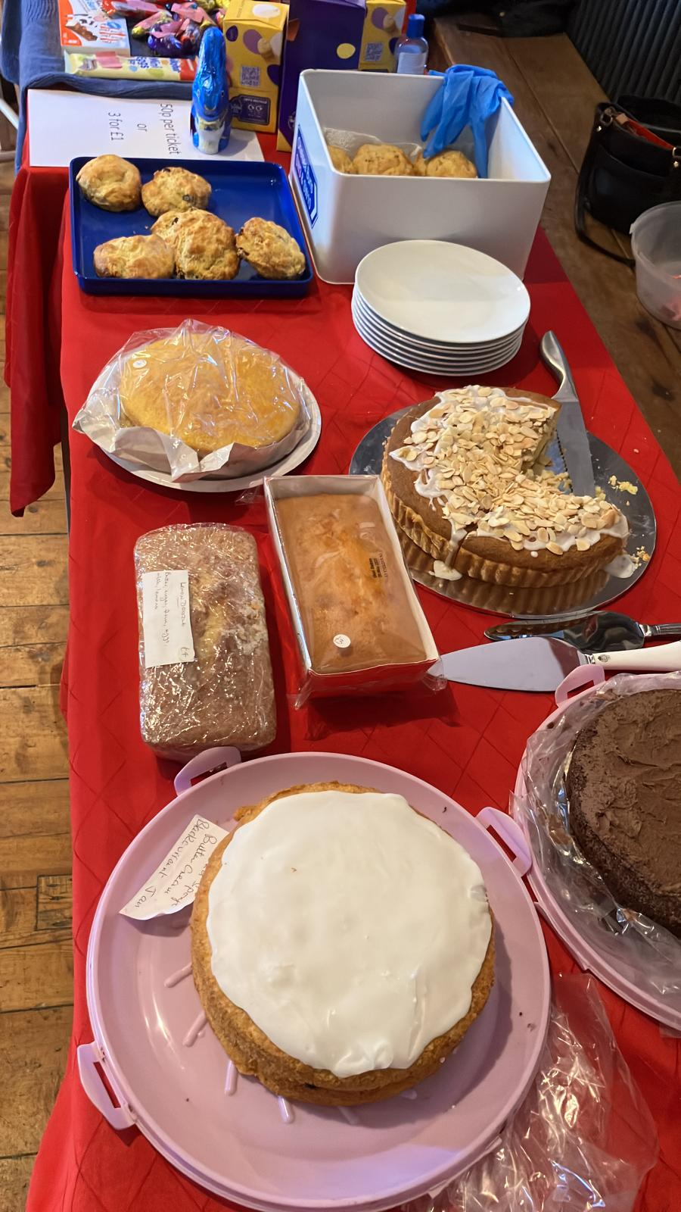
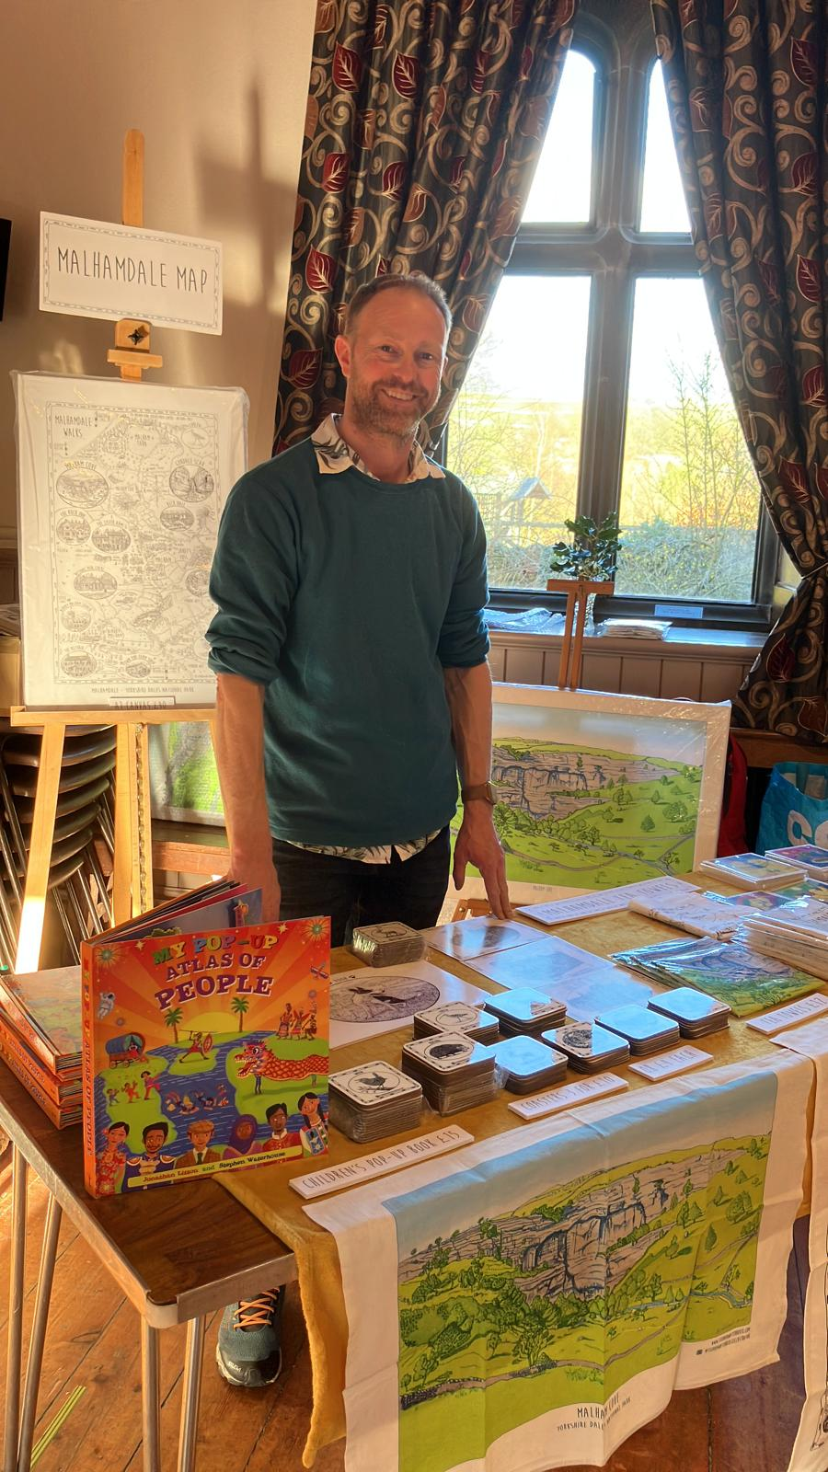
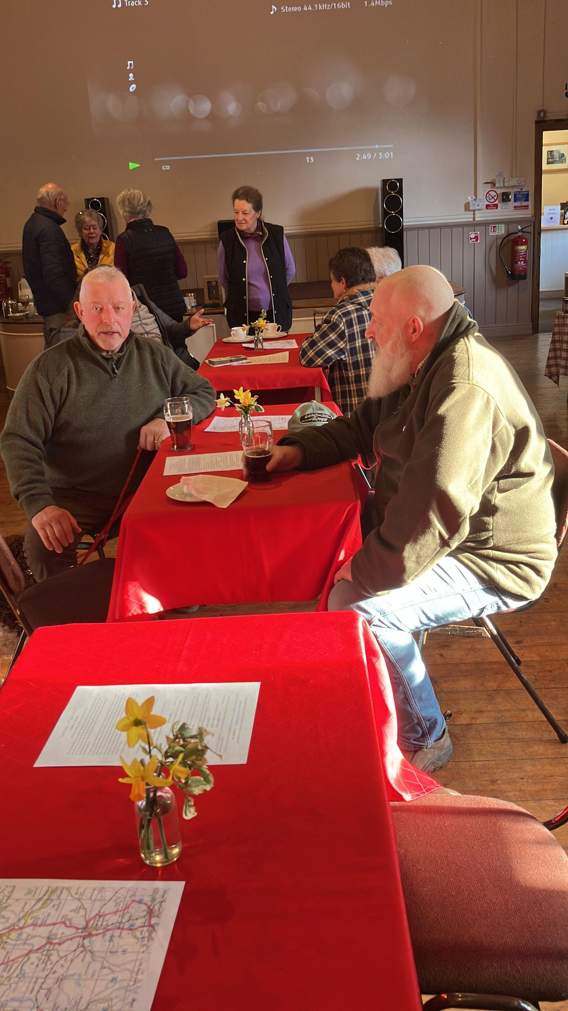
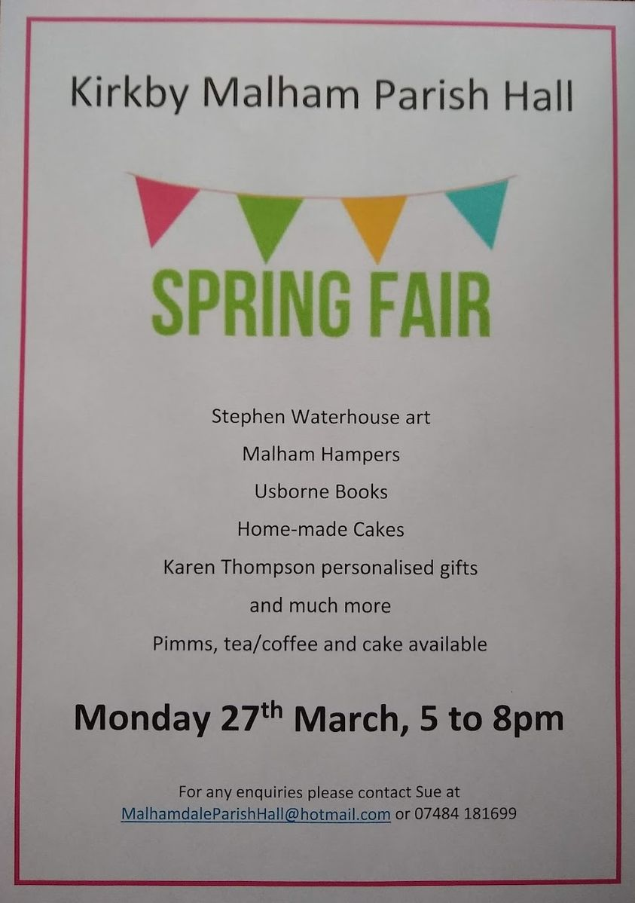
March continued:
Crafts and cakes at the Spring Fair

Slide 8
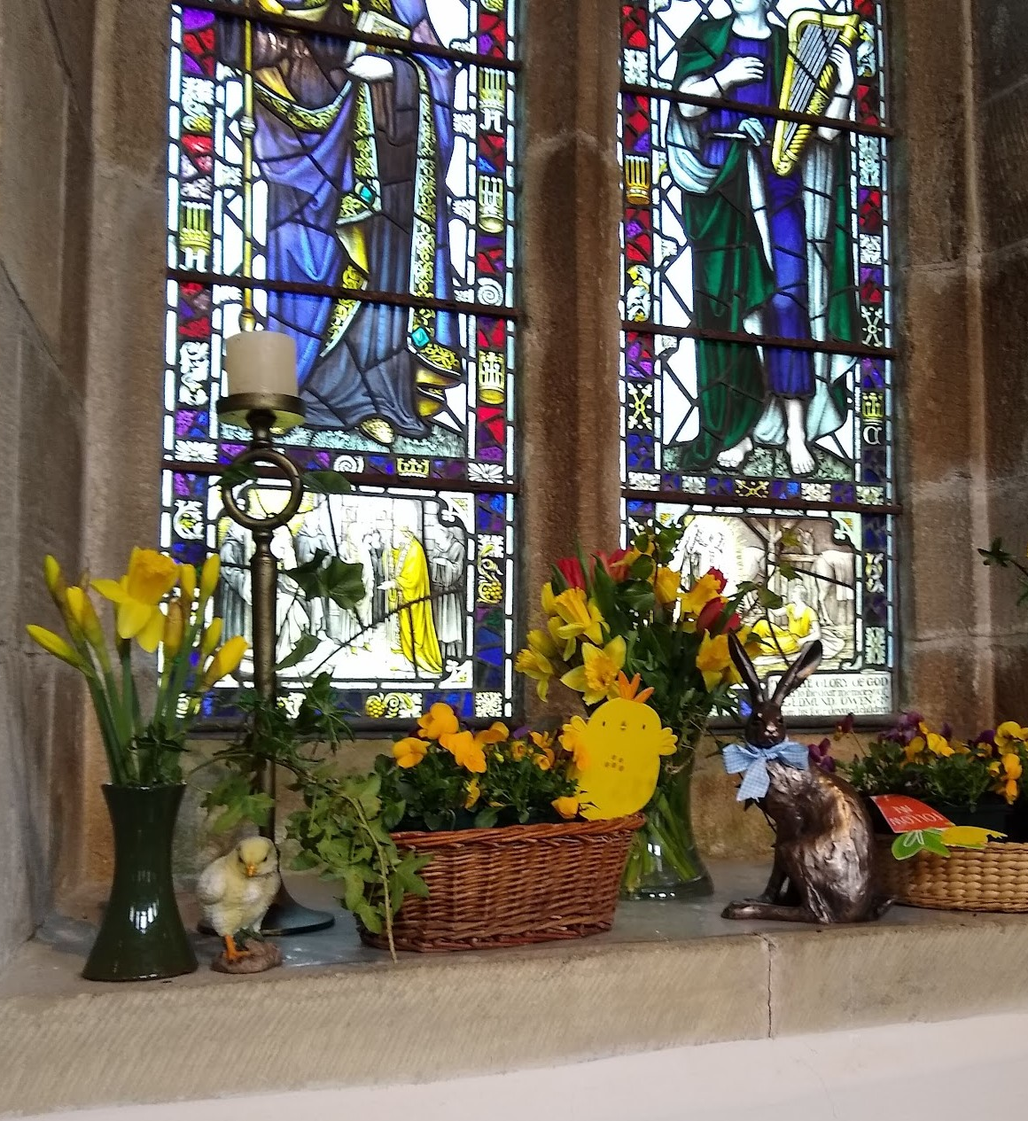
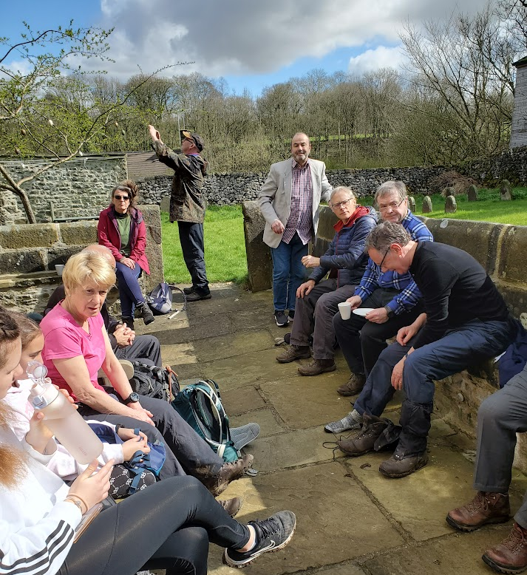
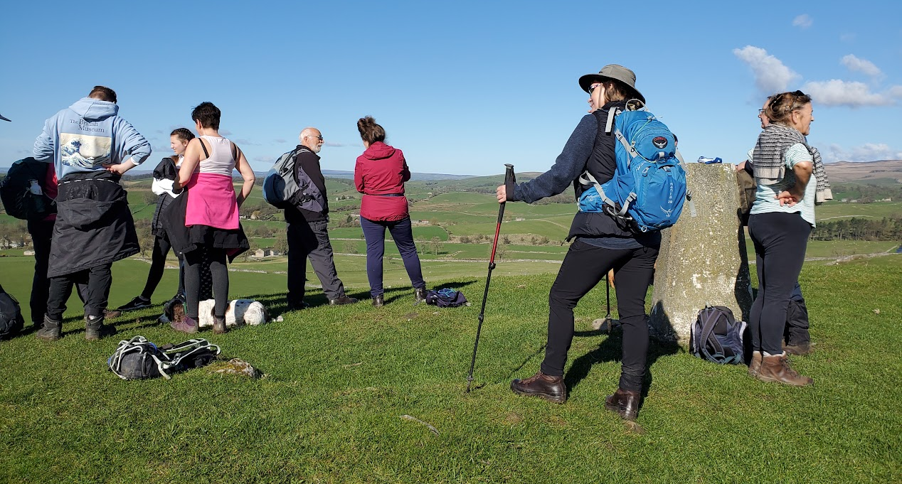
April – A walk in the Dale
The Good Friday walk from St Andrew’s in Gargrave to St Michael’s in Kirkby Malham and back took place in beautiful sunshine and was well attended.
Welcome refreshments were provided at the Quaker Meeting House in Airton and at St Peter’s in Coniston Cold.
St Michael’s was beautifully decorated for Easter Sunday.

Slide 9
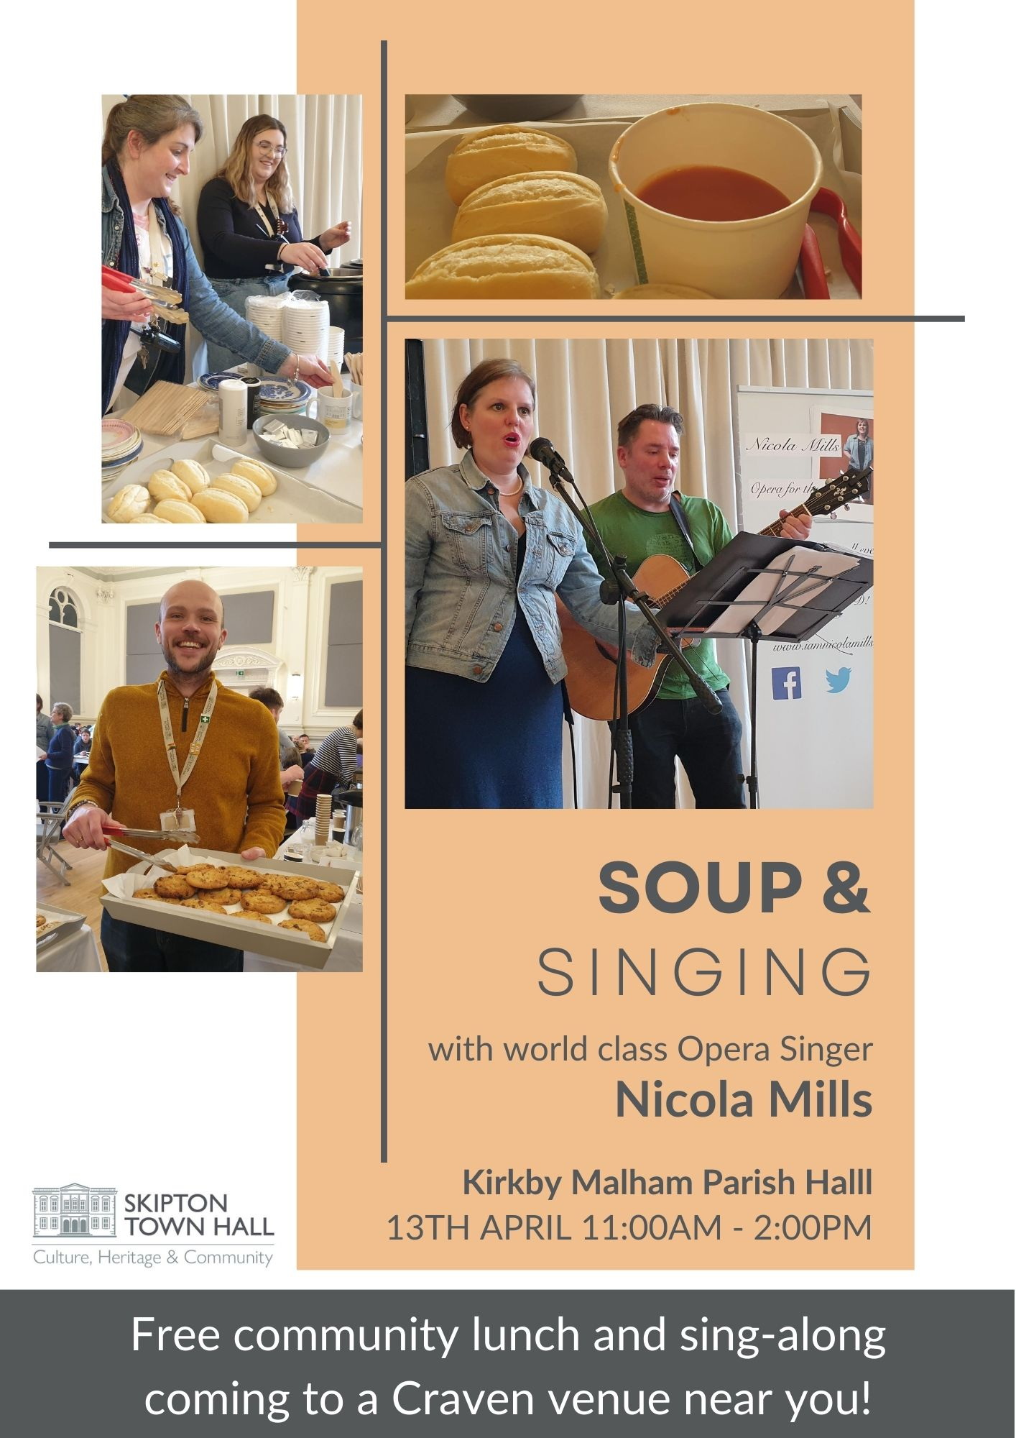
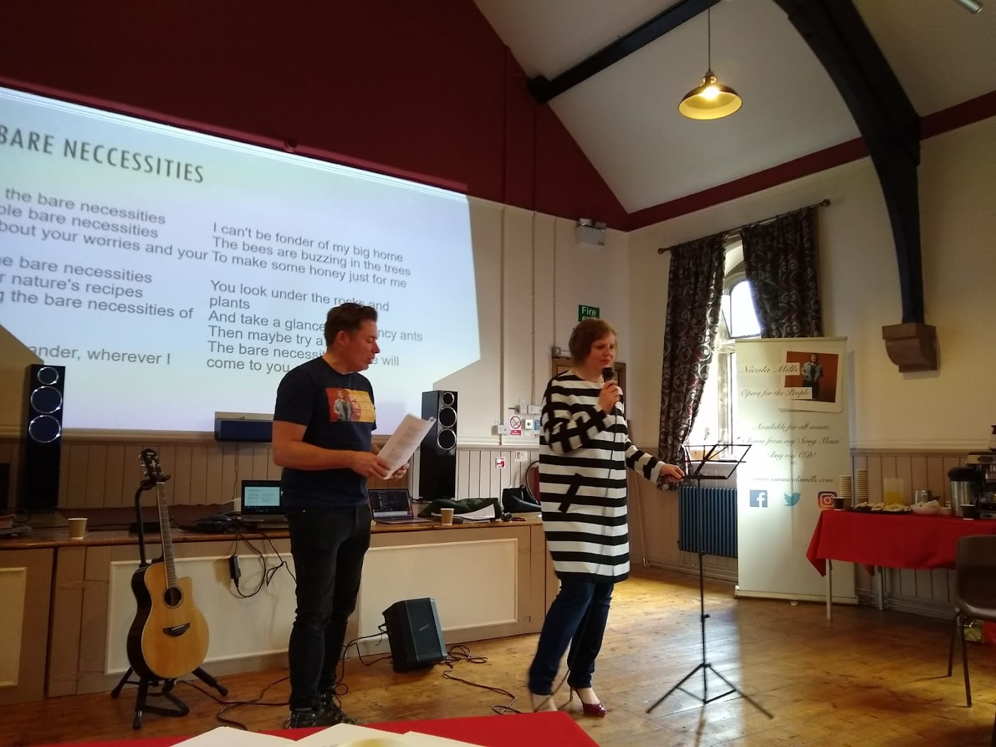
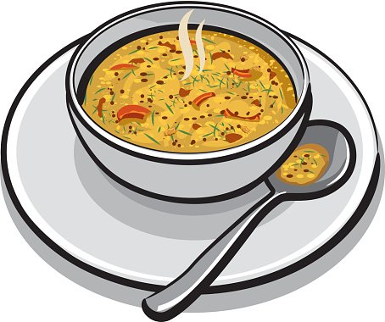

April continued - Opera Singer, Nicola Mills, led the singing at this community lunch and sing-along in the Parish Hall.

Slide 10
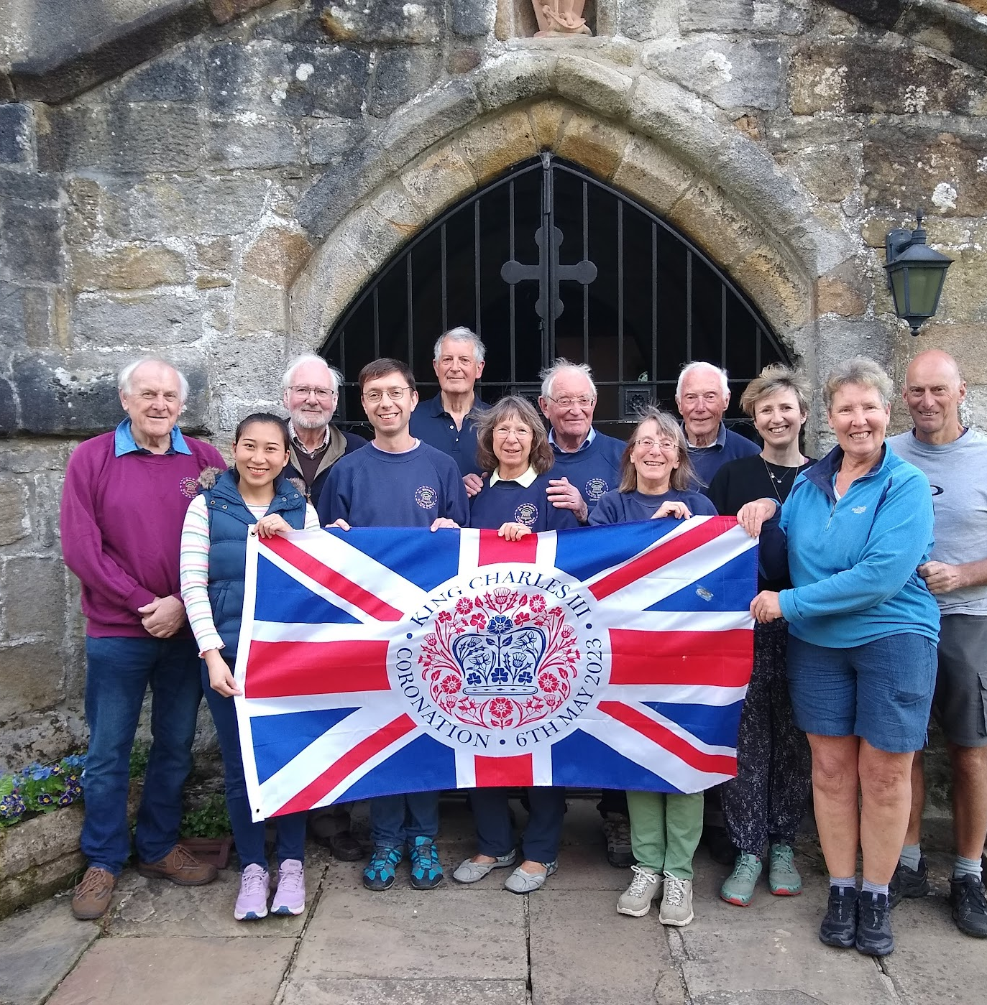
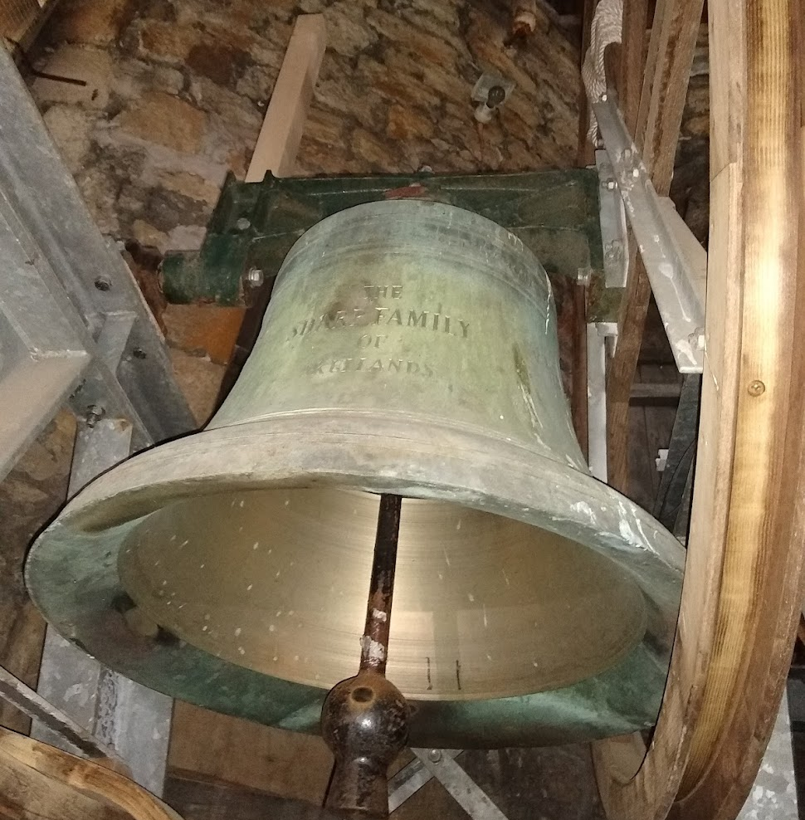
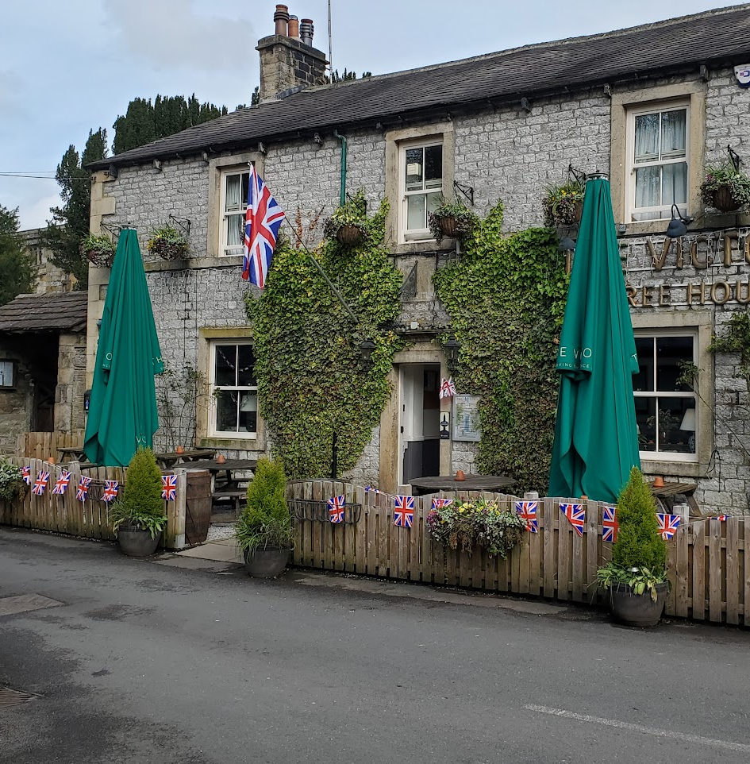
May 6th – The Coronation of King Charles III
Taking a walk round the village on the morning of 6th May you could see flags flying and hear the bells ringing as the bellringers joined in with “Ring for the King”.

Slide 11
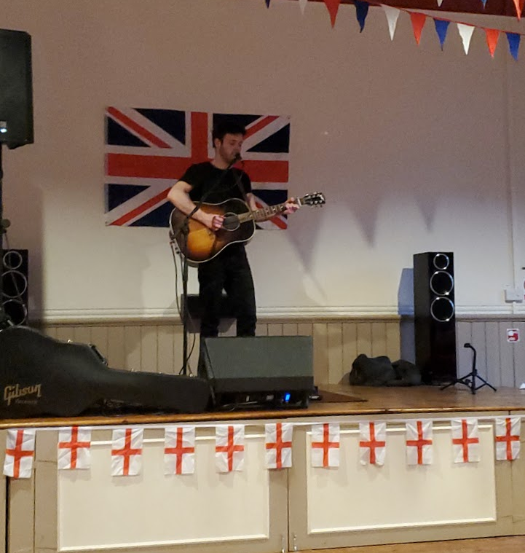
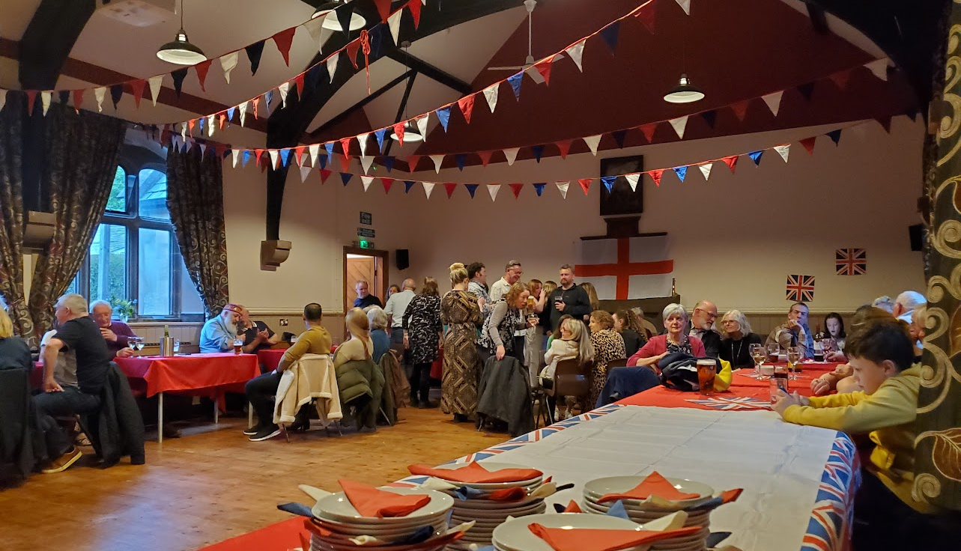
May 6th – evening
The community came together to celebrate the Coronation at the Parish Hall with Callum Spencer providing the music.
Further celebrations took place in Airton and Malham over the weekend.

Slide 12
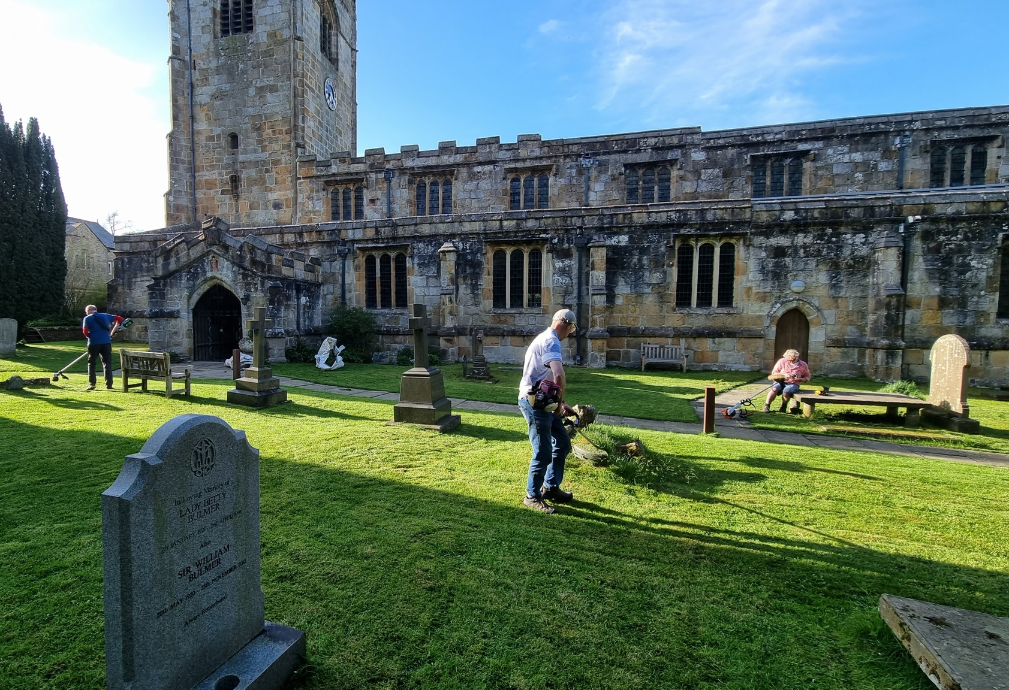
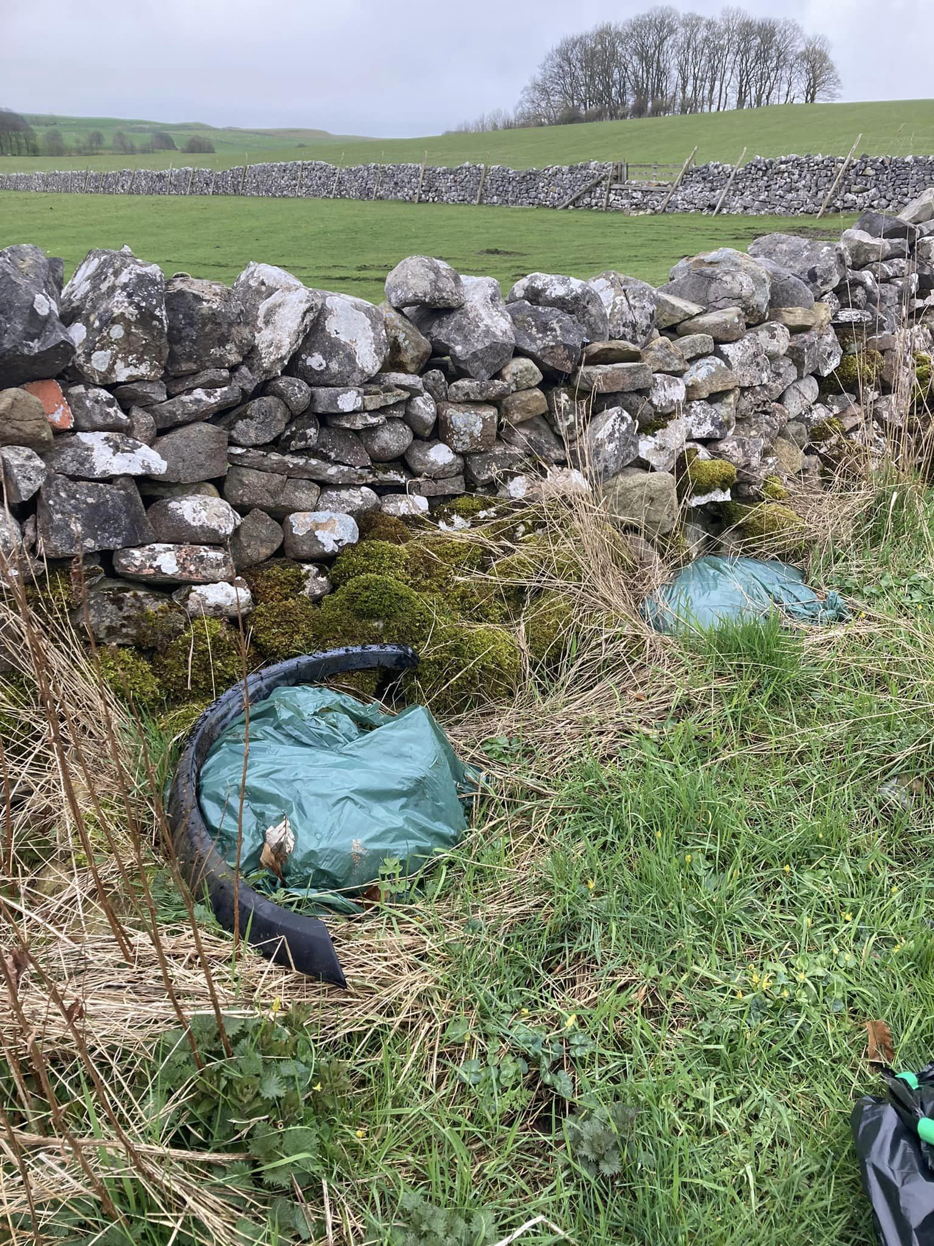

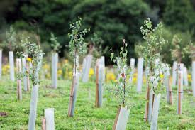
Monday 8th May - “The Big Help Out”.
Our community is blessed to have many people who give up their time to volunteer in different ways, whether as individuals or as part of an organisation or charity.
A special thank you to those who help to help to conserve and protect our local environment e.g. through litter picking, recycling, tree planting and mowing the grass at the church

Slide 13
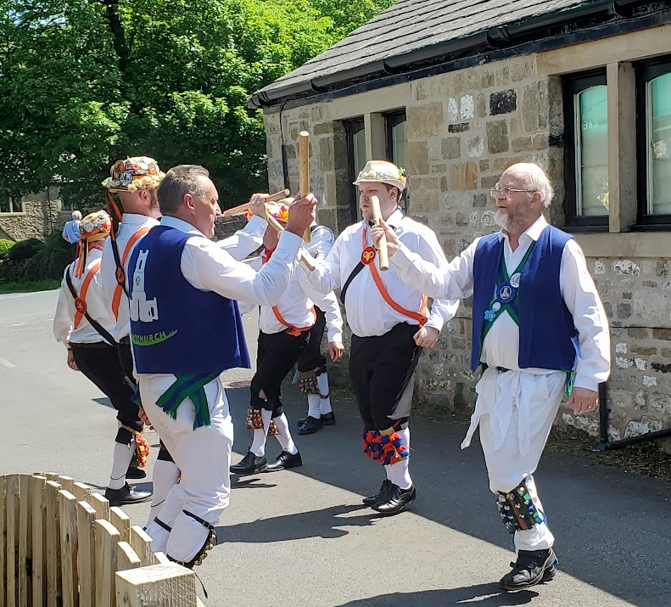
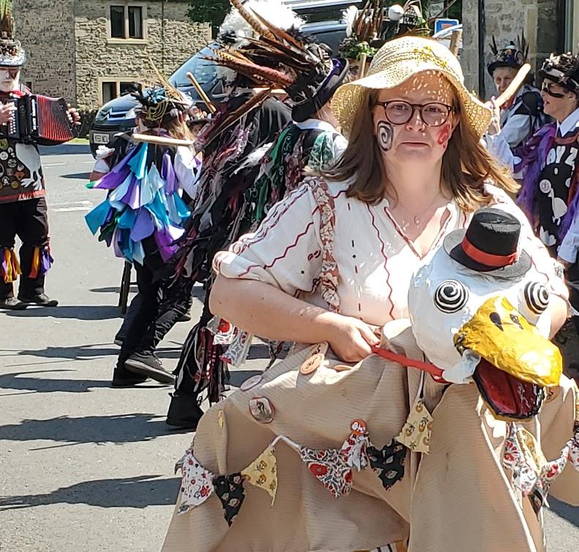
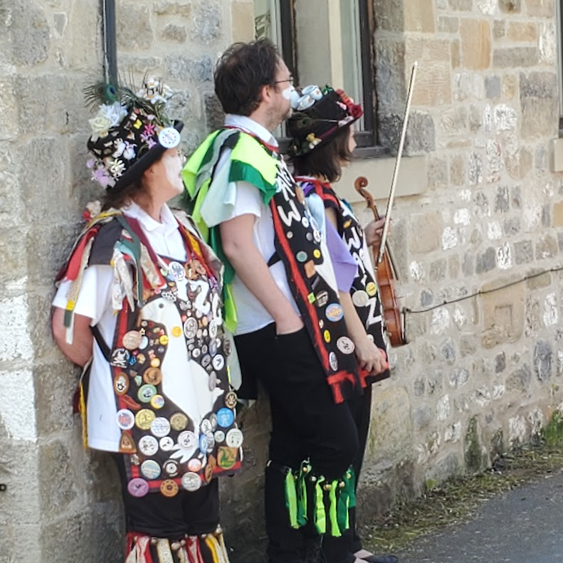
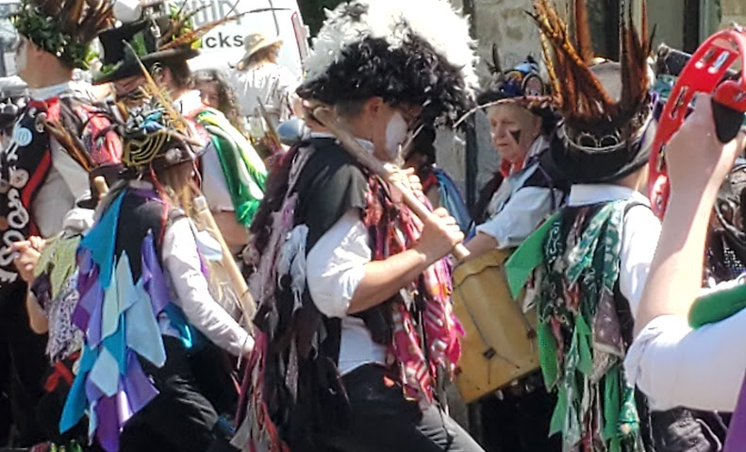
27th May – Spring Bank Holiday Weekend.
Morris dancers on tour dancing at The Vic.

Slide 14
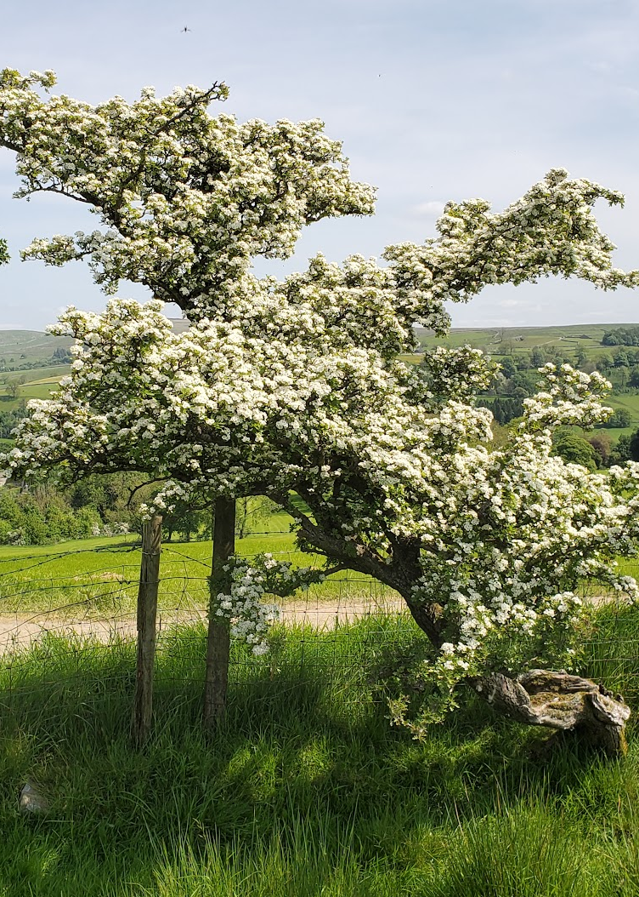
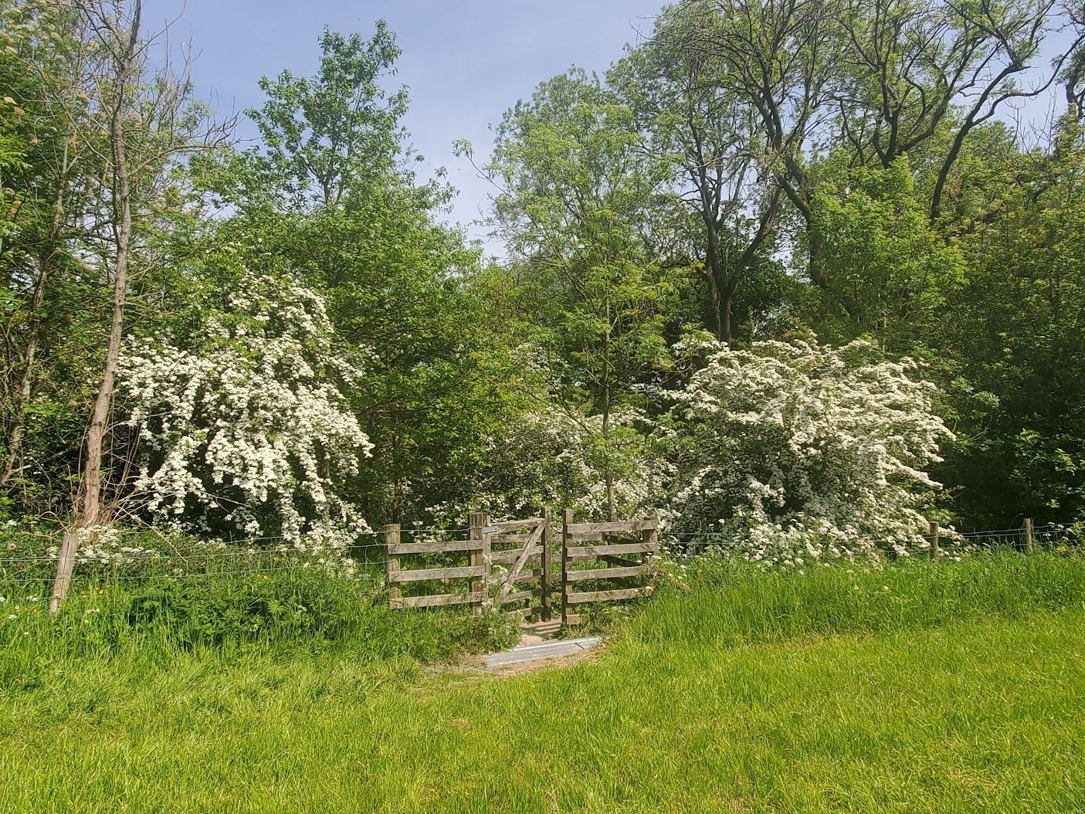
2023 was an excellent year for May blossom on the many hawthorn trees in the Dale.

Slide 15
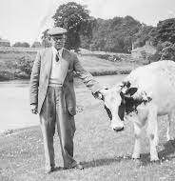
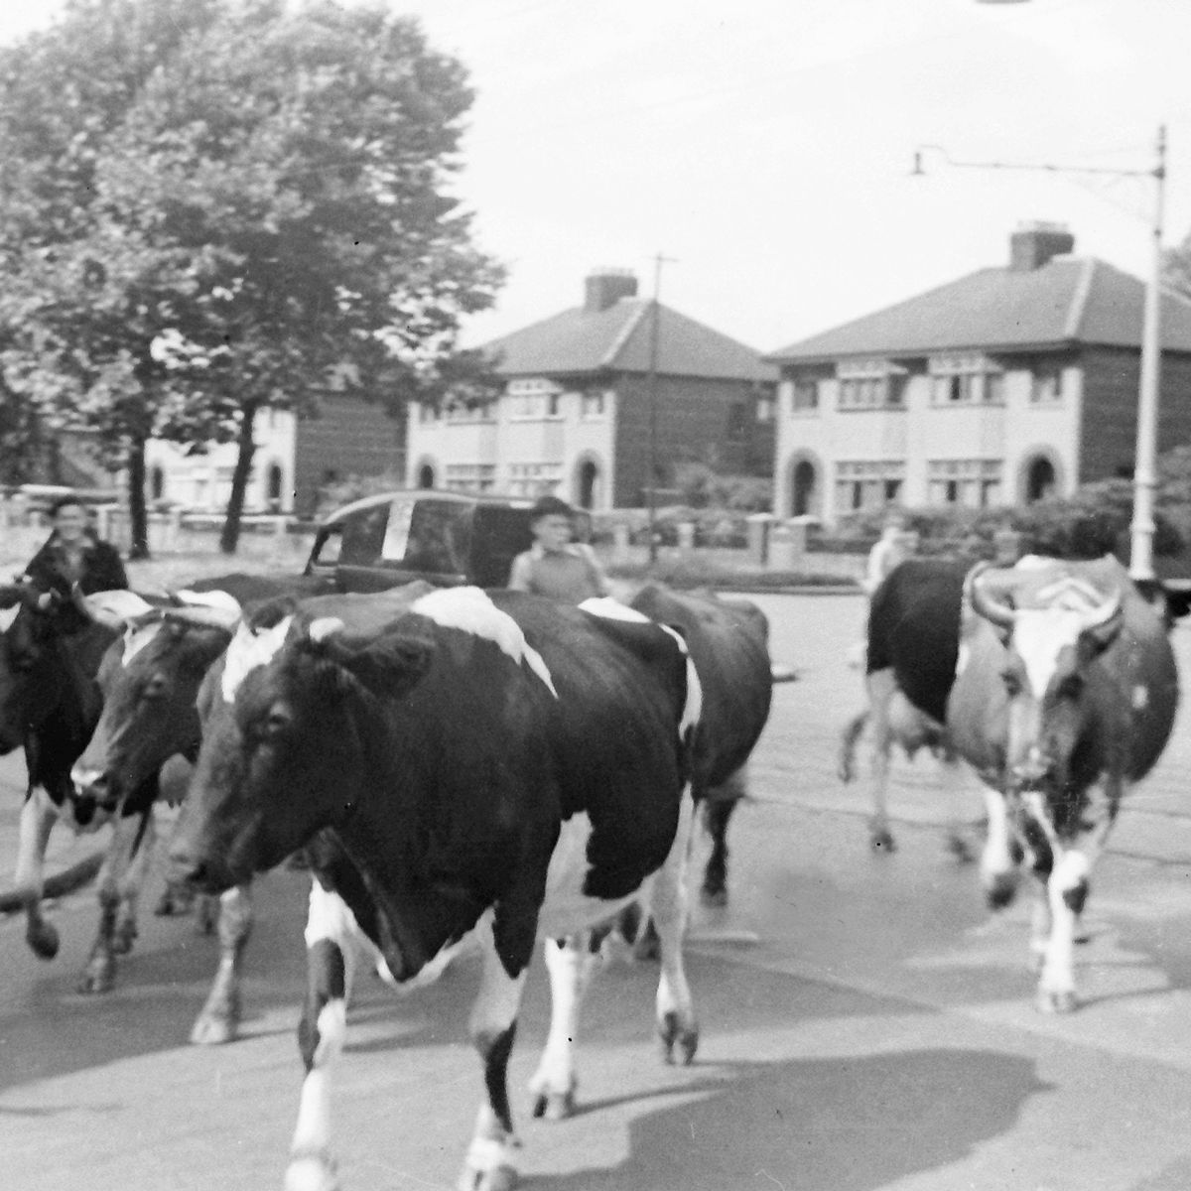
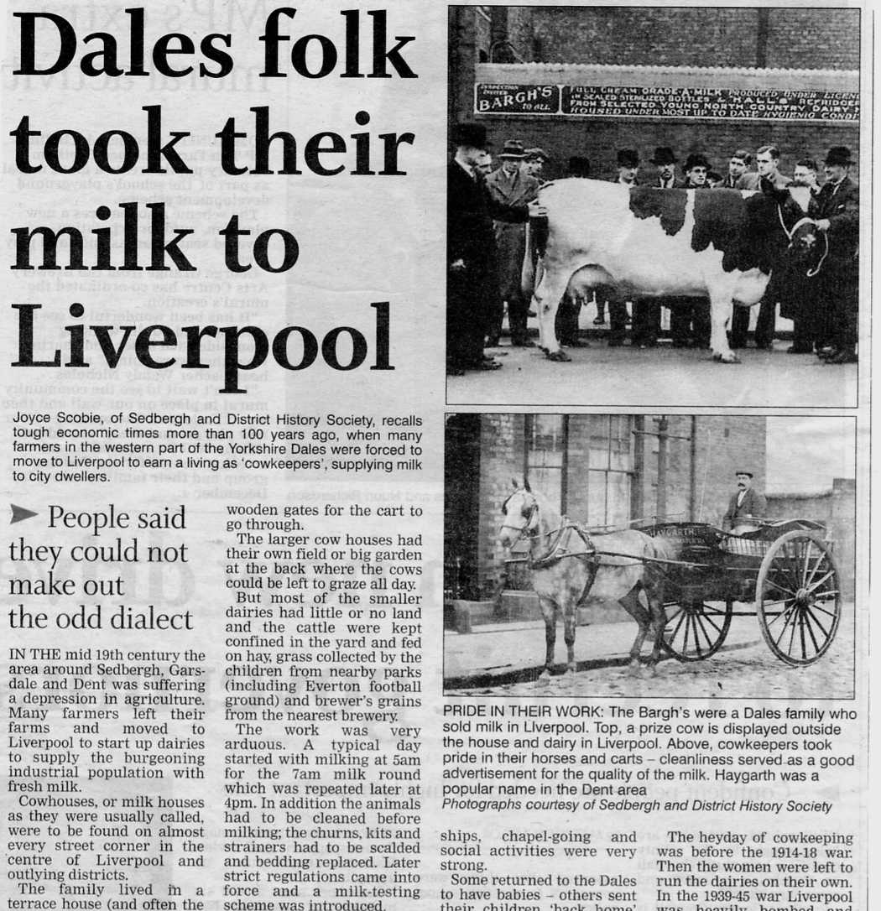
June 15th – The MLHG talk on Liverpool Cowkeepers was very well attended. We learned that several Malhamdale families had made the transition from farming in the Dales to becoming suburban cowkeepers.

Slide 16
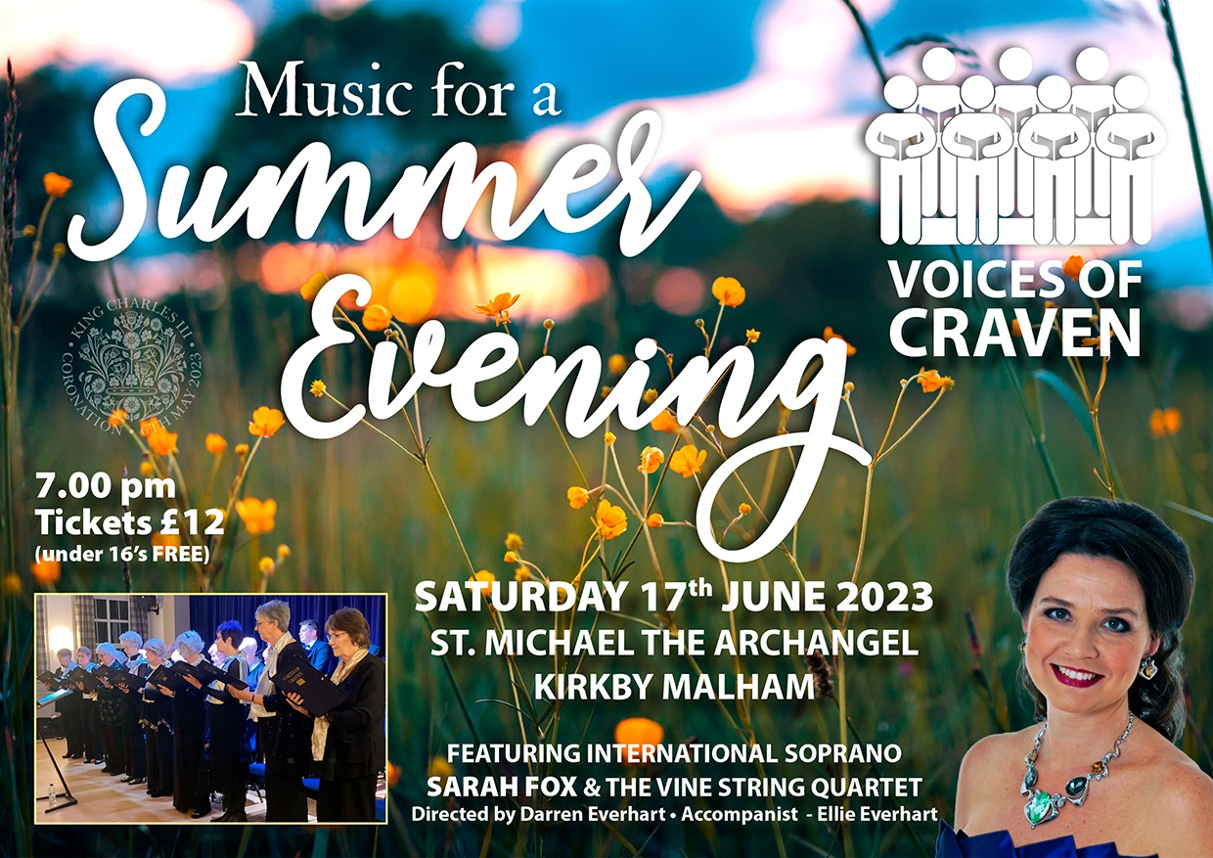
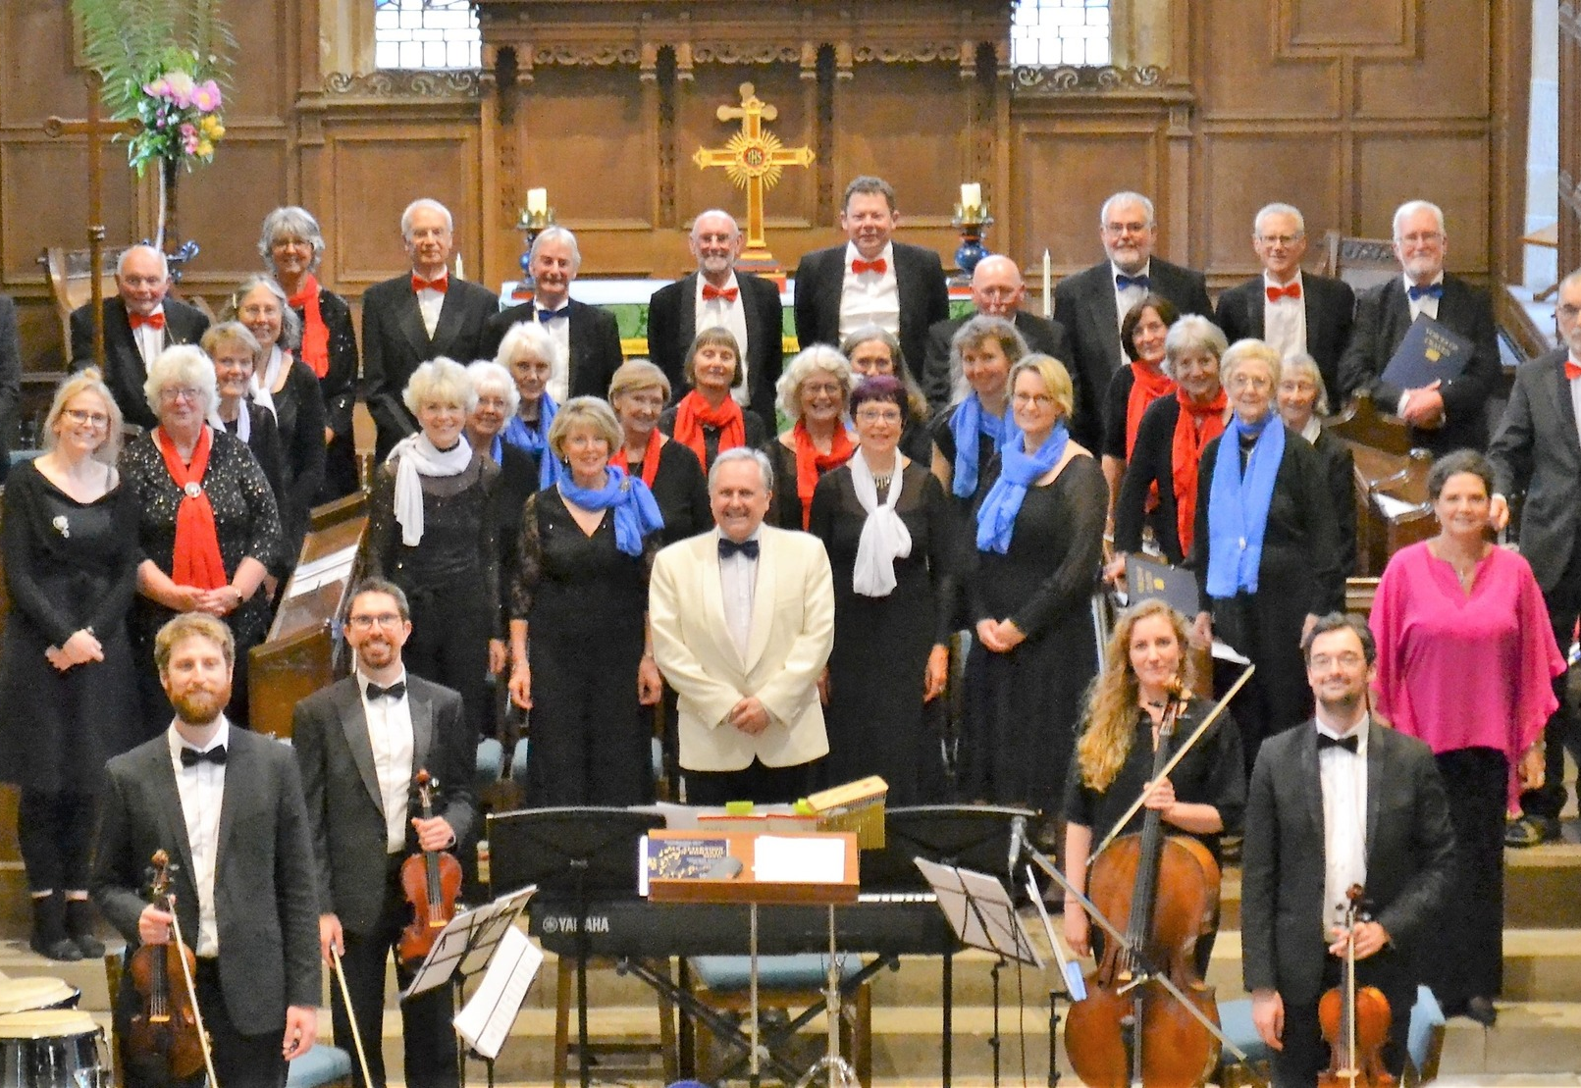
17th June
A very enjoyable evening of music at the church, featuring local musicians as well as an international soprano.

Slide 17

1st July
“Wines for Summer” with Alison Askew.
A wine tasting event was organised by Kirkby Malham Parish Hall committee. There were seven wines to taste, all on a summer theme.

Slide 18
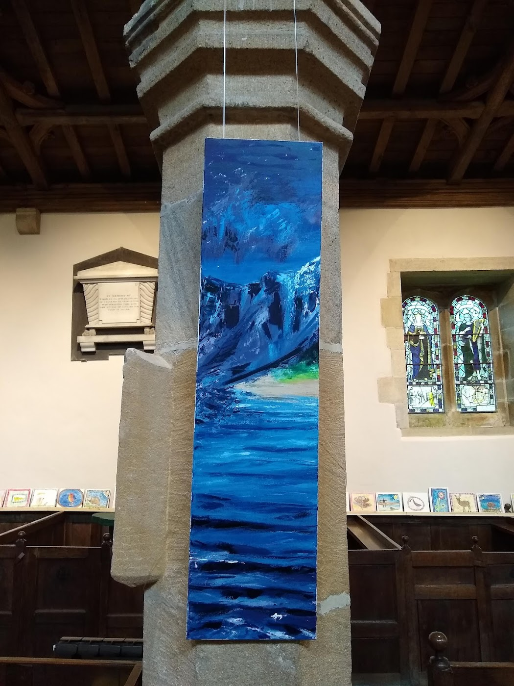
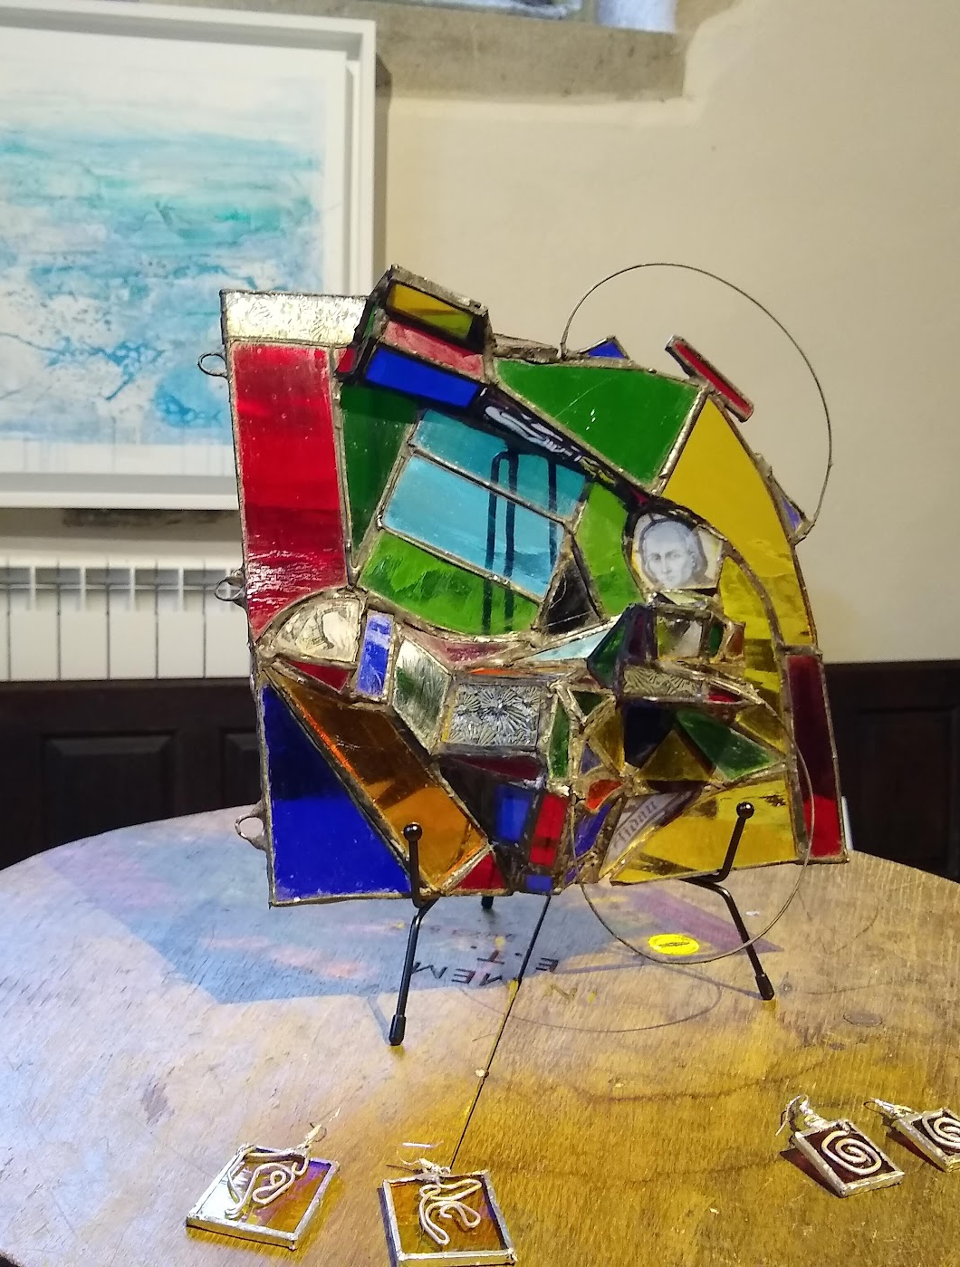
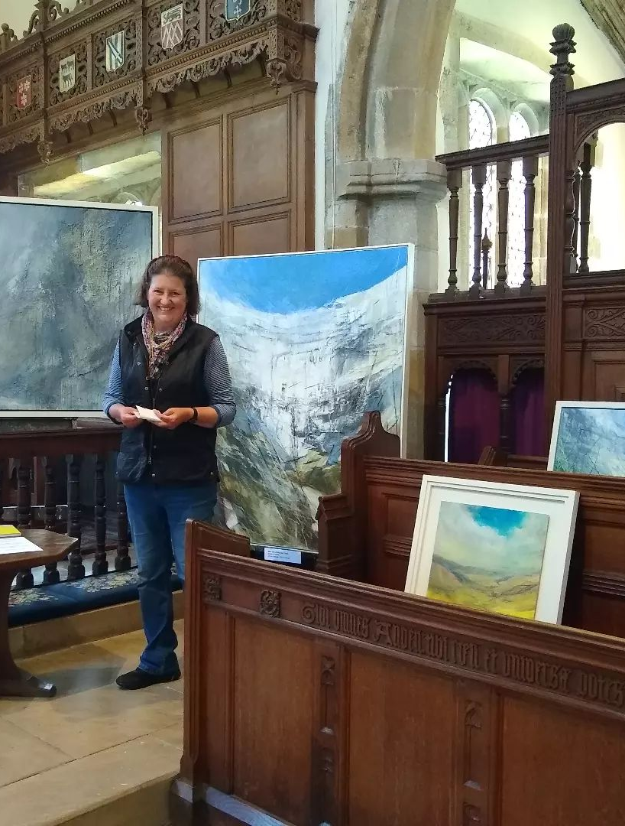
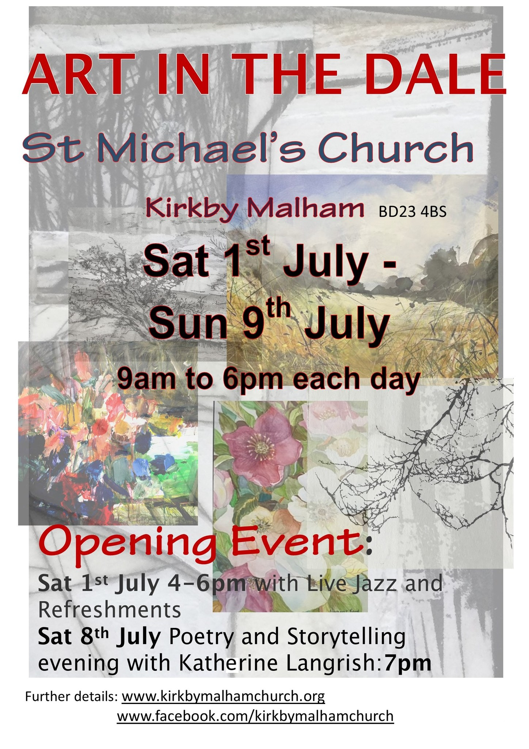
1st – 9th July saw the return of “Art in the Dale” featuring the work of talented artists living in the Dale. There were also musical events and a poetry and storytelling evening.

Slide 19
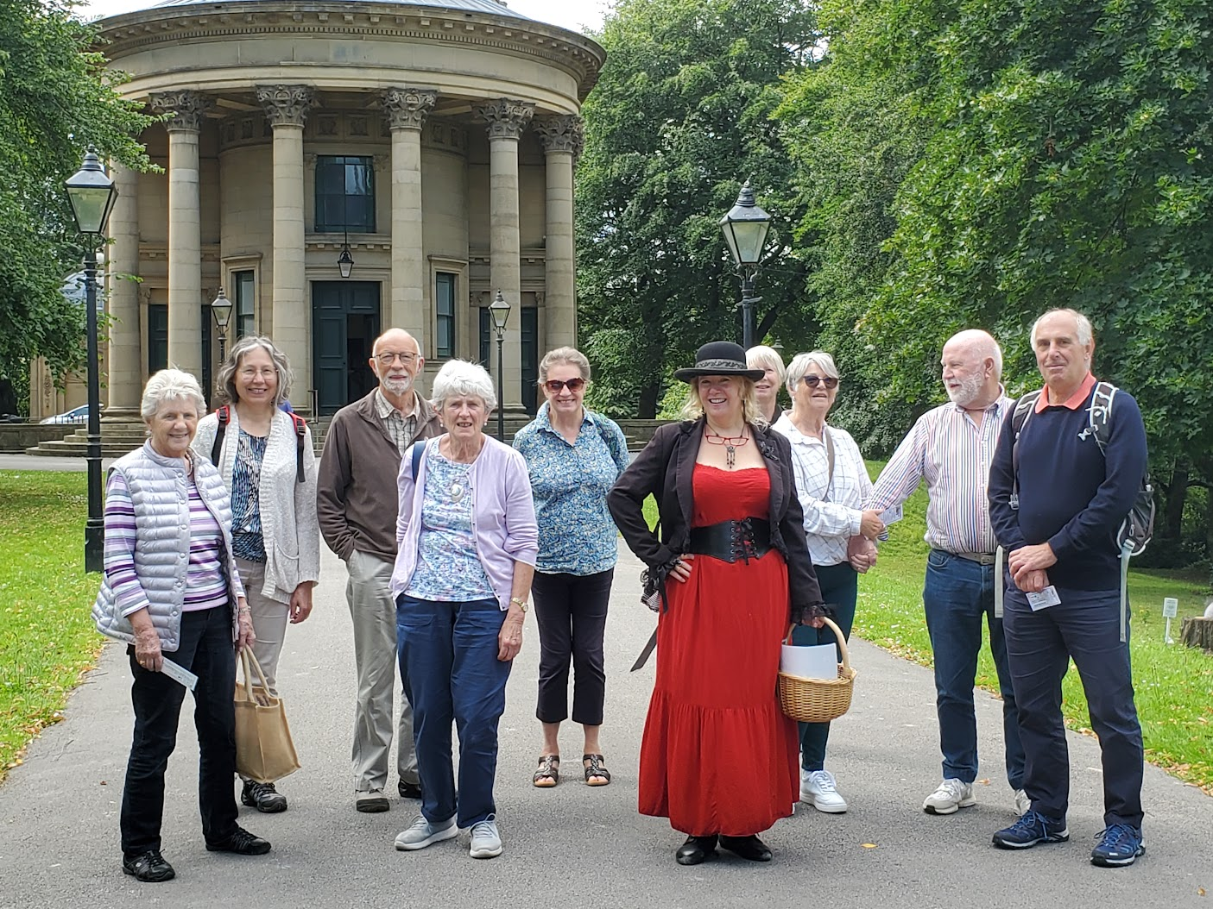
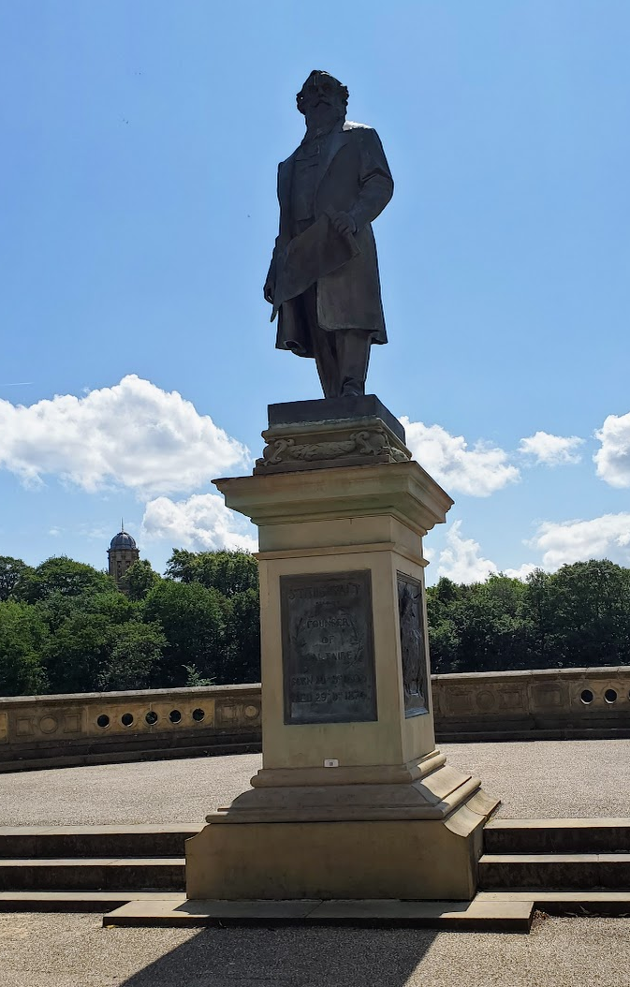
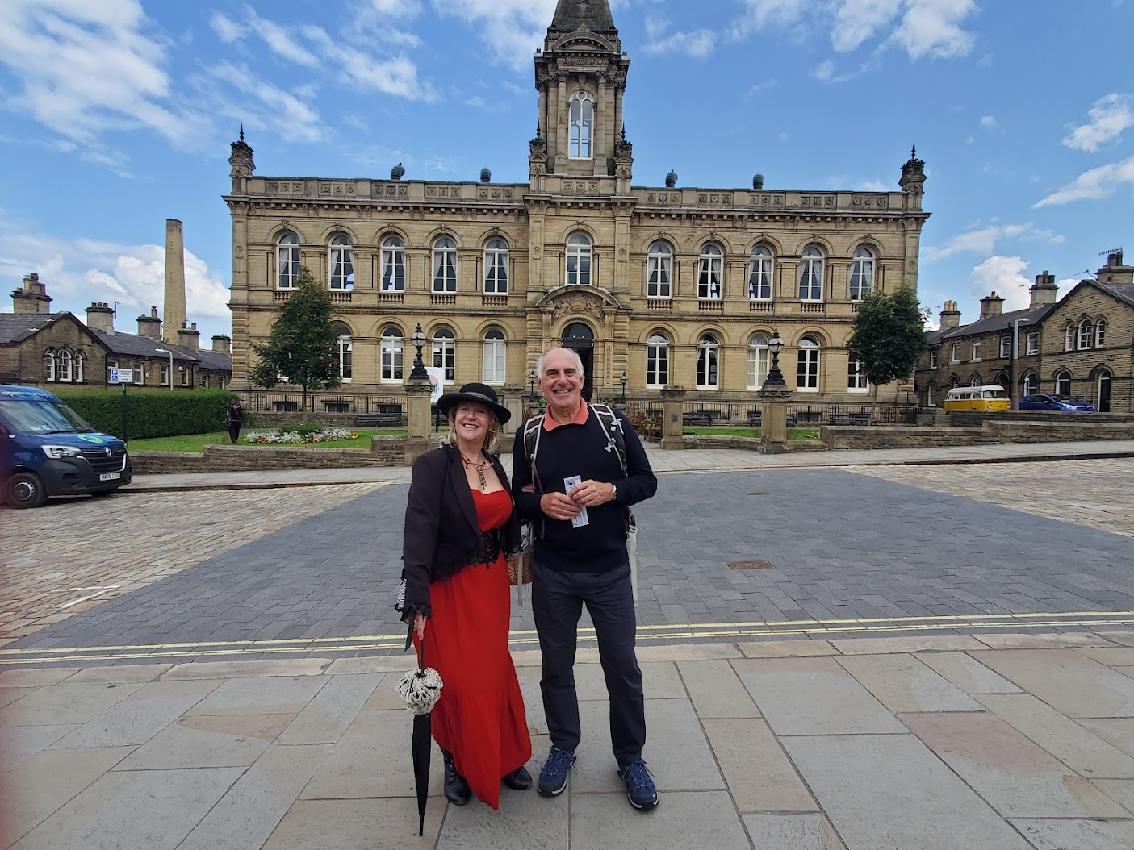
20th July – MLHG members on a tour of Saltaire with our guide, Polly Toothill.
Sir Titus Salt
We learned more about people who lived in the village through the use of character cards. Kevan was Sylvester Toothill, Polly’s husband. Here they are posing outside their home.

Slide 20
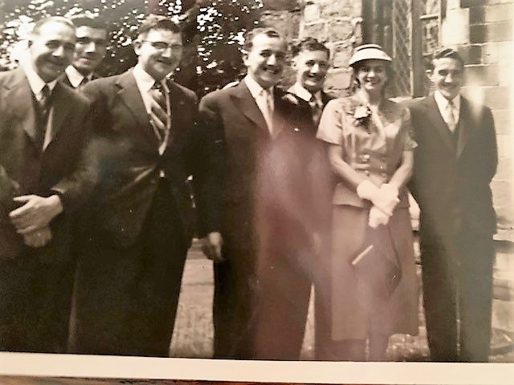
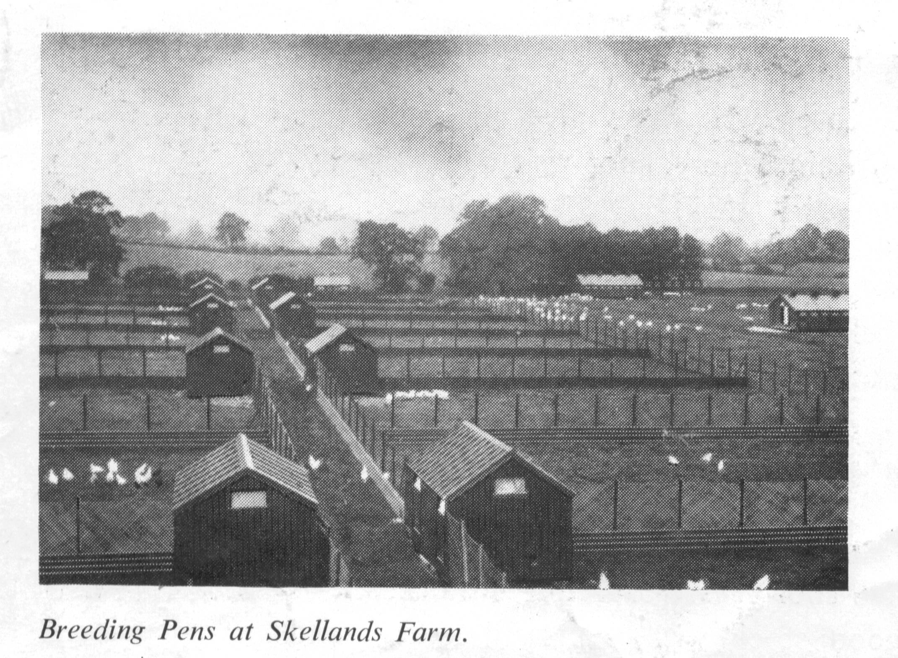
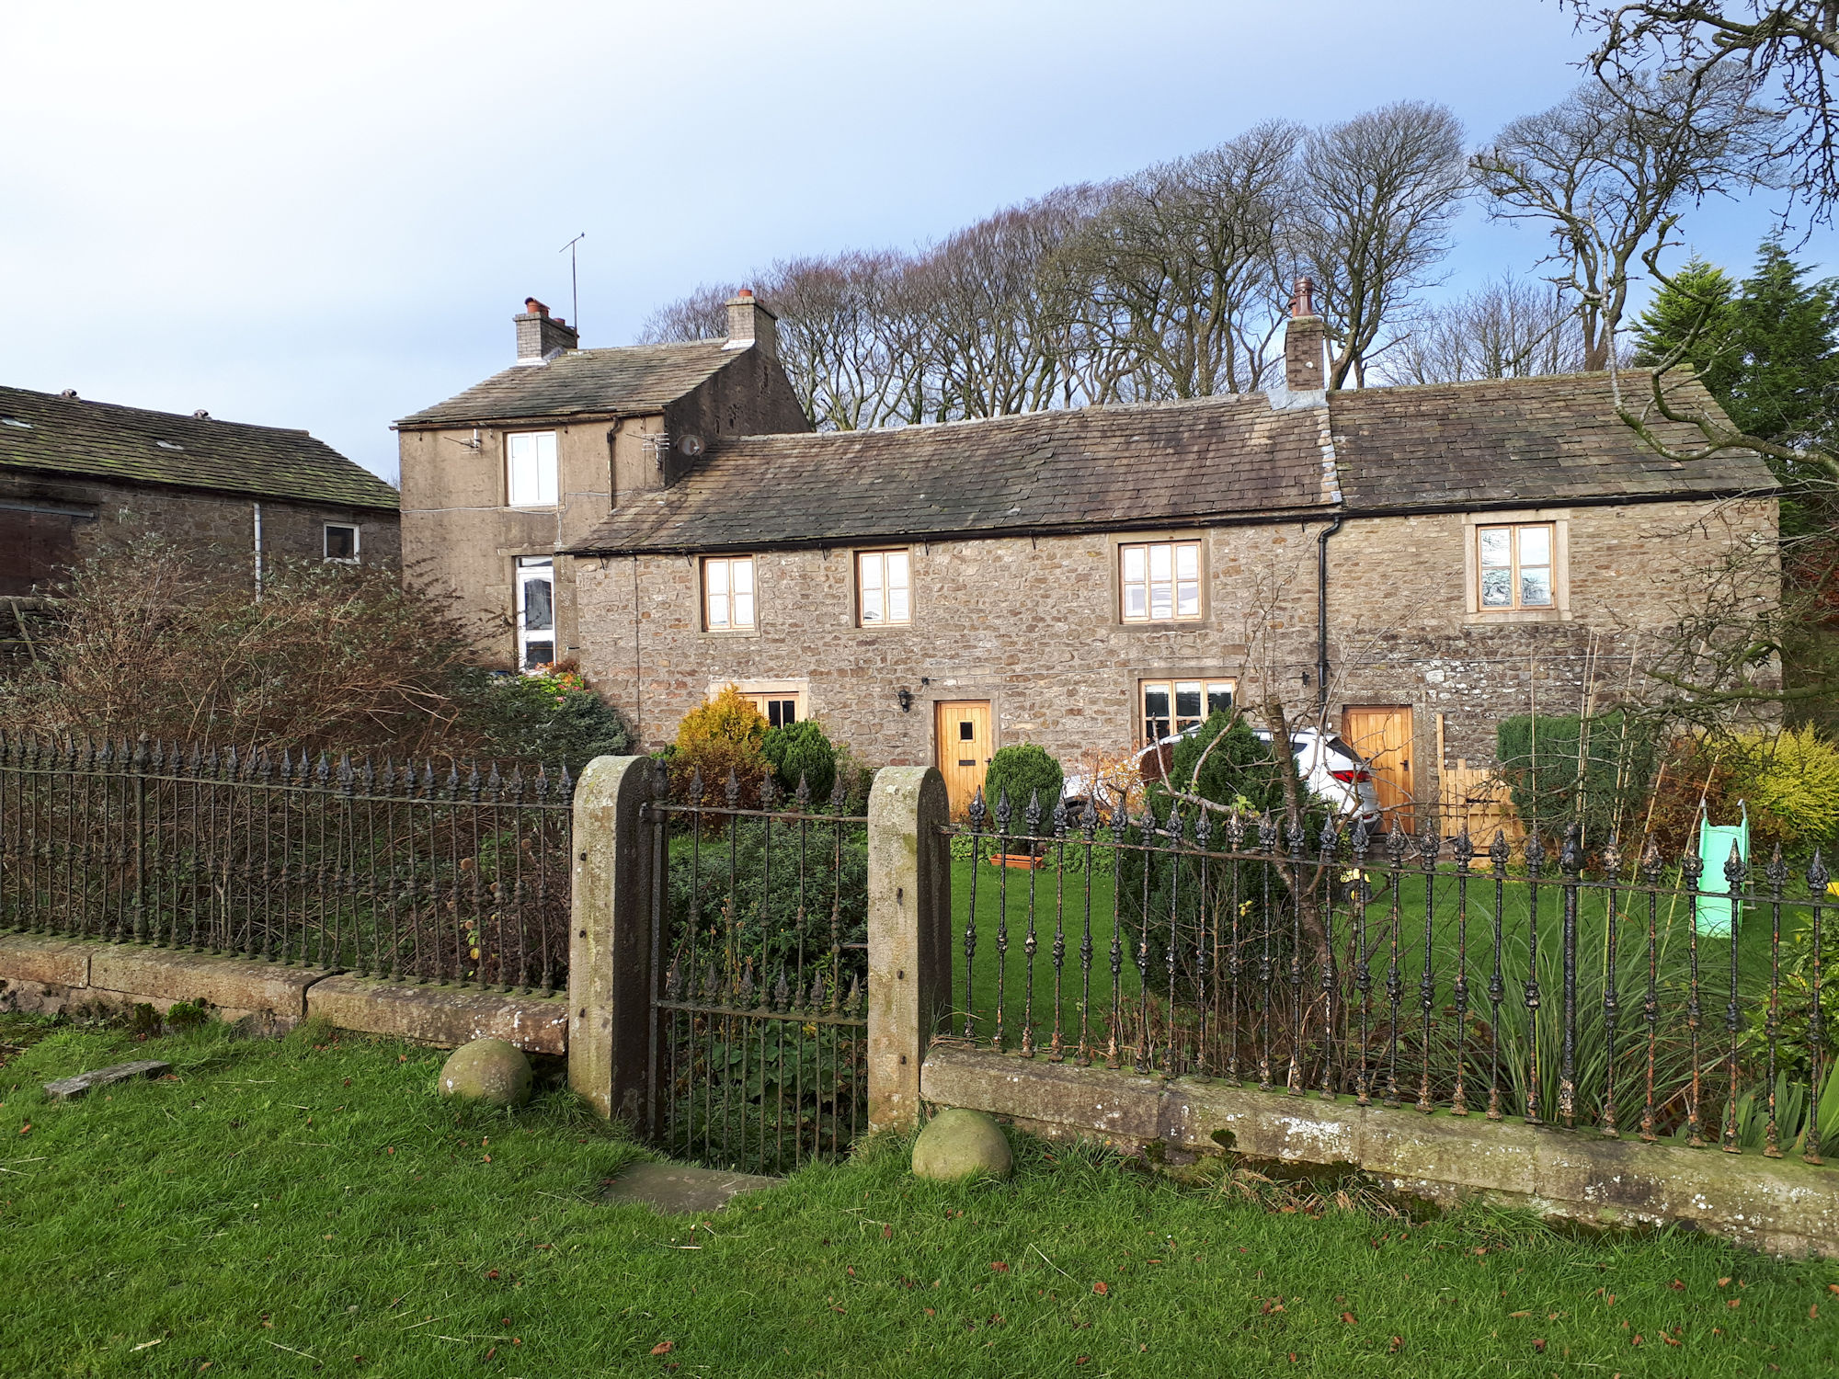
August – MLHG member, Mary Richardson, gave a talk on the “Sharp Family” to a packed Parish Hall.
Crakemoor Farm

Slide 21
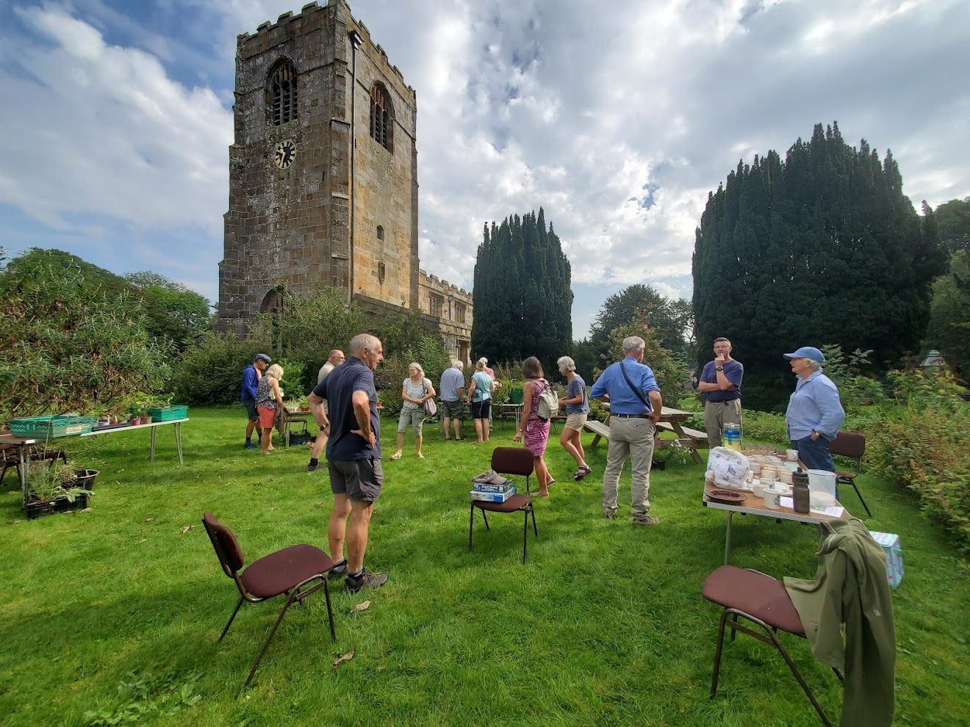
9th September Plant sale at the Vicarage.

Slide 22


September – A full peal was rung at the church for the first time.
A peal is the 'gold standard' change ringing performance during which the bells are rung continuously in over 5000 different sequences, without visual aids, typically taking 3 hours.

Slide 23



Ist October - Harvest Festival.
Supporting Skipton Food Bank.

Slide 24



November – The Parish Hall Committee organised several events.

Slide 25


12th November – A Service of Remembrance was held.
As well as commemorating those who died in the two World Wars our thoughts turned to those involved in more recent conflicts, including those in Ukraine, Sudan and Gaza.

Slide 26


1st December Christmas wreath making workshop at the
Parish Hall.

Slide 27

The School Nativity and Christingle Service were held. Christingles were made by women and children from the Leeds City of Sanctuary Group who visited the day before.

Slide 28


Church services were well attended throughout the Christmas period and Santa made his usual visit on Christmas Eve.

Slide 29


The year ended with heavy rain and strong winds. A tree fell down at Scalegill Mill but a diversion was quickly put in place so the path between Kirkby Malham and Malham could remain open.

Slide 30

These December flowering snowdrops remained unscathed and were blooming on New Year’s Eve on Hanlith Lane.

