Slide 1
Airton & Scosthrop
Parish Diary 2024
Malhamdale Local History Group

Slide 2
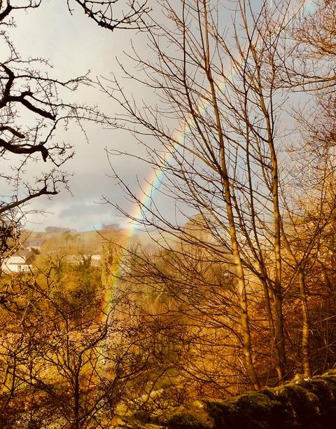
1 January
1 January
A beautiful rainbow to start the new year.

Slide 3
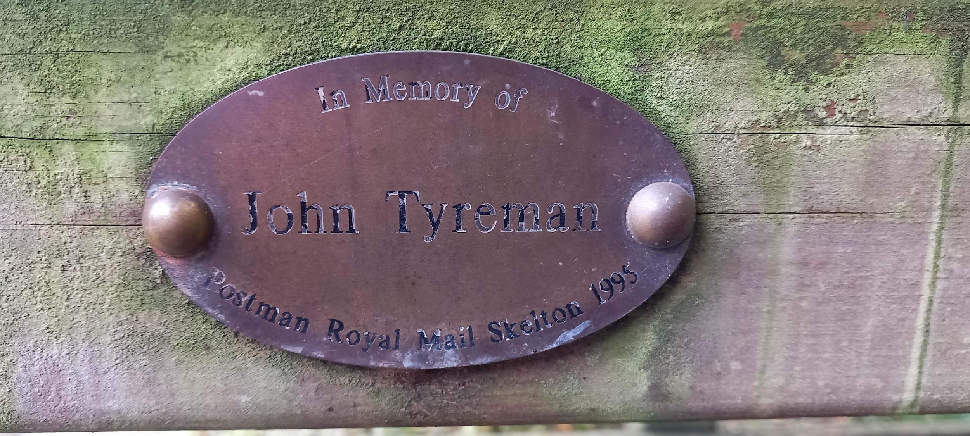
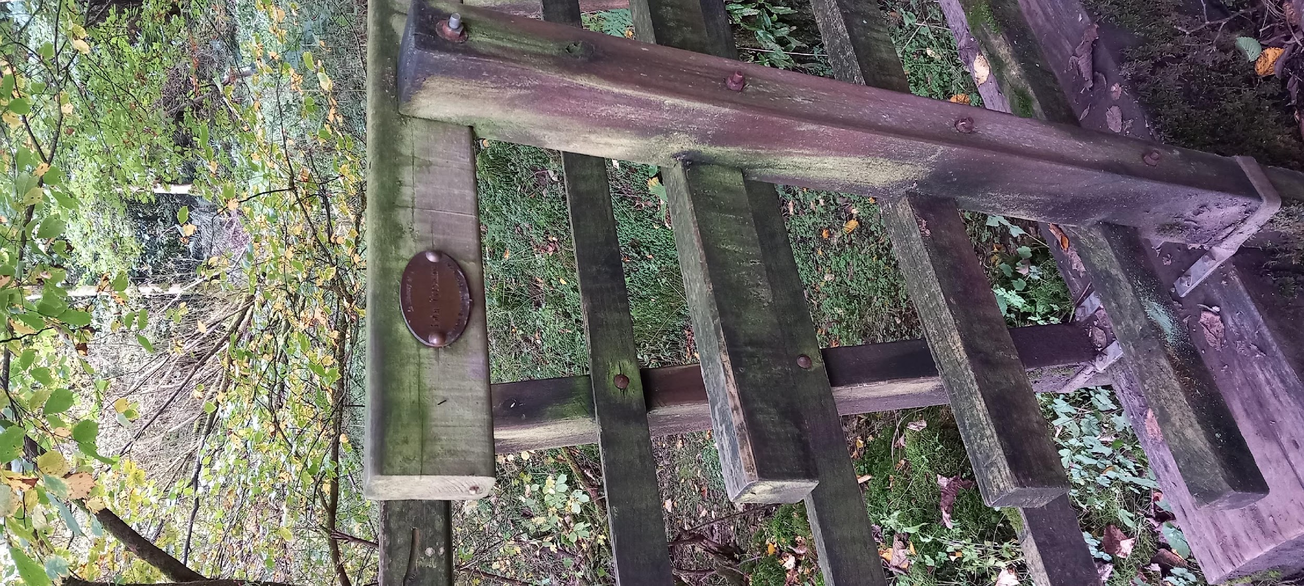
January
A similar brass plaque for Andrew Batten has disappeared (been stolen?) from the Mill side walk.

Slide 4
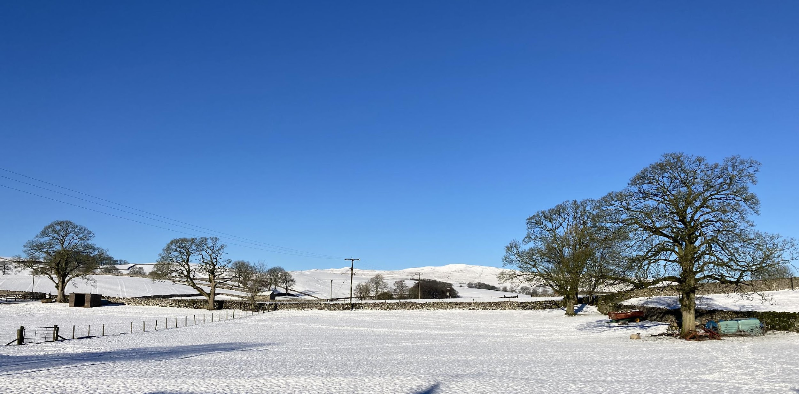
17 January

Slide 5
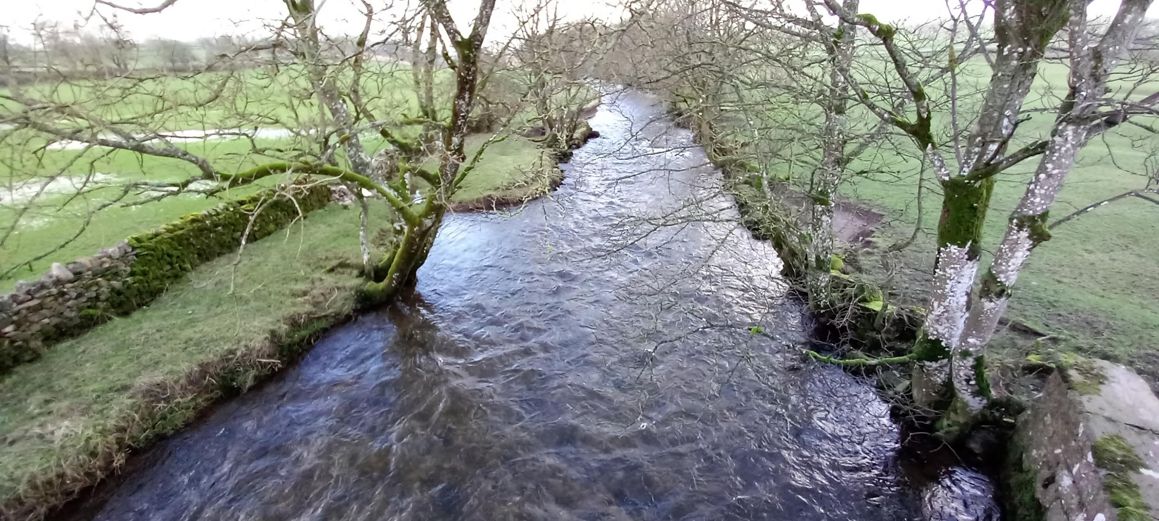
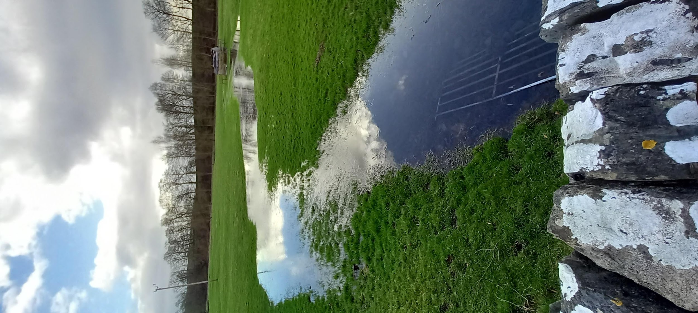
18 February Floods at Newfield Bridge.

Slide 6
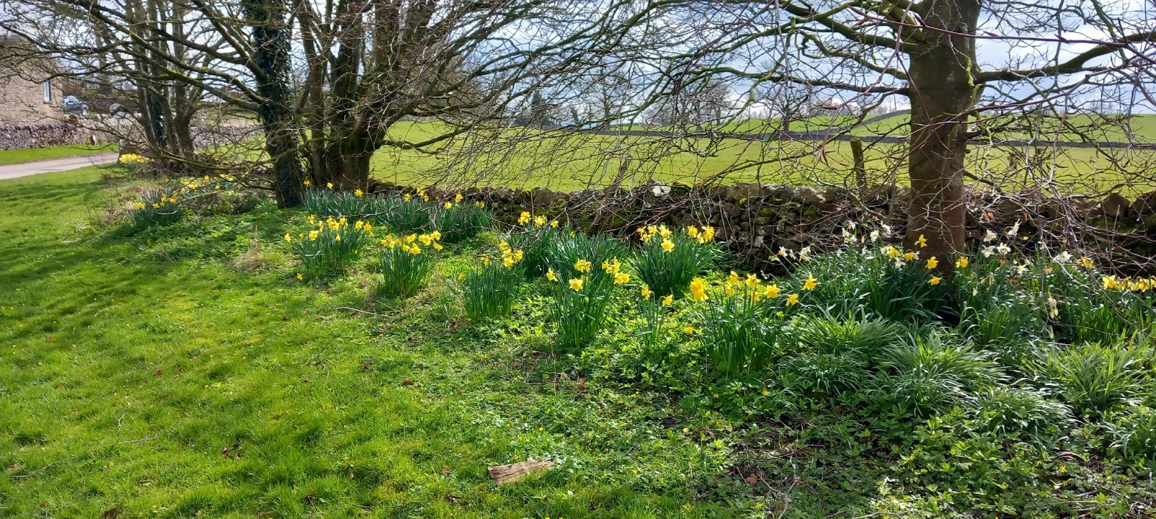
31 March
Roadside Daffodils near Watery Lane

Slide 7
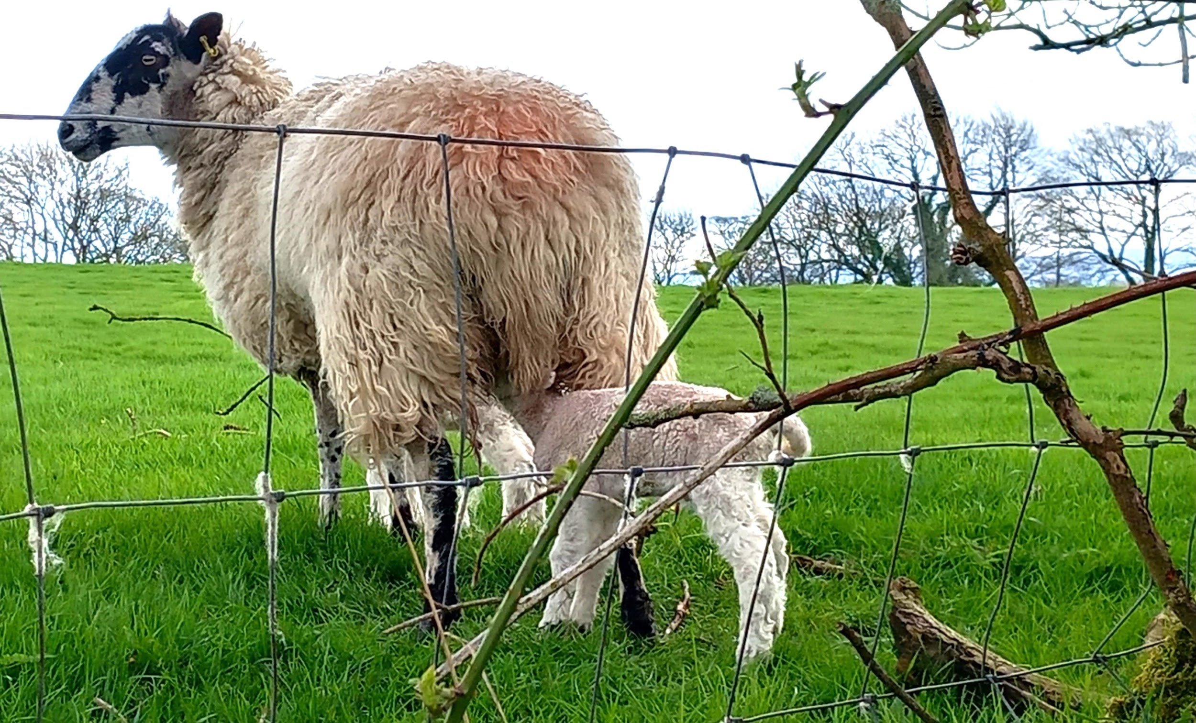
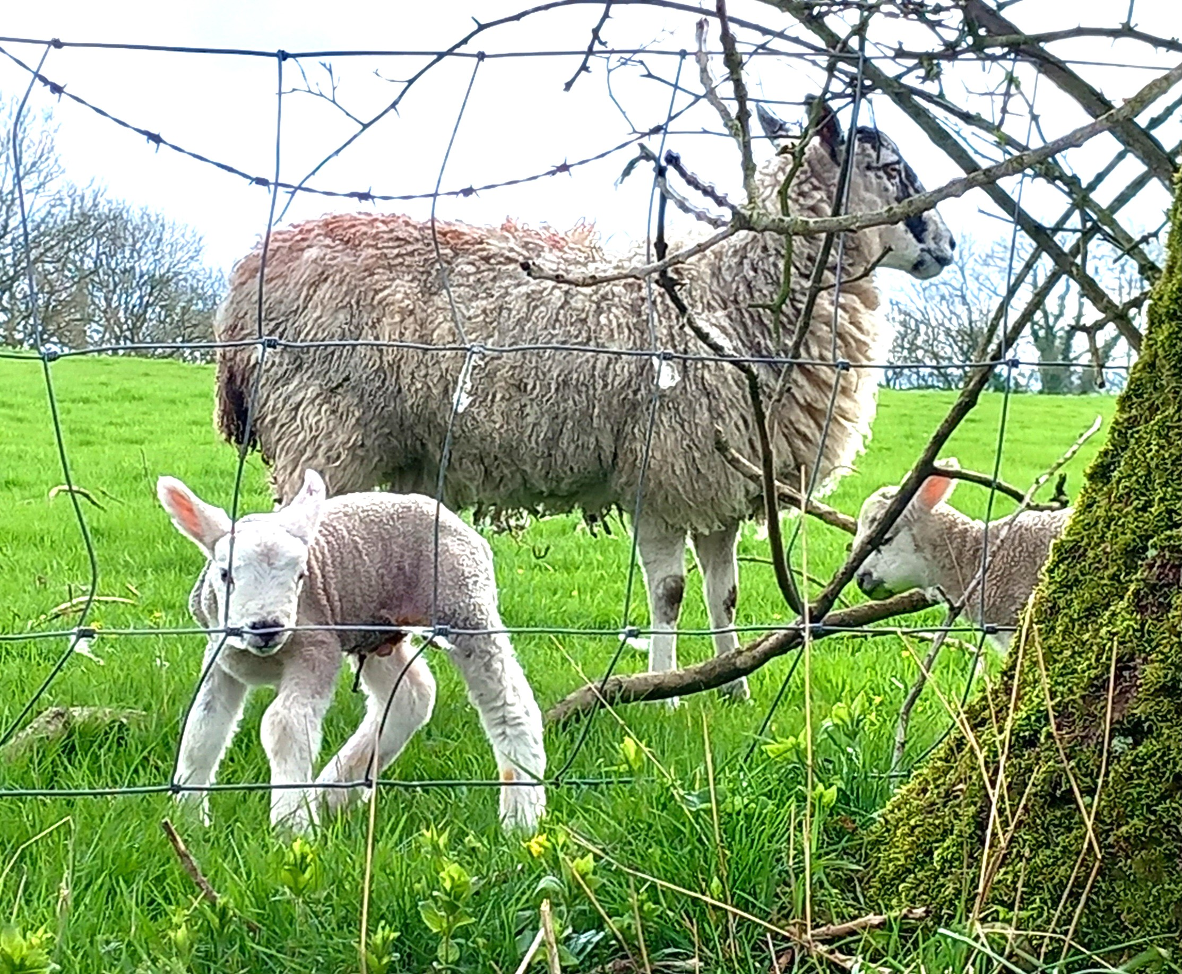
31 March – Young lambs

Slide 8
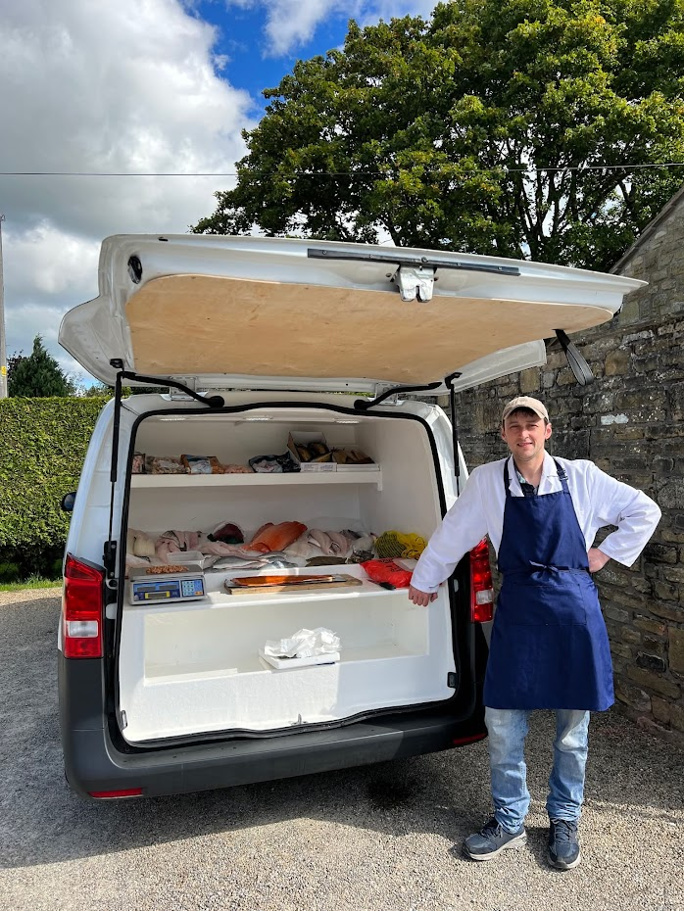
April
Local residents can buy fresh fish from the visiting fishmonger who visits the farm shop.

Slide 9
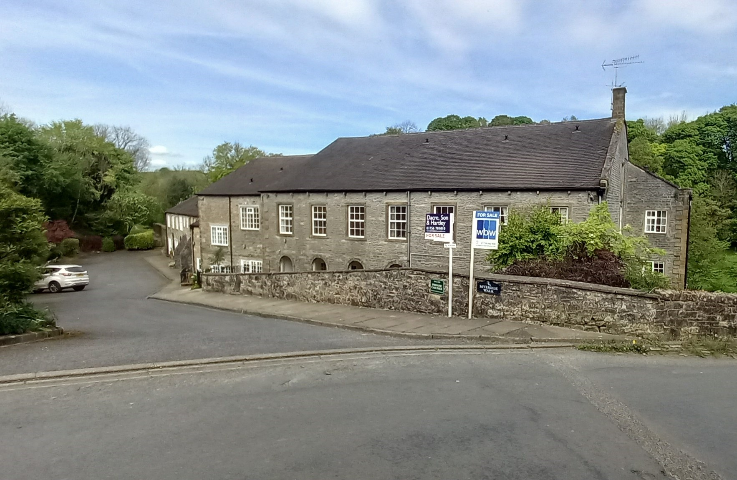
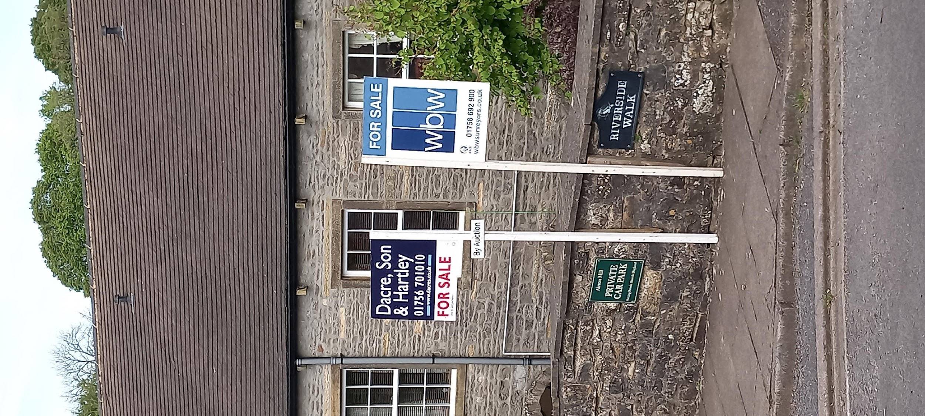
14 May
Two apartments for sale at the mill.

Slide 10

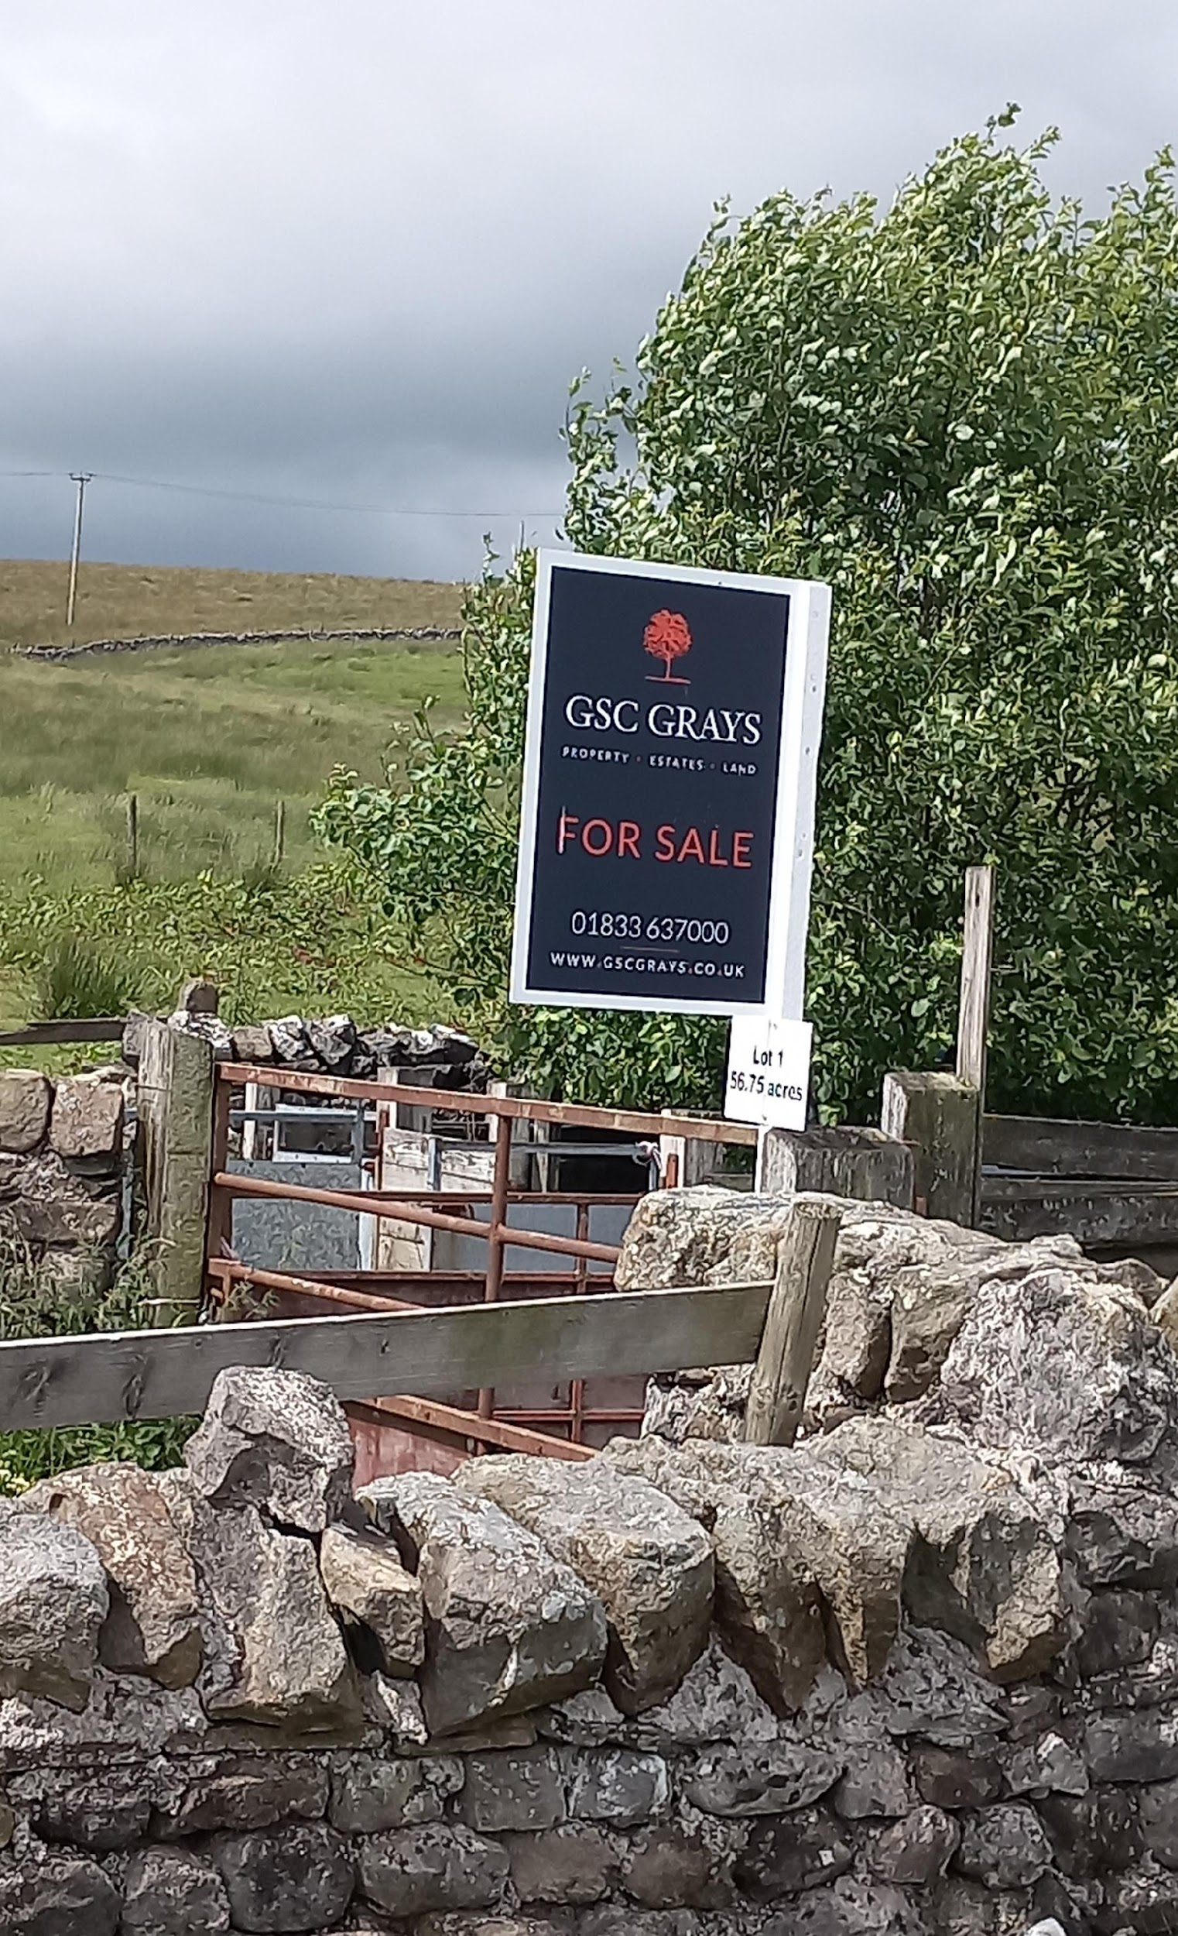
12 June
Paul and Janet Bolland selling farm land as they divest from Dairy farming.
14 June

Slide 11
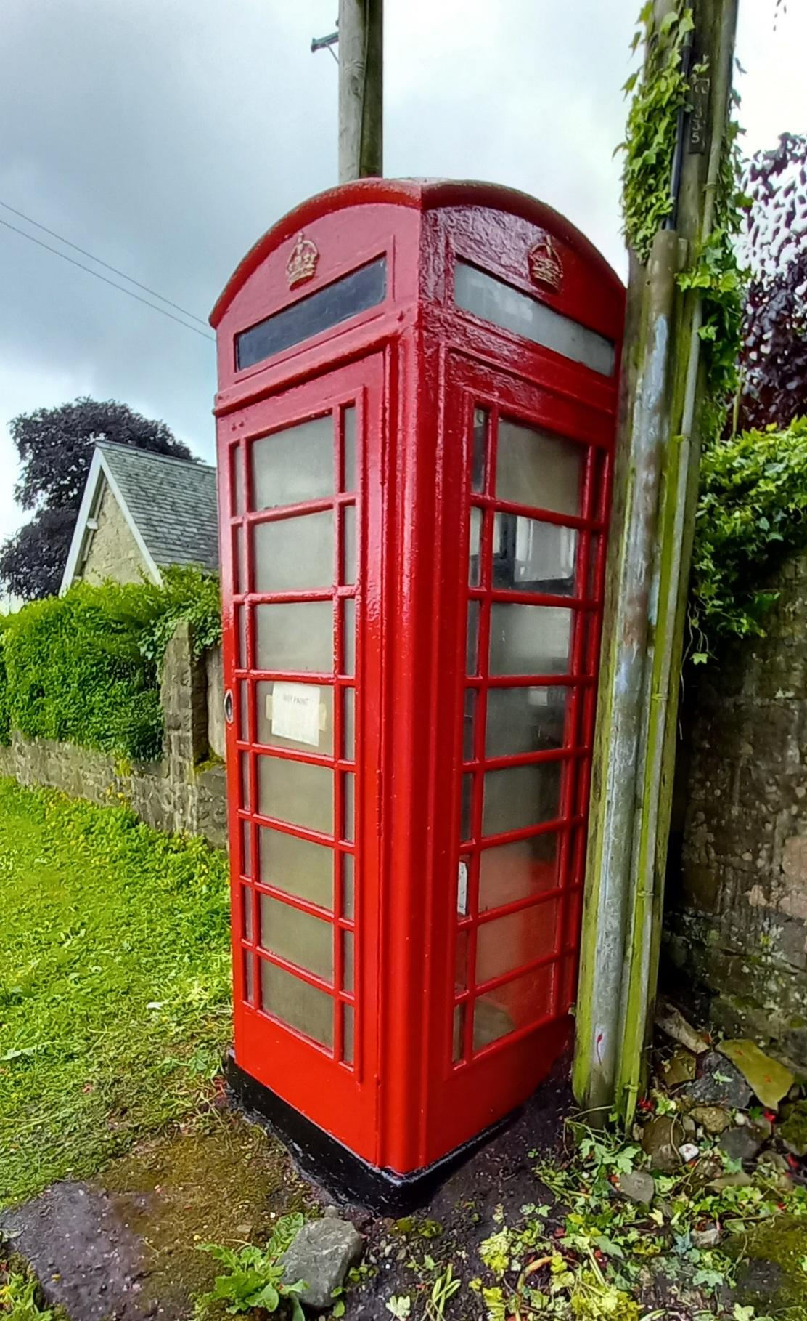
14 June
Airton’s telephone box (A Listed building) was painted today.

Slide 12
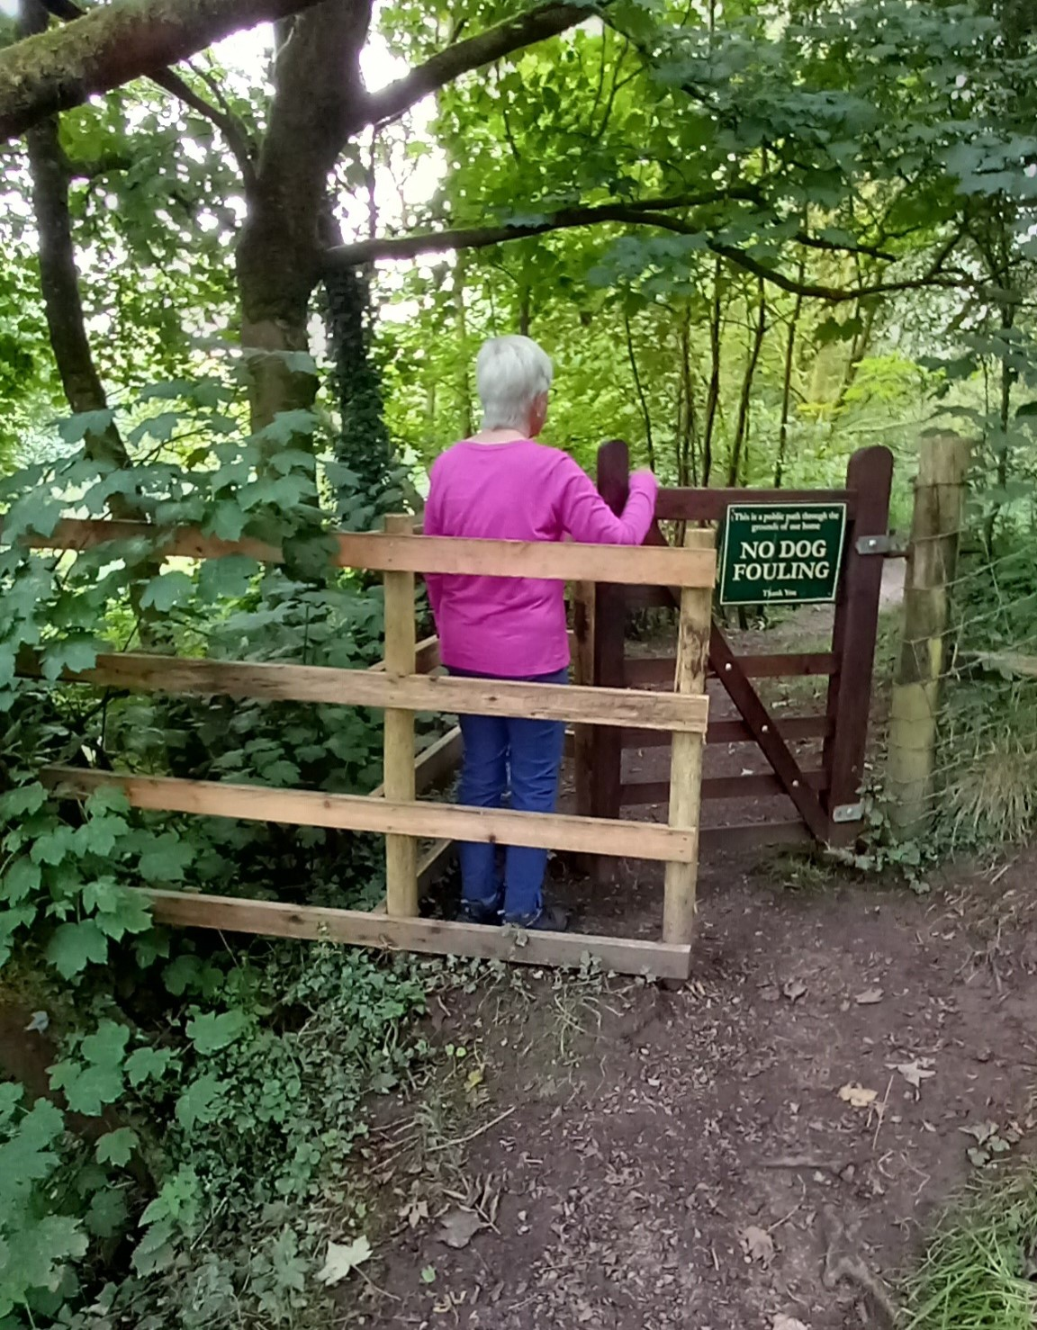
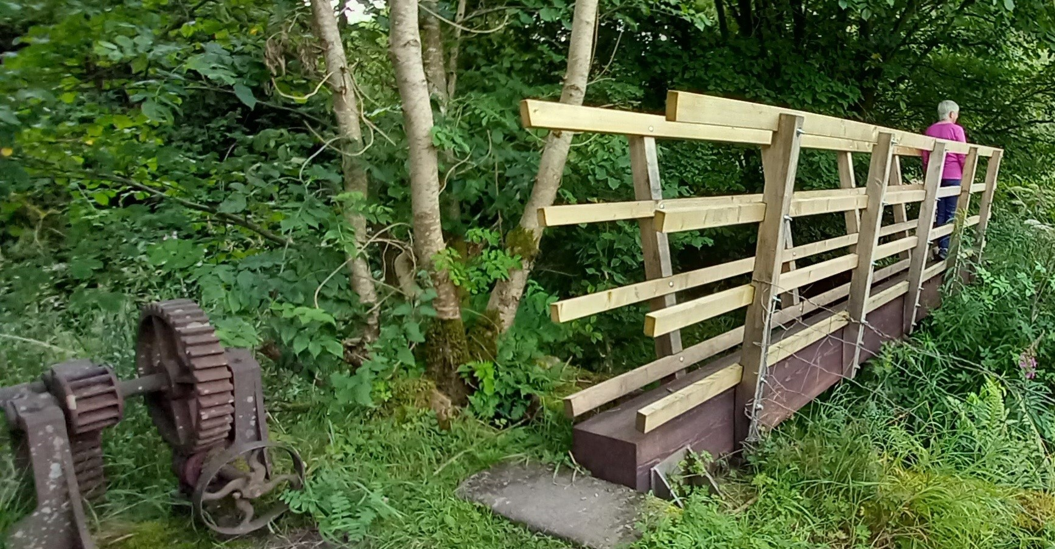
13th August
Gate and bridge repairs at Airton Mill footpath.

Slide 13
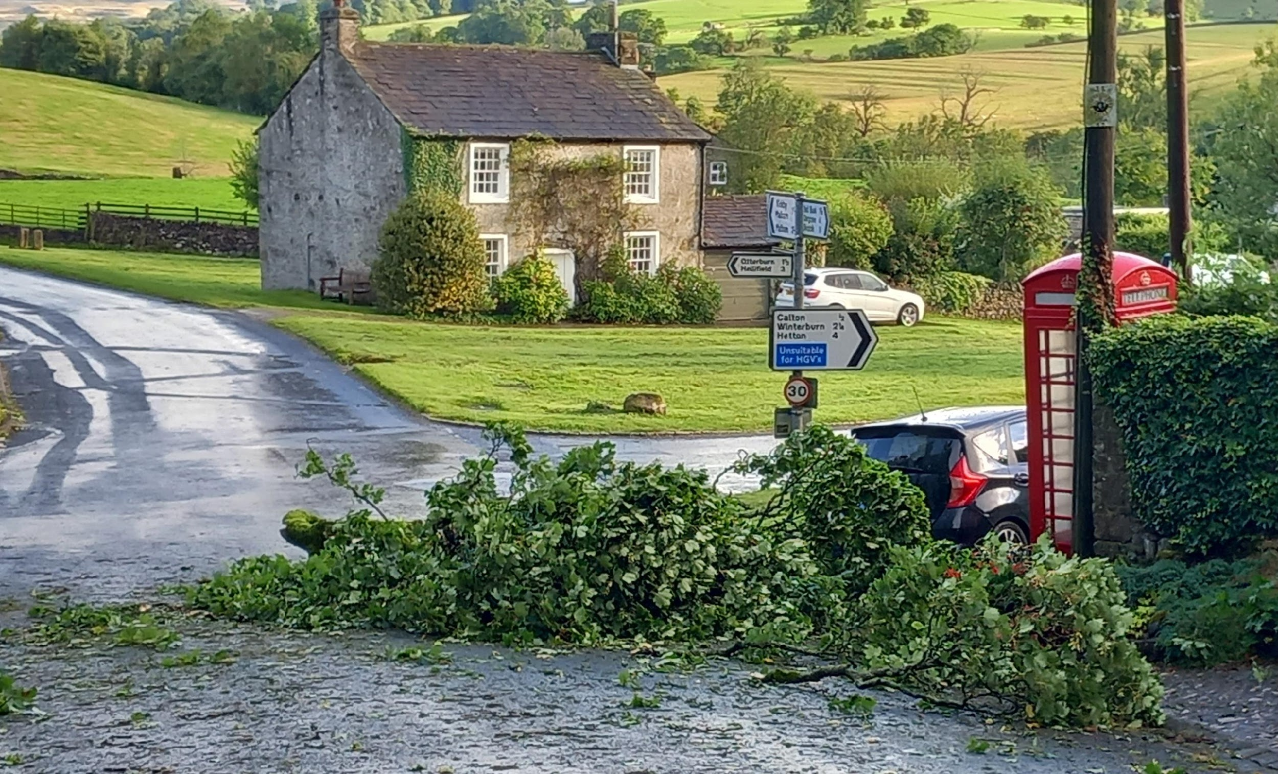
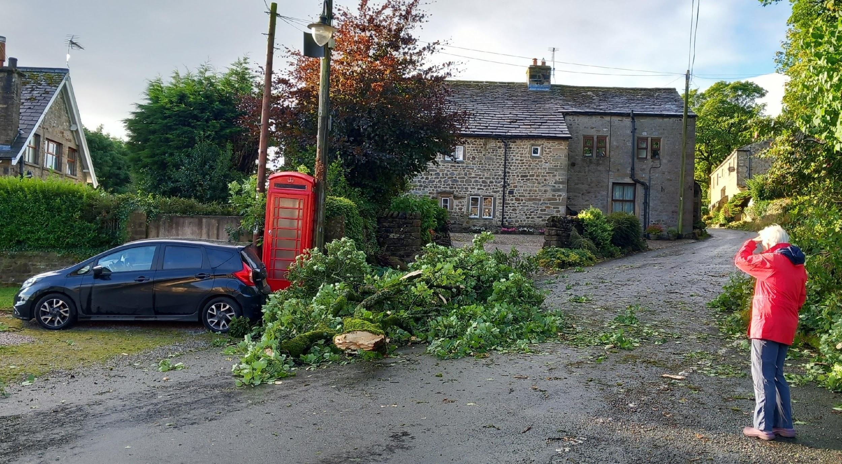
Friday 23 August – day before Malham Show – Storm Lillian struck a tree in the Pinfold,

Slide 14
1 September
Email from Airton Parish Meeting:
“I am sorry to report that, over the last 10 days or so, one property in our village has suffered damage to its windows on 3 separate occasions. In each case 2 panes have been broken and these now require reglazing.”
Second Email:
“Since my email to you of this morning I have heard of another disturbing incident.
At 3 am this morning, there was an attempted break in at a flat in Airton Mill, where 3 girls were staying.”

Slide 15
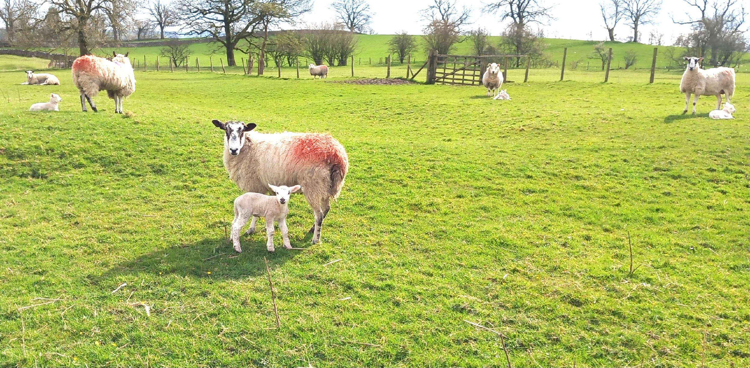
1 September
Fortunately, these last two incidents are exceedingly rare in Malhamdale, which is a safe place to raise a family.

Slide 16
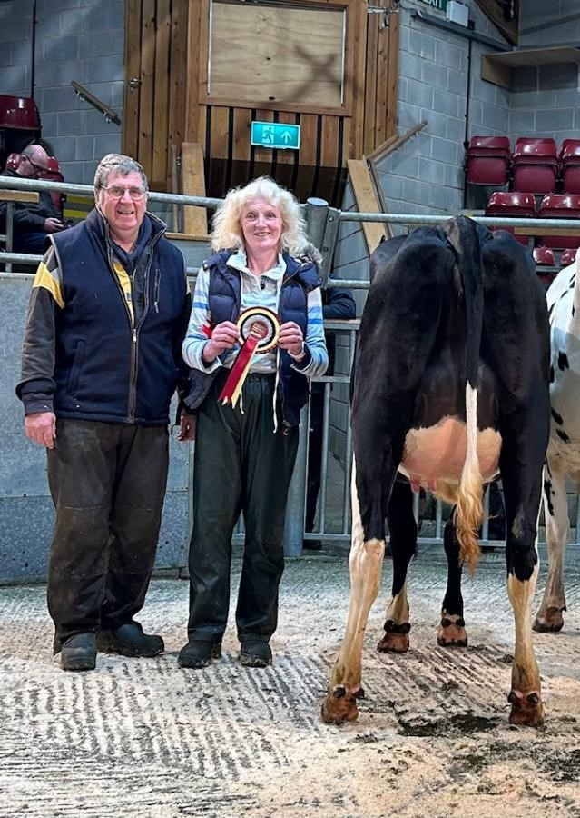
14 October
The mid-October sale of dairy cattle at Skipton Auction Mart attracted a strong crowd for the many classes of quality stock on offer. The champion was a widely admired black heifer from the Bolland family, of Airton. (Craven Herald)

Slide 17
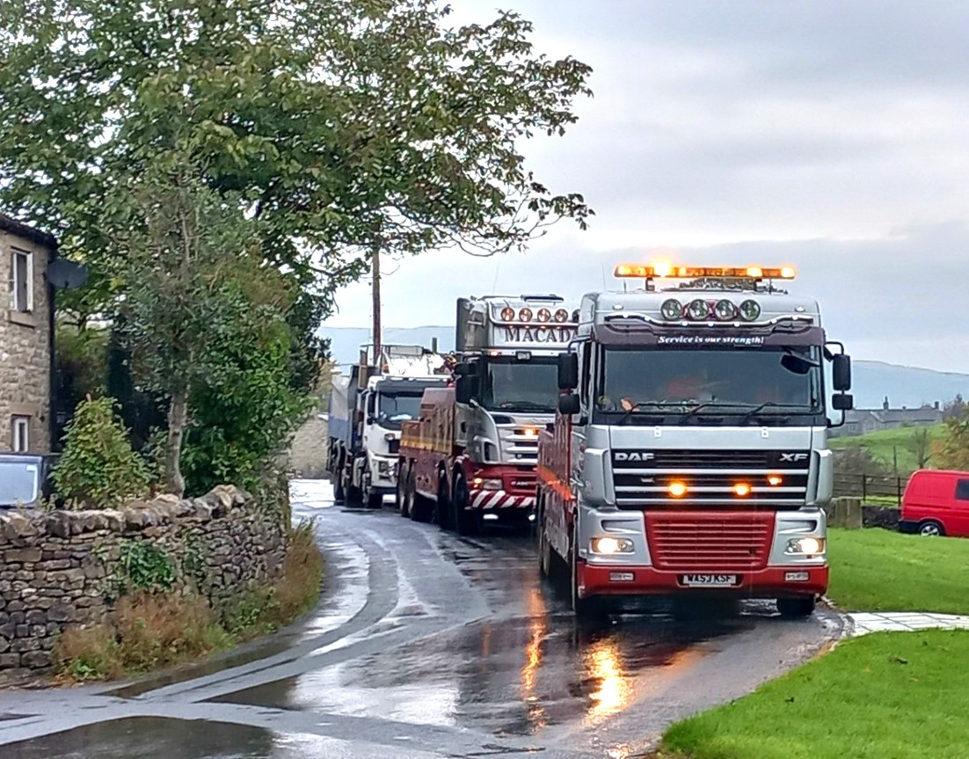
October
A large truck fully laden with stone/gravel for Langbar Lane was stuck in a culvert on Scosthrop Moor at mid-day on Thursday 10 October. Two days later it was rescued by two of Macadams pickup trucks and escorted down to Airton.

Slide 18
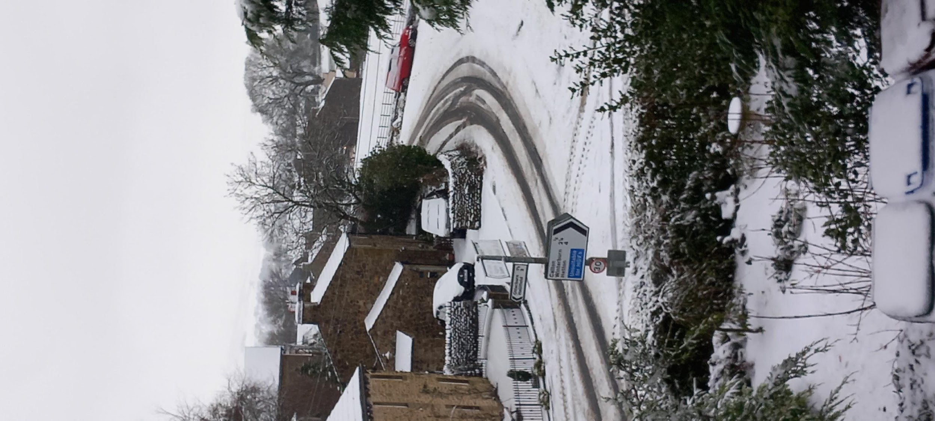
23 November
Some early winter snow in Airton. Fortunately, it soon thawed.

Slide 19
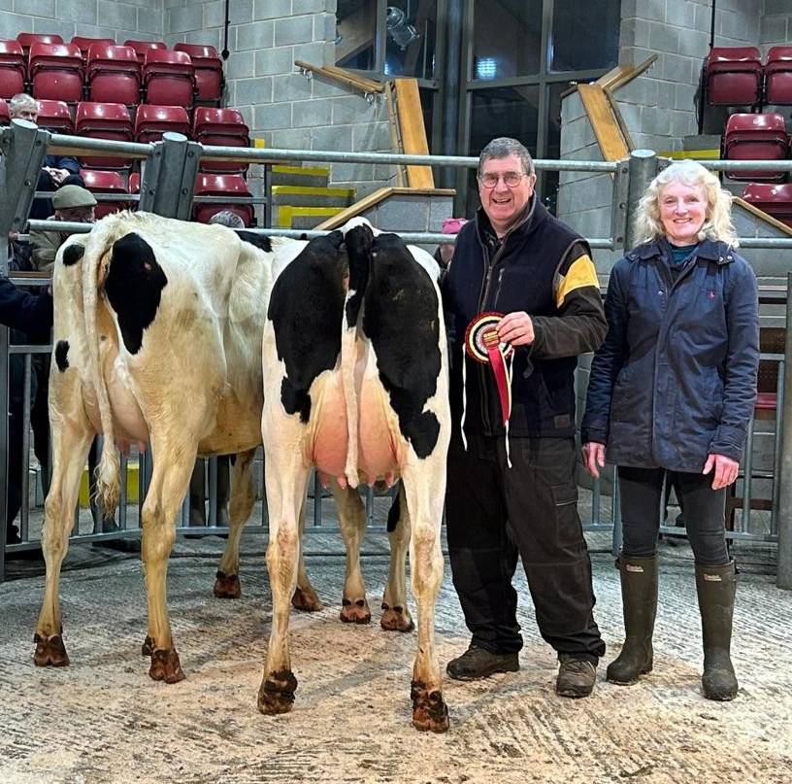
12 December
Paul and Janet Bolland of Dykelands with their final dairy auction champion of 2024. (Craven Herald)

Slide 20
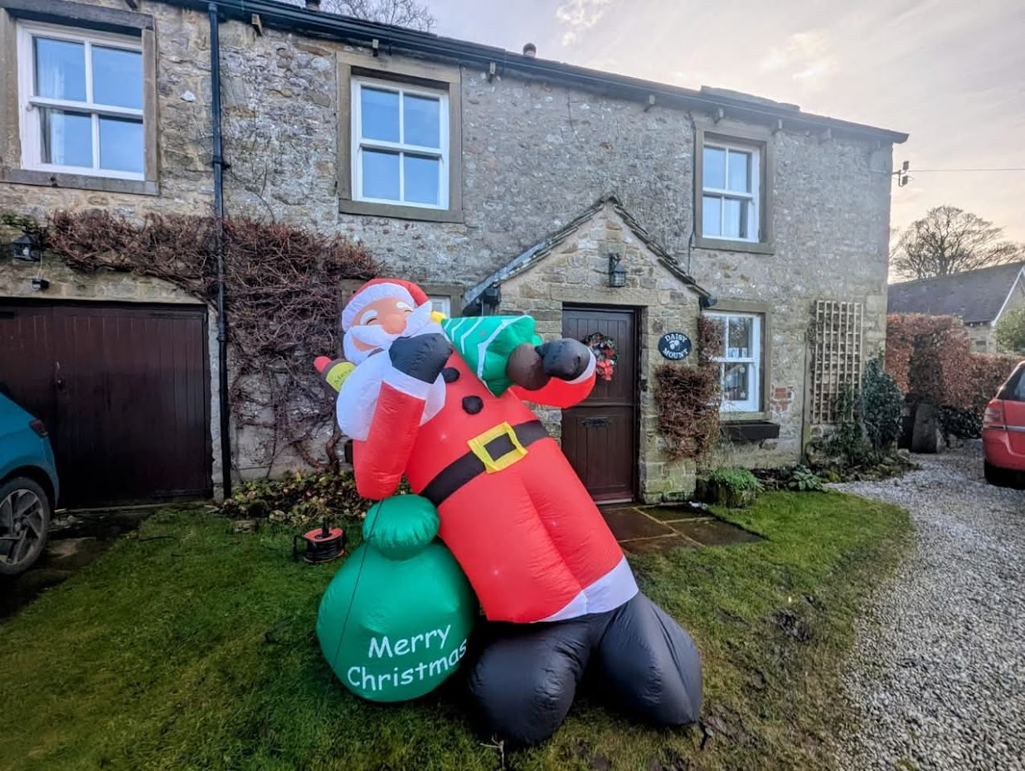
22 December
A plea went out to trace a missing Santa. Luckily, he was found before Christmas Eve.

